Slide 1

بسم اللہ الرحمٰن الرحیم

Slide 2


Slide 3
PAKISTAN STUDIES
Instructor: Khalid Makhdoom
Course code : PST-321
Credit hours : 02

Slide 4
GEOGRAPHY OF PAKISTAN
Physiography: Mountains, Plains, Plateaus, Deserts, Valleys and Coastal areas.
River Systems: Indus River and its Tributaries.
Climate Region of Pakistan.

Slide 5
PHYSIOGRAPHY-Mountains
Mountains
Pakistan is one of the most mountainous countries in the world, containing some of the highest peaks and several major ranges clustered in the north and west.
MAJOR MOUNTAIN RANGES
Karakoram Range: Lies in Gilgit–Baltistan and contains K2 (8,611 m), the second‑highest mountain on Earth and the highest peak in Pakistan.
Himalayas (Western section): Runs along northern Pakistan and includes Nanga Parbat (8,125 m), the ninth‑highest mountain in the world and sometimes called the “Killer Mountain.”
Hindu Kush: Extends from Afghanistan into northern Khyber Pakhtunkhwa and northern Balochistan, with peaks such as Koyo Zom (about 6,872 m).

Slide 6
PHYSIOGRAPHY-Mountains
Sulaiman Mountains: In eastern Balochistan and southern Khyber Pakhtunkhwa; highest peak is Takht‑e‑Sulaiman (about 3,487 m).
Kirthar Range: In Sindh and western Balochistan, about 300 km long, with Zardak as its highest point (about 2,260 m).
Salt Range: In northern Punjab, geologically famous for its salt‑and‑rock formations; Sakesar is the main peak (about 1,522 m).

Slide 7
PHYSIOGRAPHY-Plains
The plains of Pakistan are mostly formed by the Indus River and its tributaries and make up the country’s most important agricultural and populated region.
Main Indus‑River plains
Upper Indus Plain: Stretches from Attock to Mithankot and covers most of Punjab. It lies at about 180–300 m above sea level and is drained by five major rivers (Jhelum, Chenab, Ravi, Sutlej, Beas), making it very fertile.
Lower Indus Plain: Extends from Mithankot to Thatta in Sindh; it is a flat, alluvial plain, fertile but with low rainfall, so irrigation (mainly from the Indus) is essential.
Indus Delta Plain: South of Thatta toward the Arabian Sea; this low‑lying, marshy area has mangrove forests and is subject to seasonal flooding.

Slide 8
PHYSIOGRAPHY-Plains
Other significant plains
Trans‑Indus (Derajat) Plains: Lie west of the Indus in parts of Khyber Pakhtunkhwa and south‑western Punjab (Peshawar, Kohat, Bannu, Dera Ismail Khan, parts of Dera Ghazi Khan). They are less fertile than the main Indus plain but still important for local agriculture.
Kachi Sibbi Plain: A small but distinct plain in northern Balochistan, formed by streams from the Sulaiman Range; it is used for irrigated farming.
Economic importance
These plains contain Pakistan’s richest alluvial soils, support the bulk of wheat, rice, cotton, and sugarcane production, and are home to the largest share of the population and major cities such as Lahore, Faisalabad, Multan, and Karachi.

Slide 9
PHYSIOGRAPHY-Plateaus
Pakistan has several plateaus, the most important of which are the Potohar Plateau in the northeast and the Balochistan Plateau in the southwest, plus smaller high‑level plateaus such as the Salt Range and Deosai.
Potohar (Potwar) Plateau
Lies north of the Salt Range in Punjab, between the Indus and Jhelum rivers, covering parts of Rawalpindi, Jhelum, Attock, and Islamabad.
It is an open, undulating plateau (about 300–600 m elevation), dissected by ridges, ravines, and streams such as the Soan River; it is rich in coal, oil, limestone, gypsum, and salt.

Slide 10
PHYSIOGRAPHY-Plateaus
Balochistan Plateau
Occupies most of Balochistan province, west of the Indus, with an area of about 347,000 km² and heights generally between about 600 and 3,000 m.
The plateau is dry, with rocky hills, deep narrow valleys (like Quetta valley), and traditional underground irrigation channels called karez; it has important mineral resources and pastures.
Other notable plateaus
Salt Range: A low‑lying hill–plateau system in northern Punjab between the Jhelum and Indus rivers, famous for rock‑salt mines (Khewra, Warcha, Kalabagh) and coal deposits.
Deosai Plateau (Deosai Plains): Located in Gilgit–Baltistan between the Himalayas and Karakoram, at about 4,000–4,500 m altitude; it is one of the world’s highest plateaus and supports alpine meadows and wildlife such as the Himalayan brown bear.

Slide 11
PHYSIOGRAPHY-Deserts
Pakistan’s deserts cover about 11 million hectares (roughly 13–14% of the country) and are mostly hot, arid areas in the south and central regions, with one high‑altitude cold desert in the north.
Main hot deserts
Thar Desert: The largest desert in Pakistan, stretching across eastern Sindh (Tharparkar) into western Rajasthan in India; it receives very low rainfall, has shifting sand dunes, and is one of Asia’s subtropical deserts.
Cholistan Desert: Lies in southern Punjab (Bahawalpur, Rahim Yar Khan), an extension of the Thar; it consists of undulating sand dunes and hard, compact “dahar” plains, used for nomadic pastoralism.
Thal Desert: Located in northern Punjab between the Indus and Jhelum–Chenab rivers; it is a hot, sandy plain used for limited agriculture through irrigation.
Kharan Desert: In Balochistan, a sandy, arid desert with low rainfall and sparse vegetation, lying between the Sulaiman and Makran ranges.

Slide 12
PHYSIOGRAPHY-Deserts
Cold desert
Katpana (Cold) Desert: Situated near Skardu in Gilgit–Baltistan, at about 2,226 m elevation; it is a high‑altitude desert with sand dunes that can be snow‑covered in winter, one of the highest deserts in the world.​
These deserts are ecologically fragile, support nomadic or semi‑nomadic lifestyles, and have low but specific biodiversity adapted to aridity and temperature extremes.

Slide 13
PHYSIOGRAPHY-Valleys
Pakistan’s most famous valleys are high‑altitude, river‑cut corridors in the northern and eastern mountain belts, especially in Khyber Pakhtunkhwa, Gilgit–Baltistan, and Azad Kashmir. Major mountain valleys
Hunza Valley: In Gilgit–Baltistan, carved by the Hunza River; known for dramatic peaks like Rakaposhi, terraced fields, fruit orchards, and ancient forts such as Baltit and Altit.​
Neelum Valley: In Azad Kashmir along the Neelum River; long, narrow valley with pine‑forested hills, waterfalls, and tourist spots like Sharda and Arang Kel.​
Kaghan Valley: In Khyber Pakhtunkhwa, stretching from Mansehra to Naran; lush green valley with alpine meadows, lakes (e.g., Lulusar), and high‑mountain passes like Babusar.
Swat Valley: Also in KPK, formed by the Swat River; historically called the “Switzerland of Pakistan” for its scenic beauty, orchards, and Buddhist‑era ruins.

Slide 14
PHYSIOGRAPHY-Valleys
Other notable valleys
Kumrat Valley (KPK): In the upper reaches of the Panjkora River; deep forested valley with meadows and cold‑weather streams, popular for trekking.
Chitral Valley: In far‑north Chitral, drained by the Chitral River; gateway to the Hindu Kush and routes toward the Afghan border.
Kalash Valleys (Bumburet, Rumbur, Birir): In upper Chitral; home to the Kalash people, with unique culture, festivals, and high‑altitude landscapes.
Smaller but scenic valleys: Include Bagrot, Naltar, and Gilgit valleys in Gilgit–Baltistan; Ushu, Utrar, and Madyan in Swat; and Palas, Allai, and others in KPK, all carved by tributaries of the Indus system.
These valleys are economically and ecotouristically important, supporting agriculture, livestock, hydropower, and growing tourism in northern Pakistan.

Slide 15
PHYSIOGRAPHY-Coastal Areas
Pakistan’s coastal areas lie along the Arabian Sea in the south and stretch about 990–1,050 km, mainly divided into the Sindh coast and the Balochistan (Makran) coast.
Main coastal regions
Sindh coast: About 270–320 km long, from the Indus Delta past Karachi to the Iranian border; it is dominated by the Indus‑delta mudflats, tidal creeks, and mangrove forests, with fishing and port‑city economies.
Balochistan (Makran) coast: Roughly 670–720 km long, from the Iranian border eastward to the Hub River; this is a tectonically active, rocky shore with cliffs, headlands, and small sandy beaches, rich in fisheries and potential gas‑hydrate resources.

Slide 16
PHYSIOGRAPHY-Coastal Areas
Key coastal features
Indus Delta: The most prominent coastal feature in Sindh, covering about 1,000 sq mi, with a network of creeks and one of the largest mangrove ecosystems in the Indo‑Pacific region.
Karachi coast: The urbanized strip around Karachi, including Manora and Kemari; here the coastline is relatively low‑lying, with mud and sand flats adjoining the city’s port and industrial belt.
Gwadar and Makran coastline: The Makran coast features headlands like Jiwani, Ormara, and Gwadar, with deep‑water potential and plans for major port and coastal‑development projects. [web78]
These coastal areas are vital for fisheries, ports (Karachi and Gwadar), coral‑reef biodiversity, and mangrove‑linked livelihoods, though they face challenges from erosion, sea‑level rise, and over‑exploitation.

Slide 17
RIVER SYSTEMS
Indus River And Its Tributaries
The Indus River is Pakistan’s main river system and the backbone of agriculture, because its waters support Punjab and Sindh and connect many major tributaries into one drainage network. Its chief tributaries include the Jhelum, Chenab, Ravi, Sutlej, Beas, Kabul, Swat, Kurram, Gomal, Gilgit, Shayok, Zanskar, Haro, Soan, and Zhob rivers.
The Indus rises in Tibet, enters northern Pakistan through Gilgit-Baltistan, then flows south through the country before ending in the Arabian Sea near Karachi. It is about 3,180 km long and has a drainage area of roughly 1,120,000 km².
The river gains much of its volume from snow and glacier melt in the Himalayas, Karakoram, and Hindu Kush. In Pakistan, it becomes especially important in the plains, where it slows down and supports irrigation, settlements, and transport.

Slide 18
RIVER SYSTEMS
Punjab Rivers
The five famous Punjab rivers are the Jhelum, Chenab, Ravi, Sutlej, and Beas. These rivers eventually join the Indus system, and the Panjnad River is formed by the confluence of the Punjab rivers before meeting the Indus.
These rivers make Punjab one of the most fertile regions of South Asia, which is why the area is often called the “land of five rivers.” Their waters have supported farming since ancient times, including the Indus Valley Civilization.

Slide 19
RIVER SYSTEMS
Right Bank Tributaries
On the western and northern side, the Indus receives important tributaries such as the Kabul, Gilgit, Shayok, Kurram, Gomal, Swat, Haro, Soan, and Zanskar rivers. Many of these are mountain-fed streams that bring meltwater from high-altitude regions.
The Kabul River is one of the most important right-bank tributaries, joining the Indus near Attock. The Shayok and Gilgit rivers are especially important in the upper reaches because they carry glacial water into the main river.

Slide 20
RIVER SYSTEMS
Historical Importance
In historical perspective, the Indus has been central to civilization in this region for thousands of years. The Indus Valley Civilization grew along its banks and used its waters for farming, trade, and urban life.
The river also served as a natural route for invasions, migration, and exchange. At the same time, mountain barriers and river valleys shaped the political history of the region, especially in areas like Punjab, Sindh, and the northwest front

Slide 21
Climate Region Of Pakistan
Pakistan’s climate is usually divided into four major climatic regions: highland, lowland, arid/desert, and coastal/maritime. The exact conditions vary a lot because the country stretches from high mountains in the north to the Arabian Sea in the south.
Pakistan’s climate is generally arid, but it changes sharply from region to region because of differences in altitude, distance from the sea, and monsoon influence. Northern areas are cold, central plains are hot, deserts are dry, and the coast is humid and moderate.

Slide 22
Climate Region Of Pakistan
Climatic regions
Highland climate: Found in northern and western mountains such as Gilgit-Baltistan, Khyber Pakhtunkhwa, and parts of Balochistan; winters are very cold and summers are mild.
Lowland climate: Covers most of the Indus Plain, especially Punjab and Sindh; it has hot summers, cool to cold winters, and monsoon rainfall.
Arid/desert climate: Seen in places like Thar, Cholistan, Thal, and Kharan; rainfall is very low and temperatures are extreme.
Coastal/maritime climate: Found along the Makran coast and parts of Sindh; sea breezes reduce temperature extremes, but humidity is high.

Slide 23
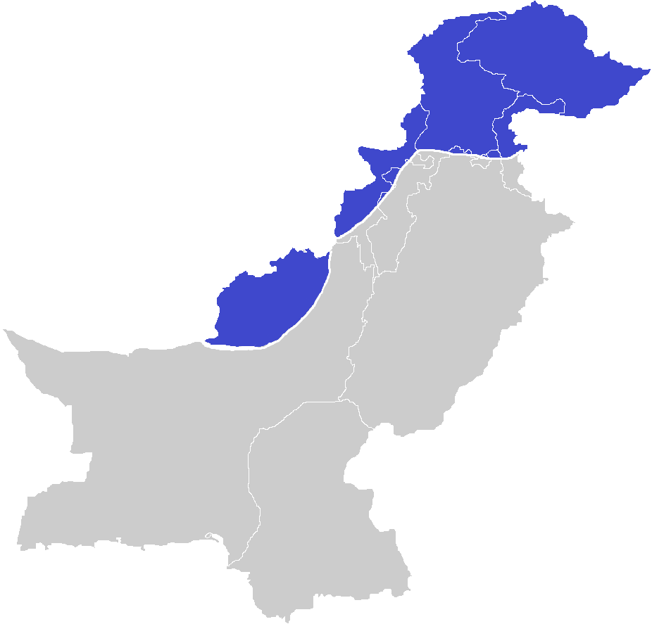
Climate Region Of Pakistan
This map shows where snowfall commonly occurs, which helps explain why the north has a much colder climate than the rest of Pakistan.

Slide 24
Thank you

Slide 25


