Slide 1

بسم اللہ الرحمٰن الرحیم

Slide 2
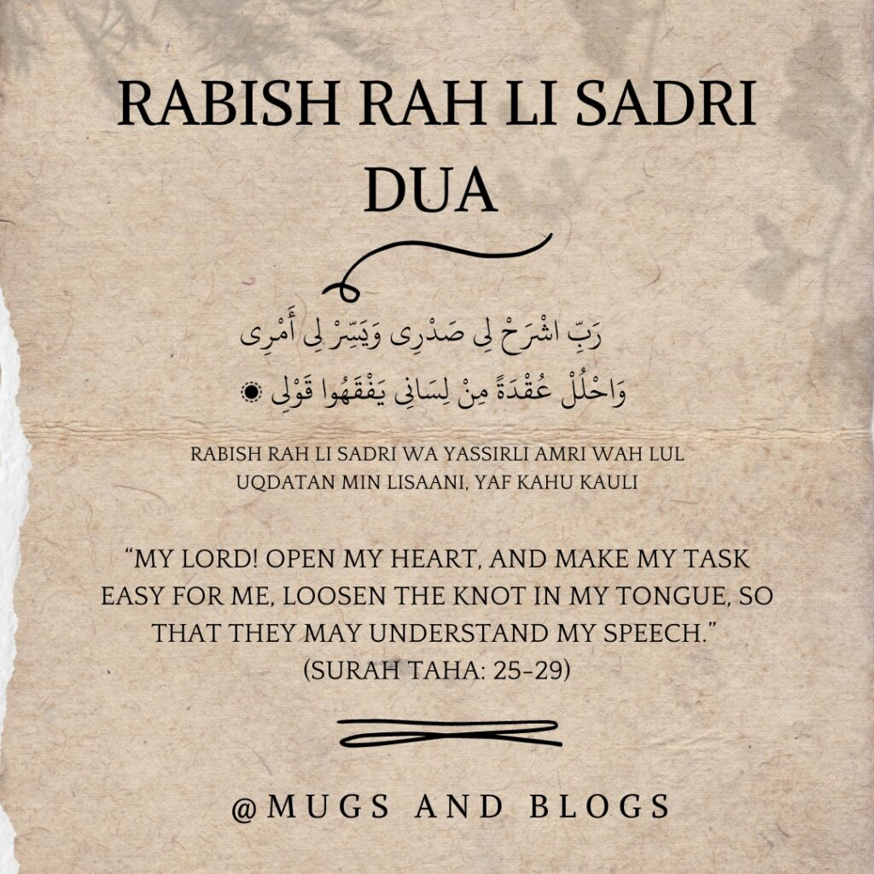

Slide 3
PAKISTAN STUDIES
Instructor: Khalid Makhdoom
Course code : PST-321
Credit hours :02

Slide 4
POLITICAL HISTORY OF PAKISTAN
Formative Phase
Military Interventions And Democratic Transitions

Slide 5
FORMATIVE PHASE
The formative phase of Pakistan refers to the period from 1947 to 1958, characterized by nation-building amid partition chaos, refugee crises, and constitutional delays.
Partition Challenges
Massive migrations and violence displaced millions, straining resources while disputes like Kashmir and water sharing with India emerged immediately. Muhammad Ali Jinnah's death in 1948 left a leadership vacuum, complicating governance.

Slide 6
FORMATIVE PHASE
Constitutional Efforts
The Constituent Assembly, formed in 1947, struggled with debates on Islam's role and federalism; the 1949 Objectives Resolution blended Islamic principles with democracy. Delays led to dissolution in 1954, but a second assembly produced the 1956 Constitution, declaring Pakistan an Islamic Republic with a parliamentary system.
Political Instability
Frequent prime ministerial changes (Liaquat Ali Khan assassinated in 1951) and East-West Pakistan tensions over representation fueled instability. The "One Unit" scheme in 1955 merged West Pakistan provinces to balance East Pakistan. Ayub Khan's 1958 martial law ended this phase.

Slide 7
MILITARY INTERVENTIONS AND DEMOCRATIC TRANSITIONS
Pakistan has experienced multiple military interventions since 1947, often due to political instability, leading to periods of martial law interspersed with democratic transitions.
Major Coups
Ayub Khan's 1958 coup ended civilian rule, imposing martial law and a new constitution in 1962. Yahya Khan took power in 1969 after Ayub's resignation, overseeing the 1970 elections but leading to Bangladesh's secession in 1971. Zia-ul-Haq's 1977 coup ousted Zulfikar Ali Bhutto, ruling until 1988 with Islamization policies. Pervez Musharraf's 1999 coup removed Nawaz Sharif, lasting until 2008.

Slide 8
MILITARY INTERVENTIONS AND DEMOCRATIC TRANSITIONS
Democratic Transitions
Post-Zia, elections in 1988 brought Benazir Bhutto to power, followed by Sharif in 1990, but both were dismissed amid corruption charges. Musharraf resigned in 2008 amid impeachment, enabling elections and PPP-led government under Yousaf Raza Gillani. Smooth transitions occurred in 2013 (PPP to PML-N) and 2018 (PML-N to PTI), marking progress despite military influence.
Patterns and Impacts
Weak institutions, leadership vacuums, and civil-military tensions triggered interventions. Transitions have strengthened judiciary and media, but military remains influential, with no successful coup since 1999.

Slide 9
Thank you

Slide 10
