Slide 1
Anatomy of thoracic surgical approaches and chest intubation
BS(OT)
ADNAN RAMZAN

Slide 2
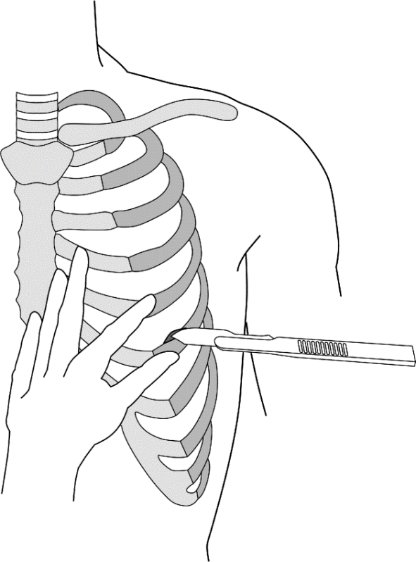
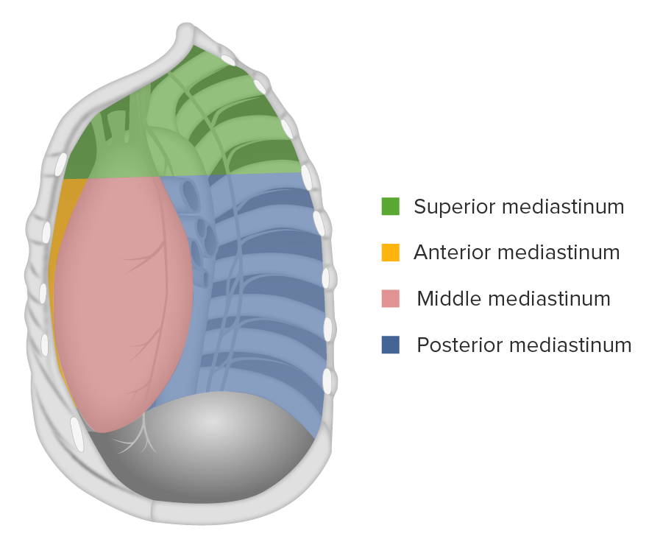

Slide 3
Mediastinoscopy
A small incision is made in the midline in the neck just above the suprasternal notch, and the superior mediastinum is explored down to the region of the bifurcation of the trachea.
This procedure can be used to determine the diagnosis and degree of spread of carcinoma of the bronchus.

Slide 4
Pneumothorax and its types
As the result of disease or injury (stab or gunshot wounds), air can enter the pleural cavity from the lungs or through the chest wall called pneumothorax.
In the old treatment of tuberculosis, air was purposely injected into the pleural cavity to collapse and rest the lung.
This was known as artificial pneumothorax.
It may be off following types

Slide 5
Spontaneous pneumothorax
It is a condition in which air enters the pleural cavity suddenly without its cause being immediately apparent.
After investigation, it is usually found that air has entered from a diseased lung and a bulla (bleb) has ruptured.

Slide 6
Open Pneumothorax
Stab wounds of the thoracic wall may pierce the parietal pleura so that the pleural cavity is open to the outside air.
This condition is called open pneumothorax.
Each time the patient inspires, it is possible to hear air under atmospheric pressure being sucked into the pleural cavity.

Slide 7
Tension Pneumothorax.
Sometimes the clothing and the layers of the thoracic wall combine to form a valve so that air enters on inspiration but cannot exit through the wound.
In these circumstances, the air pressure builds up on the wounded side and pushes the mediastinum toward the opposite side.
In this situation, a collapsed lung is on the injured side and the opposite lung is compressed by the deflected mediastinum.
This dangerous condition is called a tension pneumothorax.

Slide 8
Some others
Air in the pleural cavity associated with serous fluid is known as hydropneumothorax,
associated with pus as pyopneumothorax, and associated with blood as hemopneumothorax.
A collection of pus (without air) in the pleural cavity is called an empyema.
The presence of serous fluid in the pleural cavity is referred to as a pleural effusion

Slide 9
Needle Thoracostomy
A needle thoracostomy is necessary in patients with tension pneumothorax away from the pleural cavity to allow the lung to re expand.
It may also be necessary to withdraw a sample of pleural fluid for microbiologic examination.
Anterior Approach
For the anterior approach, the patient is in the supine position.
The sternal angle is identified, and then the 2nd costal cartilage, the 2nd rib, and the second intercostal space are found in the midclavicular line.

Slide 10
Lateral Approach
For the lateral approach, the patient is lying on the lateral side.
The 2nd intercostal space is identified as above, but the anterior axillary line is used.
The skin is prepared in the usual way, and a local anesthetic is introduced along the course of the needle above the upper border of the 3rd rib.

Slide 11
Tube Thoracostomy
The preferred insertion site for a tube thoracostomy is the fourth or fifth intercostal space at the anterior axillary line.
The tube is introduced through a small incision.

Slide 14
Traumatic Injury to the Thorax
Fractured Sternum
Rib Contusion Bruising of a rib, secondary to trauma, is the most common rib injury.
Rib Fractures
Fractures of the ribs are common chest injuries.
In children, the ribs are highly elastic, and fractures in this age group are therefore rare.
Ribs 5 through 10 are the most commonly fractured ribs.
The first four ribs are protected by the clavicle and pectoral muscles anteriorly and by the scapula and its associated muscles posteriorly.
The 11th and 12th ribs float and move with the force of impact.

Slide 15
Rib Excision
Rib excision is commonly performed by thoracic surgeons wishing to gain entrance to the thoracic cavity.
A longitudinal incision is made through the periosteum on the outer surface of the rib, and a segment of the rib is removed.
A second longitudinal incision is then made through the bed of the rib, which is the inner covering of periosteum.
After the operation, the rib regenerates from the osteogenetic layer of the periosteum.

Slide 16
Flail Chest
In severe crush injuries, a number of ribs may break.
If limited to one side, the fractures may occur near the rib angles and anteriorly near the costochondral junctions.
This causes flail chest, in which a section of the chest wall is disconnected to the rest of the thoracic wall.
If the fractures occur on either side of the sternum, the sternum may be flail.

Slide 17


