Slide 1
Applied Science
Awais Hamza
Fsc Medical Technology

Slide 2
Density
Density is a measurement that compares the amount of matter an object has to its volume.
An object with much matter in a certain volume has a high density.
The density of a material shows the denseness of that material in a specific given area.
A material's density is defined as its mass per unit volume.
Density is essentially a measurement of how tightly matter is packed together.

Slide 3
Density
It is a unique physical property of a particular object.
The principle of density was discovered by the Greek scientist Archimedes.
It is easy to calculate density if you know the formula and understand the related units.
The symbol ρ (rho) represents density, or it can also be represented by the letter D.

Slide 4
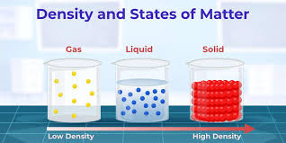
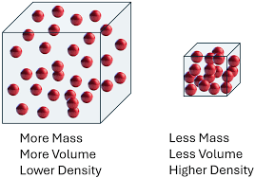
Density and State of Matter

Slide 5
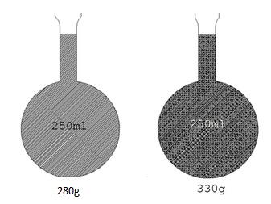
Examples of Density
Iron, platinum, and lead are examples of dense materials.
Many types of rock and minerals are examples of dense material.
Dense materials are most likely to feel heavy or hard.
The opposite of dense is sparse, and a few examples of sparse material are glass, bamboo, aluminum, and Styrofoam.

Slide 6
Density in Different States
In general, liquids are less dense than solids and gases are less dense than liquids.
This is because solids have densely packed particles.
Liquids are materials where particles can slide around one another.
Gases have particles that are free to move all over the place.

Slide 7
How Is Density Calculated?
Mathematically, the density of an object is expressed as follows:
Mass / Volume

Slide 8
Unit of Density
Though the SI unit of density is kg/m³, for convenience we use:
g/cm³ for solids
g/ml for liquids
g/L for gases

Slide 9
Concept of Density
Density can be explained as the relationship between the mass of the substance and the volume it takes up.
In qualitative terms, it shows how heavy an object is at constant volume.
Different substances have different densities, which means for the same volume different substances weigh differently.

Slide 10
SI Unit of Density
Each substance has a specific density.
Generally, the density of water (approximately 1 gram per cubic centimetre) is taken as the standard value for calculating the density of substances.
However, the SI unit of density is measured using kilograms per cubic metre (kg/m³).

Slide 11
Other Density Units
Talking about other density units, metric tons and liters are also used even
though they are not part of the SI.
gram per milliliter (g/mL)
metric ton per cubic meter (t/m³)
kilogram per liter (kg/L)
megagram (metric ton) per cubic meter (Mg/m³)
gram per cubic centimeter (g/cm³)
1 g/cm³ = 1000 kg/m³
kilogram per cubic decimeter (kg/dm³)
In addition to this, in the CGS system density is measured in grams per cubic centimeter (g/cm³).

Slide 12
How to Know if a Substance is Less Dense than Water
A substance is less dense than water if its density is less than 1 g/cm³ (or 1000 kg/m³).
If placed in water, a less dense substance will float on the surface.
If the substance sinks, it means it is more dense than water.
Density can be checked using the formula:
Compare the calculated density of the substance with water’s density:
  < 1 g/cm³ → floats (less dense)
  > 1 g/cm³ → sinks (more dense)
Example: Oil floats on water because its density is less than water.

Slide 13
What happens to the least dense of two immiscible liquids
When two liquids are immiscible (do not mix), they form separate layers.
The least dense liquid rises to the top.
The more dense liquid settles at the bottom.
This happens because lower density substances float above higher density substances.
Example:
Oil and water → Oil (less dense) floats on water (more dense)

Slide 14
How to Find Density of a Human Body
Step 1: Measure the body mass (weight) using a weighing scale.
Step 2: Measure the body volume (usually by water displacement method).
Step 3: Divide mass by volume to calculate density.

Slide 15
How to Find Density of a Human Body
If body density is less than water → body floats.
If body density is greater than water → body sinks.
Human body density is usually close to that of water, so people can float with effort.

Slide 16
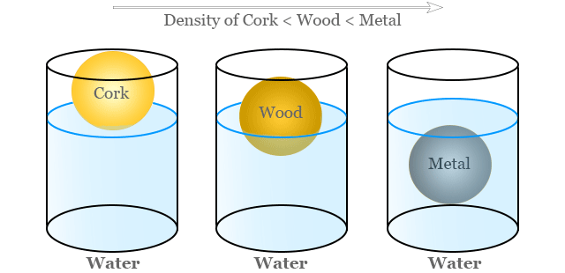
Density of Different Materials

