Slide 1

ANATOMY
THE LOWER LIMB
DPT
2ND SEMESTER
DR DANISH

Slide 2
Ankle Joint
Type
Synovial hinge joint
Movement occurs in a single plane

Slide 3
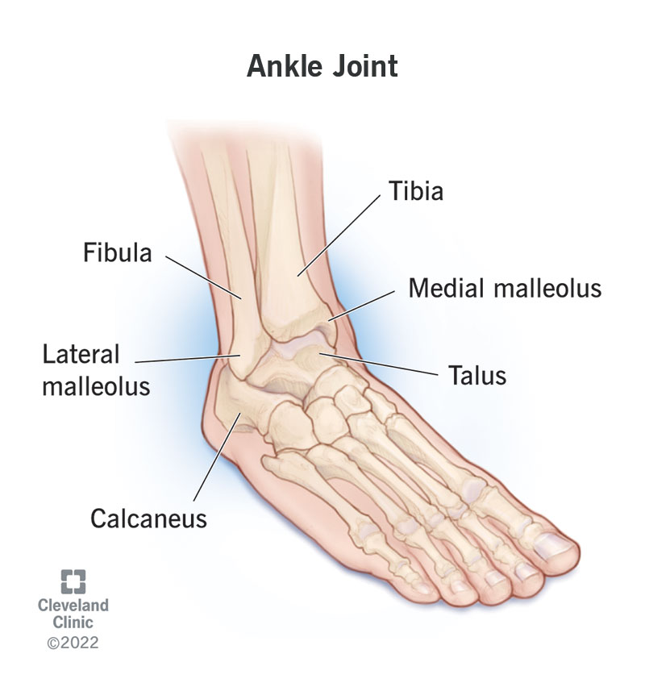

Slide 4
Articular Surfaces
Formed by:
  Lower end of tibia
  Medial malleolus (tibia)
  Lateral malleolus (fibula)
These structures form a socket
Socket fits the trochlea of the talus

Slide 6
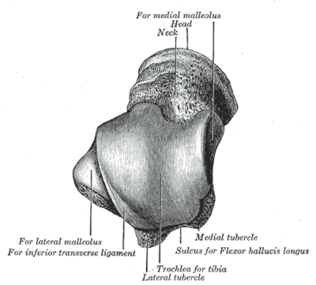

Slide 7
Capsule
Encloses the joint
Attached:
  Above → margins of tibia and fibula
  Below → near articular margins of talus

Slide 8
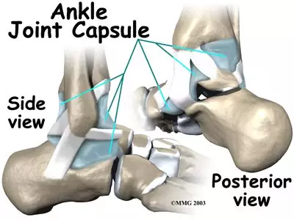

Slide 9
Ligaments
Medial (Deltoid) Ligament
Lateral Ligaments

Slide 10
Medial (Deltoid) Ligament
Strong, triangular ligament
Extends from medial malleolus to:
  Talus
  Calcaneum
  Navicular bone
Provides strong medial stability

Slide 11
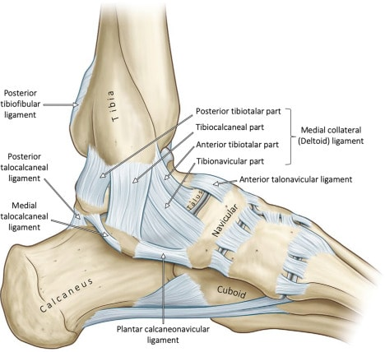

Slide 12
Lateral Ligaments
Weaker than medial ligament
Three main parts:
  Anterior talofibular ligament
  Posterior talofibular ligament
  Calcaneofibular ligament
More prone to injury

Slide 13
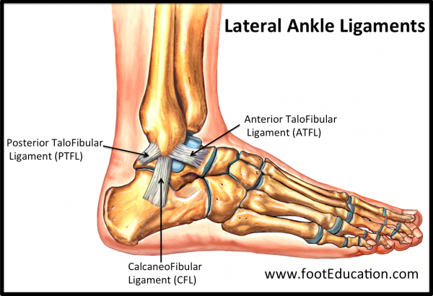

Slide 14
Nerve Supply
Nerve Supply
Deep fibular (peroneal) nerve
Tibial nerve

Slide 15
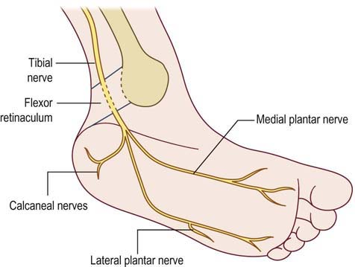

Slide 16
Movements
Dorsiflexion (toes upward)
Plantar flexion (toes downward)

Slide 17
Stability of Ankle Joint
Depends on:
  Shape of bones
  Strength of ligaments
Joint is most stable during dorsiflexion
Less stable during plantar flexion

Slide 18
Clinical Notes (Ankle)
Ankle Sprain
Common injury
Usually involves lateral ligaments
Caused by excessive inversion
Leads to pain, swelling, and instability

Slide 20
Continued
Pott’s Fracture
Fracture of malleoli due to forceful eversion
Often associated with ligament injury
Dislocation
Rare due to strong ligaments
May occur with fractures

Slide 21
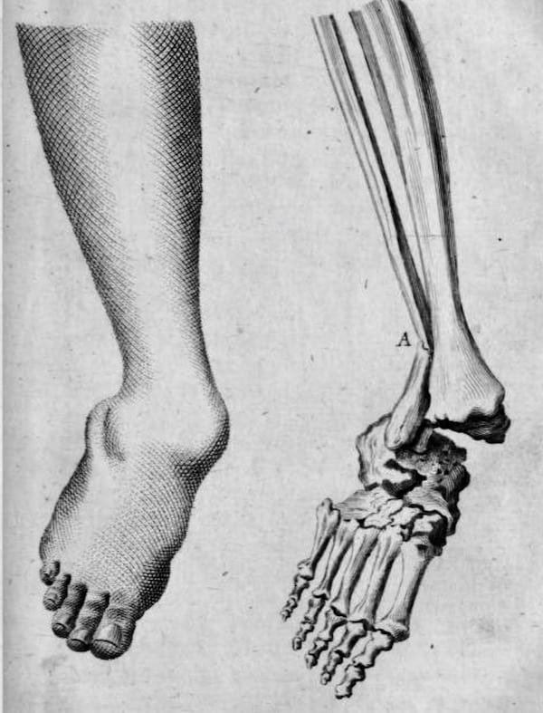

Slide 22
Subtalar (Talocalcaneal) Joint
Type
Plane synovial joint
Articular Surfaces
Between talus and calcaneum
Covered with hyaline cartilage
Movements
Gliding and rotation

Slide 23
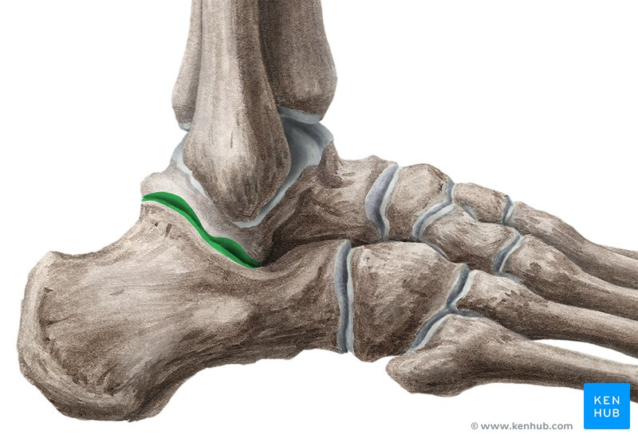

Slide 24
Talocalcaneonavicular Joint
Type
Synovial joint
Articular Surfaces
Head of talus
Calcaneum
Navicular bone

Slide 25
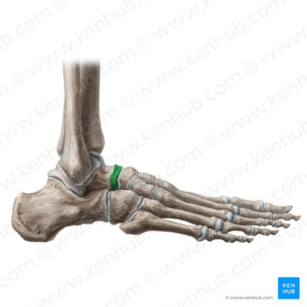

Slide 26
Continued
Ligament Support
Plantar calcaneonavicular (spring) ligament
Supports head of talus
Movements
Gliding and rotational movements

Slide 27
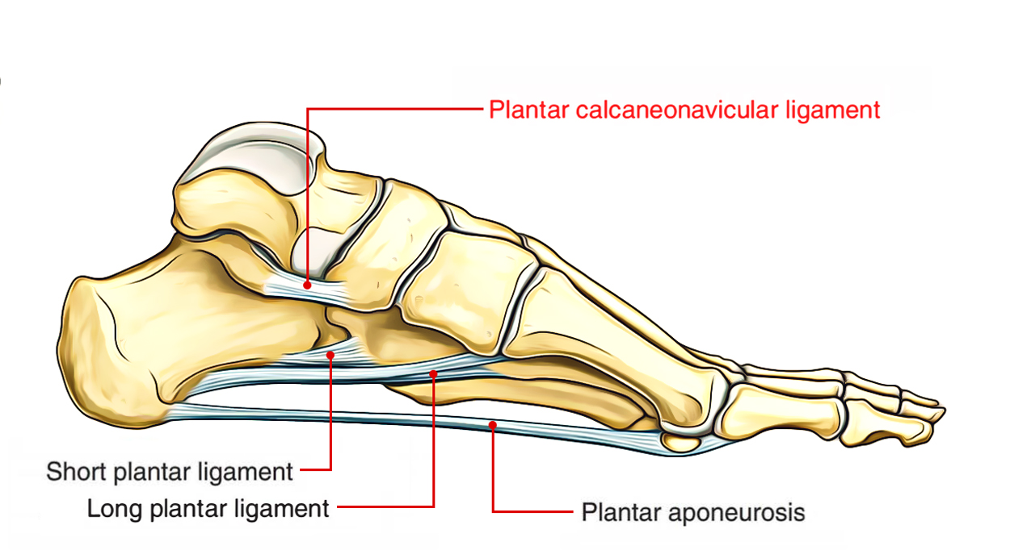

Slide 28
Transverse Tarsal Joint
Includes:
  Talonavicular joint
  Calcaneocuboid joint
Important for foot flexibility

Slide 29
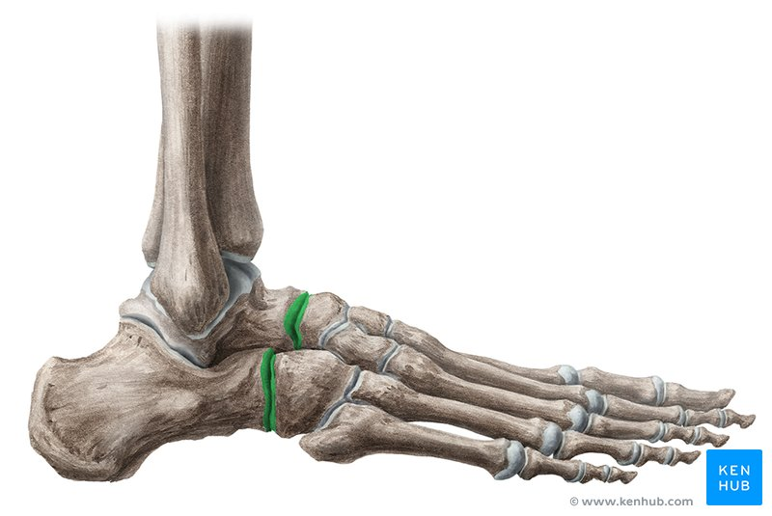

Slide 30
Calcaneocuboid Joint
Type
Plane synovial joint
Capsule
Encloses the joint
Ligaments
Strong ligaments reinforce the joint

Slide 31
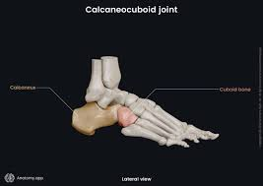

Slide 32
Cuneonavicular Joint
Between navicular and cuneiform bones
Supported by strong ligaments
Limited gliding movement

Slide 33
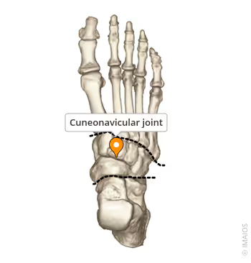

Slide 34
Intertarsal Joints
Between tarsal bones
Types:
  Plane synovial joints
Movements:
  Small gliding movements

Slide 35
Tarsometatarsal Joints
Between tarsal bones and metatarsals
Strongly bound by ligaments
Limited movement

Slide 36
Metatarsophalangeal Joints
Type
Condyloid synovial joints
Movements
Flexion
Extension
Abduction
Adduction

Slide 37
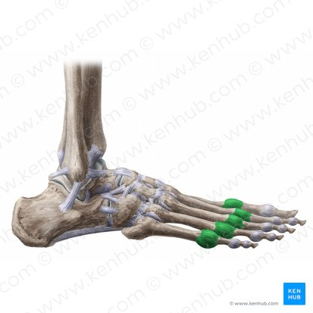

Slide 38
Interphalangeal Joints
Type
Hinge joints
Movements
Flexion
Extension

Slide 39
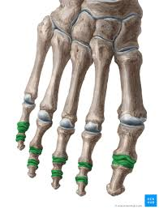

Slide 40


Slide 41


