Slide 1

ANATOMY
THE THORAX
BS RIT,OTT
2ND SEMESTER
DR DANISH

Slide 2
LOWER RESPIRATORY TRACT
The respiratory tract is the network of passages that carry air to the lungs.
Upper respiratory tract: includes nasal passages and sinuses.
Lower respiratory tract (tracheobronchial tree) includes:
  Lower part of the trachea
  Bronchi
  Bronchioles

Slide 3
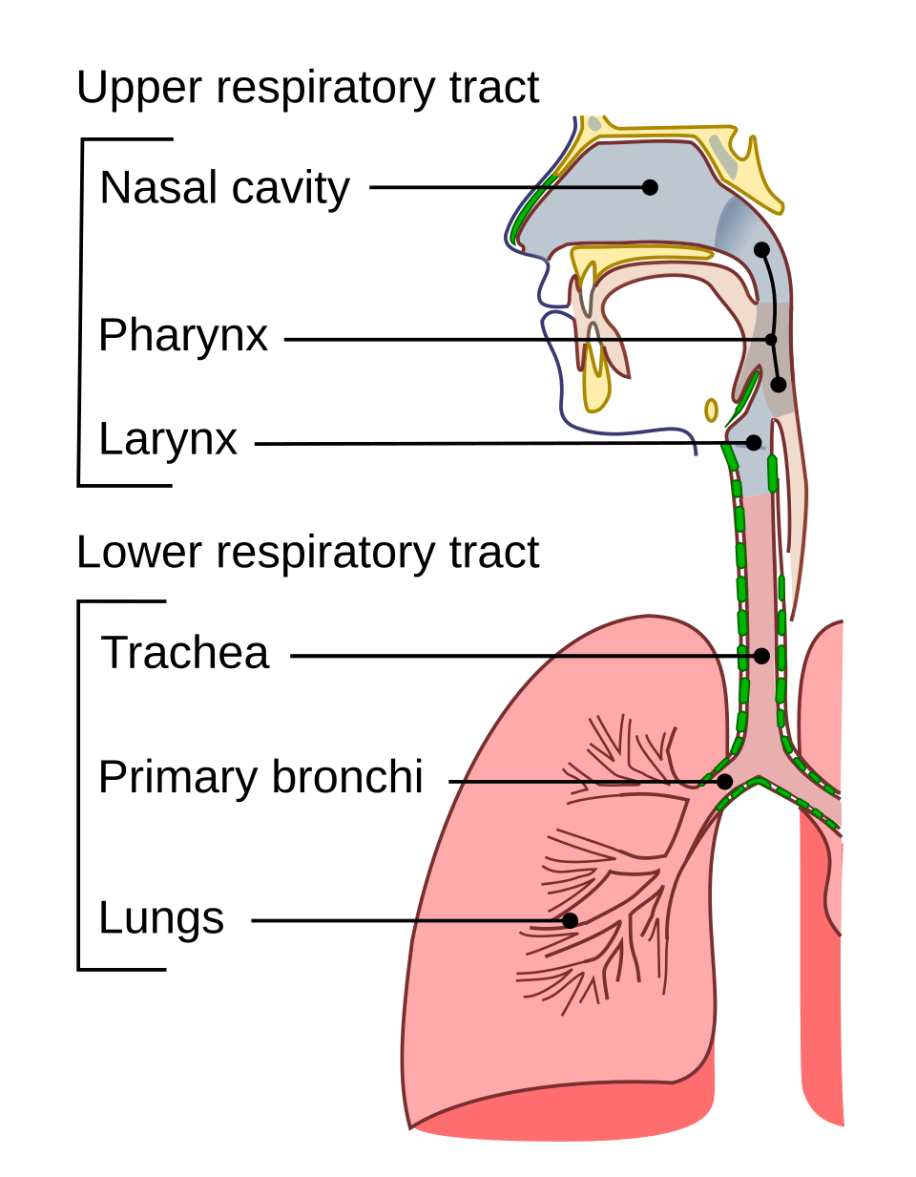

Slide 4
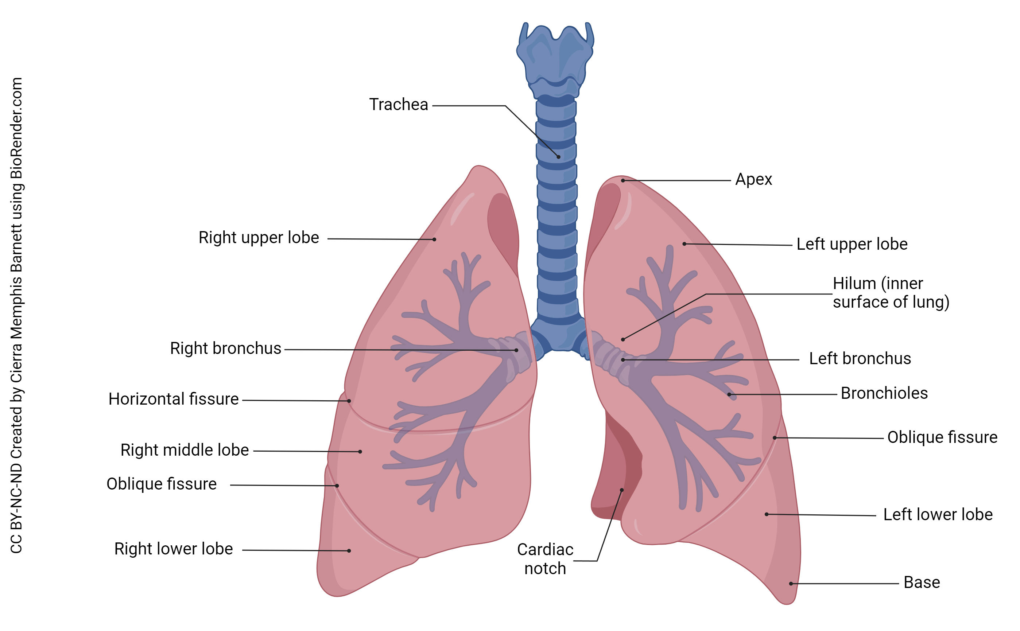

Slide 5
TRACHEA
A mobile cartilaginous and membranous tube.
Begins as a continuation of the larynx in the neck.
Descends in the midline:
  Starts around C6 vertebral level
  Ends at the sternal angle (T4–T5 level)
Passes through the superior mediastinum.
Divides into right and left main bronchi.

Slide 7
Structure
Approximately:
  10–12 cm long
  2.5 cm in diameter
Supported by U-shaped (C-shaped) hyaline cartilage rings.
The open posterior ends are connected by the:
  Trachealis muscle (smooth muscle)
Posterior wall:
  Adjacent to the esophagus
  Allows esophageal expansion during swallowing

Slide 8
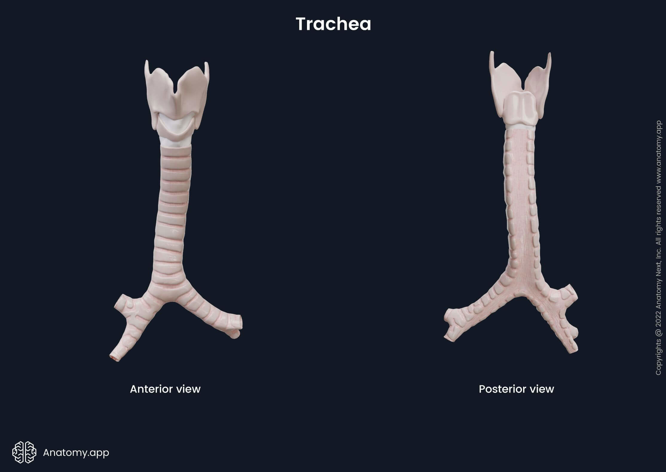

Slide 9
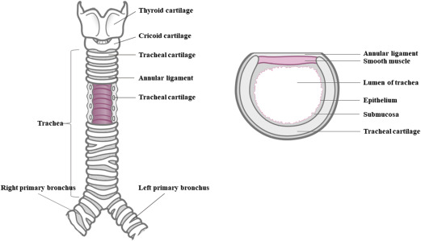

Slide 10
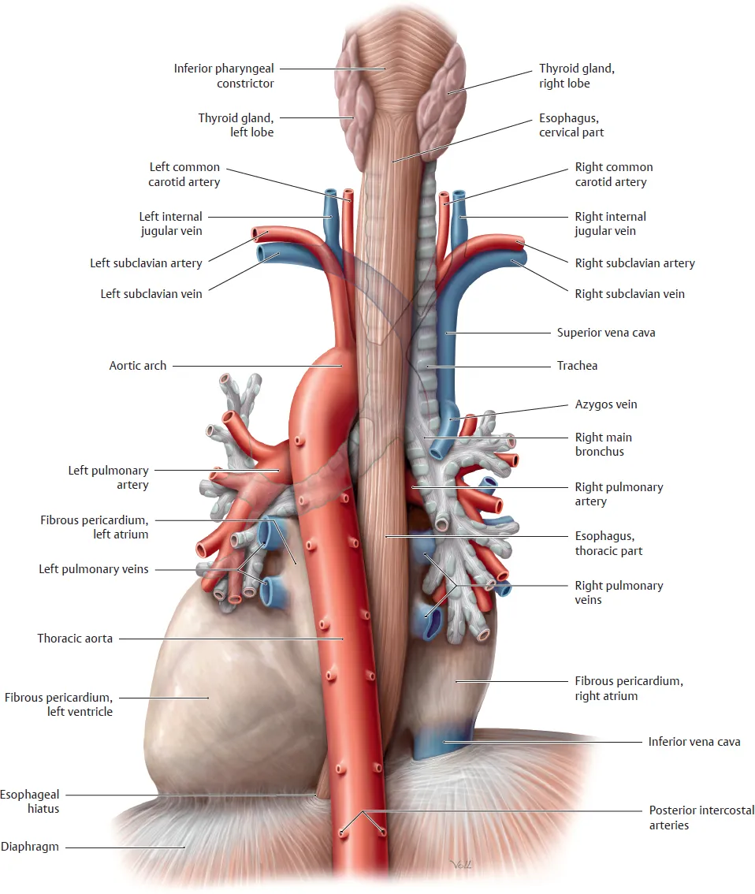

Slide 11
RELATIONS OF THE TRACHEA (THORAX)
Anteriorly
Sternum
Thymus (remnants)
Left brachiocephalic vein
Brachiocephalic artery
Beginning of the aortic arch

Slide 12
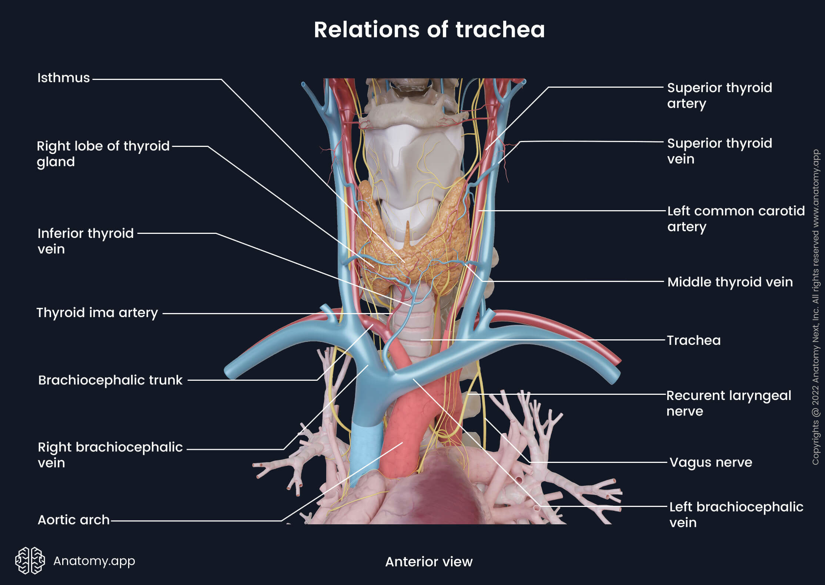

Slide 13
Continued
Posteriorly
Esophagus
Left recurrent laryngeal nerve

Slide 15
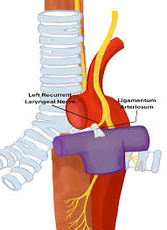

Slide 16
Continued
Right Side
Right vagus nerve
Pleura

Slide 17
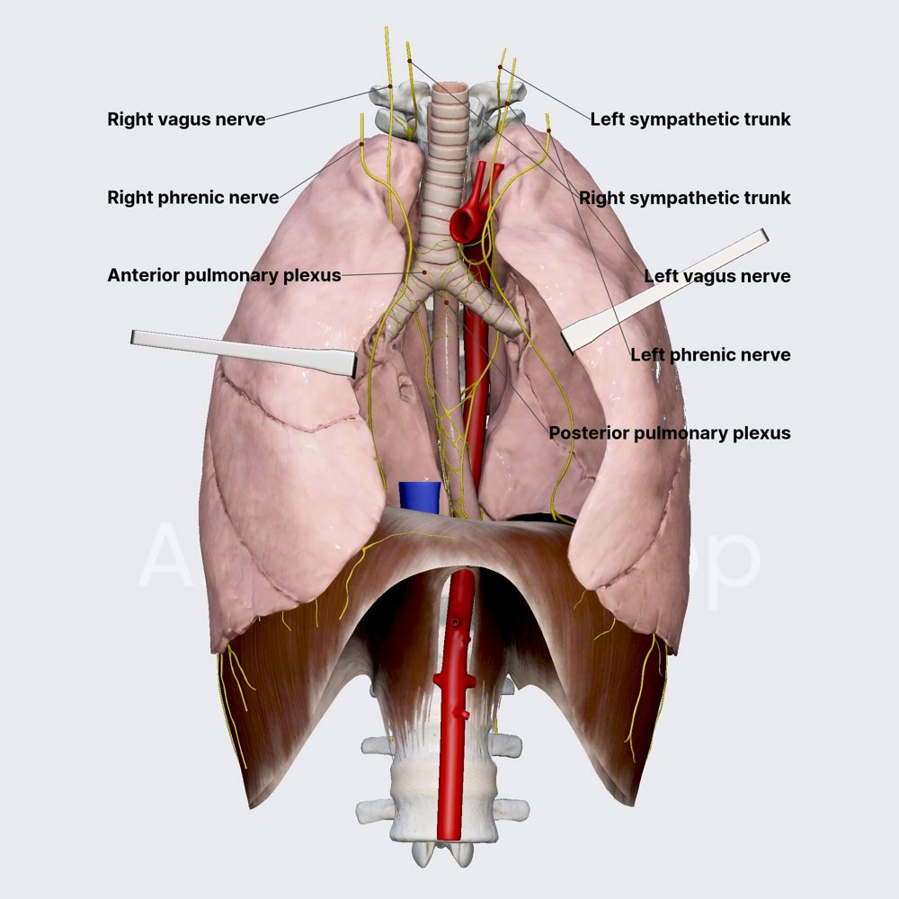

Slide 18
Continued
Left Side
Arch of aorta
Left common carotid artery
Left subclavian artery
Left vagus nerve
Left phrenic nerve
Pleura

Slide 21
BLOOD SUPPLY
Inferior thyroid arteries (branches of subclavian arteries):
  Supply upper two-thirds of trachea
Bronchial arteries (branches of thoracic aorta):
  Supply lower third

Slide 22
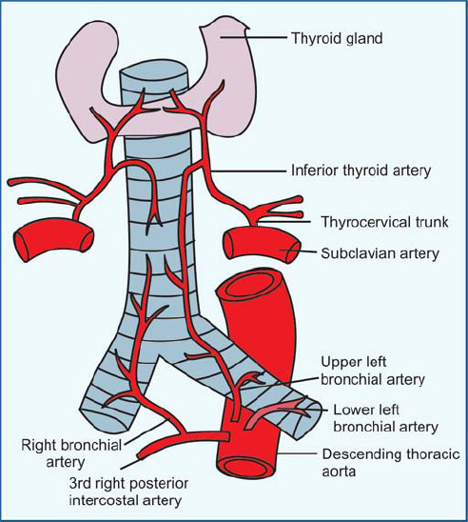

Slide 23
NERVE SUPPLY
Vagus nerve and recurrent laryngeal nerves:
  Sensory innervation
Sympathetic nerves:
  Supply the trachealis muscle

Slide 24
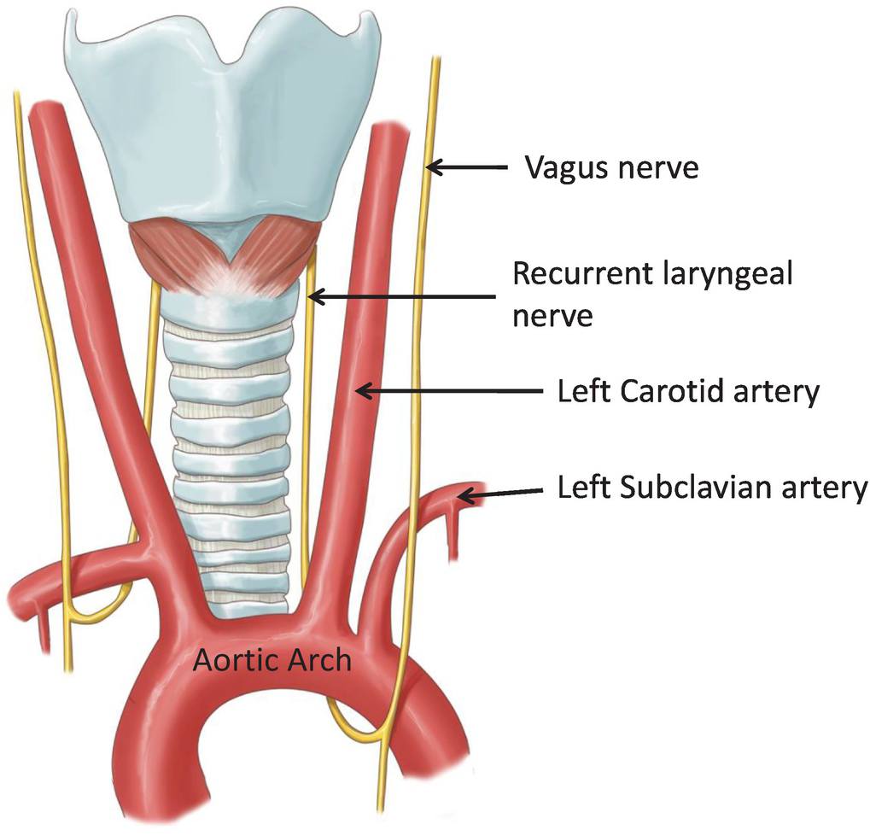

Slide 25
BRONCHI
Formation
Trachea bifurcates behind the arch of the aorta into:
  Right main (primary) bronchus
  Left main (primary) bronchus
The ridge at the bifurcation is called the carina.

Slide 28
RIGHT MAIN BRONCHUS
Wider, shorter, and more vertical than the left
About 2.5 cm long
Enters the hilum of the right lung
Divides into:
  Superior lobar bronchus
  Middle lobar bronchus
  Inferior lobar bronchus

Slide 31
LEFT MAIN BRONCHUS
Narrower, longer, and more horizontal
About 5 cm long
Passes below the arch of the aorta and in front of the esophagus
Enters hilum of left lung
Divides into:
  Superior lobar bronchus
  Inferior lobar bronchus

Slide 34
BRONCHIAL TREE & AIRWAYS
Bronchi divide repeatedly
Form secondary (lobar) bronchi → supply lobes
  Then tertiary (segmental) bronchi → supply bronchopulmonary segments
Continue branching into:
  Bronchioles
  Terminal bronchioles

Slide 35
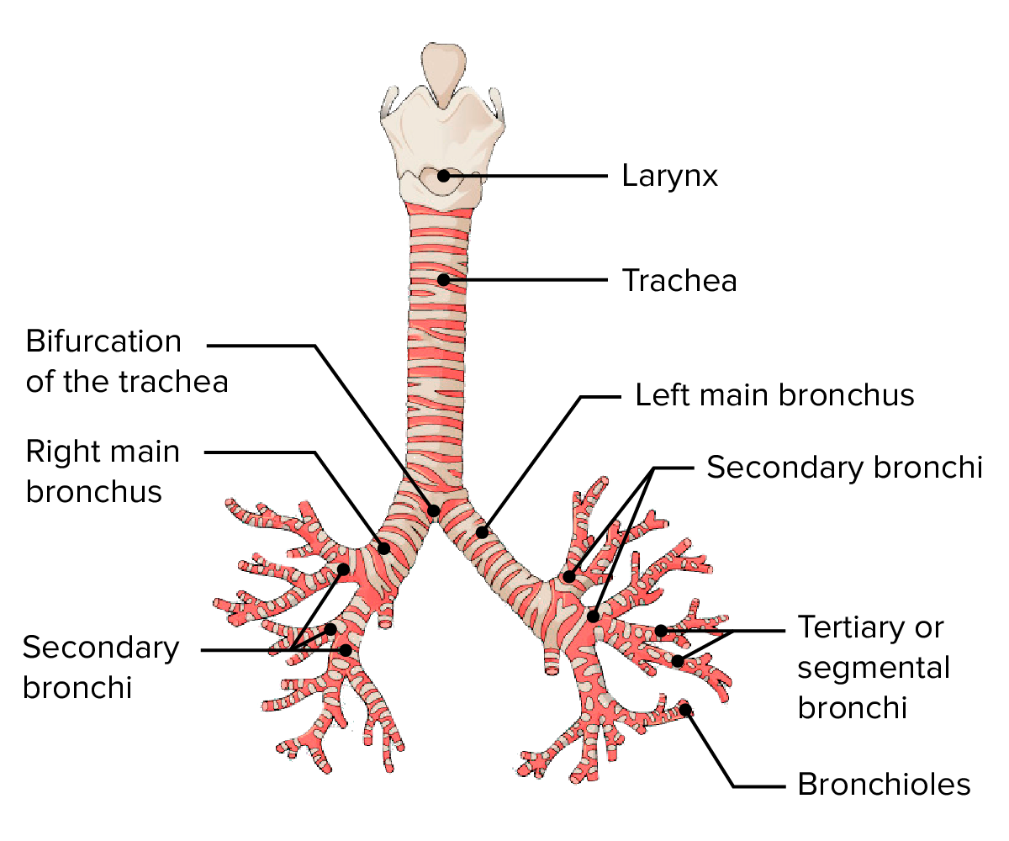

Slide 36
RESPIRATORY PORTION
Terminal bronchioles give rise to:
  Respiratory bronchioles
These divide into:
  2–11 alveolar ducts
Alveolar ducts open into:
  Alveolar sacs
Walls of sacs contain:
  Alveoli (site of gas exchange)

Slide 37
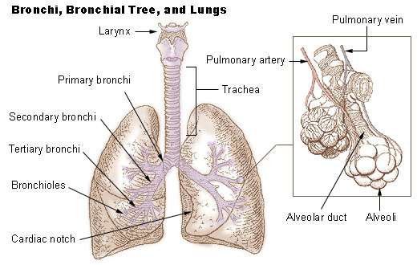

Slide 38
Important CLINICAL NOTE
The right main bronchus is more vertical:
  Inhaled foreign bodies are more likely to enter the right lung.

Slide 40
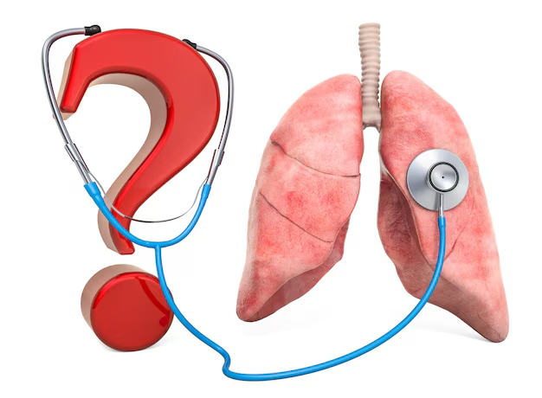

Slide 41


