Slide 1

ANATOMY
THE THORAX
BS RIT,OTT
2ND SEMESTER
DR DANISH

Slide 2
PLEURAE
Overview:
The pleurae are paired membranes surrounding the lungs.
Located on either side of the mediastinum within the thoracic cavity.
Each pleura consists of:
  Parietal layer
  Visceral layer

Slide 3
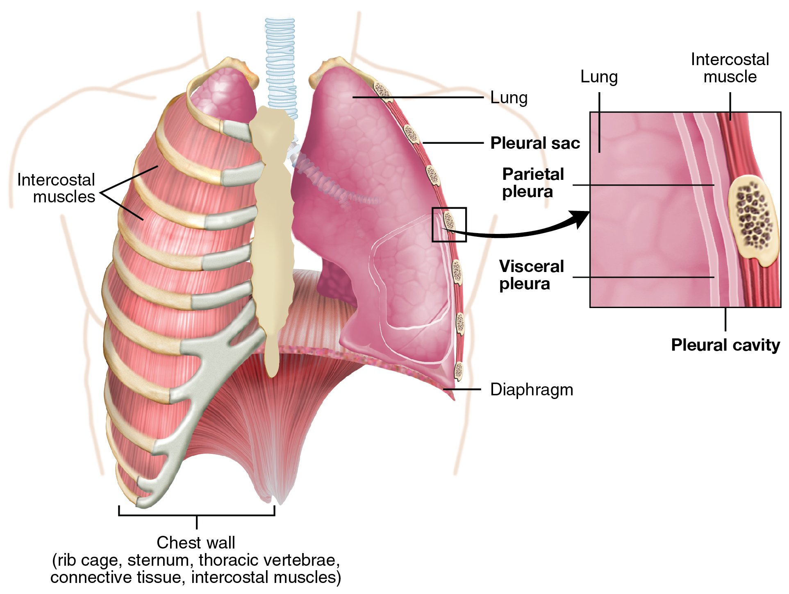

Slide 4
Parietal Pleura
Lines the thoracic wall.
Covers:
  Thoracic surface of the diaphragm
  Lateral aspect of the mediastinum
Extends into the root of the neck.
Lines the undersurface of the suprapleural membrane.

Slide 5
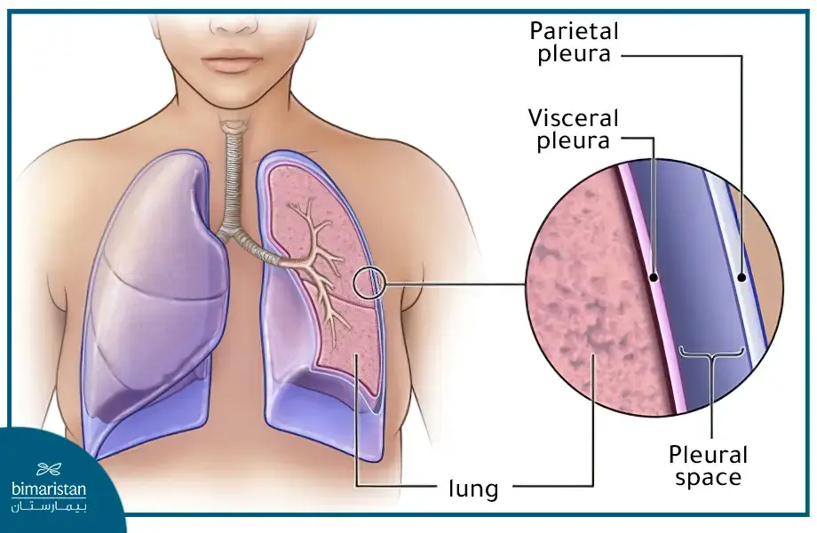

Slide 6
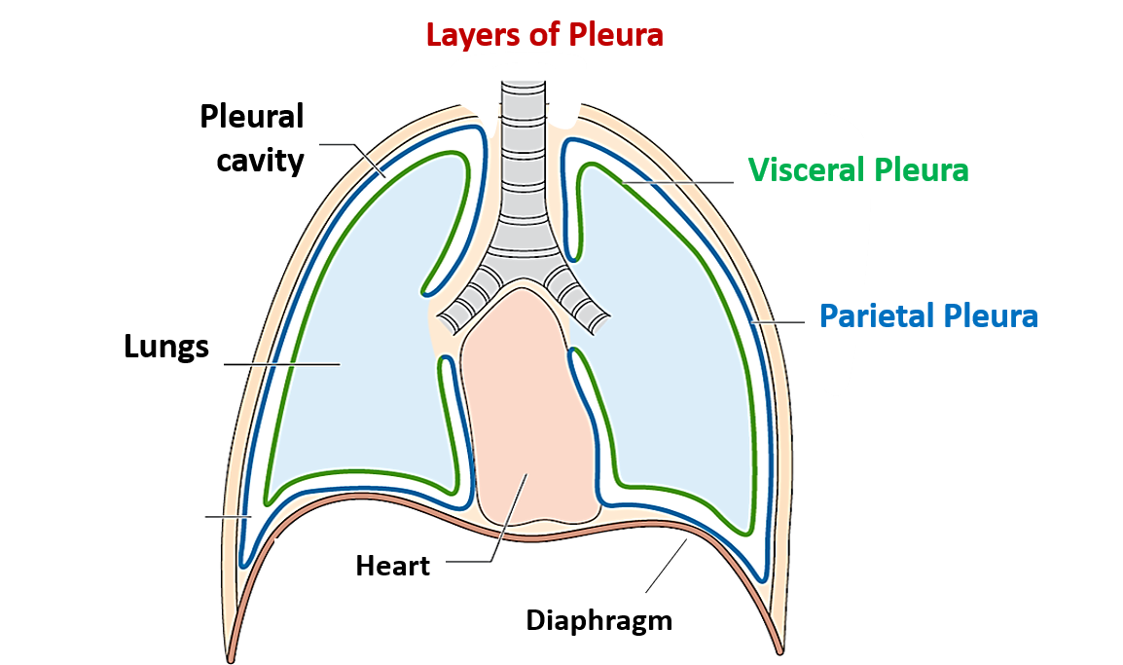

Slide 7
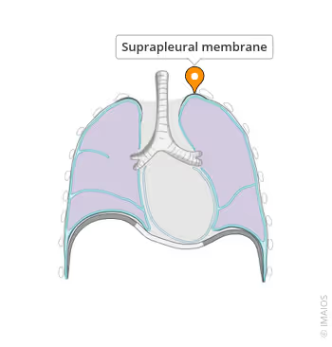

Slide 8
Visceral Pleura
Covers the outer surface of the lung.
Thinner than the parietal pleura.

Slide 11
Continuity of Pleura
Parietal and visceral layers are continuous at the hilum of the lung.
Form a sleeve-like cuff around structures entering/leaving the lung.
This cuff extends downward as the:
  Pulmonary ligament
Allows movement of:
  Pulmonary vessels
  Large bronchi during respiration

Slide 12
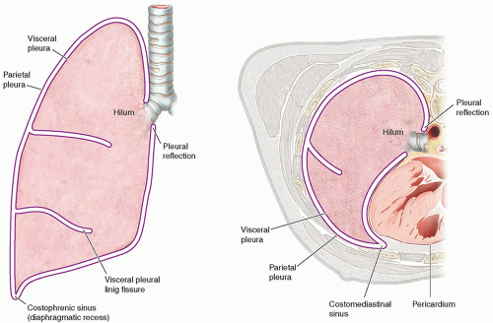

Slide 13
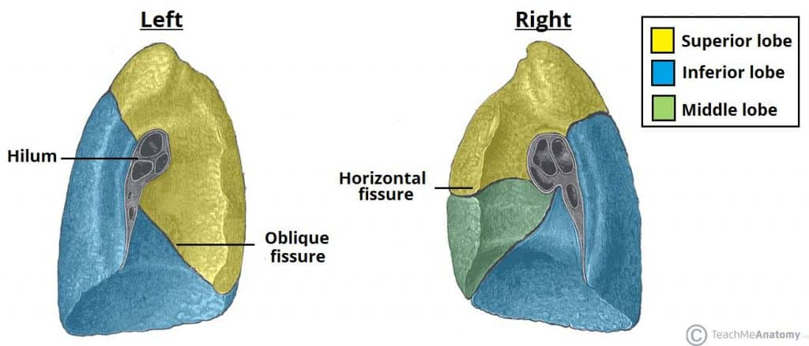

Slide 14
Pleural Cavity (Pleural Space)
A slit-like space between parietal and visceral pleura.
Contains a small amount of pleural fluid.
Functions:
  Reduces friction
  Allows smooth movement of pleural layers
Normally a potential space (not visible unless abnormal).

Slide 16
Regions of Parietal Pleura
Cervical Pleura
Extends into the neck.
Lines suprapleural membrane.
Reaches ~2.5–4 cm above medial third of clavicle.

Slide 18
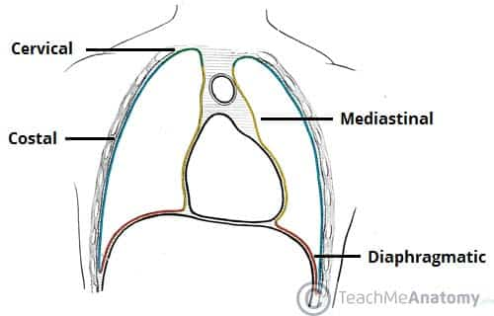

Slide 19
Continued
Costal Pleura
Lines:
  Inner surfaces of ribs
  Costal cartilages
  Intercostal spaces
  Sides of vertebral bodies
  Back of sternum

Slide 22
Continued
Diaphragmatic Pleura
  Covers thoracic surface of the diaphragm.
Mediastinal Pleura
  Covers lateral boundary of mediastinum.
  Reflects at hilum to become visceral pleura.

Slide 24
Pleural Recesses
Costodiaphragmatic Recess
Between costal and diaphragmatic pleura.
Largest recess.
Lung expands into it during inspiration.
Contains only pleural fluid at rest.
Costomediastinal Recess
Between costal and mediastinal pleura.
Located along anterior margins.

Slide 25
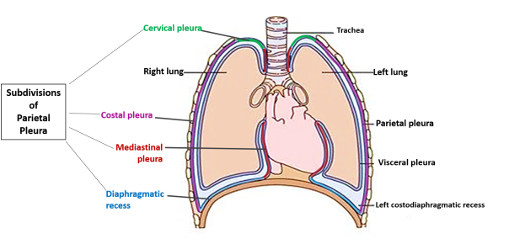

Slide 26
Movement During Breathing
During inspiration:
  Lungs expand into recesses.
During expiration:
  Lungs recoil and leave recess spaces.
In quiet breathing:
  Pleural layers remain closely apposed.

Slide 28
Nerve Supply
Supplied by somatic nerves (pain sensitive):
  Intercostal nerves → costal pleura
  Phrenic nerve → mediastinal pleura
  Phrenic nerve → central diaphragmatic pleura

Slide 30
Visceral Pleura
Supplied by visceral afferent nerves.
Sensitive to stretch only.
Insensitive to:
  Pain
  Temperature
  Touch
Innervation via pulmonary plexus.

Slide 32


Slide 33


