Slide 1

ANATOMY
THE THORAX
BS RIT,OTT
2ND SEMESTER
DR DANISH

Slide 2
Mediastinum
The mediastinum is the central compartment of the thoracic cavity
Located between:
  Sternum (anteriorly)
  Vertebral column (posteriorly)
  Two pleural cavities (laterally)
Extends:
  Superiorly → thoracic outlet/root of neck
  Inferiorly → diaphragm

Slide 3
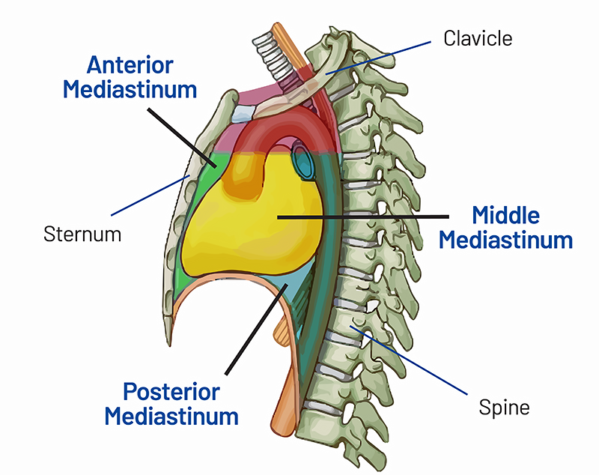

Slide 4
Continued
Contains:
Heart and great vessels
Trachea and esophagus
Thymus (remnants in adults)
Thoracic duct and lymph nodes
Vagus and phrenic nerves
Sympathetic trunks

Slide 5
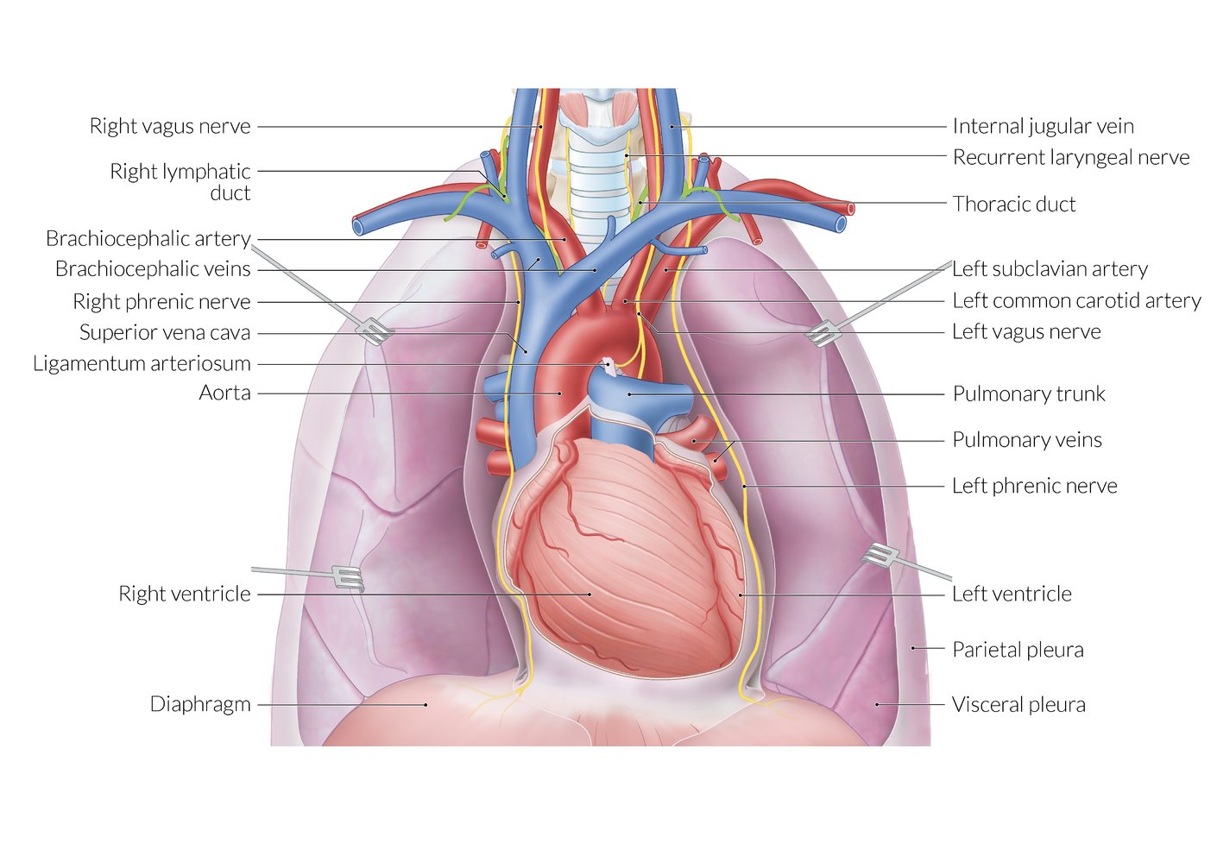

Slide 6
Division of Mediastinum
Divided into superior and inferior mediastinum
Division plane:
  From sternal angle → to T4 vertebra (intervertebral disc)

Slide 7
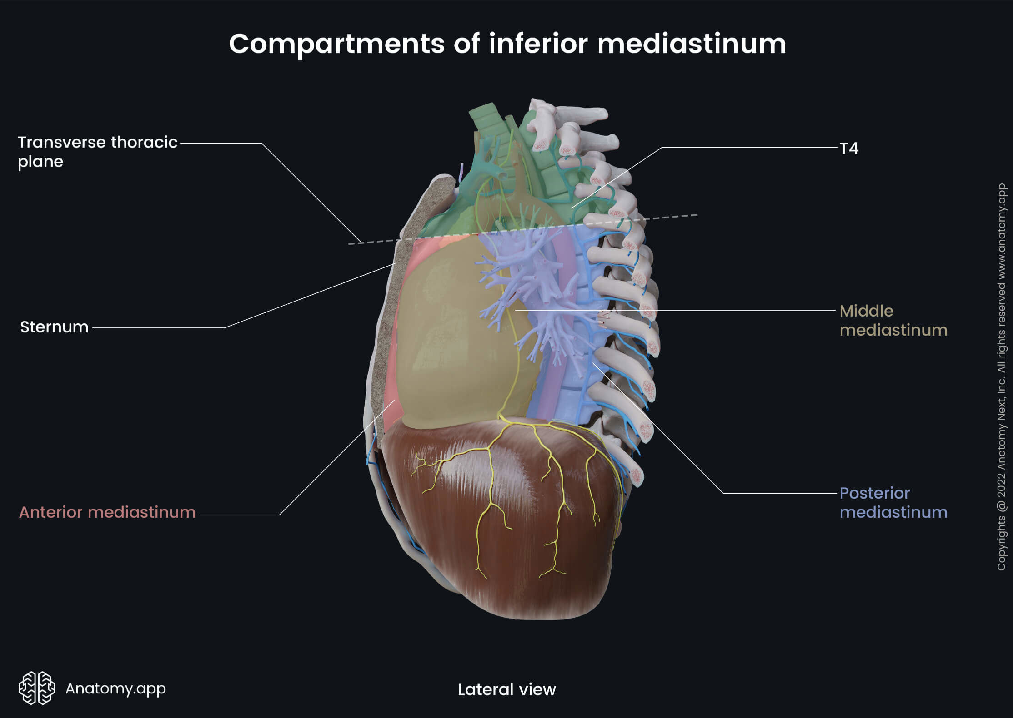

Slide 8
Key Landmarks at This Plane
Manubriosternal joint
Second costosternal joint
Transition:
  Ascending aorta → arch of aorta
  Arch of aorta → descending aorta
Bifurcation of trachea
Beginning of left primary bronchus
Level of T4 intervertebral disc

Slide 10
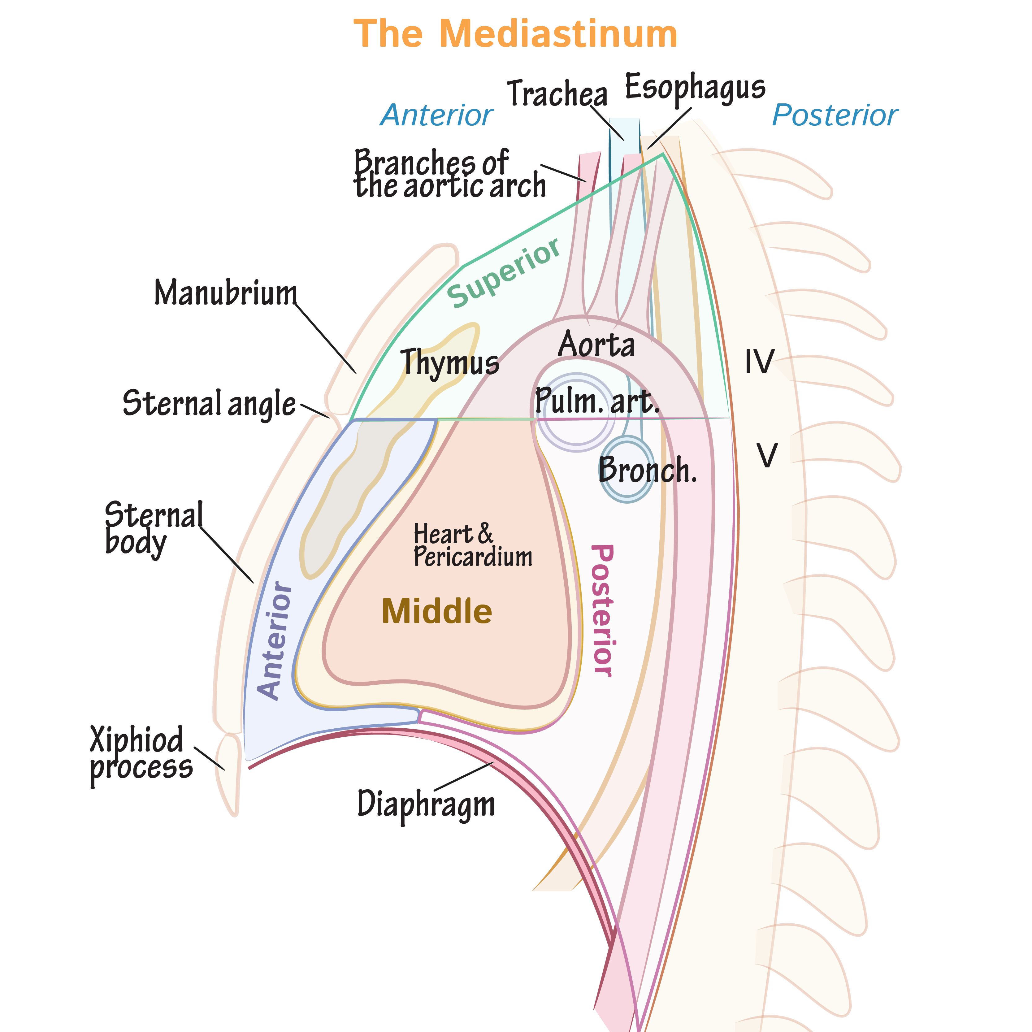

Slide 11
Inferior Mediastinum Subdivisions
Anterior mediastinum
  Between sternum and pericardium
Middle mediastinum
  Contains pericardium and heart
Posterior mediastinum
  Between pericardium and vertebral column

Slide 13
Superior Mediastinum (Anterior → Posterior Order)
Thymus
Large veins
Large arteries
Trachea
Esophagus & thoracic duct
Sympathetic trunks
Boundaries
Anterior → manubrium sterni
Posterior → T1–T4 vertebrae

Slide 14
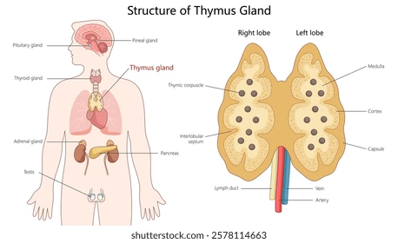

Slide 15
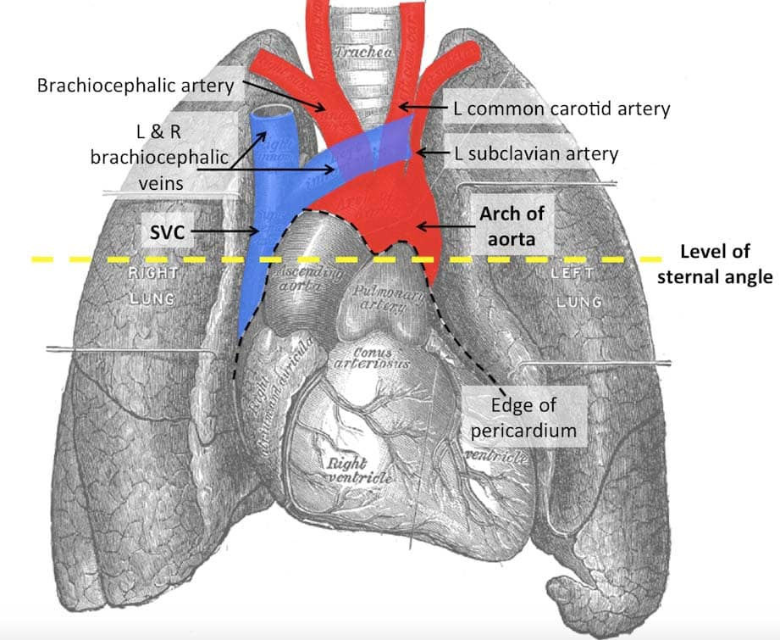

Slide 17
Inferior Mediastinum (Anterior → Posterior Order)
Thymus
Heart (within pericardium) + phrenic nerves
Esophagus & thoracic duct
Descending aorta
Sympathetic trunks
Boundaries
Anterior → body of sternum
Posterior → T5–T12 vertebrae

Slide 19


Slide 20


