Slide 1

BMS
THE PHYSIOLOGY
FSC MEDICAL TECHNOLOGY I
DR DANISH

Slide 2
Functions of the Atria (Upper Chambers)
Right Atrium
Receives deoxygenated blood
  Collects blood returning from the body via the superior and inferior vena cava.
Acts as a holding chamber
  Temporarily stores blood before passing it to the right ventricle.
Initiates heartbeat (SA node)
  Contains the sinoatrial (SA) node, which generates electrical impulses to regulate heart rhythm.

Slide 3
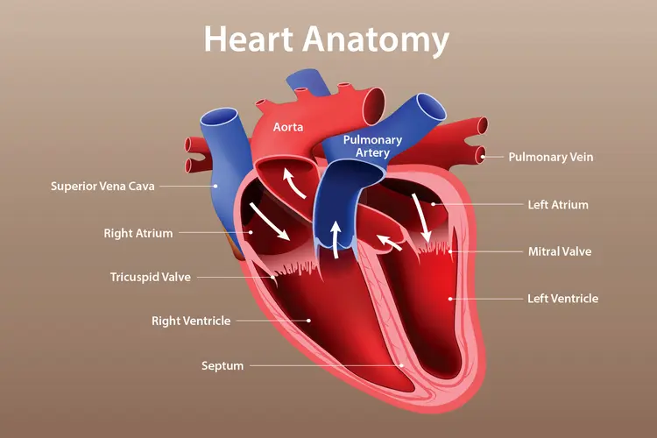

Slide 4
Left Atrium
Receives oxygenated blood
  Gets oxygen-rich blood from the lungs through the pulmonary veins.
Transfers blood to left ventricle
  Pushes blood into the left ventricle for systemic circulation.
Maintains smooth blood flow
  Ensures continuous movement of oxygenated blood into the ventricle.

Slide 6
CONTINUED
Overall Role of Atria
Primer pump function
  Enhance ventricular filling by contracting before ventricles.
Low-pressure chambers
  Designed to handle blood return rather than forceful pumping.

Slide 7
Functions of the Ventricles (Lower Chambers)
Right Ventricle
Pumps blood to the lungs
  Sends deoxygenated blood to the lungs via the pulmonary artery.
Supports pulmonary circulation
  Ensures gas exchange (CO₂ out, O₂ in) occurs in the lungs.
Moderate pressure pumping
  Generates enough force to reach lungs but not as strong as left ventricle.

Slide 9
Functions of the Ventricles (Lower Chambers)
Right Ventricle
Pumps blood to the lungs
  Sends deoxygenated blood to the lungs via the pulmonary artery.
Supports pulmonary circulation
  Ensures gas exchange (CO₂ out, O₂ in) occurs in the lungs.
Moderate pressure pumping
  Generates enough force to reach lungs but not as strong as left ventricle.

Slide 11
Left Ventricle
Pumps blood to the entire body
  Delivers oxygenated blood through the aorta to all body tissues.
Generates high pressure
  Has thick muscular walls to create strong contractions.
Maintains systemic circulation
  Ensures constant supply of oxygen and nutrients to organs.

Slide 13
Overall Role of Ventricles
Main pumping chambers
  Responsible for forceful ejection of blood.
Pressure generators
  Create the pressure needed for blood circulation in pulmonary and systemic circuits.

Slide 14
Functions of Heart Valves
Atrioventricular (AV) Valves
Tricuspid Valve (Right Side)
Located between right atrium and right ventricle
Prevents backflow into right atrium
  Closes during ventricular contraction.
Ensures forward flow to lungs
  Keeps blood moving toward pulmonary circulation.

Slide 15
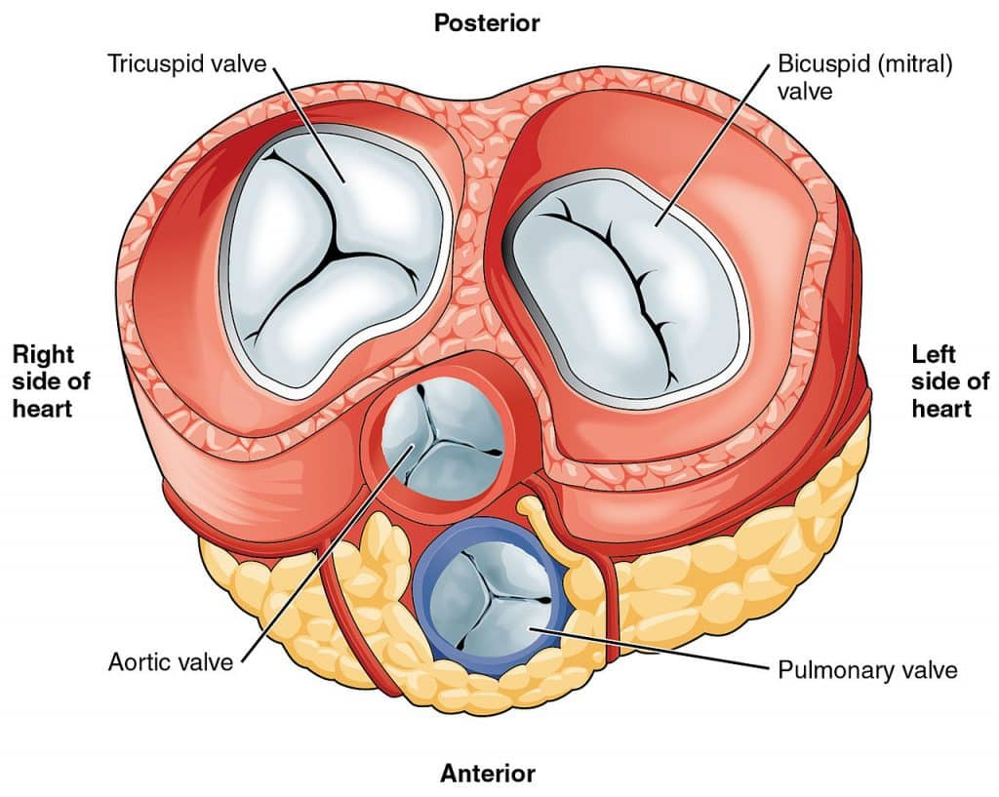

Slide 16
CONTINUED
Mitral (Bicuspid) Valve (Left Side)
Located between left atrium and left ventricle
Prevents backflow into left atrium
Supports efficient systemic circulation
  Maintains proper filling and ejection of blood.

Slide 18
Semilunar Valves
Pulmonary Valve
Between right ventricle and pulmonary artery
Prevents backflow into right ventricle
  Closes after blood is pumped to lungs.
Maintains forward pulmonary flow

Slide 20
CONTINUED
Aortic Valve
Between left ventricle and aorta
Prevents backflow into left ventricle
Supports high-pressure circulation
  Ensures blood moves efficiently to the body.

Slide 21


Slide 22


