Slide 1

PHARMACOLOGY
BS RIT,OTT,MLT
2ND SEMESTER
DR DANISH

Slide 2
Dose–Response Relationship
Definition:
Relationship between the dose of a drug and the magnitude of its effect
Fundamental for:
  Determining safe doses
  Comparing drug potency and efficacy
  Understanding therapeutic vs toxic effects

Slide 3
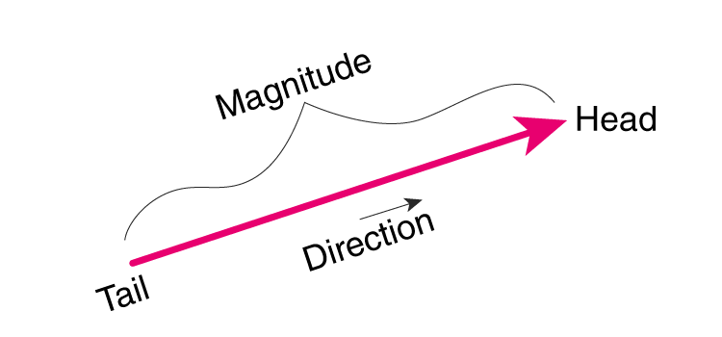

Slide 4
Types of Dose–Response Relationships
A. Graded Dose–Response:
Measures continuous response in an individual (e.g., BP reduction, enzyme inhibition)
Response increases proportionally with dose (up to a maximum)
Key features:
Smooth curve (often plotted on log scale → sigmoidal curve)
Shows:
  Emax (Maximum efficacy) → maximum effect drug can produce
  EC50 (Half-maximal effective concentration) → dose producing 50% of max effect

Slide 5
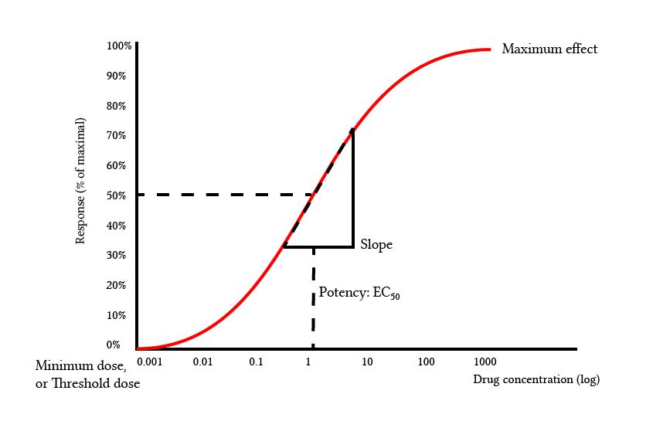

Slide 6
B. Quantal Dose–Response
Measures all-or-none response in a population
Used to determine:
  ED50 (Median effective dose) → effective in 50% of population
  TD50 (Median toxic dose)
  LD50 (Median lethal dose)

Slide 8
Key Parameters
A. Potency
Amount of drug needed to produce a given effect
More potent drug → lower dose required
Example:
Drug A produces effect at 5 mg
Drug B produces same effect at 50 mg
→ Drug A is more potent

Slide 10
Efficacy (Intrinsic Activity)
Maximum effect a drug can produce (Emax)
Independent of potency
Important:
A less potent drug can be more efficacious

Slide 12
Therapeutic Index (TI)
Measure of drug safety
TI=TD50/ED50
Higher TI → safer drug

Slide 13
Shape of Dose–Response Curve
Linear Scale
Hyperbolic curve
Harder to interpret
Log Scale
Sigmoid (S-shaped curve)
Easier to compare drugs:
  Middle portion is linear
  Highlights EC50 clearly

Slide 14
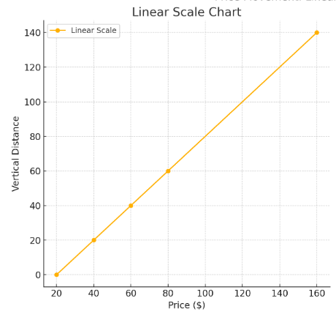

Slide 16
Factors Affecting Dose–Response
Age
Body weight
Genetics
Disease conditions
Drug interactions
Tolerance (reduced response over time)

Slide 17
Example (Clinical)
Paracetamol (Acetaminophen)
Low dose → analgesic and antipyretic effect
Increasing dose → greater pain relief (graded response)
Very high dose → toxicity (liver damage)
Illustrates:
Graded dose-response
Therapeutic window
Toxicity at high doses

Slide 18
CONCLUSION OF LECTURE
Dose–response relationship is central to pharmacology
Distinguishes potency vs efficacy
Helps determine safe and effective drug use

Slide 19


Slide 20


