Slide 1
Proofreading & Peer Review
Process of Writing
Expository Writing
BS Psy & DPT
Hafsa Rasheed

Slide 2
What is the Proofreading?
Proofreading is the final stage of the writing process, occurring after drafting and revision.
Proofreading is the careful, systematic checking of a written text to identify and correct surface-level errors in grammar, spelling, punctuation, formatting, and word usage.
Unlike revision (which deals with ideas), proofreading focuses on:
- Accuracy - correctness - mechanical precision
👉 In simple terms: Proofreading is the process of “cleaning the final version of your writing.”

Slide 3
WHY IS PROOFREADING IMPORTANT?
Proofreading is essential because even strong ideas can lose credibility if presented with errors.
1. Professionalism
Errors reduce the writer’s authority and academic credibility.
2. Clarity
Mistakes can distort meaning.
3. Precision
Ensures every sentence communicates exactly what is intended.
4. Reader experience
Clean writing is easier to read and more persuasive.
5. Academic standards
In universities and exams, marks are often lost due to avoidable errors.

Slide 4
WHAT IS “FINE-TUNING” A DRAFT?
Fine-tuning is the bridge between revision and proofreading.
It involves
improving sentence flow
adjusting ton
removing awkward phrasing
refining word choice
smoothing transitions
Think of it as: “making the writing sound natural, elegant, and effortless.”

Slide 5
COMMON ERRORS DETECTED IN PROOFREADING
Proofreading focuses on specific error categories:
🧩 A. HOMOPHONES (SOUND-SIMILAR WORDS)
These are words that sound the same but have different meanings.
Common examples:
--their / there / they’re --your / you’re -- its / it’s --accept / except --affect / effect
👉 Problem: Spellcheck cannot detect these errors because both words are correct.

Slide 6
B. MISSING OR REPEATED WORDS
These occur when:
a word is accidentally omitted
a word is repeated twice
Examples:
❌ “She went to to the market.”
❌ He is is very intelligent.”
❌ “She went market.” (missing word: to the)
👉 These are often caused by fast typing or fatigue.

Slide 7
C. PUNCTUATION ERRORS
Punctuation controls meaning and rhythm.
Common issues:
missing commas
incorrect apostrophes
misuse of semicolons
incorrect full stops
run-on sentence
Example:
❌ “Let’s eat grandpa” vs “Let’s eat, grandpa”
👉 Punctuation is not decoration—it is meaning control.

Slide 8
D. GRAMMATICAL ERRORS
Includes:
subject–verb agreement
tense inconsistency
sentence fragments
incorrect word order
article misuse (a/an/the)
Example:
❌ “He go to school every day.”
✔ “He goes to school every day.”

Slide 9
E. PAIRING ERRORS (PARALLELISM ISSUES)
Pairing or parallel structure ensures grammatical symmetry.
Example:
❌ “She likes reading, to write, and swimming.”
✔ “She likes reading, writing, and swimming.”
👉 Writing must maintain structural balance.

Slide 10
F. DASHES AND HYPHENS
Common confusion:
hyphen (-) = connects words (well-known)
dash (—) = interruption or emphasis
Example:
“She was late—again.”
“well-known author”
Incorrect usage can make writing unclear or informal

Slide 11
HOW TO PROOFREAD EFFECTIVELY
Proofreading is a skill-based process, not random reading.
📌 STEP 1: DISTANCE YOURSELF FROM THE TEXT
Wait before proofreading (10–24 hours if possible).
👉 This helps you read like a new reader.
📌 STEP 2: READ SLOWLY AND LINE BY LINE
Do not skim. Focus on:
each word
each punctuation mark

Slide 12
Continued. . .
📌 STEP 3: READ OUT LOUD
This helps detect:
missing words
awkward rhythm
sentence errors
📌 STEP 4: FOCUS ON ONE ERROR TYPE AT A TIME
Example:
first check grammar
then punctuation
then spelling
👉 Avoid multitasking during proofreading.

Slide 13
Continued. . .
📌 STEP 5: USE DIGITAL + MANUAL COMBINATION
Do not rely only on tools.
🧰 6. TOOLS FOR PROOFREADING IN THE DIGITAL AGE
Modern proofreading uses both AI and traditional tools.

Slide 14
PEER AND INSTRUCTOR FEEDBACK
A. DIGITAL TOOLS
1. Grammarly
grammar correction
tone suggestions
clarity improvements
2. Microsoft Word Editor
built-in grammar and spelling check
3. Google Docs Suggestion
real-time collaboration feedback
4. Hemingway Editor
improves readability
highlights complex sentences
B. AI ASSISTED TOOLS
ChatGPT-style proofreading
paraphrasing assistants
AI grammar correction systems
📚 C. TRADITIONAL METHODS
printed proofreading
reading aloud
reverse reading (sentence-by-sentence backward checking)

Slide 15
PROOFREADING DIFFERENT TYPES OF TEXTS
Different writing types require different focus
A. ACADEMIC ESSAYS
Focus on:
grammar accuracy
formal tone
citation formatting
coherence
D. CREATIVE WRITING
Focus on:
rhythm
dialogue punctuation
stylistic consistency
emotional tone

Slide 16
Continued. . .
✂️ 4. Conciseness
Avoid unnecessary words.
🎯 5. Precision
Say exactly what you mean.
📊 6. Structure symmetry
introduction → body → conclusion
logical progression of ideas
🎨 6. Consistency
Maintain:
tone
tense
voice
style

Slide 17
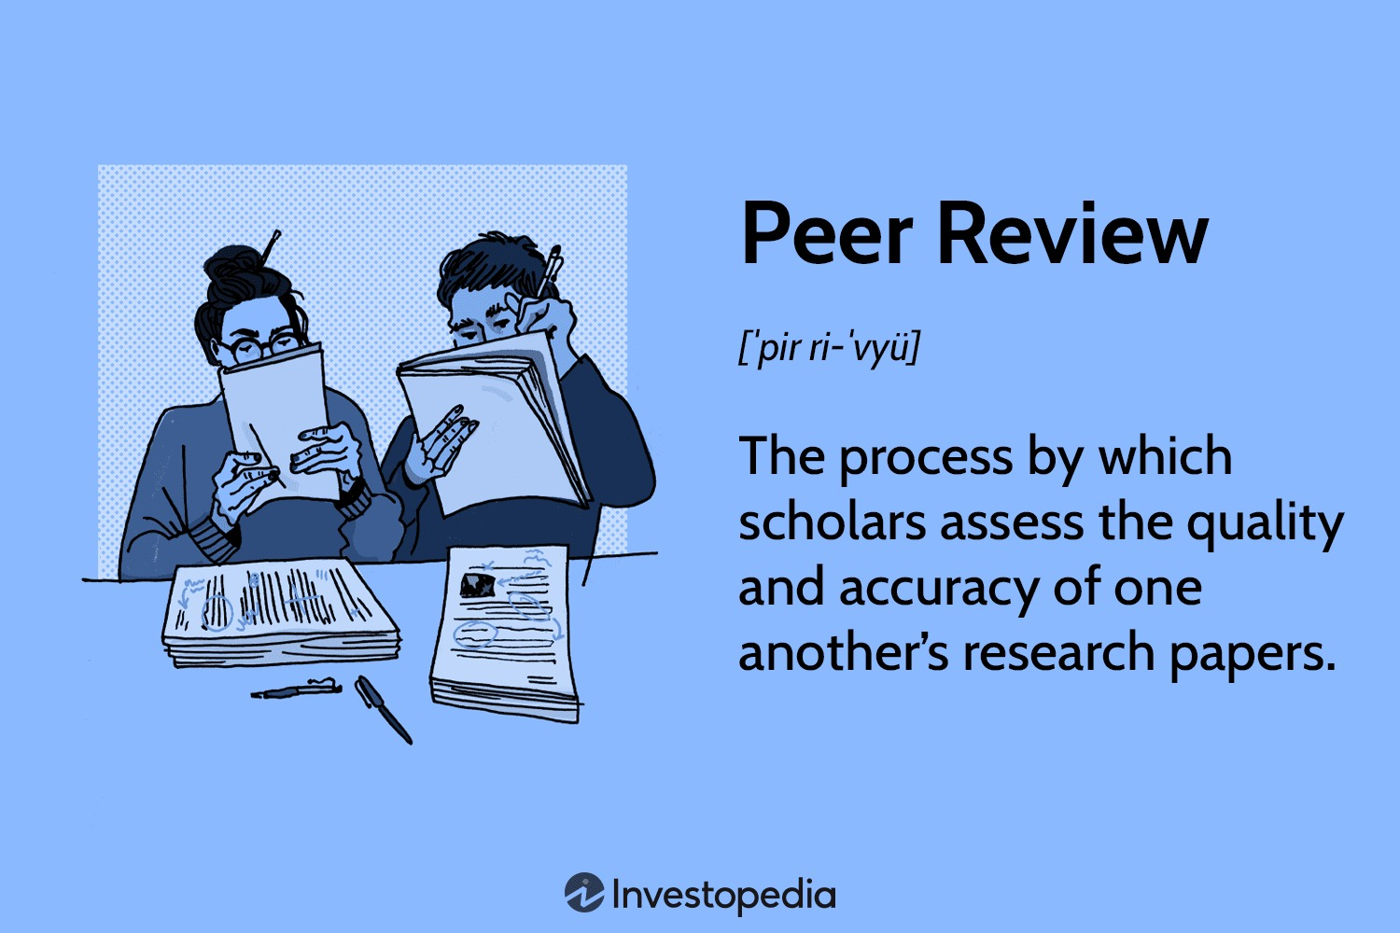
PEER REVIEW: MEANING AND IMPORTANCE
Peer review is the process in which writers evaluate each other’s work to improve clarity, structure, and effectiveness
🎯 Why peer review is important:
gives a reader’s perspective
identifies blind spots
improves clarity
strengthens argument
enhances academic quality
👉 Writing is communication: It must be tested on real readers.

Slide 18
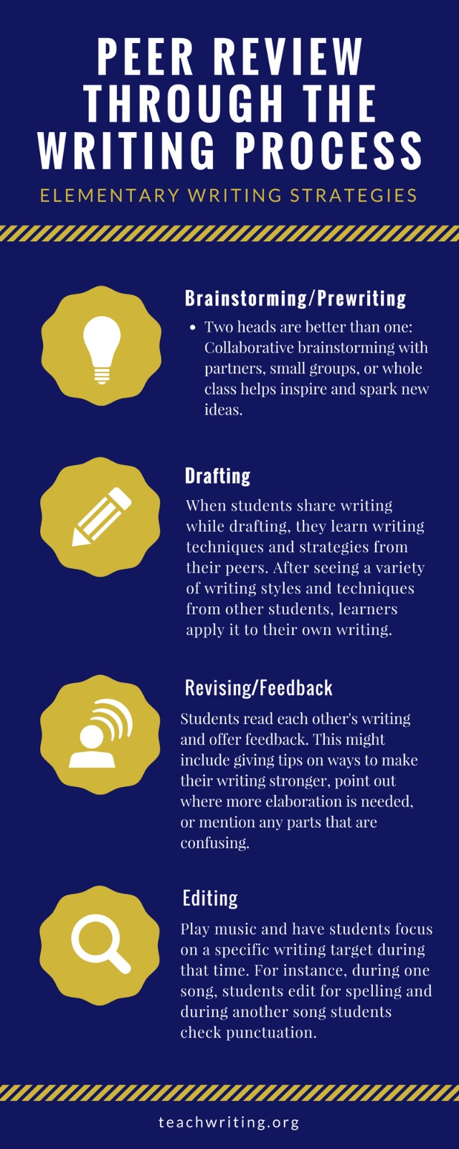

Slide 19
HOW TO GIVE EFFECTIVE PEER FEEDBACK
Good peer feedback is:
✔ Constructive
“This paragraph is unclear because…”
✔ Specific
not “this is bad” but “this sentence needs clarity”
✔ Balanced
mention strengths + weaknesses
✔ Respectful
focus on writing, not the writer
What NoT to do:
over-correct grammar unnecessarily
rewrite everything
impose personal style preferences
give vague comments

Slide 20
HOW TO RECEIVE FEEDBACK
Receiving feedback is a skill.
🧠 Best approach:
stay open-minded
avoid defensive reaction
look for patterns in comments
decide what improves meaning
👉 Important idea: Feedback is data, not judgment.

Slide 21
PEER REVIEW IN THE DIGITAL AGE
Modern peer review is increasingly online.
1. Google Doc
real-time comments
suggestion mode
collaborative editing
2. Microsoft Word Track Changes
visible revision history
structured feedback
3. Notion / collaborative platforms
shared writing spaces
4. Email + annotated PDFs
formal academic feedback

Slide 22


