Slide 1
Art and Everyday Life
Introduction to Visual Arts
DPT
Hafsa Rasheed

Slide 2
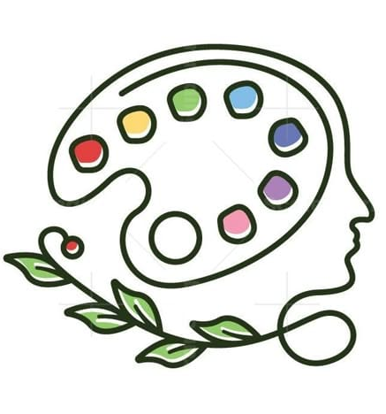
What is Art?
Art is human expression shaped into a meaningful or aesthetic form
It can be:
- A painting
- A poem
- A dance
Or even… the way you arrange your desk, your outfit,
your Instagram feed

Slide 3
What is “Everyday Life”?
Everyday life = the ordinary, repeated, routine experiences of being human
--Waking up – Eating -- Working --Talking – Scrolling -- Feeling bored, anxious, in love
👉 It is:-- Repetitive -- Often ignored -- But actually the largest part of human existence
Core Idea: If most of life is “ordinary”… then shouldn’t art exist inside it, not outside it?

Slide 4
How Art Emerged from Everyday Life
1. Early Humans (Cave Paintings)
Time: ~30,000 BCE
No galleries. No “artists.”
Why they painted? Survival (hunting magic)
Communication and Emotional release
👉 Example: Lascaux caves (France)
🧠 Meaning: Art began as a basic human instinct to understand and control life.

Slide 5
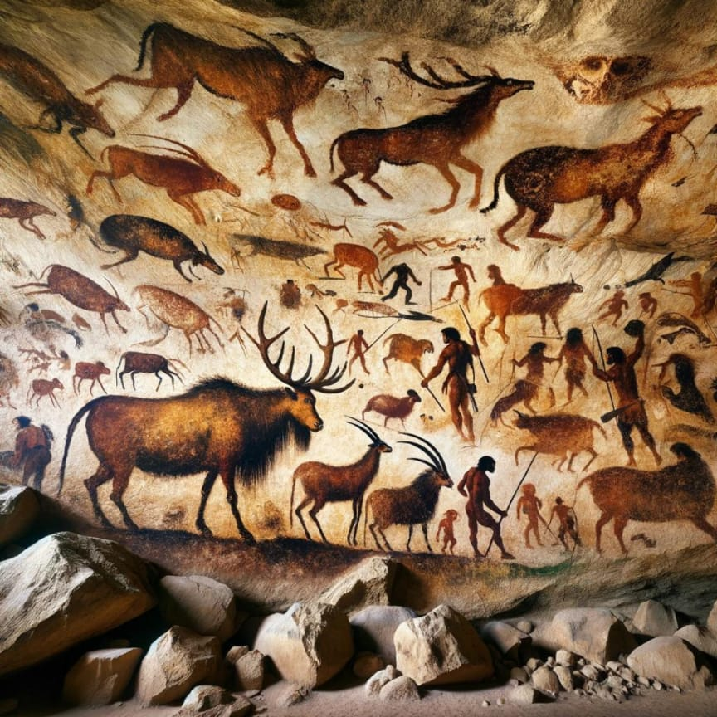

Slide 6
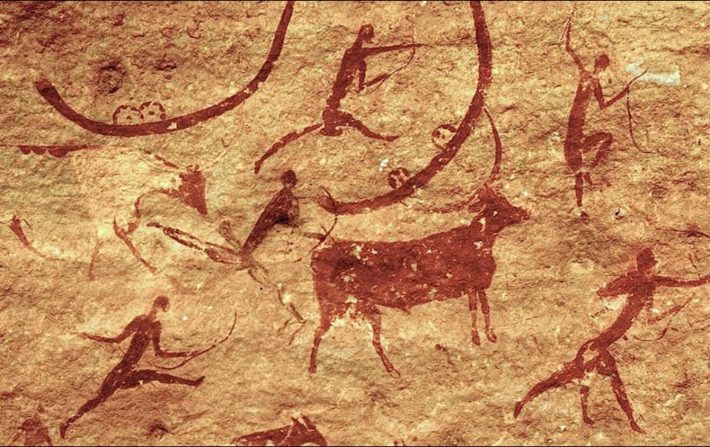

Slide 7
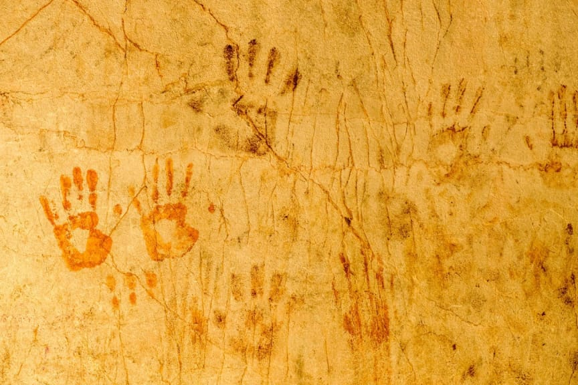

Slide 8
Theory (Important)
👤 Aristotle “Art imitates nature” (mimesis)
👉 Humans naturally:
- Observe
- Imitate
- Represent

Slide 9
Art for Ritual, Myth, and the Beyond
Uses: -- Religion – Myth -- Spiritual connection
👉 Ancient Egypt:
Paintings = afterlife survival tools
👉 Tribal cultures: Masks, dance = spirit communication
💫 Key Idea| Art helps humans go beyond the visible world(into myth, fantasy, spirituality)

Slide 10
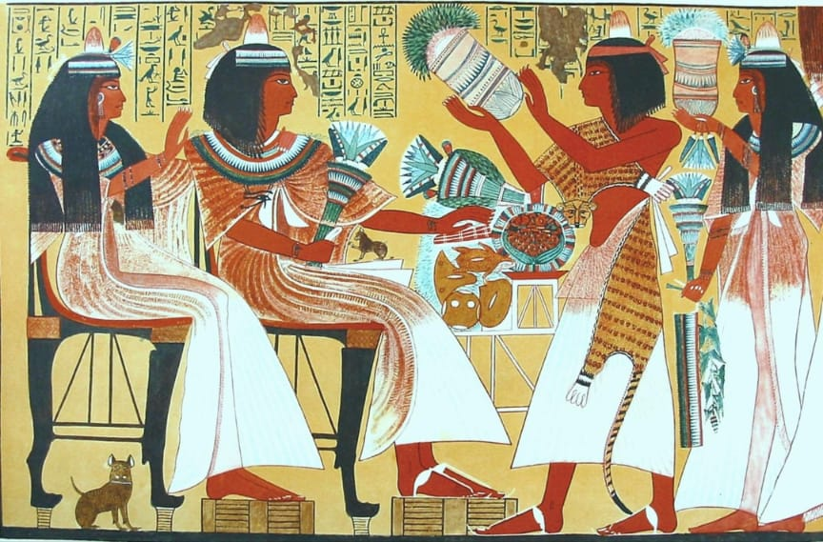

Slide 11
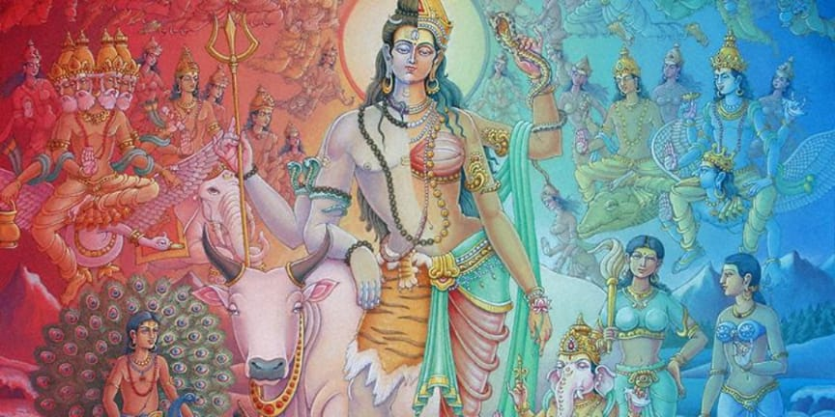

Slide 12
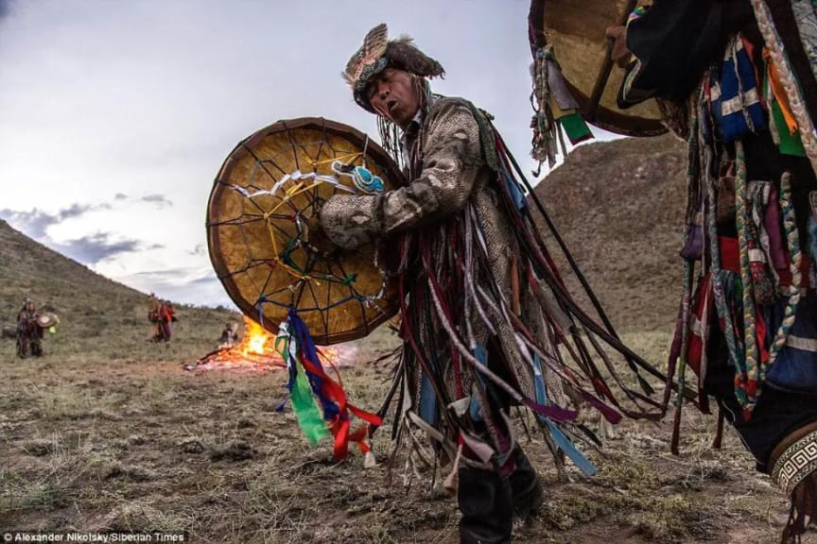

Slide 13
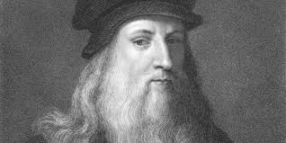
Scientific Illustration — Art for Knowledge
Leonardo da Vinci
-- Anatomical sketches -- Scientific observation
Purpose:
- Understand body, nature, universe
- Make the invisible visible
💡 Meaning | Art becomes a tool to understand/enhance perception of reality

Slide 14
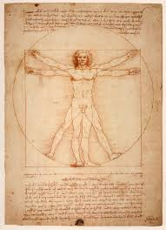

Slide 15
Decorative Art — Beautifying Everyday Life
Uses:
-- Homes -- Clothes -- Architecture
👉 Example: -- Islamic geometric patterns -- Mughal decoration
💡 Meaning | Humans have a natural urge to beautify their surroundings

Slide 18
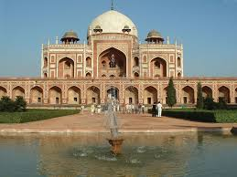

Slide 19
Narrative Art — Stories, Ethics, Knowledge
Uses:
-- Storytelling -- Teaching morality -- Preserving history
👉 Example: -- Ajanta Caves (India) -- Biblical Renaissance paintings
💡 Meaning | Art becomes a visual language of culture and values

Slide 20
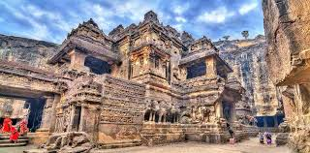

Slide 21
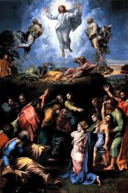

Slide 22
Art as Performance & Culture
Forms:
-- Dance -- Theatre -- Music
Purpose:
-- Ritual -- Celebration -- Identity---💡
Meaning | Art lives in movement, body, and collective experience of a culture

Slide 23
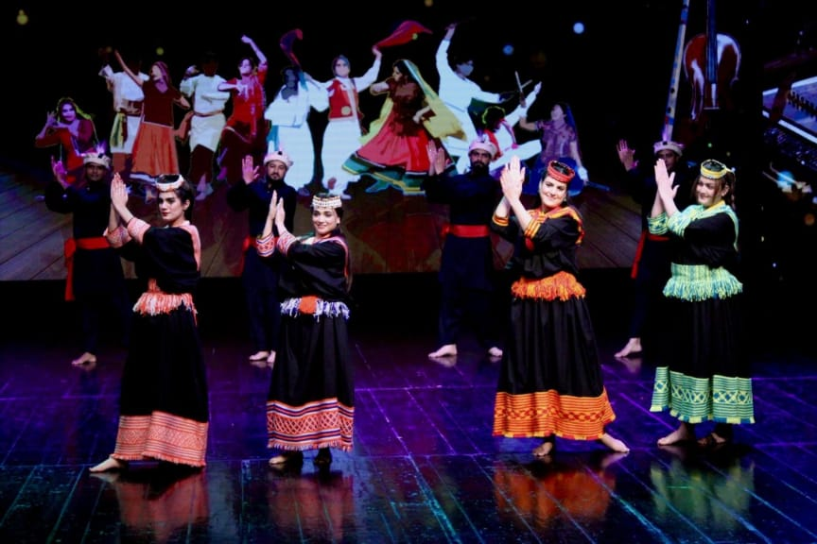
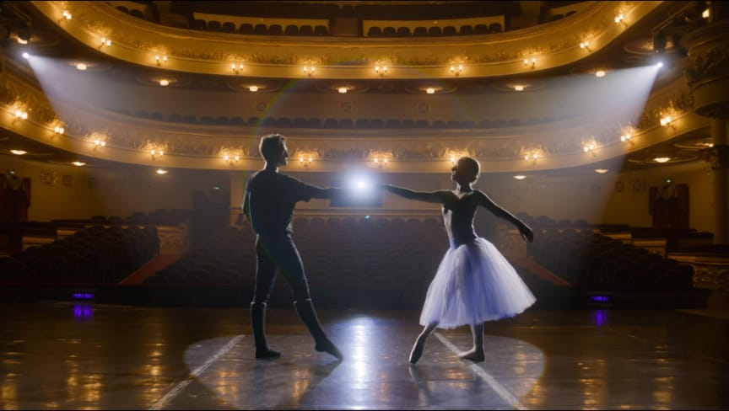

Slide 24
Art as Human Instinct & Mystery
“The most beautiful thing we can experience is the mysterious. It is the source of all true art and science.” –Albert Einstein
Meaning: Humans are drawn to
-- Unknown -- Wonder -- Curiosity
💡 Insight | Art begins where logic ends

Slide 25
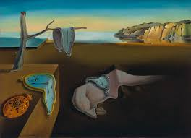
Expression & Imagination
👤 Salvador Dalí’s The Persistence of Memory (1931)

Slide 26
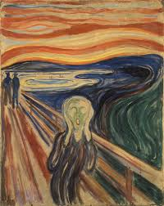
👤 Edvard Munch’s The Scream (1893)
Art expresses: -- Dreams -- Fear -- Imagination

Slide 27
Communication & Entertainment
Uses: -- Film -- Media -- Comics
Meaning| Art becomes a mass communication system

Slide 28
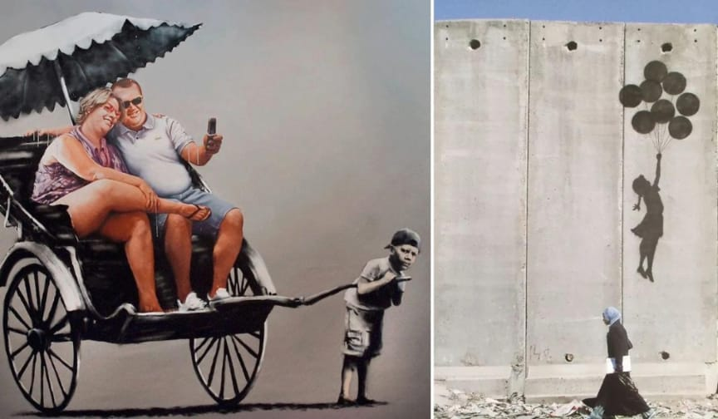
Political & Avant-Garde Art
Meaning: Art = protest Art = resistance

Slide 29
Art as Free Zone (Against Censorship)
-- Graffiti -- Street art -- Underground art
👉 Breaks: -- Authority -- Norms
💡 Idea | Art becomes a space of freedom

Slide 30
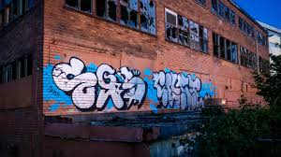

Slide 31
Social Causes & Healing
Uses: -- Therapy -- Awareness campaigns
💡 Meaning | Art heals and connects communities

Slide 32
