Slide 1
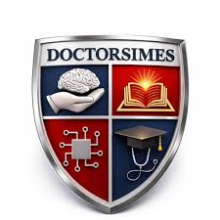
PHARMACOLOGY
BS RIT,OTT,MLT
2ND SEMESTER
DR DANISH

Slide 2
Excretion of Drugs via Non-Renal Routes
Drug excretion = removal of drugs from the body
Major route: renal (kidneys)
Other routes are important for:
  Lipophilic drugs
  Drugs with large molecular size
  Drugs undergoing enterohepatic cycling

Slide 3
Non-Renal Routes Overview
Biliary/Fecal excretion
Pulmonary (lungs)
Saliva
Sweat
Breast milk

Slide 4
Biliary Excretion
Occurs via liver → bile → intestine
Important for:
  Large molecular weight drugs (>300 Da)
  Conjugated drugs (e.g., glucuronides)
  Glucuronides are water-soluble metabolites formed when the liver links glucuronic acid to drugs, toxins, or waste products via glycosidic bonds
Transported by active transport systems
Examples:
  Rifampin
  Morphine glucuronides

Slide 5
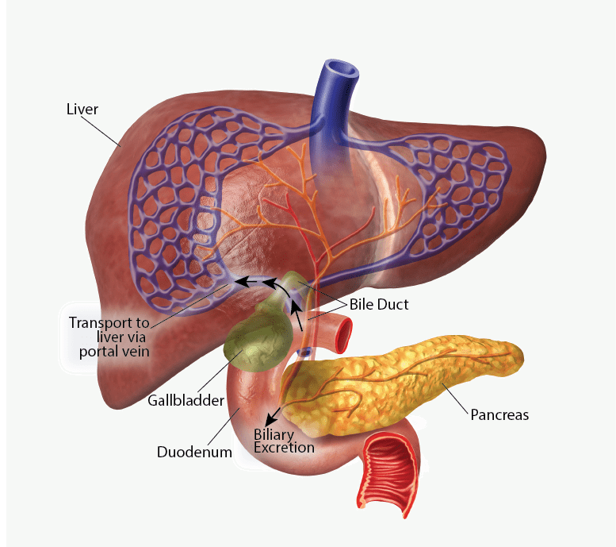

Slide 6
Enterohepatic Circulation
Drug excreted in bile → reaches intestine
Gut bacteria may deconjugate drug
Drug is reabsorbed into bloodstream
Leads to:
  Prolonged drug action
  Secondary peaks in plasma levels

Slide 7
Fecal Excretion
Drugs eliminated in feces via:
  Biliary excretion
  Unabsorbed oral drugs
Common in:
  Poorly absorbed drugs
  Large polar compounds

Slide 8
Pulmonary Excretion
Occurs through lungs
Important for:
  Volatile substances
  Gases
Examples:
  General anesthetics (e.g., nitrous oxide)
  Alcohol (small amount)
Depends on:
  Blood-gas partition coefficient
  Respiratory rate

Slide 9
Salivary Excretion
Drugs diffuse from plasma into saliva
Usually passive diffusion
Depends on:
  Lipid solubility
  Ionization (pH dependent)
Clinical relevance:
  Drug monitoring (e.g., phenytoin)

Slide 10
Sweat Excretion
Small amounts of drugs excreted in sweat
Mechanism: passive diffusion
Can cause:
  Skin irritation
  Unusual odor (e.g., garlic-like smell with some drugs)
Limited clinical significance

Slide 11
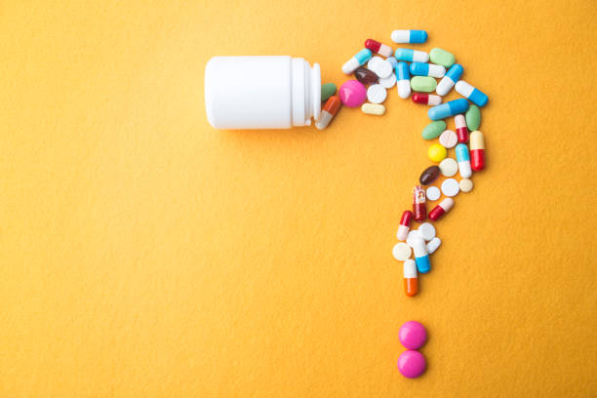

Slide 12
