Slide 1

ANATOMY
THE LOWER LIMB
DPT
2ND SEMESTER
DR DANISH

Slide 2
Foot Bones
The foot consists of:
  Tarsal bones
  Metatarsals
  Phalanges
These groups are comparable to:
  Carpals, metacarpals, and phalanges of the hand

Slide 3
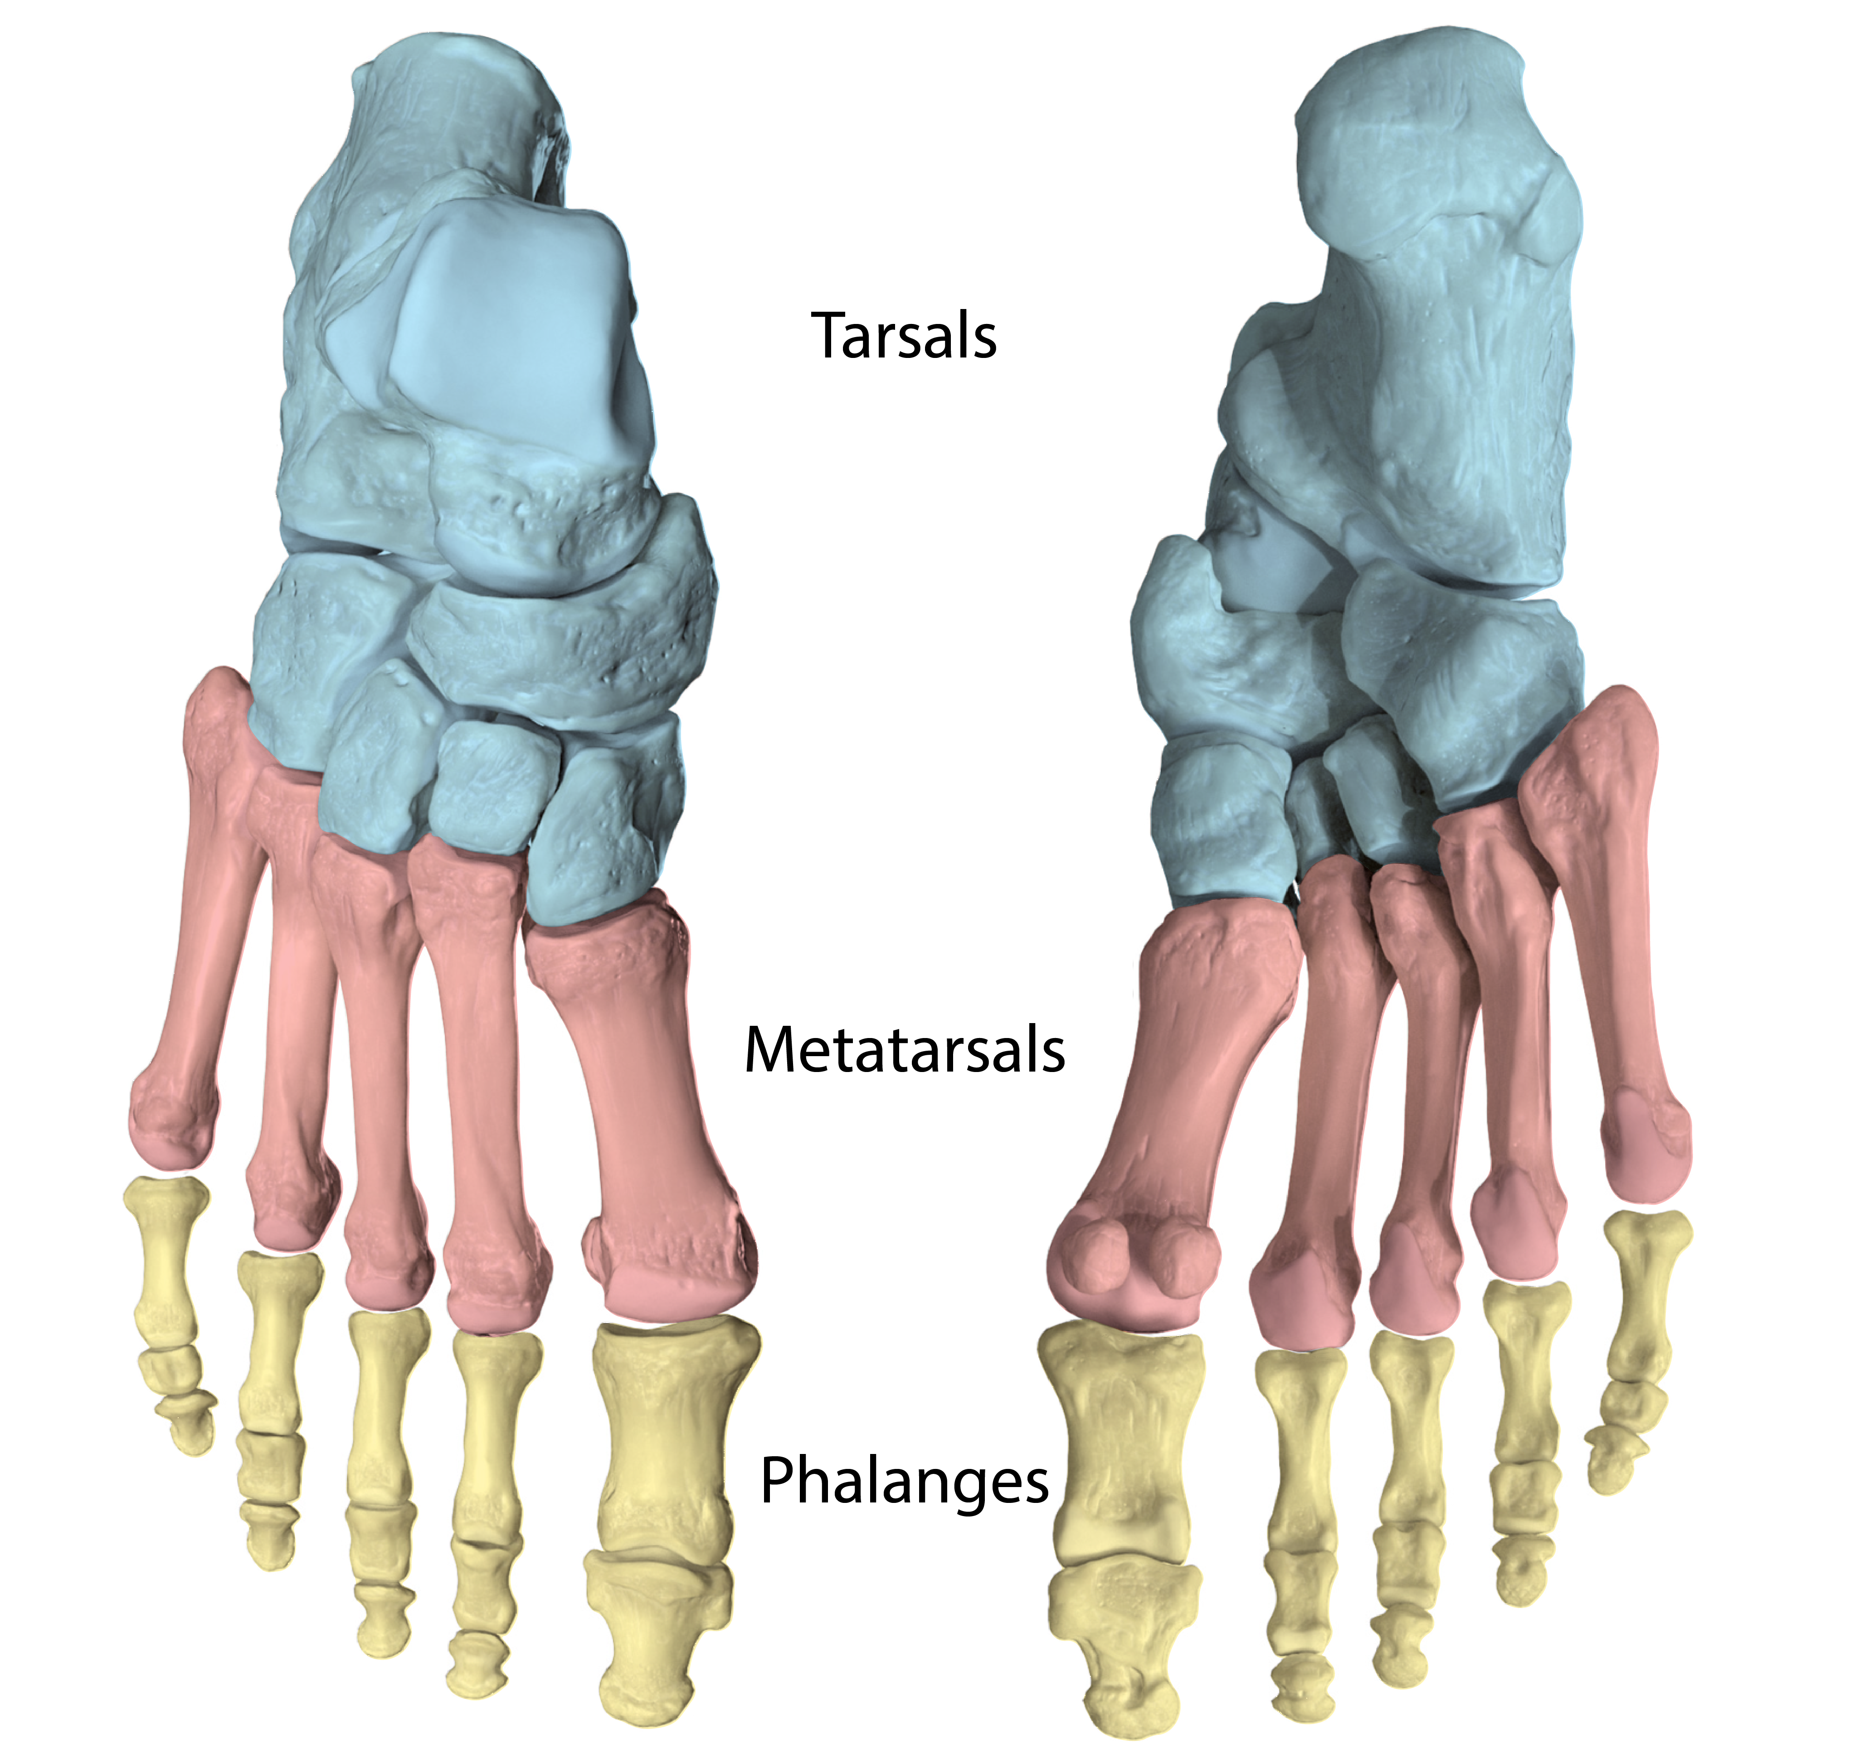

Slide 4
Tarsal Bones
Tarsal bones include:
  Calcaneum (calcaneus)
  Talus
  Navicular
  Cuboid
  Three cuneiform bones

Slide 5
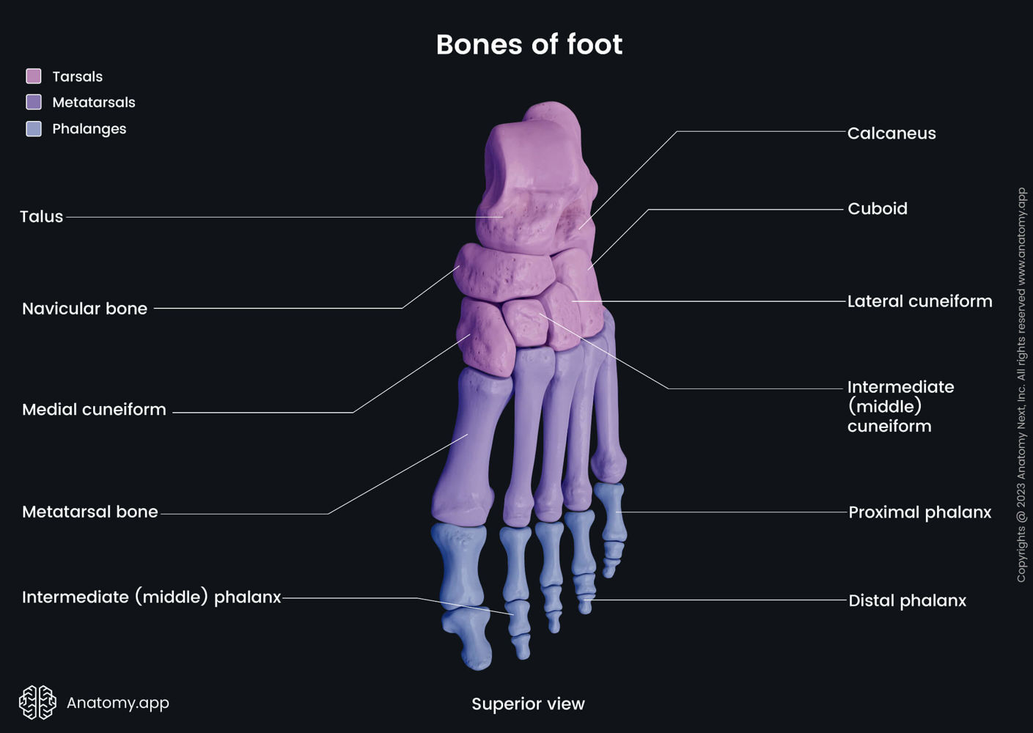

Slide 6
Continued
Key point:
  Only the talus articulates with the tibia and fibula (ankle joint)
Development:
  Ossification begins before birth (except navicular)
  Ossification completed by ~5 years

Slide 7
Calcaneum (Heel Bone)
Largest bone of the foot
Forms the prominence of the heel
Articulations:
  Superiorly with talus
  Anteriorly with cuboid

Slide 8
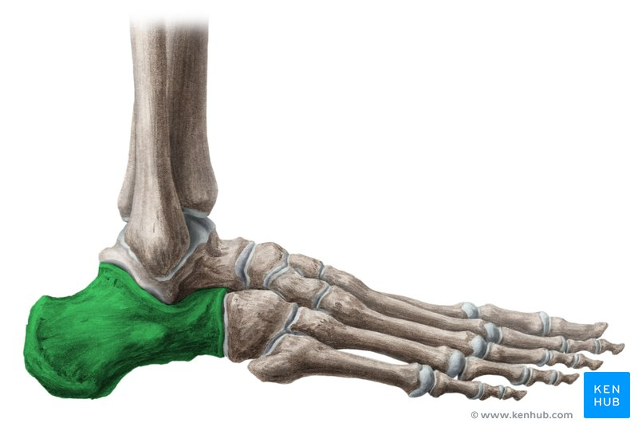

Slide 9
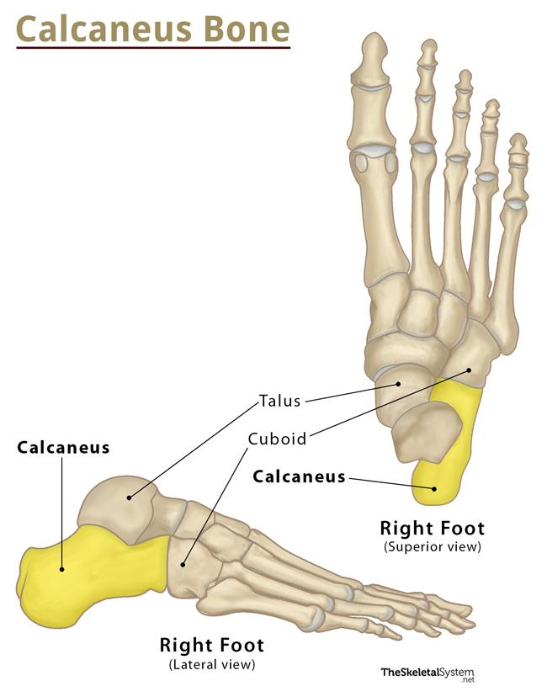

Slide 10
Features
  Anterior surface:
    Articular facet for cuboid
  Posterior surface:
    Forms heel prominence
    Attachment for tendo calcaneus (Achilles tendon)
  Superior surface:
    Two articular facets for talus
    Separated by sulcus calcanei
  Inferior surface:
    Anterior tubercle
    Medial and lateral tubercles

Slide 12
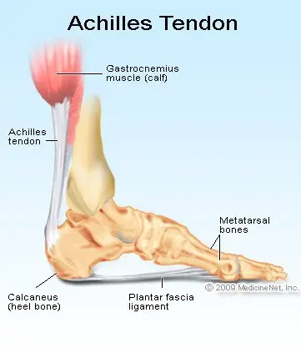

Slide 13
Talus
Talus
Articulates with:
  Tibia and fibula (ankle joint)
  Calcaneum
  Navicular
Structure:
  Head, neck, and body

Slide 14
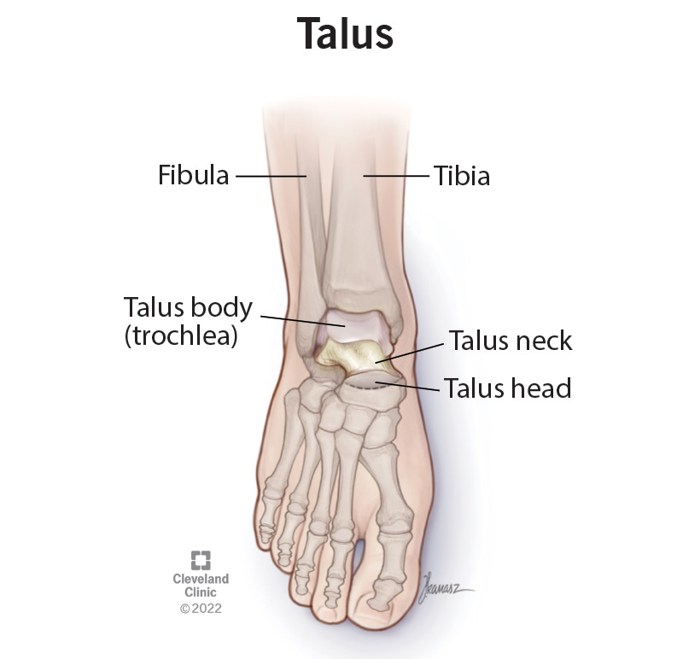

Slide 15
Continued
Head:
  Directed anteriorly
  Articulates with navicular
  Inferior surface rests on:
    Calcaneus
    Calcaneonavicular ligament

Slide 17
Continued
Neck:
  Slightly narrowed
  Contains sulcus tali
Body:
  Cuboidal
  Superior surface articulates with tibia
  Lateral surface → facet for lateral malleolus
  Medial surface → facet for medial malleolus
  Posterior surface:
    Two tubercles

Slide 20
Navicular Bone
Tuberosity:
  Located on medial side of foot
  Palpable in front of and below medial malleolus
Function:
  Attachment for tibialis posterior tendon

Slide 21
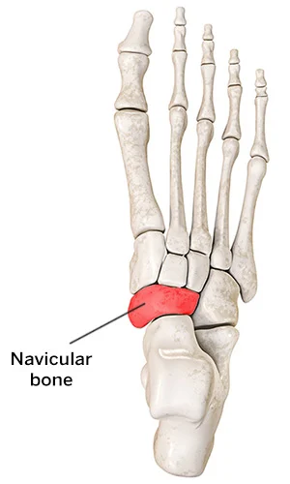

Slide 22
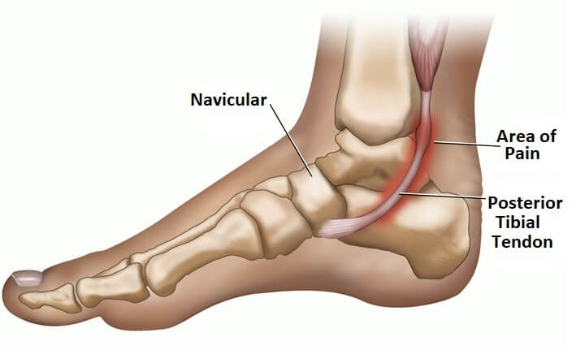

Slide 23
Cuboid Bone
Located on lateral side of foot
Feature:
  Deep groove on inferior surface
  Lodges tendon of fibularis (peroneus) longus

Slide 24
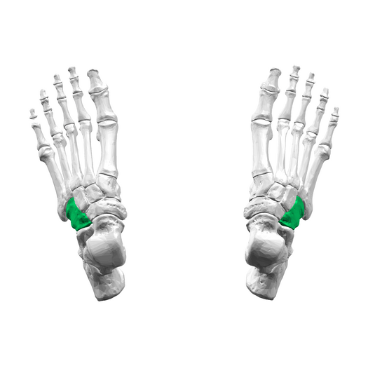

Slide 25
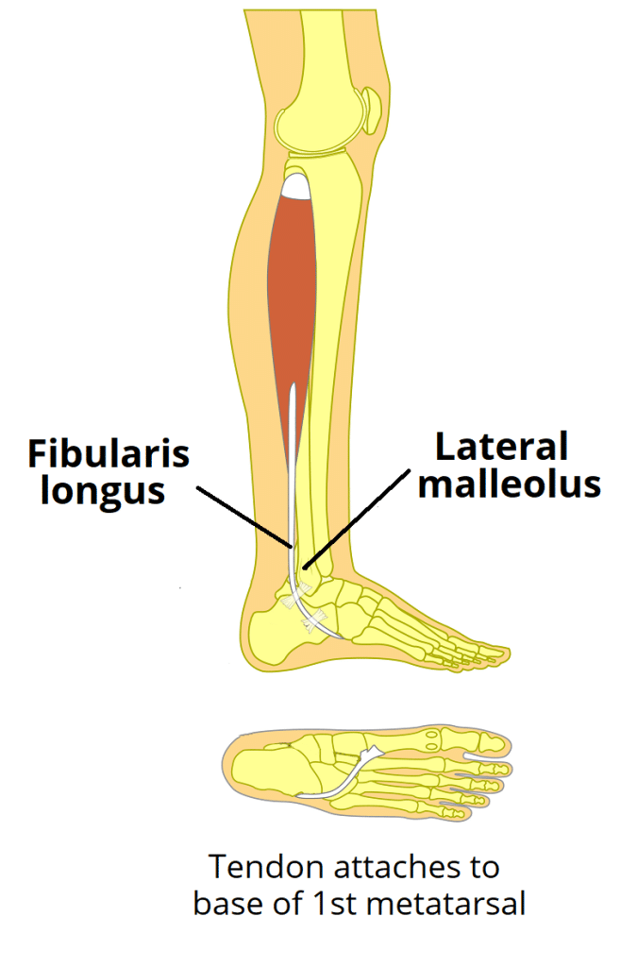

Slide 26
Cuneiform Bones
Three bones:
  Medial, intermediate, lateral
Shape:
  Wedge-shaped
Articulations:
  Proximally with navicular
  Distally with first three metatarsals
Function:
  Help maintain transverse arch of the foot

Slide 28
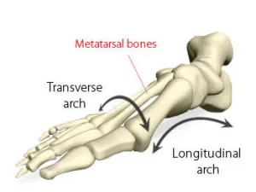

Slide 29
Metatarsal Bones
Five metatarsals
Structure:
  Head (distal)
  Shaft
  Base (proximal)
Arrangement:
  Numbered medial → lateral (1st to 5th)

Slide 30
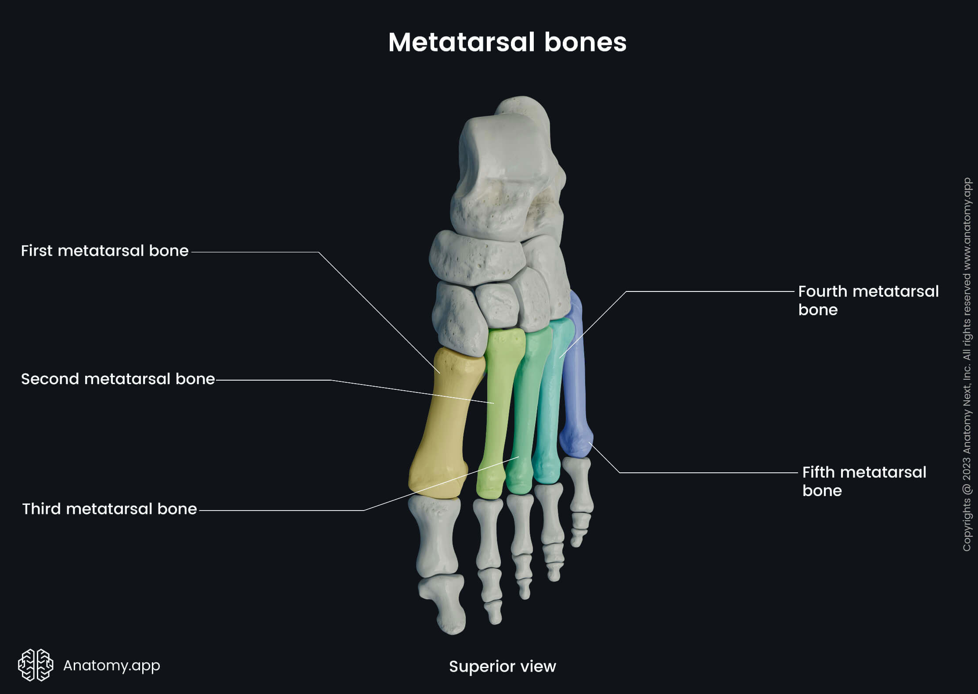

Slide 31
First Metatarsal
Strong and large
Supports body weight
Head:
  Grooved for sesamoid bones

Slide 32
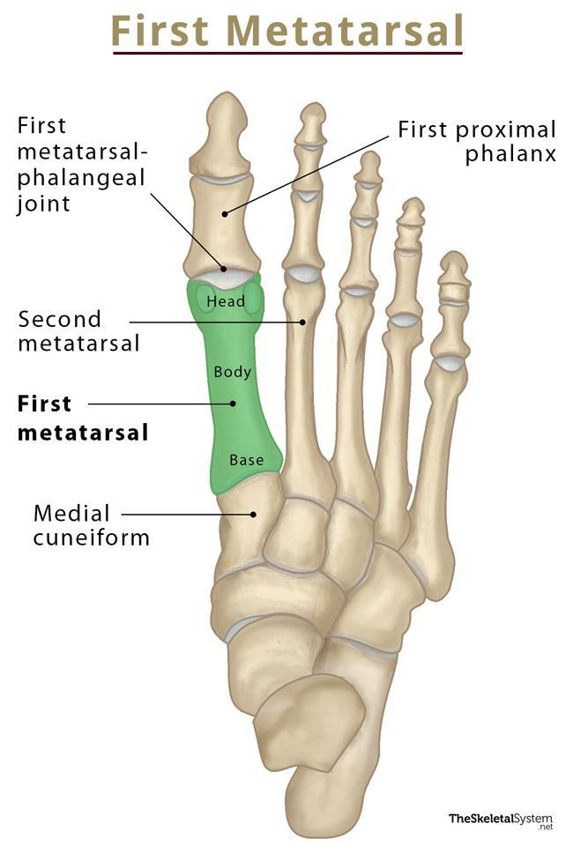

Slide 33
Fifth Metatarsal
Has prominent tubercle at base
Easily palpable
Attachment:
  Fibularis brevis tendon

Slide 35
Phalanges
Similar to fingers
Each toe:
  Three phalanges (proximal, middle, distal)
Exception:
  Great toe (hallux) has two phalanges only

Slide 37


Slide 38


