Slide 1

PHARMACOLOGY
BS RIT,OTT,MLT
2ND SEMESTER
DR DANISH

Slide 2
Drug Excretion Through the Kidney
Kidney is the major organ of drug excretion
Removes:
  Unchanged drugs
  Water-soluble metabolites
Maintains drug concentration and prevents toxicity

Slide 3
Basic Renal Physiology
Functional unit: Nephron
Key processes:
  Glomerular filtration
  Tubular secretion
  Tubular reabsorption
Renal blood flow influences drug elimination

Slide 4
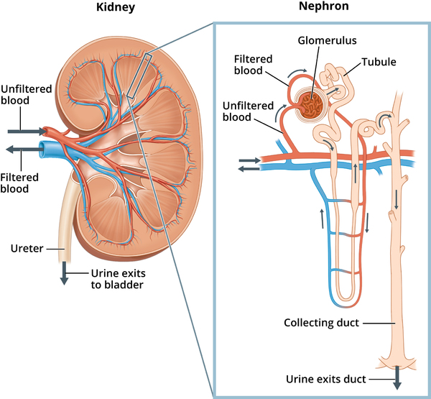

Slide 5
Glomerular Filtration
Passive process driven by blood pressure
Filters:
  Free (unbound) drugs only
Protein-bound drugs remain in circulation
Filtration rate depends on:
  Glomerular filtration rate (GFR)
  Drug size and charge (usually minimal effect)

Slide 7
Tubular Secretion
Active transport process in proximal tubule
Requires energy (carrier-mediated)
Two main systems:
  Organic anion transporters (OATs) → acidic drugs (e.g., penicillin)
  Organic cation transporters (OCTs) → basic drugs
Characteristics:
  Can be saturated
  Subject to competition between drugs

Slide 9
Tubular Reabsorption
Occurs mainly in distal tubule
Passive diffusion
Depends on:
  Lipid solubility
  Ionization of drug
Non-ionized (lipid-soluble) drugs → reabsorbed
Ionized (water-soluble) drugs → excreted

Slide 11
Role of Urinary pH
Affects drug ionization
Principle: Ion trapping
  Weak acids:
    More ionized in alkaline urine → increased excretion
  Weak bases:
    More ionized in acidic urine → increased excretion
Clinical use:
  Alkalinization of urine (e.g., in aspirin overdose)

Slide 12
Factors Affecting Renal Drug Excretion
Renal function (GFR)
Age:
  Neonates → immature kidneys
  Elderly → decreased renal function
Drug interactions:
  Competition for secretion transporters
Protein binding
Urine flow rate
Pathological conditions:
  Renal disease

Slide 13
Clinical Implications
Dose adjustment required in renal impairment
Monitoring:
  Creatinine clearance
  Plasma drug levels
Risk of drug accumulation and toxicity

Slide 14


Slide 15


