Slide 1

ANATOMY
THE THORAX
BS RIT,OTT
2ND SEMESTER
DR DANISH

Slide 2
Intercostal Nerves
Overview
Intercostal nerves supply the entire thoracic wall
They are the anterior (ventral) rami of the first 11 thoracic spinal nerves (T1–T11)
The 12th thoracic nerve (T12) is called the subcostal nerve
  Runs in the abdominal wall rather than between ribs
These nerves carry:
  Motor fibers → intercostal muscles
  Sensory fibers → skin and parietal pleura

Slide 3
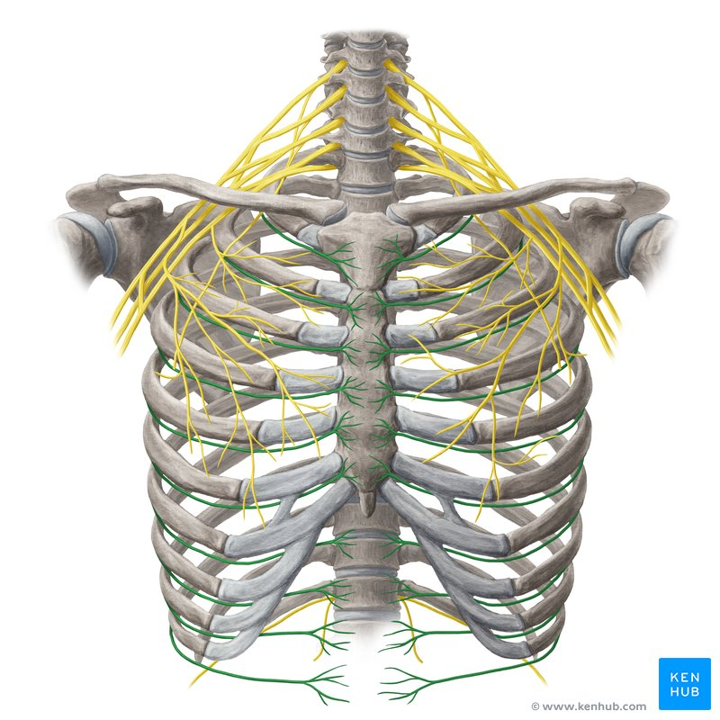

Slide 4
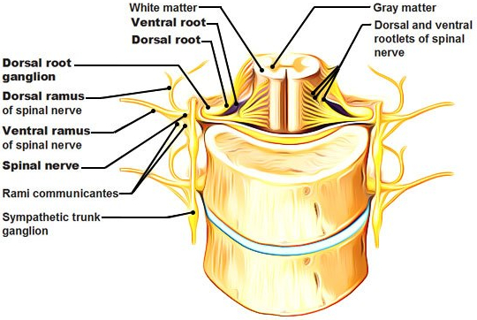

Slide 5
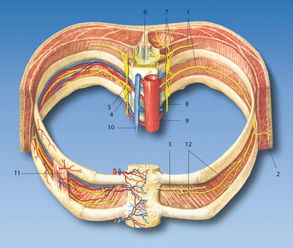

Slide 6
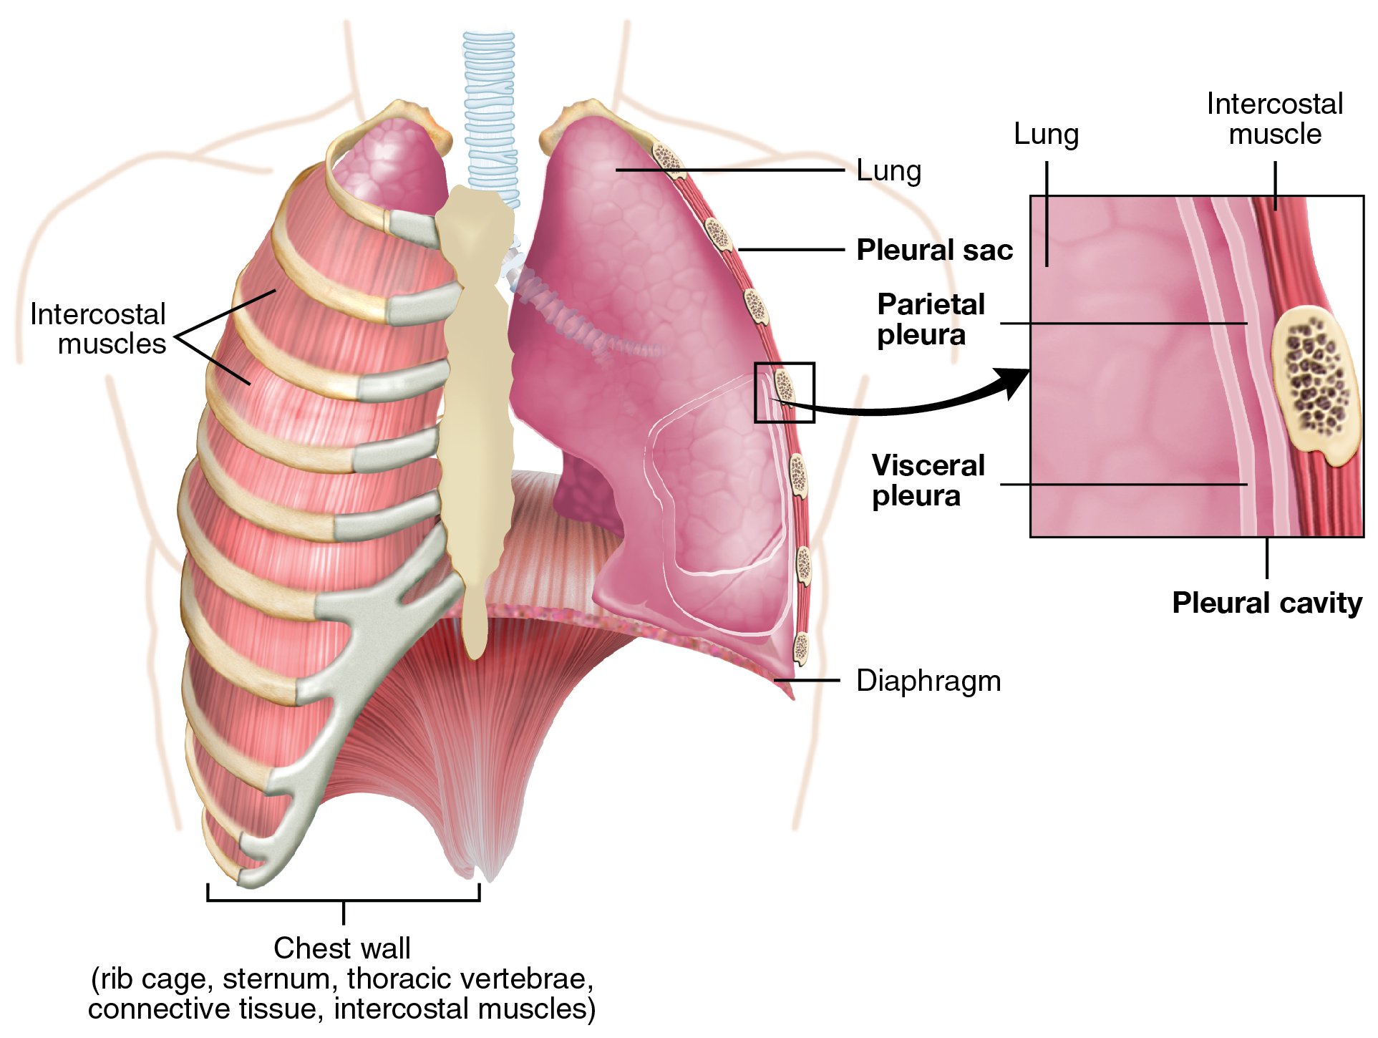

Slide 7
Course of Intercostal Nerves
Each nerve enters its corresponding intercostal space
Travels between:
  Internal intercostal muscle
  Innermost intercostal muscle

Slide 9
Continued
Runs within the costal groove along the inferior border of the rib
Accompanied by:
  Intercostal vein
  Intercostal artery
Arrangement from superior to inferior:
  Vein → Artery → Nerve (VAN)

Slide 10
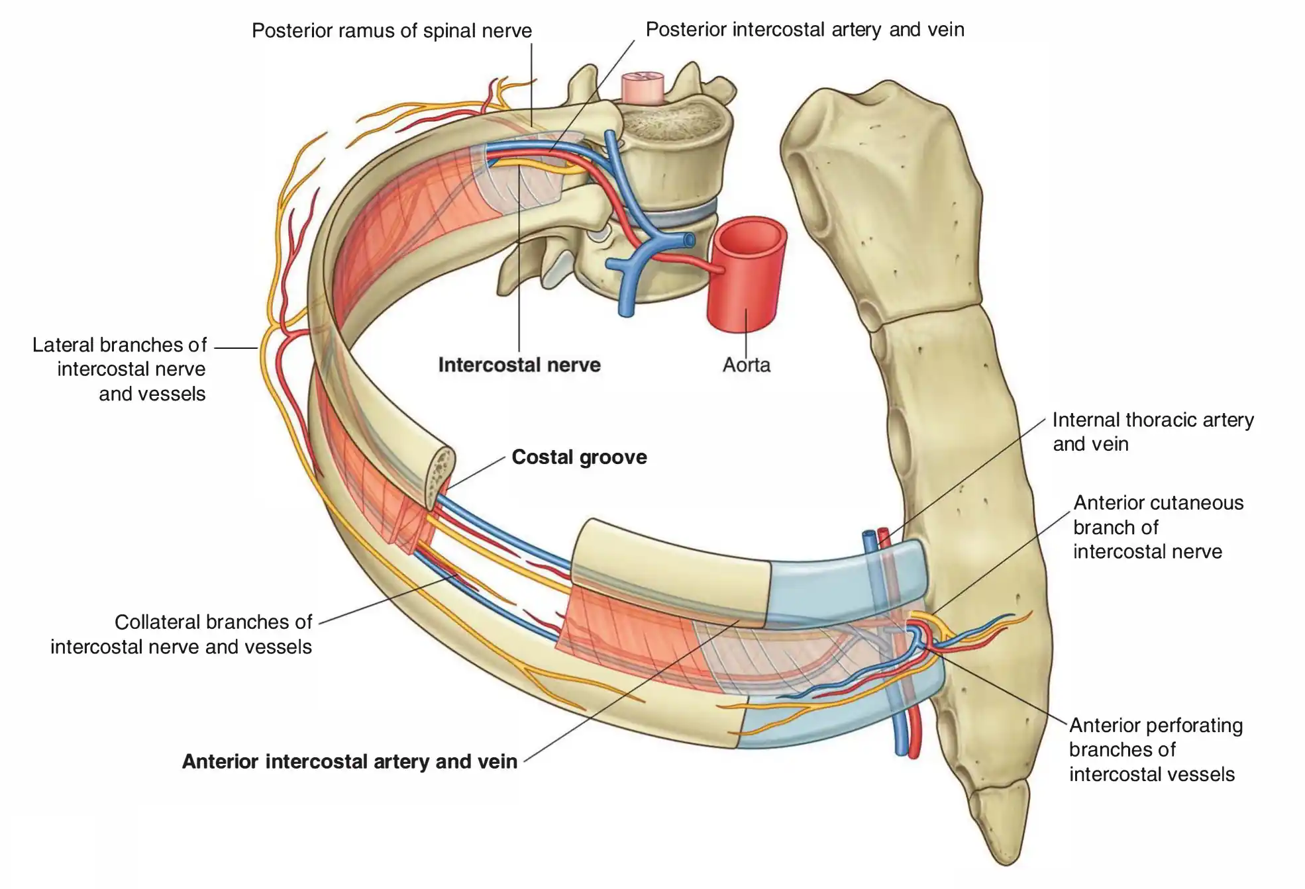

Slide 12
Branches of Intercostal Nerves
Rami communicantes
  Connect intercostal nerves to the sympathetic trunk
Collateral branch
  Runs along the upper border of the rib below
  Smaller than main branch
Lateral cutaneous branch
  Emerges at the midaxillary line
  Supplies skin of the lateral chest wall
  Divides into:
    Anterior branch
    Posterior branch

Slide 15
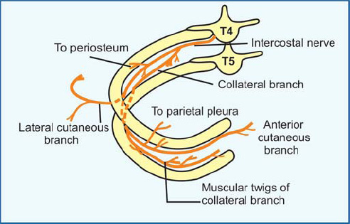

Slide 16
Continued
Anterior cutaneous branch
  Terminal branch near the sternum
  Supplies skin of the anterior chest
Muscular branches
  Supply intercostal muscles
Pleural sensory branches
  Supply the parietal pleura

Slide 17
Special Intercostal Nerves
First Intercostal Nerve (T1)
Joins brachial plexus
Large branch → upper limb
Second Intercostal Nerve (T2)
Gives intercostobrachial nerve
Supplies:
  Axilla
  Medial arm
Important in referred pain (e.g., cardiac pain)

Slide 19


Slide 20


