Slide 1

Mass Communication
BS PSYCHOLOGY
1ST SEMESTER
Ms. Shehwar Saeed

Slide 2
Process of Communication
process of communication is the step-by-step system
a message is created, transmitted, received, and understood between a sender and a receiver.
Harold Lasswell described communication process as:
“Who says what, in which channel, to whom, and with what effect.”

Slide 3
Steps in the Communication Process
1. Sender (Source)
The person or organization who creates the message
Responsible for initiating communication
Example: A journalist, news channel, or government
2. Idea / Message
The information, thought, or feeling to be communicated
Example: News, advertisement, awareness message

Slide 4
Steps in the Communication Process
3. Encoding
Converting ideas into words, symbols, images, or gestures
Example: Writing a news script or designing an ad
4. Channel (Medium)
The path through which the message is sent
Examples:
Television
Radio

Slide 5
Steps in the Communication Process
5. Receiver (Audience)
The person or group who receives the message
In mass communication: large, diverse audience
6. Decoding
Interpreting and understanding the message
Depends on audience’s education, culture, and experience

Slide 6
Steps in the Communication Process
7. Feedback
Response from the receiver back to the sender
Examples:
Comments on social media
TV ratings
Public opinion
8 . Noise (Barrier)
Any disturbance that affects communication
Types of Noise:
Physical (e.g., poor signal)
Psychological (e.g., bias)
Semantic (e.g., difficult language)

Slide 7
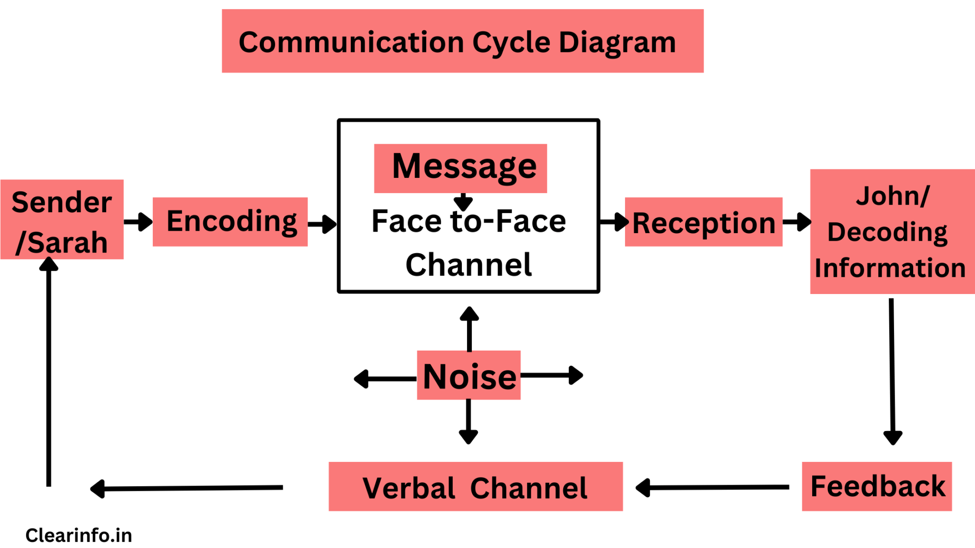

Slide 8
Models of Communication Process
Lasswell Model-By Harold Lasswell
Focus:
Who (Sender)
Says What (Message)
In Which Channel (Medium)
To Whom (Receiver)
With What Effect (Impact)

Slide 9
Models of Communication Process
2. Shannon-Weaver Model
By Claude Shannon and Warren Weaver
Introduced:
Noise (disturbance)
Technical view of communication

Slide 10
Models of Communication Process
3. Schramm Model
By Wilbur Schramm
Features:
Two-way communication
Feedback is essential
Shared experience (field of experience)

Slide 11
Importance of Communication Process in Mass Communication
1. Ensures Effective Message Delivery
Proper process helps deliver clear messages
2. Reaches Large Audience
Through media channels, information spreads widely
3. Influences Society
Shapes opinions, attitudes, and behavior
4. Improves Interaction
Feedback helps improve future communication
5. Reduces Misunderstanding
Clear encoding and decoding minimize confusion

Slide 12
Examples of Communication Process
TV News
Sender: News channel
Message: Breaking news
Encoding: Script + visuals
Channel: Television
Receiver: Viewers
Decoding: Understanding news
Feedback: Social media reactions
Noise: Poor signal or bias

Slide 13

Any Question?

Slide 14


