Slide 1

Mass Communication
BS PSYCHOLOGY
1ST SEMESTER
Ms. Shehwar Saeed

Slide 2

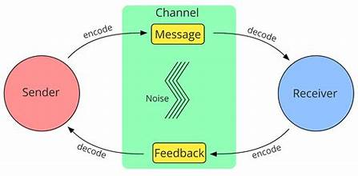
Communication
Communication is the process of exchanging information, ideas, thoughts, feelings, or messages
through a common system of symbols, signs, or behavior.

Slide 3

Communication
Key Definitions by Scholars:
Wilbur Schramm:
“Communication is the process of establishing a commonness of thought between a sender and a receiver.”
Harold Lasswell:
“Who says what, in which channel, to whom, and with what effect.”
Keith Davis:
“Communication is the process of passing information and understanding from one person to another.”

Slide 4
Types
A. Based on Expression
1. Verbal Communication
Use of words (spoken or written)
Examples: speeches, news, conversations
Sub-types:
Oral Communication – Face-to-face, lectures
Written Communication – Emails, letters, newspapers

Slide 5
Types
2. Non-Verbal Communication
Communication without words
Body language
Facial expressions
3. Visual Communication
Use of visuals like images, charts, graphs, videos
Common in media and advertising
Gestures
Eye contact
Tone of voice

Slide 6
Types
B. Based on Scale
1. Intrapersonal Communication
Communication within oneself
Thinking, self-talk
2. Interpersonal Communication
Between two people
Example: conversation between friends

Slide 7
Types
3. Group Communication
Small group interaction
Meetings, discussions
4. Public Communication
One person addressing a large audience
Speeches, seminars
5. Mass Communication
Communication to a large, diverse audience through media

Slide 8
Types
C. Based on Direction
1. One-way Communication
No feedback
Example: TV broadcast
2. Two-way Communication
Feedback is present
Example: conversation, interviews
4. Significance (Importance) of Communication

Slide 9
Significance of Communication
Communication plays a vital role in mass communication and daily life:
1. Spreads Information
Helps in delivering news and knowledge quickly
Keeps society informed
2. Creates Awareness
Educates people about social, political, and economic issues
Example: awareness campaigns

Slide 10
Significance of Communication
3. Builds Relationships
Strengthens personal and professional connections
Promotes understanding and cooperation
4. Influences Public Opinion
Media shapes thoughts and attitudes
Important in politics and advertising

Slide 11
Significance of Communication
5. Promotes Education
Online learning, educational programs
Platforms like YouTube help spread knowledge
6. Helps in Business and Development
Essential for marketing, management, and growth
Improves organizational efficiency

Slide 12
Significance of Communication
7. Supports Cultural Exchange
Sharing traditions, values, and lifestyles globally
8. Important in Crisis Situations
Spreads emergency information (e.g., disasters, pandemics)

Slide 13

Any Question?

Slide 14


