Slide 1

PHARMACOLOGY
BS RIT,OTT,MLT
2ND SEMESTER
DR DANISH

Slide 2
Drug Distribution
Drug distribution = reversible transfer of drug from blood to tissues and body fluids
Occurs after absorption and before metabolism/excretion
Determines:
  Onset of action
  Intensity of effect
  Duration of action
Example
After IV injection of thiopental (an ultra-short-acting barbiturate used for the rapid induction of anesthesia), it rapidly reaches the brain → causes anesthesia within seconds

Slide 3
Factors Affecting Drug Distribution
Blood Flow
Capillary Permeability
Plasma Protein Binding
Tissue Binding
Lipid Solubility (Lipophilicity)
Ionization

Slide 4
Blood Flow (Perfusion)
Distribution depends on rate of blood supply to tissues
Highly perfused organs
Brain
Liver
Kidneys
Heart

Slide 5
Continued
Poorly perfused tissues
Skin
Fat
Bone
Key Point
Drugs reach brain faster than muscle or fat
Example
Thiopental quickly induces anesthesia because it reaches the brain rapidly due to high blood flow

Slide 6
Capillary Permeability
Movement of drugs depends on capillary structure
Continuous capillaries (tight junctions):
  Brain → restrict drug entry
Fenestrated capillaries:
  Liver, kidney → allow easier passage
Example
Large or hydrophilic drugs cannot easily enter the brain

Slide 7
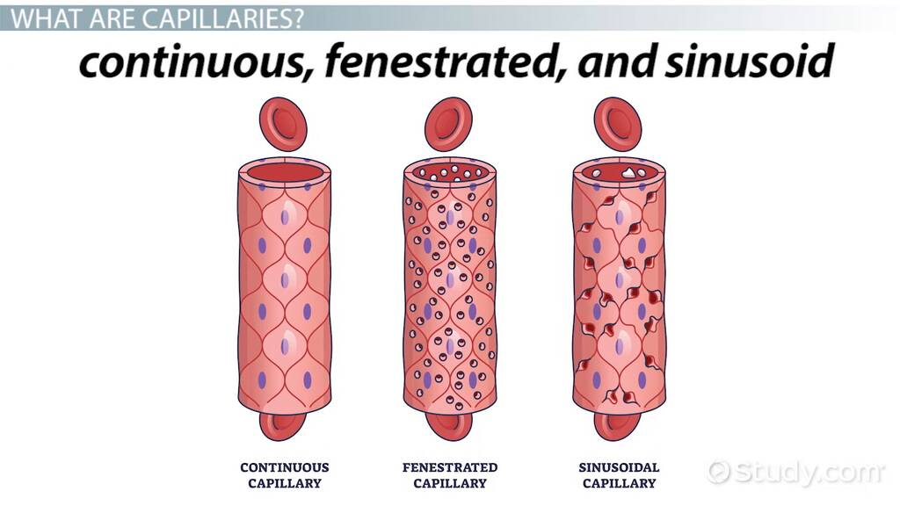

Slide 8
Plasma Protein Binding
Drugs bind reversibly to plasma proteins:
  Albumin (a vital protein produced by the liver that constitutes about half of the blood's total serum protein) → binds acidic drugs
  α1-acid glycoprotein → binds basic drugs
Examples
Warfarin → highly albumin-bound (~99%)
Ibuprofen → strongly protein bound

Slide 9
Tissue Binding
Drugs may accumulate in specific tissues
Sites
Fat → lipophilic drugs
Bone → certain antibiotics
Organs → liver, kidney

Slide 10
Continued
Examples
Tetracycline binds to calcium → accumulates in bones and teeth
Lipid-soluble drugs (e.g., diazepam) accumulate in fat
Effect
Prolonged drug action
Delayed elimination

Slide 11
Lipid Solubility (Lipophilicity)
Determines ability to cross membranes
Lipid-soluble drugs
Easily cross cell membranes
Enter CNS and fat
Water-soluble drugs
Remain in plasma or extracellular fluid
Examples
Diazepam → highly lipophilic → enters brain quickly
Gentamicin → hydrophilic → remains in extracellular fluid

Slide 12
Volume of Distribution
Definition
Hypothetical volume that relates drug amount in body to plasma concentration
Formula
Vd = Total drug in body / Plasma concentration

Slide 13
Interpretation
Low Vd
Drug stays in plasma
Example:
  Heparin
High Vd
Drug distributes widely into tissues
Example:
  Digoxin

Slide 14
Redistribution
Drug moves from one organ to another over time
Example
Thiopental
  First → brain (rapid effect)
  Then → muscle and fat (effect wears off)

Slide 15
Summary
Drug distribution is influenced by:
  Blood flow
  Protein binding
  Lipid solubility
  Barriers
Only free drug (the portion of a medication in the bloodstream that is unbound to plasma proteins such as albumin) is active.
Volume of distribution is key for dose calculation
Redistribution and tissue storage affect duration of action

Slide 16
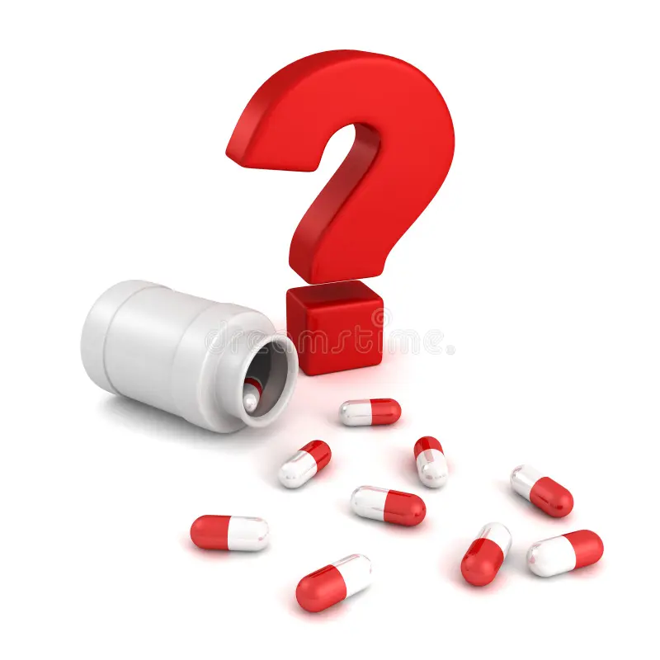

Slide 17


