Slide 1

ANATOMY
THE LOWER LIMB
DPT
2ND SEMESTER
DR DANISH

Slide 2
Tibia
Large, weight-bearing medial bone of the leg
Articulates with:
  Condyles of the femur (above)
  Head of the fibula (above and lateral)
  Talus (below)
  Distal fibula (below)
Has:
  Upper end
  Shaft
  Lower end

Slide 3
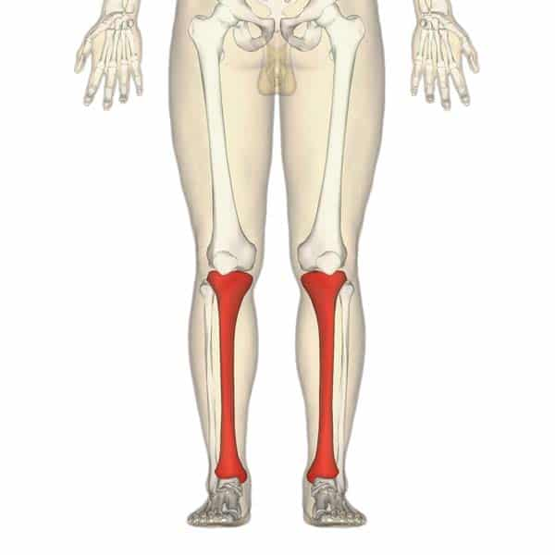

Slide 4
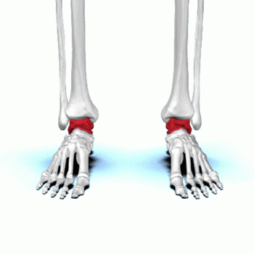

Slide 5
Upper End
Expanded
Contains:
  Medial and lateral tibial condyles
Articulations:
  With medial and lateral condyles of femur
Features:
  Intervening medial and lateral menisci
  Anterior and posterior intercondylar areas
Lateral condyle:
  Has a circular facet for articulation with head of fibula

Slide 6
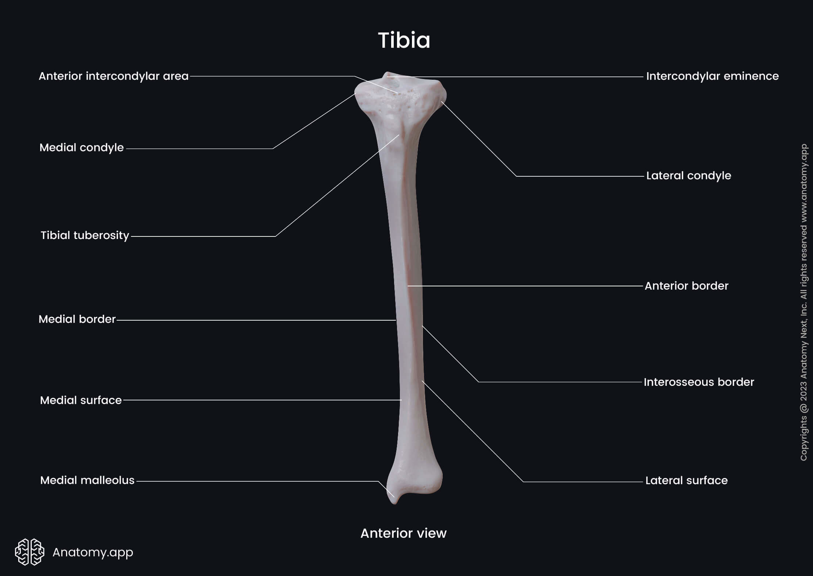

Slide 7
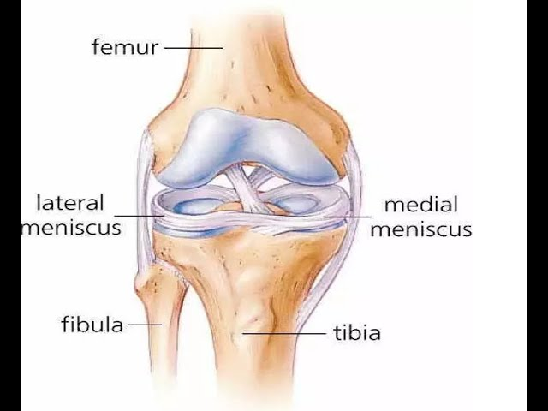

Slide 8
Shaft
Triangular in cross-section
Has:
  Three borders
  Three surfaces
Borders:
  Anterior border:
    Most prominent
    Subcutaneous
    Forms the shin
  Lateral (interosseous) border:
    Attachment for interosseous membrane

Slide 10
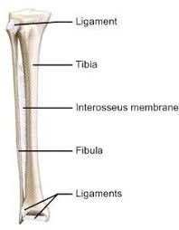

Slide 11
CONTINUED
Posterior surface:
  Shows soleal line for attachment of soleus muscle
Tibial tuberosity:
  At junction of anterior border with upper end
  Receives attachment of ligamentum patellae

Slide 12
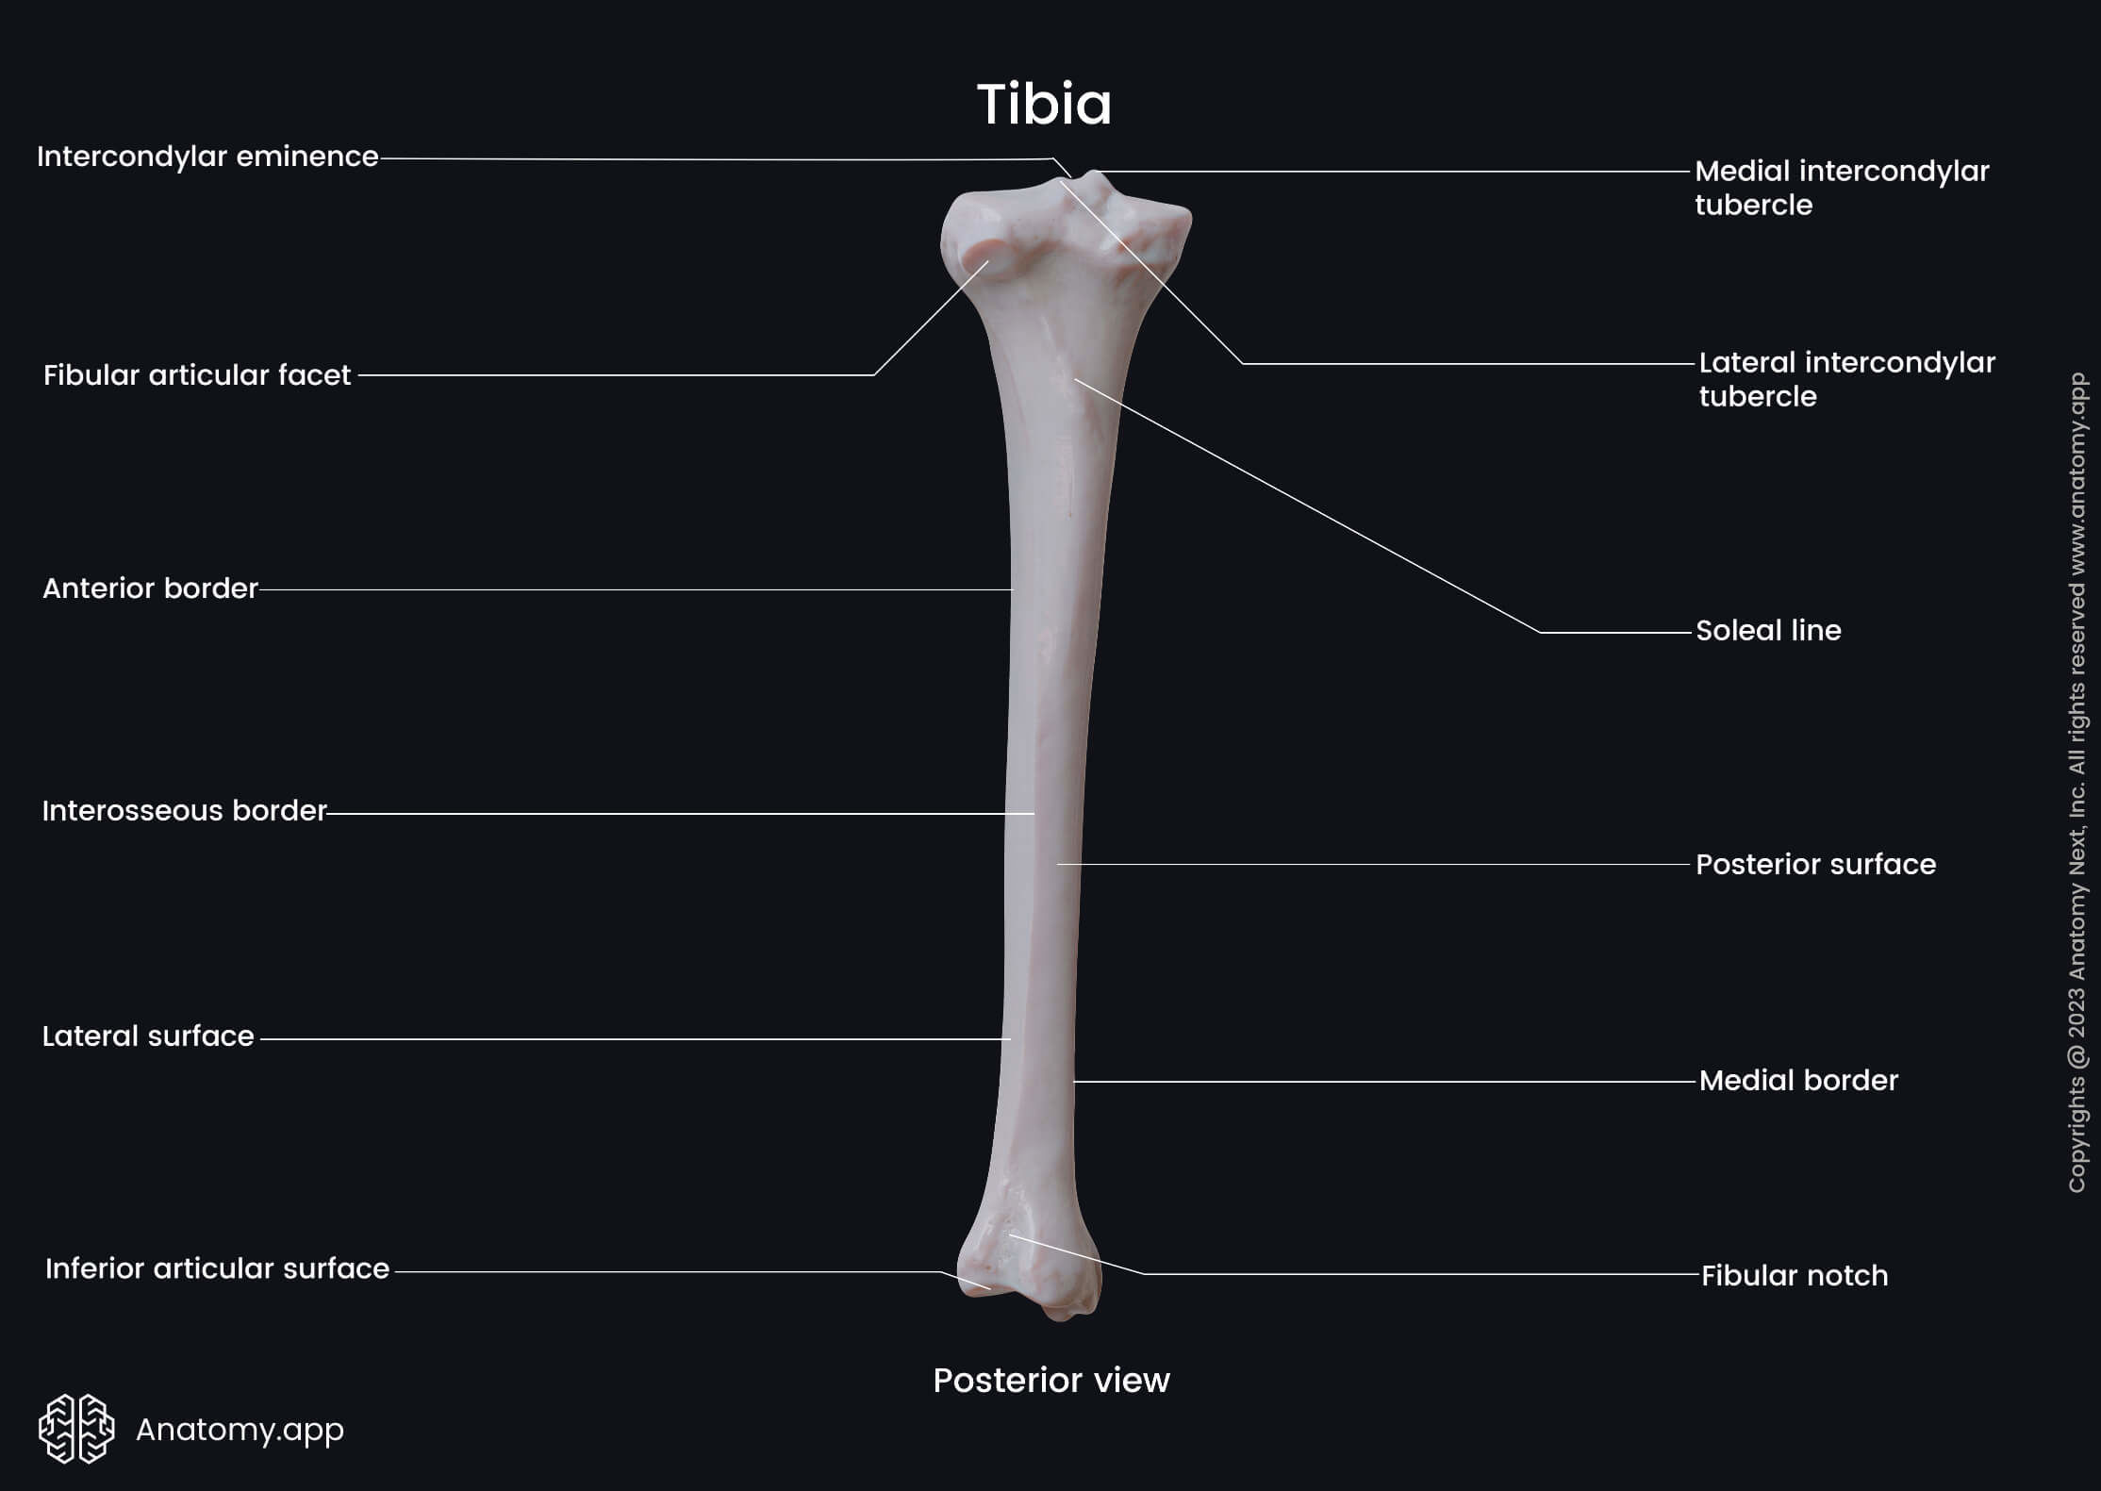

Slide 14
Lower End
Slightly expanded
Inferior surface:
  Saddle-shaped for articulation with talus
Medial projection:
  Forms medial malleolus
Articulations:
  Medial malleolus with talus
Lateral surface:
  Rough depression for articulation with fibula

Slide 15
Fibula
Slender lateral bone of the leg
Does not participate in knee joint
Participates in ankle joint
Does not transmit body weight
Provides muscle attachments
Has:
  Upper end
  Shaft
  Lower end

Slide 16
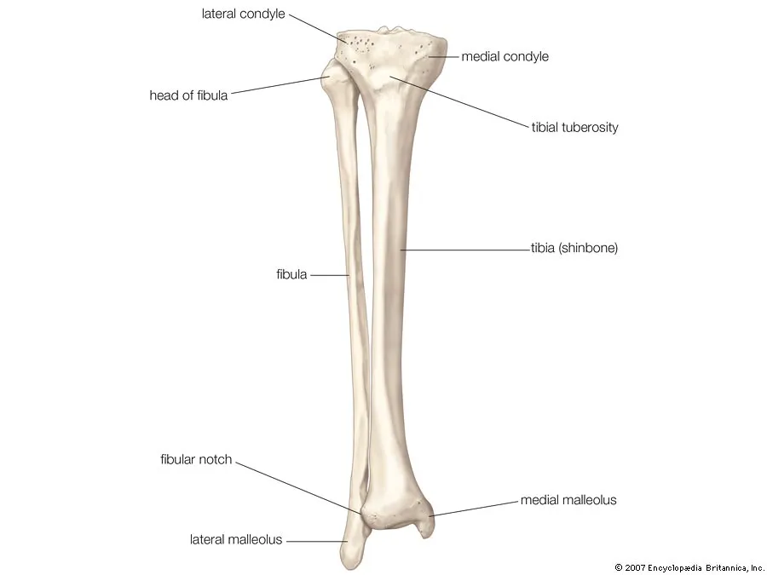

Slide 17
Upper End (Head)
Possesses:
  Styloid process
  Articular surface
Articulates with:
  Lateral condyle of tibia

Slide 19
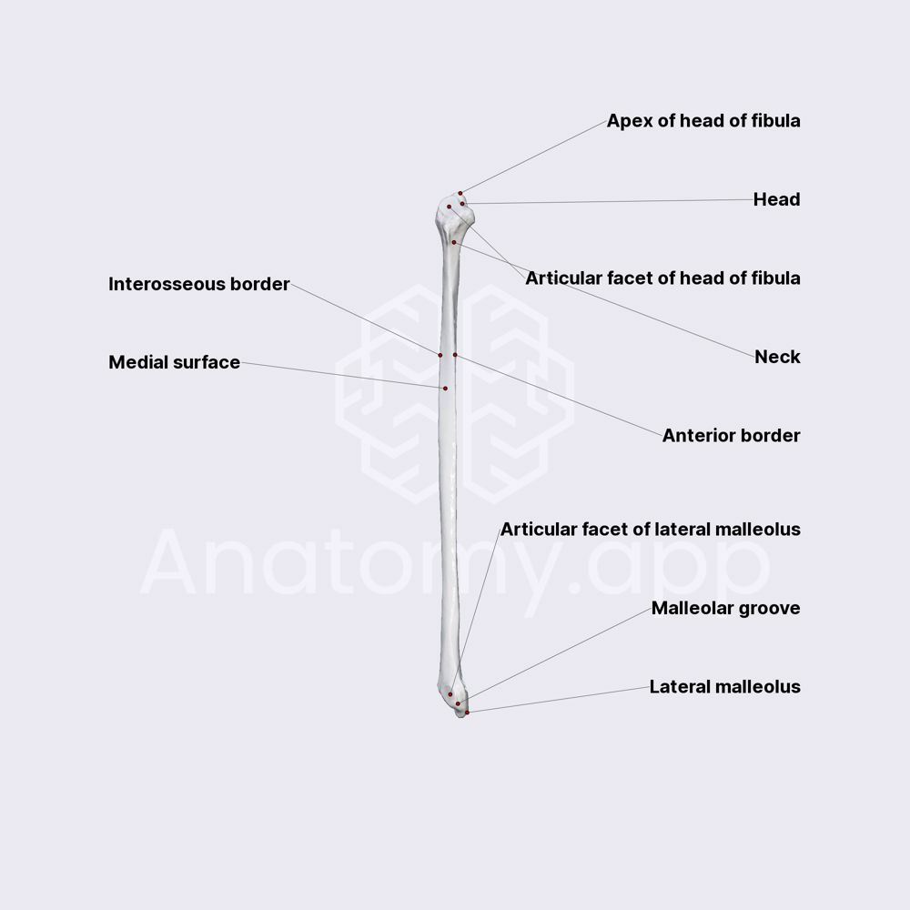

Slide 20
Shaft
Long and slender
Typically has:
  Four borders
  Four surfaces
Medial (interosseous) border:
  Attachment for interosseous membrane

Slide 23
Lower End
Forms lateral malleolus
Subcutaneous
Medial surface:
  Has triangular articular facet for talus
Posterior aspect:
  Malleolar fossa present
  Located below and behind articular facet

Slide 24
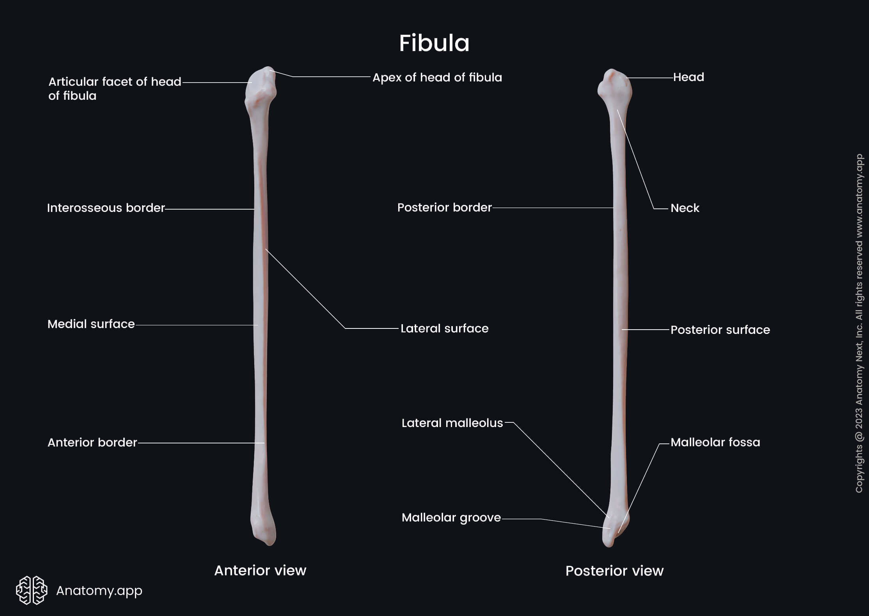

Slide 26
Tibia and Fibula Fractures
Fractures are common
If only one bone fractures:
  The other acts as a splint
  Displacement is minimal
Tibial shaft fractures:
  Often open fractures
  Due to medial surface being covered only by skin and superficial fascia
Distal third tibial fractures:
  Prone to delayed union or nonunion
  Cause: damage to nutrient artery

Slide 27
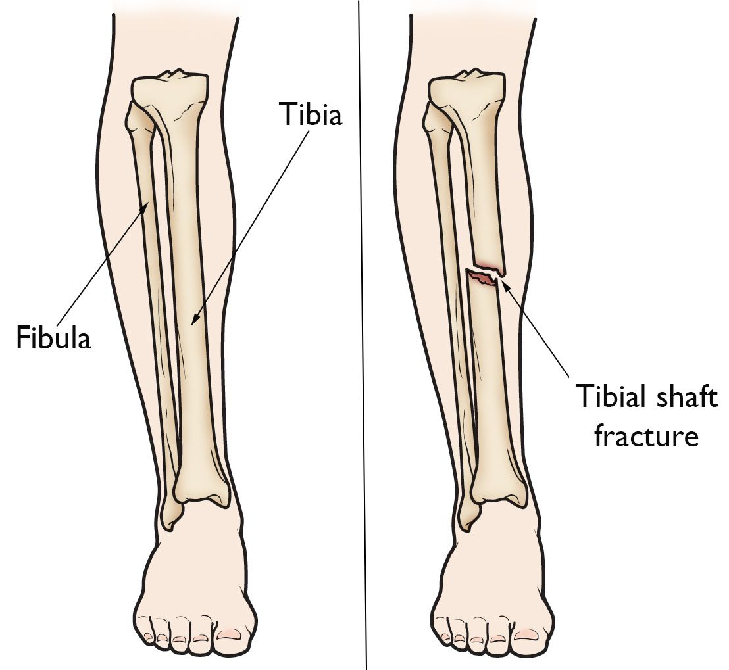

Slide 28
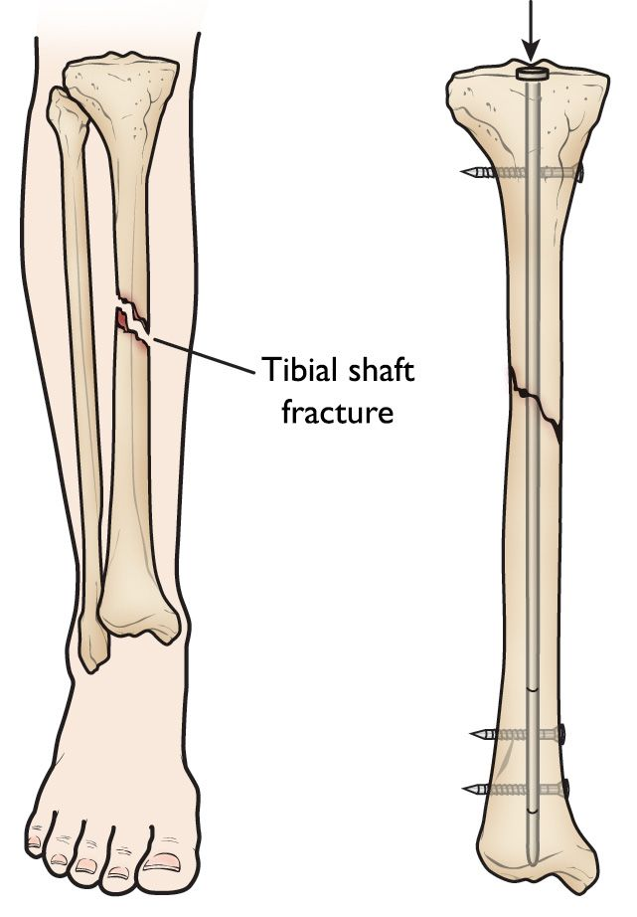

Slide 29


Slide 30


