Slide 1

ANATOMY
THE THORAX
BS RIT,OTT
2ND SEMESTER
DR DANISH

Slide 2
Intercostal Spaces
OVERVIEW:
Intercostal spaces = spaces between adjacent ribs
Total: 11 pairs
Filled with:
  Muscles
  Vessels
  Nerves
Function:
  Protect thoracic organs
  Assist in respiration

Slide 3
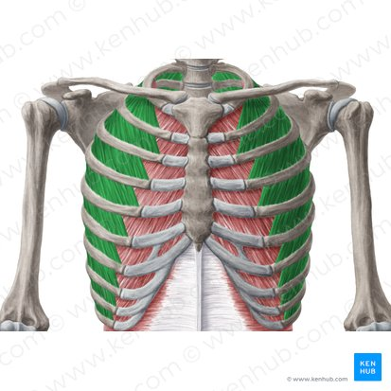

Slide 4
Boundaries of Intercostal Space
Superiorly: Lower border of rib above
Inferiorly: Upper border of rib below
Anteriorly: Sternum
Posteriorly: Vertebral column

Slide 5
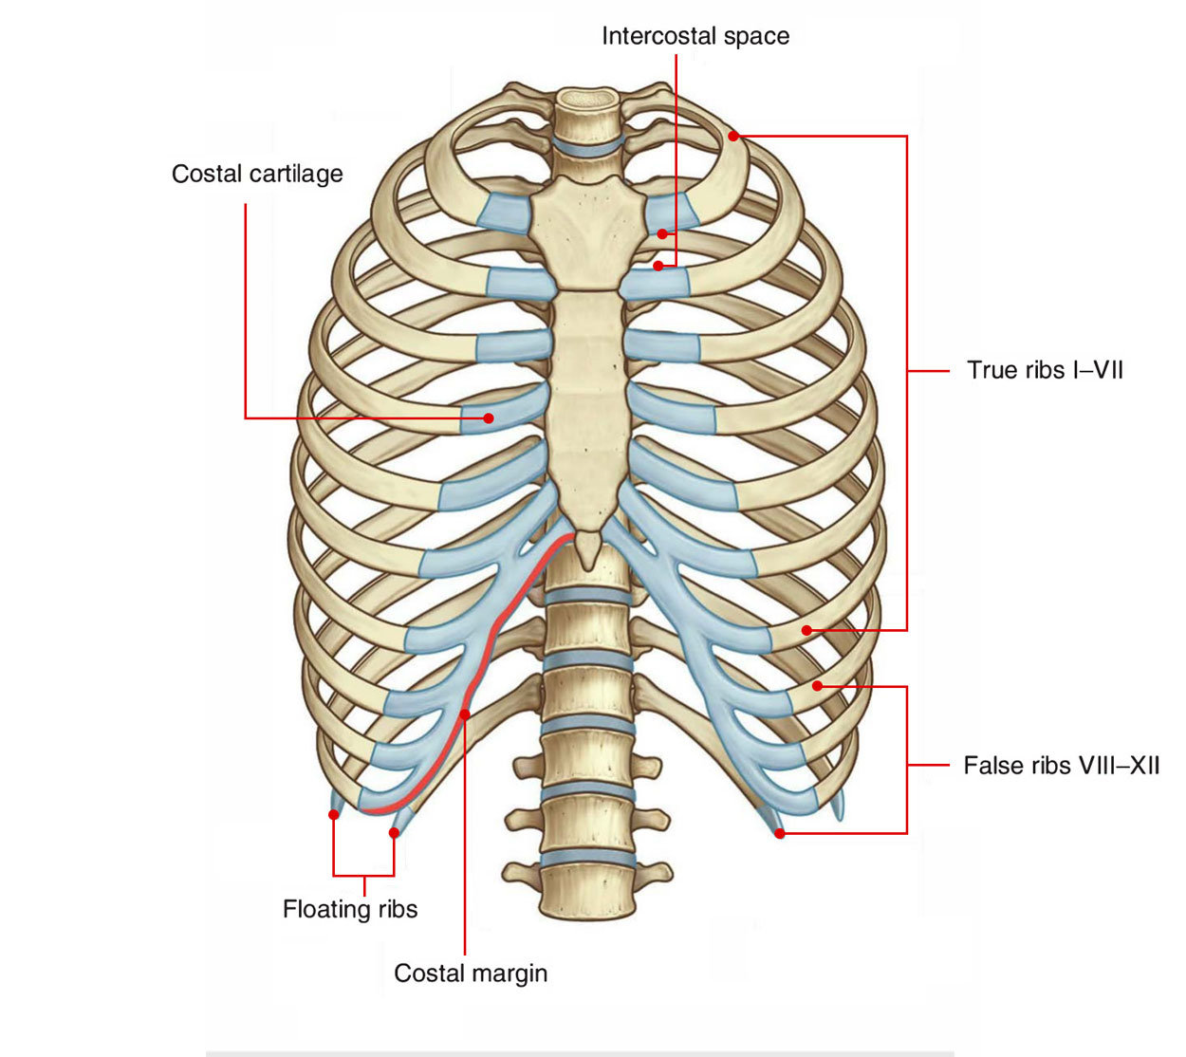

Slide 6
Contents of Intercostal Space
Muscles (3 layers):
  External intercostal
  Internal intercostal
  Innermost intercostal
Neurovascular bundle:
  Vein
  Artery
  Nerve (VAN arrangement)
Located in costal groove of upper rib

Slide 7
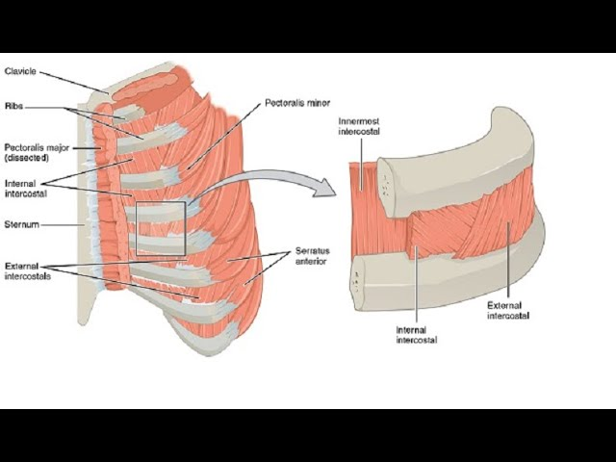

Slide 8
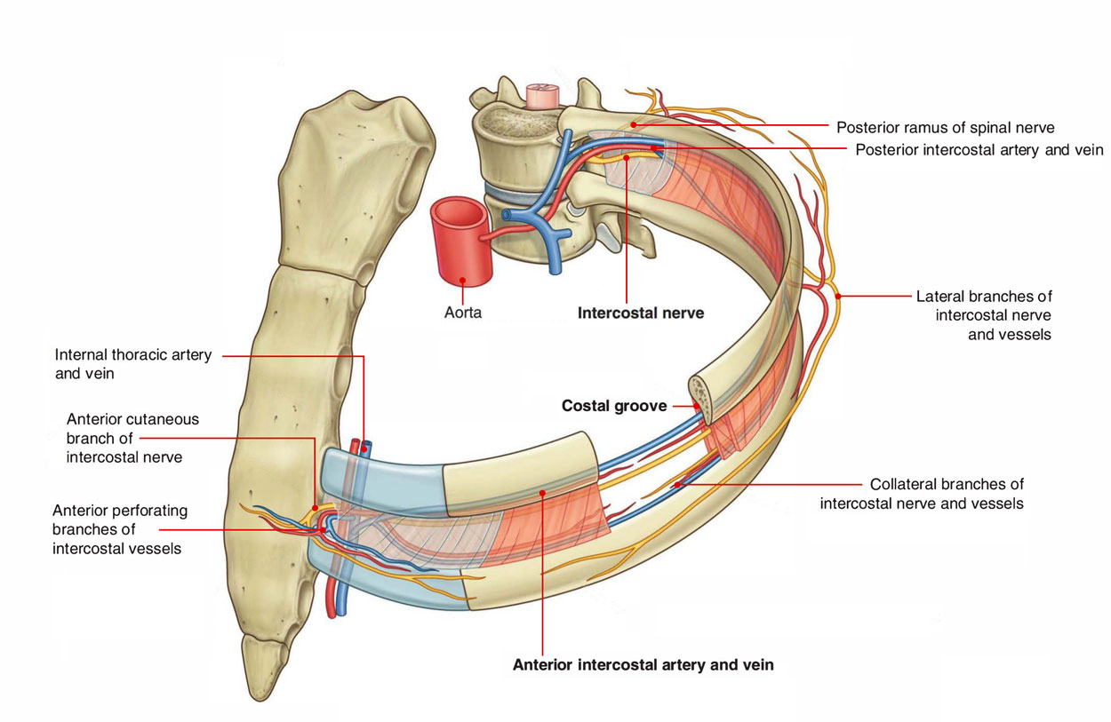

Slide 9
Intercostal Muscles
Arranged in three layers
Extend between ribs
Play major role in breathing mechanics

Slide 10
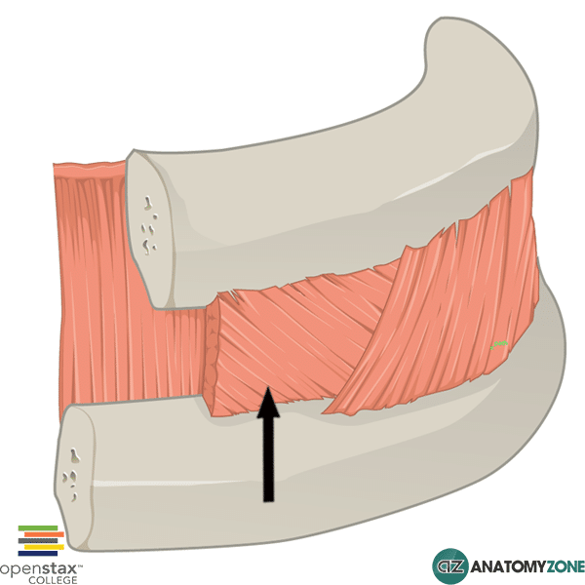

Slide 11
External Intercostal Muscles
Direction of fibers:
  Downward & forward (“hands-in-pocket” direction)
Extent:
  From rib tubercle → costochondral junction
  Replaced anteriorly by membrane
Function:
  Elevate ribs
  Aid in inspiration

Slide 13
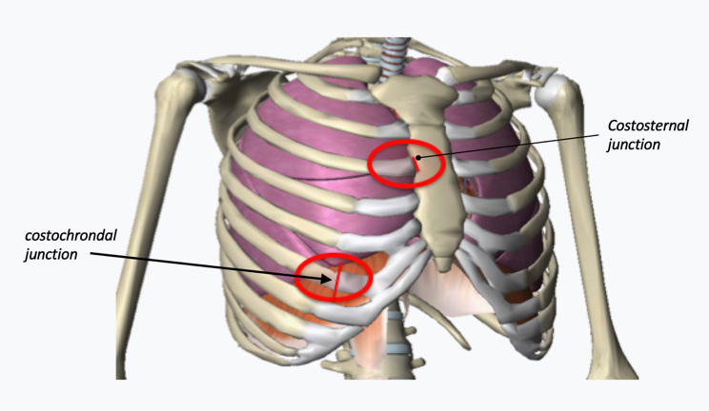

Slide 14
Internal Intercostal Muscles
Direction of fibers:
  Downward & backward (perpendicular to external layer)
Extent:
  Sternum → angle of ribs
  Replaced posteriorly by membrane
Function:
  Interosseous part → depress ribs (expiration)
  Interchondral part → elevate ribs

Slide 16
Innermost Intercostal Muscles
Incomplete layer
Best developed in lateral thoracic wall
Includes:
  Innermost intercostals
  Subcostales
  Transversus thoracis
Function:
  Assist internal intercostals

Slide 18
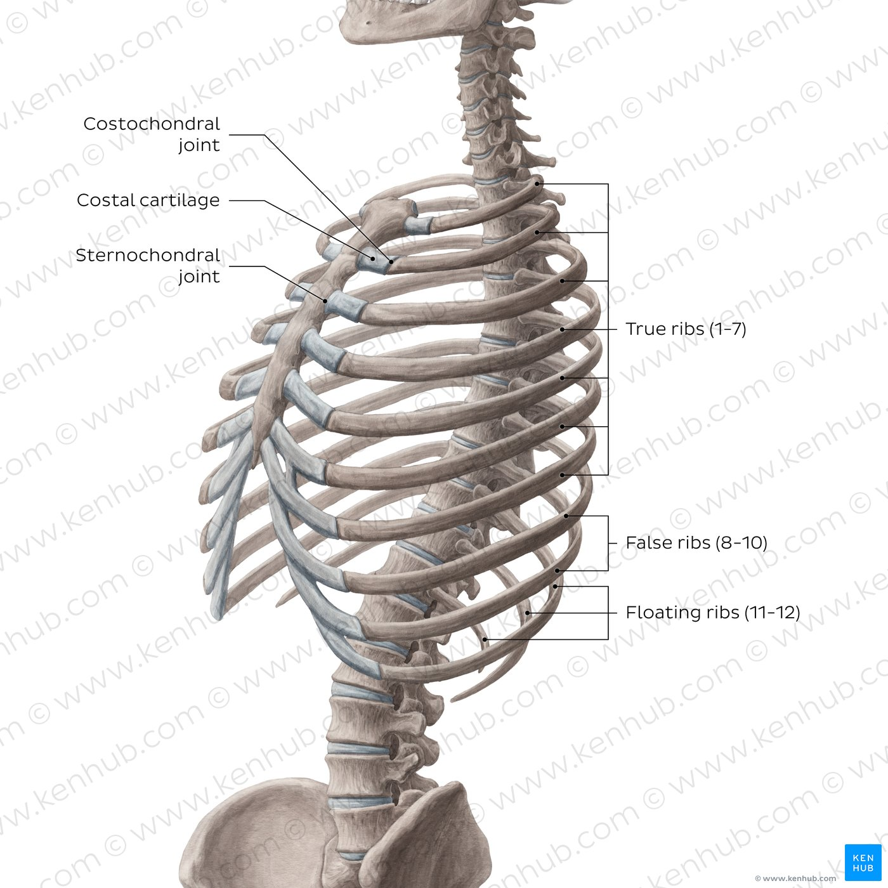

Slide 19
Neurovascular Bundle
Located between:
  Internal & innermost layers
Arranged as:
  V → A → N (superior to inferior)
Components:
  Intercostal vein
  Intercostal artery
  Intercostal nerve

Slide 20
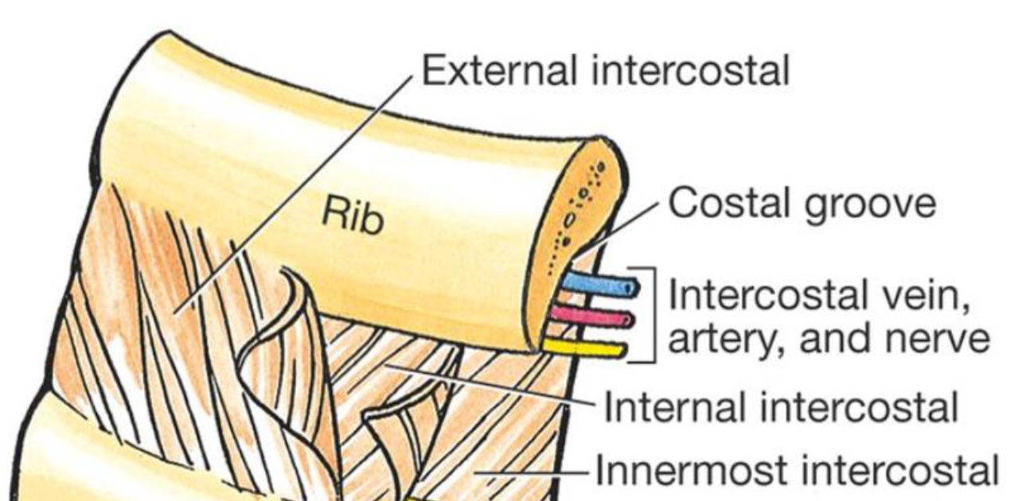

Slide 21
Intercostal Nerves
Ventral rami of thoracic spinal nerves (T1–T11)
Supply:
  Intercostal muscles
  Skin of thoracic wall

Slide 22
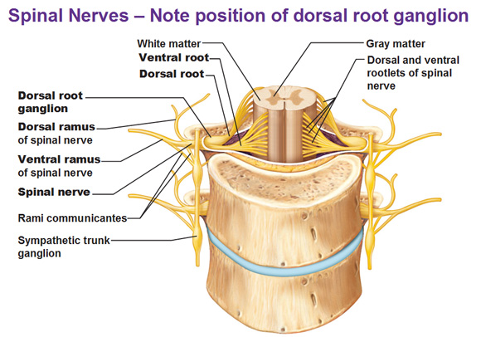

Slide 23
Functions of Intercostal Muscles
Maintain intercostal space rigidity
Assist in:
  Inspiration (external muscles)
  Expiration (internal muscles)
Stabilize thoracic wall during breathing

Slide 24
Clinical Correlations
Intercostal nerve block:
  Used for pain relief (e.g., rib fractures)
Chest tube insertion:
  Insert above upper border of rib (avoid VAN bundle)
Thoracentesis:
  Needle placed in safe zone to prevent injury

Slide 25


Slide 26


