Slide 1

ANATOMY
THE LOWER LIMB
DPT
2ND SEMESTER
DR DANISH

Slide 2
Femur
The femur articulates:
  Above with the acetabulum → forms the hip joint
  Below with the tibia and patella → forms the knee joint
Upper end of femur has:
  Head
  Neck
  Greater and lesser trochanters
The head:
  Forms about two-thirds of a sphere
  Articulates with the acetabulum of the os coxae → hip joint

Slide 3
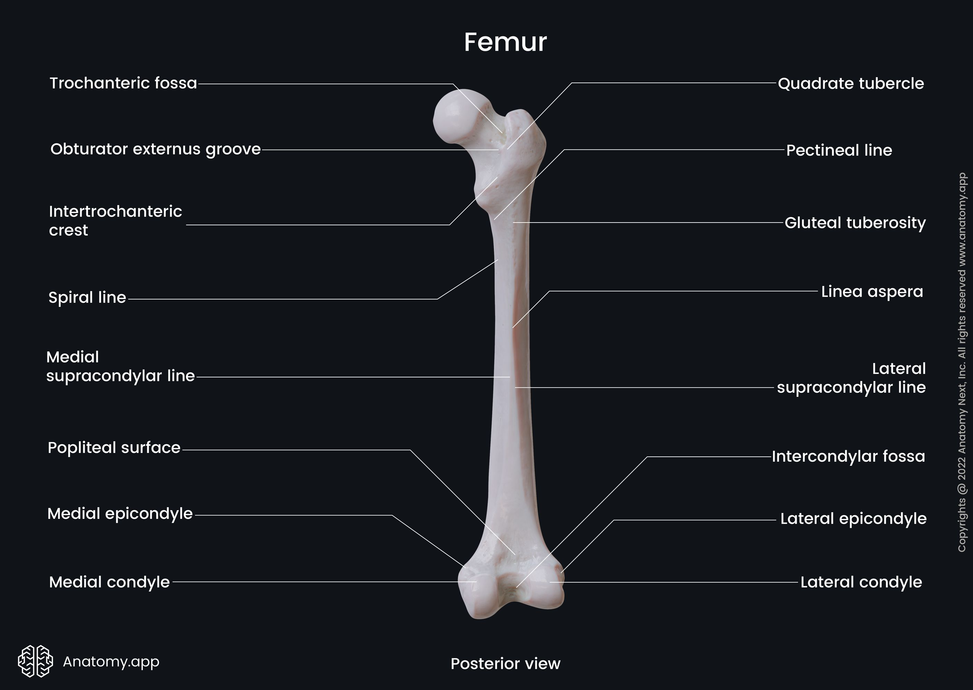

Slide 4
CONTINUED
Center of the head:
  Small depression called fovea capitis
  Attachment site for ligament of the head
Blood supply:
  Partly from obturator artery
  Travels along the ligament and enters at the fovea

Slide 5
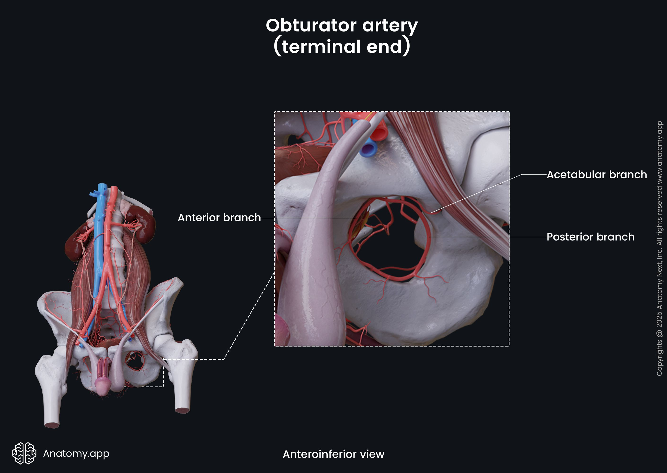

Slide 6
Neck of Femur
Connects head to shaft
Directed:
  Downward
  Backward
  Laterally
Makes an angle of about 125° with the long axis of the shaft
  Slightly less in females
Disease can alter this angle

Slide 8
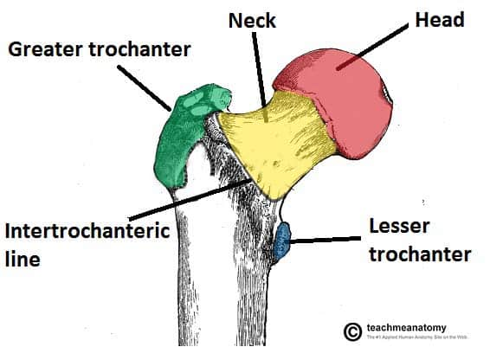

Slide 9
Trochanters
Greater and lesser trochanters:
  Large eminences
  Located at junction of neck and shaft
Intertrochanteric line:
  Connects trochanters anteriorly
  Attachment for iliofemoral ligament
Intertrochanteric crest:
  Prominent ridge connecting trochanters posteriorly

Slide 11
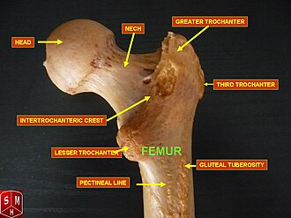

Slide 12
Shaft of Femur
Smooth and rounded anteriorly
Posterior surface has a ridge → linea aspera
  Site for muscle and intermuscular septa attachment
Linea aspera:
  Diverges above and below

Slide 14
CONTINUED
Medial margin:
  Continues as medial supracondylar ridge to adductor tubercle
Lateral margin:
  Continues as lateral supracondylar ridge
Gluteal tuberosity:
  Located on posterior surface below greater trochanter

Slide 17
Lower End of Femur
Has:
  Medial condyle
  Lateral condyle
Posterior separation:
  Intercondylar notch
Anterior surfaces:
  Form articular surface for patella

Slide 19
CONTINUED
Condyles:
  Participate in formation of knee joint
Epicondyles:
  Medial and lateral epicondyles located above condyles
Adductor tubercle:
  Continuous with medial epicondyle

Slide 21
Popliteal Surface
Posterior distal femur:
  Forms flat triangular area
  Called popliteal surface

Slide 22
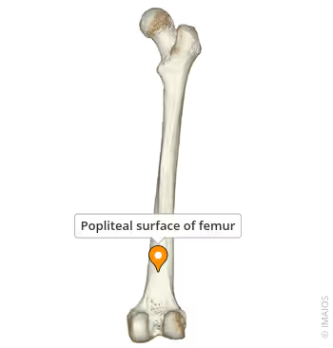

Slide 23
Patella
Patella
Also called kneecap
Largest sesamoid bone
  Develops within tendon of quadriceps femoris
Shape:
  Triangular
  Apex lies inferiorly
Apex:
  Connected to tibial tuberosity
  Via ligamentum patellae (patellar ligament)

Slide 24
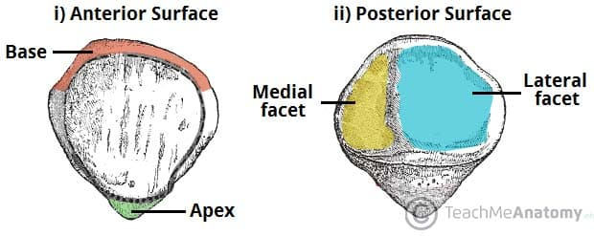

Slide 25
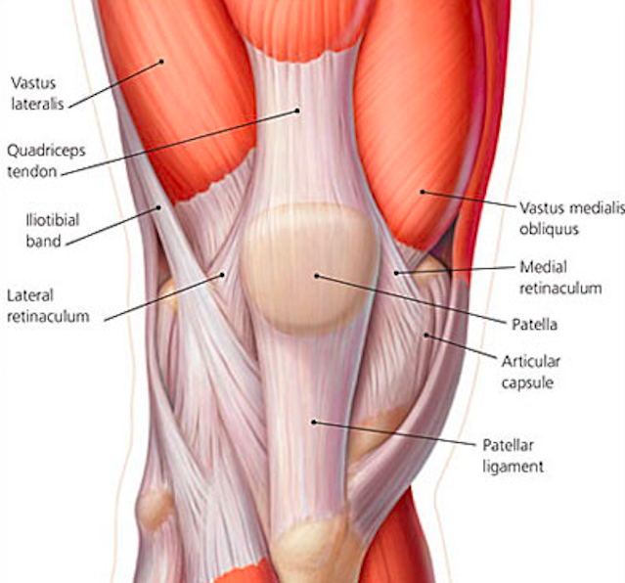

Slide 26
CONTINUED
Posterior surface:
  Articulates with femoral condyles
Position:
  In front of knee joint
  Easily palpable through skin
Separated from skin by:
  Prepatellar bursa
Margins:
  Upper, medial, and lateral margins
  Provide attachment to quadriceps femoris muscle

Slide 28


Slide 29


