Slide 1

BASIC MEDICAL SCIENCE
FSC MEDICAL TECHNOLOGIES I
DR DANISH

Slide 2
Male Reproductive System
Testes:
Located in the scrotum; each testis is divided into lobules
Contain seminiferous tubules:
  Site of spermatogenesis (sperm formation)
  Lined with germ cells → develop into sperm
Sertoli cells:
  Support and nourish developing sperm
  Form blood-testis barrier (protection)

Slide 3
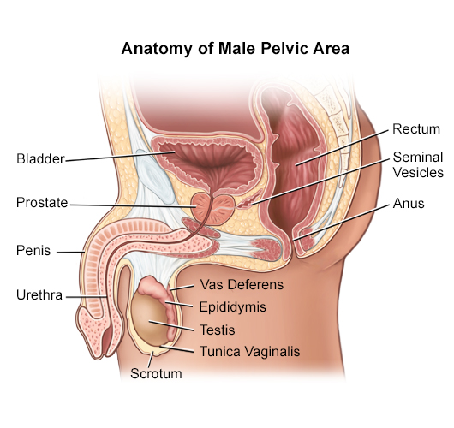

Slide 4
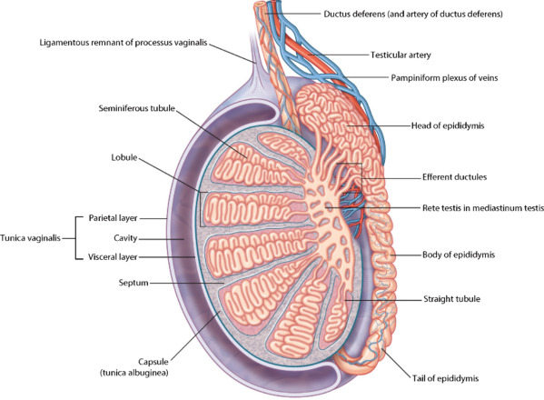

Slide 5
CONTINUED
Leydig (interstitial) cells:
  Produce testosterone
  Hormone responsible for:
    Male reproductive organ development
    Secondary sexual characteristics

Slide 6
Scrotum
Divided into two compartments (one for each testis)
Contains dartos and cremaster muscles:
  Adjust position of testes depending on temperature
Helps maintain optimal sperm production environment

Slide 8
Epididymis
Divided into:
  Head, body, tail
Functions:
  Sperm maturation (gain motility and fertilizing ability)
  Storage of sperm for several days

Slide 10
Vas Deferens (Ductus Deferens)
Thick-walled muscular tube
Transports sperm during ejaculation via peristalsis
Joins seminal vesicle duct → forms ejaculatory duct

Slide 12
Ejaculatory Duct
Short duct passing through prostate
Mixes sperm with glandular secretions

Slide 13
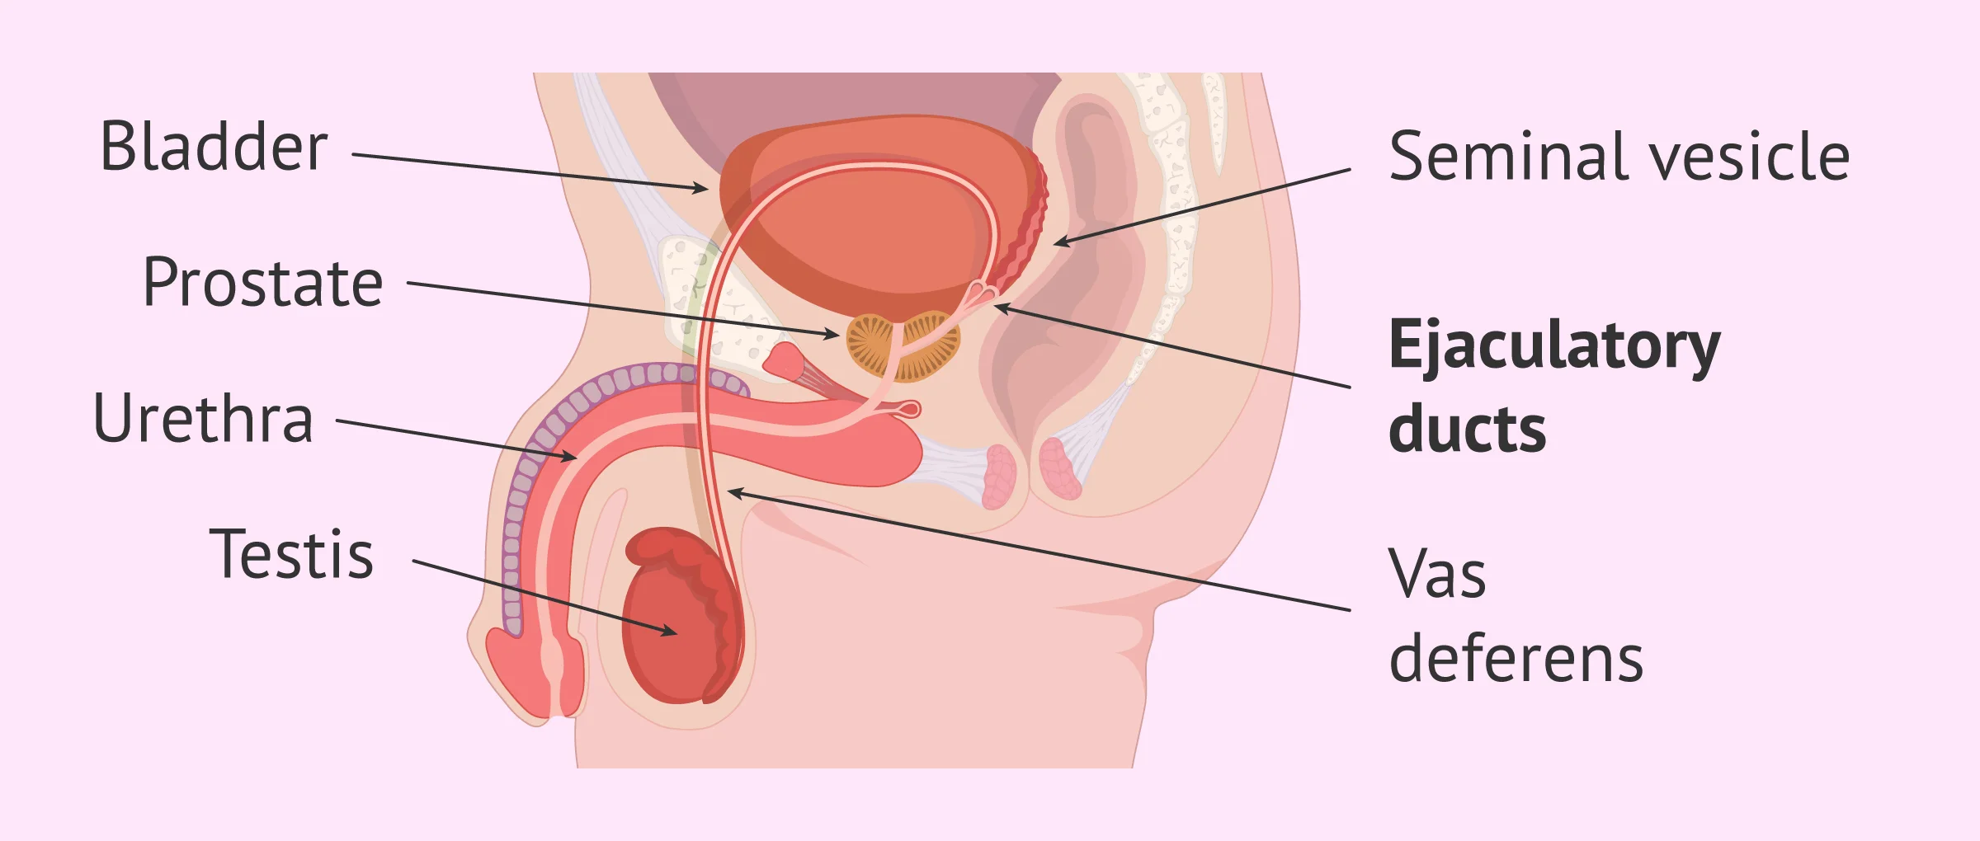

Slide 14
Urethra
Divided into:
  Prostatic
  Membranous
  Spongy (penile)
Dual function:
  Urinary excretion
  Semen passage

Slide 16
Prostate Gland
Surrounds urethra below bladder
Secretes thin, milky, alkaline fluid
Contains enzymes that activate sperm

Slide 18
Bulbourethral (Cowper’s) Glands
Secrete mucus before ejaculation
Functions:
  Lubrication
  Neutralization of acidic urine residue

Slide 19
Penis
Composed of:
  Two corpora cavernosa
  One corpus spongiosum (contains urethra)
Engorges with blood during erection
Delivers semen during intercourse

Slide 20
Female Reproductive System
Ovaries
Contain follicles at different stages of development
Each month:
  One follicle matures → releases ovum (ovulation)

Slide 21
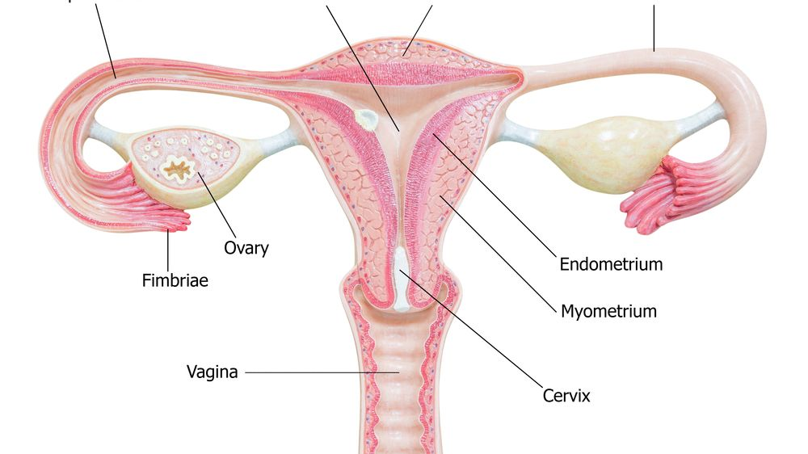

Slide 22
Hormones:
  Estrogen:
    Development of female reproductive organs
    Secondary sexual characteristics
  Progesterone:
    Prepares uterus for implantation
    Maintains pregnancy

Slide 23
Fallopian Tubes (Oviducts)
Divided into:
  Infundibulum (with fimbriae)
  Ampulla (site of fertilization)
  Isthmus
Lined with cilia:
  Help move ovum toward uterus

Slide 24
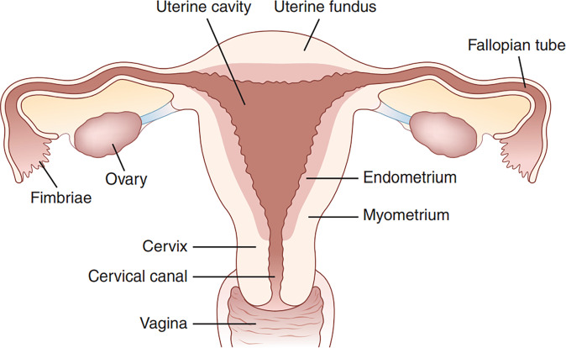

Slide 25
Uterus
Pear-shaped organ in pelvic cavity
Functions:
  Implantation of fertilized egg
  Nourishment and protection of embryo

Slide 27
Layers Explained:
Endometrium
  Undergoes cyclic changes (menstrual cycle)
  Rich in blood vessels
Myometrium
  Smooth muscle layer
  Contracts strongly during labor
Perimetrium
  Outer serous covering

Slide 29
Cervix
Has cervical canal connecting uterus to vagina
Produces mucus:
  Thin during ovulation (helps sperm)
  Thick at other times (blocks sperm)

Slide 31
Vagina
About 8–10 cm long
Highly elastic and muscular
Maintains slightly acidic pH (prevents infections)
No glands — lubrication comes from cervical mucus

Slide 32
External Genitalia
Mons pubis – fatty tissue over pubic bone
Labia majora – outer folds with hair
Labia minora – inner folds (no hair)
Clitoris:
  Erectile tissue
  Highly sensitive
Vestibular glands:
  Secrete lubricating fluid

Slide 33


Slide 34


