Slide 1
Basic Concept of Computer
BS(OT+RIT+MLT)
ADNAN RAMZAN
2nd Samester

Slide 2
IPO Cycle
Input data
Process
Output

Slide 3
Basic Components of Computer
A computer has several important components.
Main components include input, output, CPU, and memory.
Each component performs a specific function.
All components work together as a system.
The CPU acts as the brain of the computer.
These components ensure proper functioning.

Slide 4
Input Unit
Input unit is used to enter data into the computer.
It converts data into machine-readable form.
Common input devices include keyboard and mouse.
It allows users to communicate with the computer.
Input is the first step in processing.
It plays a vital role in computing.

Slide 5
Output Unit
Output unit displays processed information.
It converts machine data into human-readable form.
Common output devices include monitor and printer.
It provides results to the user.
Output is the final step in processing.
It helps users understand results.

Slide 6
Central Processing Unit
CPU is the brain of the computer.
It processes all instructions.
It controls all operations of the computer.
It consists of ALU and Control Unit.
It performs calculations and decision making.
It ensures proper execution of tasks.

Slide 7
Arithmetic Logic Unit
ALU performs arithmetic operations.
It handles addition, subtraction, multiplication, division.
It also performs logical operations.
It compares values and makes decisions.
It is a part of the CPU.
It is essential for calculations.

Slide 8
Control Unit
Control Unit manages all operations.
It directs the flow of data.
It tells components what to do.
It does not perform calculations.
It coordinates between input and output.
It ensures proper execution of instructions.

Slide 9
Memory Unit
Memory stores data and instructions.
It holds data before and after processing.
It is essential for computer functioning.
It is divided into primary and secondary memory.
It helps in quick access to data.
It improves system performance.

Slide 10
Primary Memory
Primary memory is the main memory.
It is directly accessed by the CPU.
It includes RAM and ROM.
It is fast but has limited capacity.
It stores temporary data.
It is essential for running programs.

Slide 11
Secondary Memory
Secondary memory stores data permanently.
It includes hard drives and SSDs.
It has large storage capacity.
It is slower than primary memory.
It is used for long-term storage.
It keeps data safe even when power is off.

Slide 12
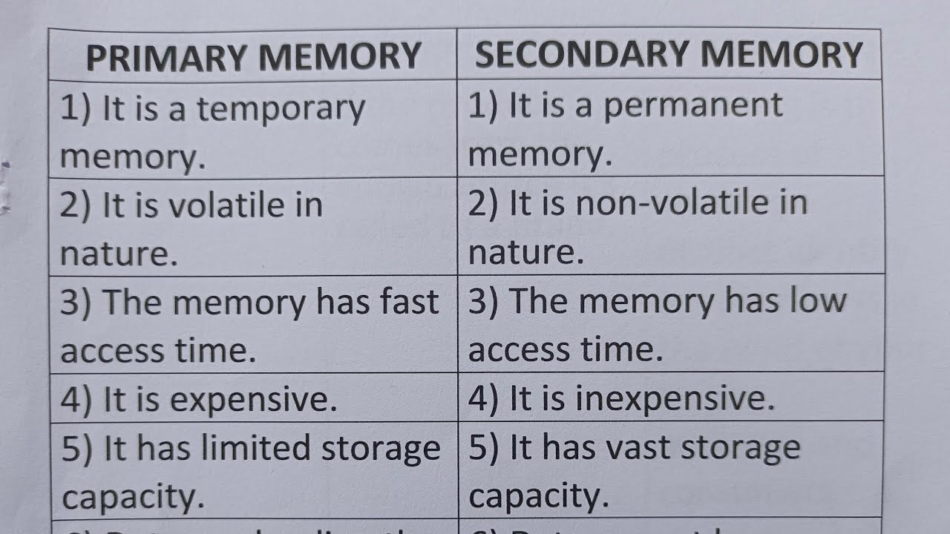
Key Difference

Slide 13


