Slide 1

BASIC MEDICAL SCIENCE
FSC MEDICAL TECHNOLOGIES I
DR DANISH

Slide 2
Pleura
A double-layered membrane surrounding each lung and lining the chest cavity
Parietal pleura:
  Outer layer
  Lines the chest wall and diaphragm
Visceral pleura:
  Inner layer
  Covers the surface of the lungs
Pleural cavity:
  Space between the two layers
  Contains fluid to reduce friction during breathing

Slide 3
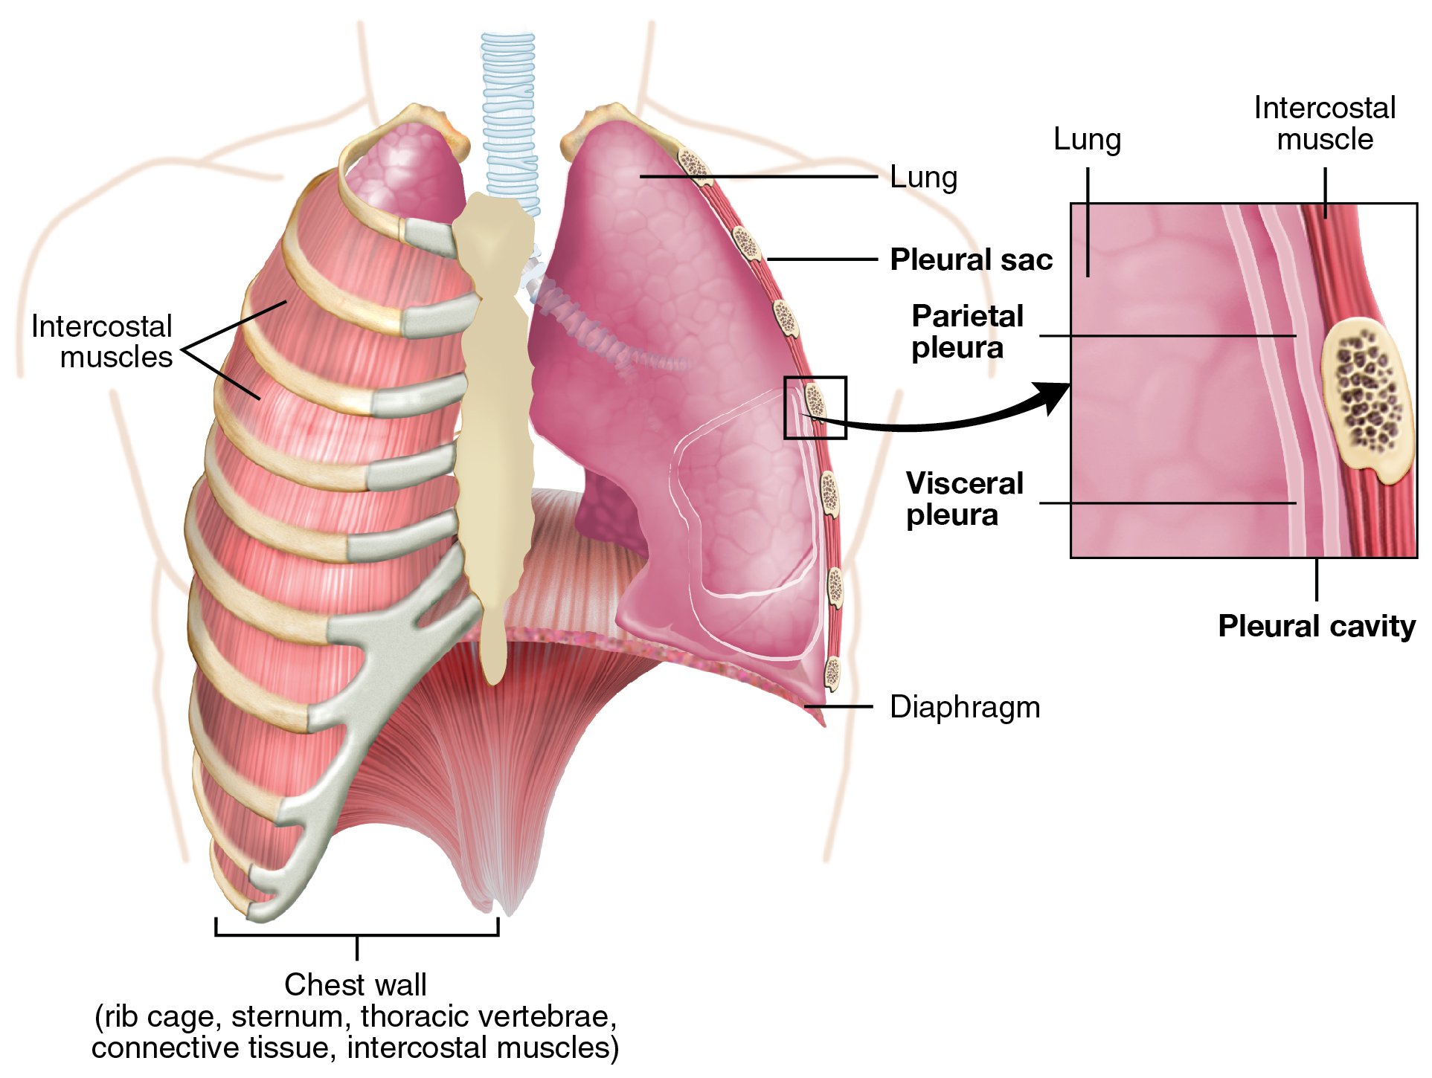

Slide 4
Breathing vs Respiration
Breathing:
  Physical process
  Involves inhaling oxygen and exhaling carbon dioxide
Respiration:
  Chemical process
  Oxygen is used to break down glucose to produce energy

Slide 5
Difference Between Upper and Lower Respiratory Tract
Upper Respiratory Tract:
Uppermost portion of the respiratory system
Located above the lungs
Includes:
  Nose
  Sinuses
  Throat
  Larynx
  Trachea
Lined by pseudostratified epithelium
Main function: transport air to lower regions

Slide 6
Common infections:
Flu
Common cold
Laryngitis
Sinusitis
Tonsillitis

Slide 7
Lower Respiratory Tract
Most active part for gas exchange
Located within the lungs
Includes:
  Bronchi
  Bronchioles
  Alveoli
Lined by simple squamous epithelium
Functions:
  Air transport
  Gas exchange

Slide 8
Common diseases:
  Pneumonia
  Tuberculosis (TB)
  Bronchitis
  Bronchiolitis

Slide 9


