Slide 1

ANATOMY
THE THORAX
BS RIT,OTT
2ND SEMESTER
DR DANISH

Slide 2
RIBS
Ribs are elongate, flattened, arched bones.
They form a large part of the thoracic wall.
They consist largely of highly vascular cancellous bone enclosed by a thin shell of compact bone.

Slide 3
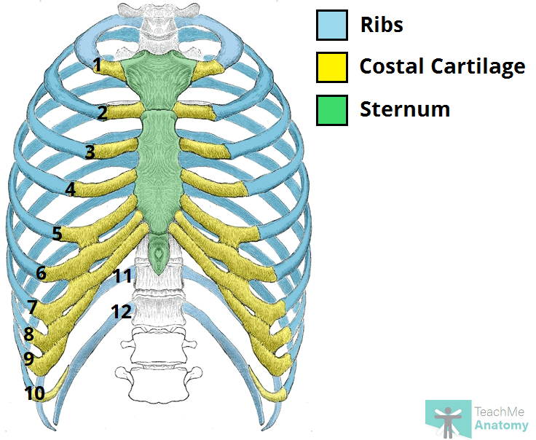

Slide 4
CONTINUED
Normally, both males and females have 12 pairs of ribs.
The posterior (dorsal; vertebral) end of each rib articulates with one or two thoracic vertebrae.
The anterior (ventral; sternal) ends have variable relations allowing classification as:
  True ribs
  False ribs
  Floating ribs

Slide 5
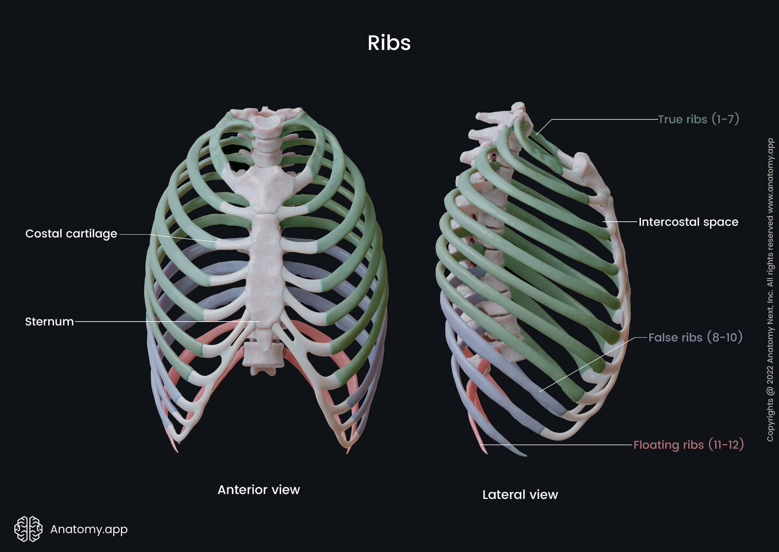

Slide 6
Classification of Ribs
True ribs (pairs 1–7)
  Connected directly to the sternum via individual costal cartilages.
False ribs (pairs 8–10)
  Connected to the sternum via individual costal cartilages.
  These cartilages join and attach collectively to the seventh costal cartilage.
Floating ribs (pairs 11–12)
  Do not attach to the sternum.

Slide 7
Typical Rib
All ribs share a common structural plan.
A typical rib is:
  Long
  Twisted
  Flat
  Has a rounded, smooth superior border
  Has a sharp, thin inferior border
The anterior end of each rib is attached to the corresponding costal cartilage.

Slide 8
Parts of a Typical Rib
Head
Posterior (vertebral) end.
Has two facets for articulation with:
  The numerically corresponding vertebral body.
  The vertebra immediately above.

Slide 9
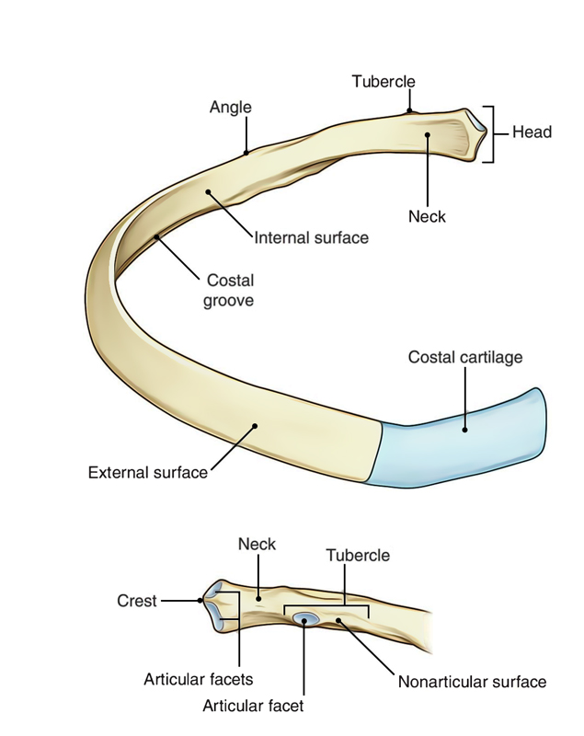

Slide 10
CONTINUED
Neck
Flattened, slightly constricted portion.
Situated between the head and the tubercle.

Slide 12
CONTINUED
Tubercle
  Prominence on the outer posterior surface.
  Located at the junction of the neck with the body.
  Has a facet for articulation with the transverse process of the corresponding vertebra.

Slide 14
CONTINUED
Body (Shaft):
Long, thin, flattened, and twisted part.
Extends from the tubercle to the anterior (sternal) end.

Slide 16
CONTINUED
Costal Groove
  Elongated depression along the inferior aspect of the internal surface.
  Holds the intercostal vessels and nerve.
Angle
  Point slightly distal to the tubercle.
  Where the rib bends sharply.
  Turns from lateral to a more anteriorly directed orientation.
Anterior (Sternal) End
  Flat.
  Has a depression for the costal cartilage.

Slide 18
First Rib
Clinically important due to close relationship to:
  Lower nerves of the brachial plexus.
  Main vessels to the arm:
    Subclavian artery
    Subclavian vein.
Small and flattened from above downward.
Scalenus anterior muscle is attached to:
  Upper surface
  Inner border

Slide 19
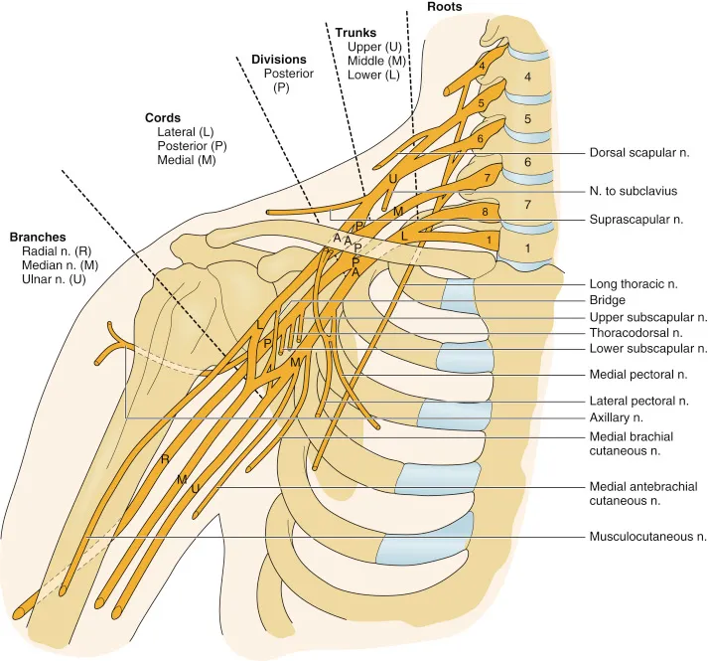

Slide 20
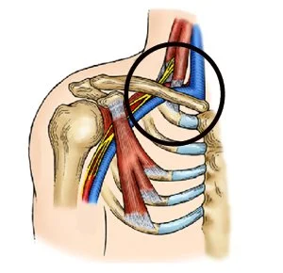

Slide 21
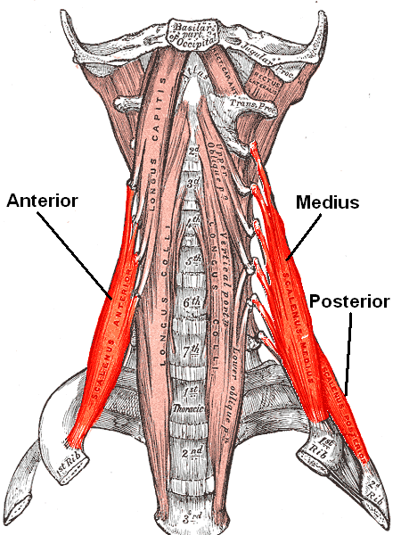

Slide 22
CONTINUED
Relations:
Anterior to scalenus anterior → subclavian vein crosses the rib.
Posterior to the muscle attachment → subclavian artery and lower trunk of the brachial plexus cross the rib and lie in contact with the bone.

Slide 25
Costal Cartilages
Bars of cartilage connecting:
  Ribs 1–7 to the lateral edge of the sternum.
  Ribs 8–10 to the cartilage immediately above.
Cartilages of ribs 11 and 12 end in the abdominal musculature.
Contribute significantly to:
  Elasticity
  Mobility of the thoracic walls.
In old age:
Tend to lose flexibility.
Due to superficial calcification.

Slide 28


Slide 29


