Slide 1

BASIC MEDICAL SCIENCE
FSC MEDICAL TECHNOLOGIES I
DR DANISH

Slide 2
Respiratory System
1. Upper Respiratory Tract (URT)
Involved in breathing, filtration, warming, and humidifying air
Includes: nose, nasal cavity, pharynx, and larynx

Slide 3
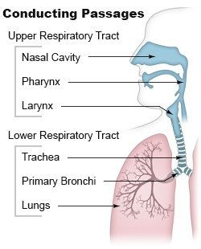

Slide 4
Nose
Primary entry point for air
Made of bone, cartilage, and soft tissue
External parts: nasal bridge, nostrils (nares), nasal septum
Leads to nasal cavity through nostrils

Slide 5
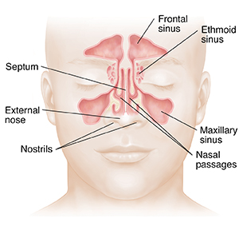

Slide 6
Nasal Cavity
Large space behind the nose
Divided into left and right halves by nasal septum
Lined with mucus membranes
Contains nasal conchae (turbinates) to increase surface area
Cilia help trap dust and pathogens

Slide 7
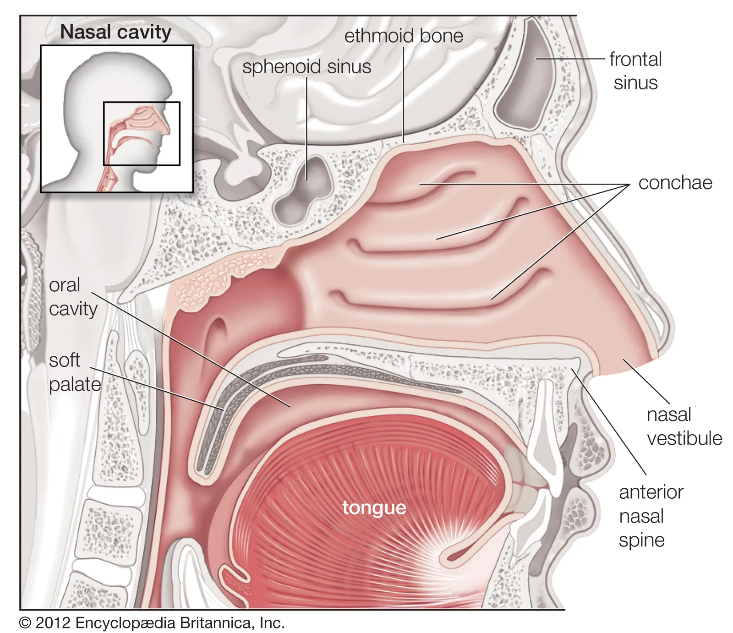

Slide 8
Pharynx (Throat)
Muscular tube connecting nasal cavity and mouth to larynx and esophagus
Divided into:
  Nasopharynx (behind nasal cavity)
  Oropharynx (behind mouth)
  Laryngopharynx (connects to larynx and esophagus)

Slide 9
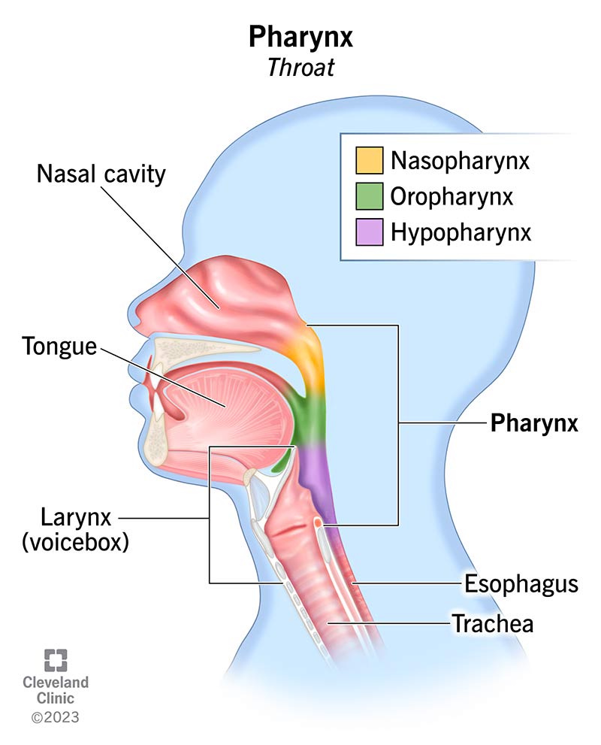

Slide 10
Larynx (Voice Box)
Located below pharynx and above trachea
Contains vocal cords (produce sound)
Epiglottis prevents food/liquid from entering airway

Slide 12
Tonsils and Adenoids
Lymphoid tissues in pharynx
Adenoids located in nasopharynx
Help trap and destroy pathogens

Slide 13
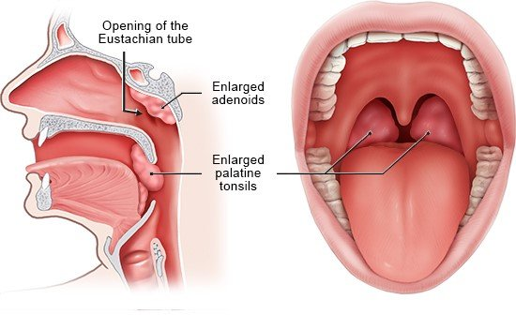

Slide 14
Lower Respiratory Tract
Responsible for gas exchange (oxygen in, carbon dioxide out)
Includes: trachea, bronchi, bronchioles, alveoli, lungs

Slide 15
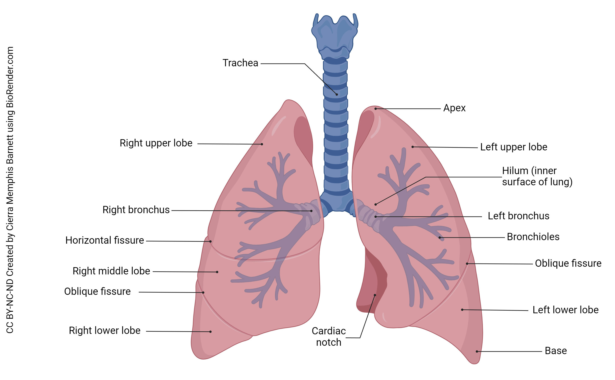

Slide 16
Trachea (Windpipe)
Rigid tube with C-shaped cartilage rings
Connects larynx to bronchi
Lined with cilia and mucus to trap particles

Slide 18
Bronchi
Trachea divides into right and left primary bronchi
Right bronchus is wider, shorter, more vertical
Further divides into secondary bronchi

Slide 20
Bronchial Tree
Network of branching bronchi
Ends in bronchioles and alveoli

Slide 22
Bronchioles
Small airways without cartilage
Surrounded by smooth muscle
Divide into terminal bronchioles

Slide 23
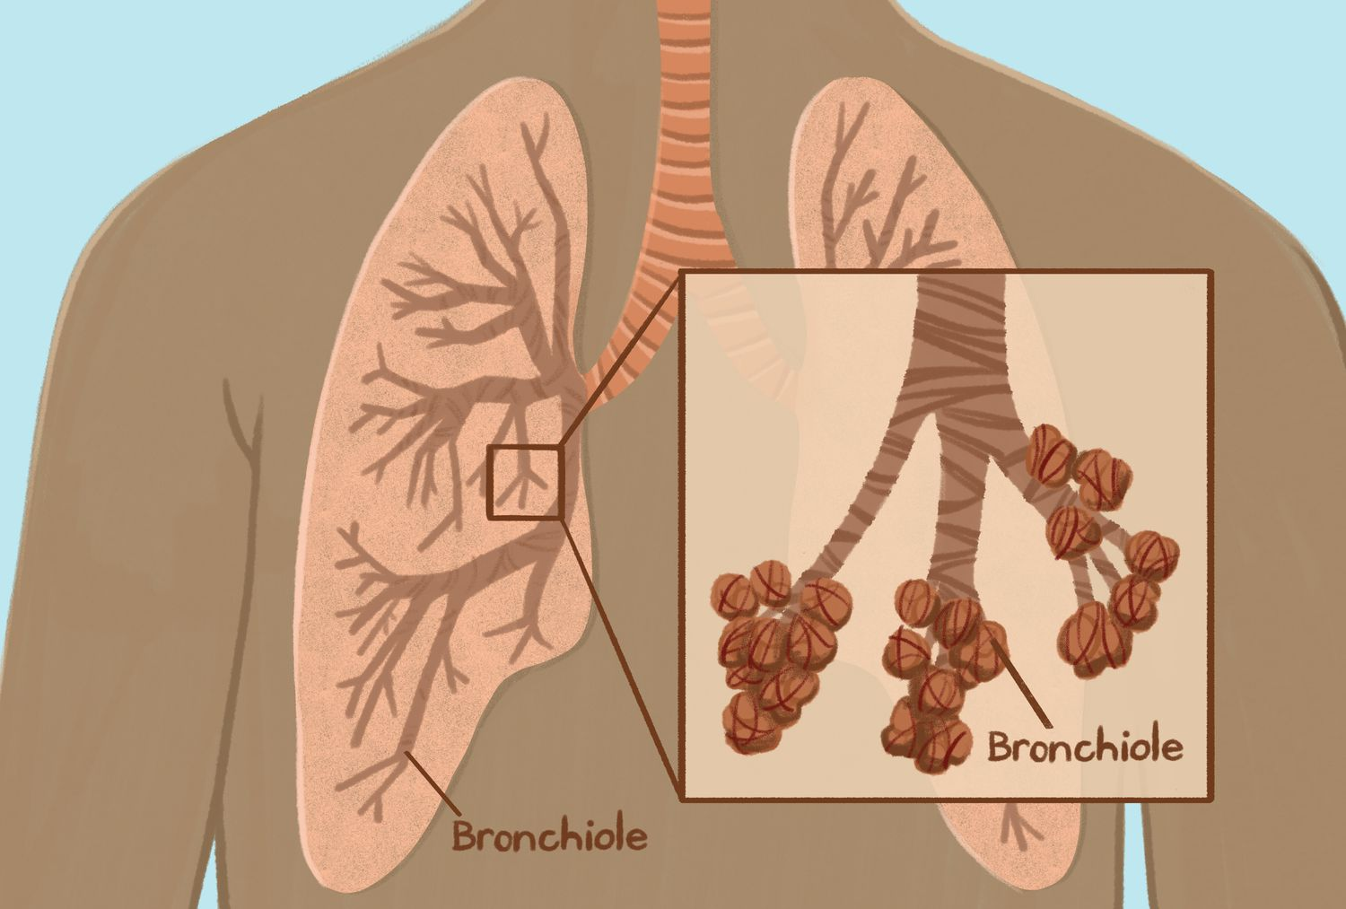

Slide 24
Alveoli
Site of gas exchange
Tiny balloon-like sacs
Surrounded by capillaries
Oxygen and carbon dioxide exchanged with blood

Slide 25
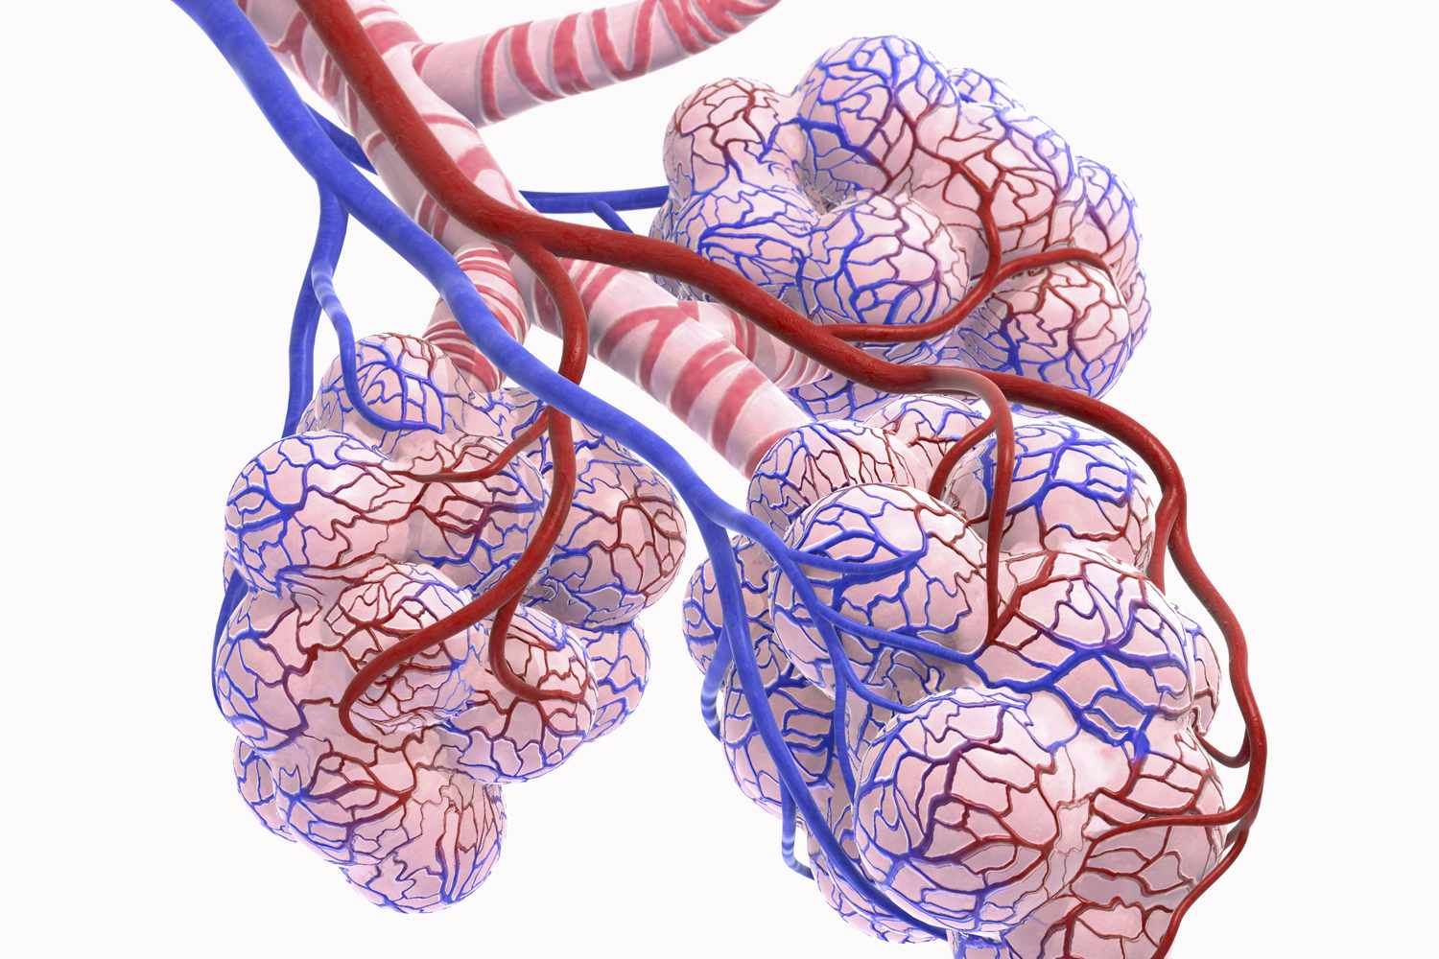

Slide 26
Lungs
Paired organs in thoracic cavity
Located on either side of the heart
Covered by pleural membrane
Right lung: 3 lobes; Left lung: 2 lobes

Slide 28
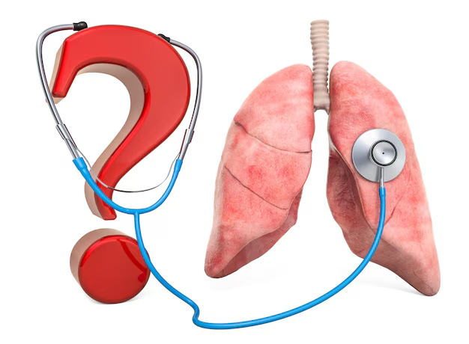

Slide 29


