Slide 1

REGIONAL ANATOMY
BS RIT
2ND SEMESTER
DR DANISH

Slide 2
THE THORAX
Region of the body between the neck and abdomen
Enclosed by the thoracic cage
Contains vital organs:
  Heart
  Lungs
  Great vessels
Separated from abdomen by the diaphragm

Slide 3
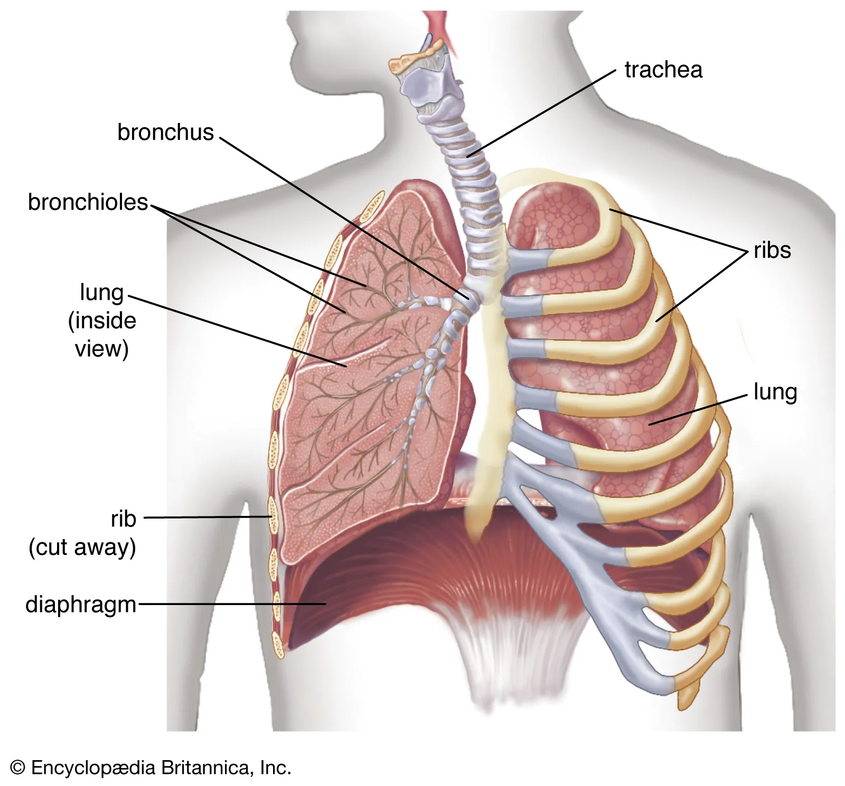

Slide 4
Functions of Thorax
Protection of vital organs (heart & lungs)
Respiration (breathing movements)
Passage for structures between neck and abdomen
Support for upper limb attachment

Slide 5
Thoracic Cage Components
Anteriorly: Sternum
Posteriorly: 12 thoracic vertebrae
Laterally: 12 pairs of ribs and costal cartilages

Slide 6
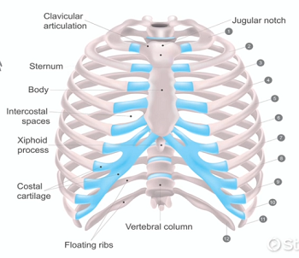

Slide 7


Slide 8


