Slide 1

HISTOLOGY
DPT
2ND SEMESTER
DR DANISH

Slide 2
HISTOLOGY
Study of microscopic structure of tissues
  Focuses on cells and extracellular components.
Derived from:
  Histo = tissue
  Logy = study

Slide 3
THE CELL
Basic structural and functional unit of life
  The smallest unit capable of carrying out all vital functions (metabolism, growth, reproduction).
Building block of tissues and organs
  Cells group together to form tissues → organs → systems.

Slide 4
Characteristics of Cells
Bounded by plasma membrane
  Separates intracellular from extracellular environment.
Contains cytoplasm and nucleus
  Cytoplasm = metabolic activities
  Nucleus = genetic control center
Highly organized
  Organelles perform specialized functions.

Slide 5
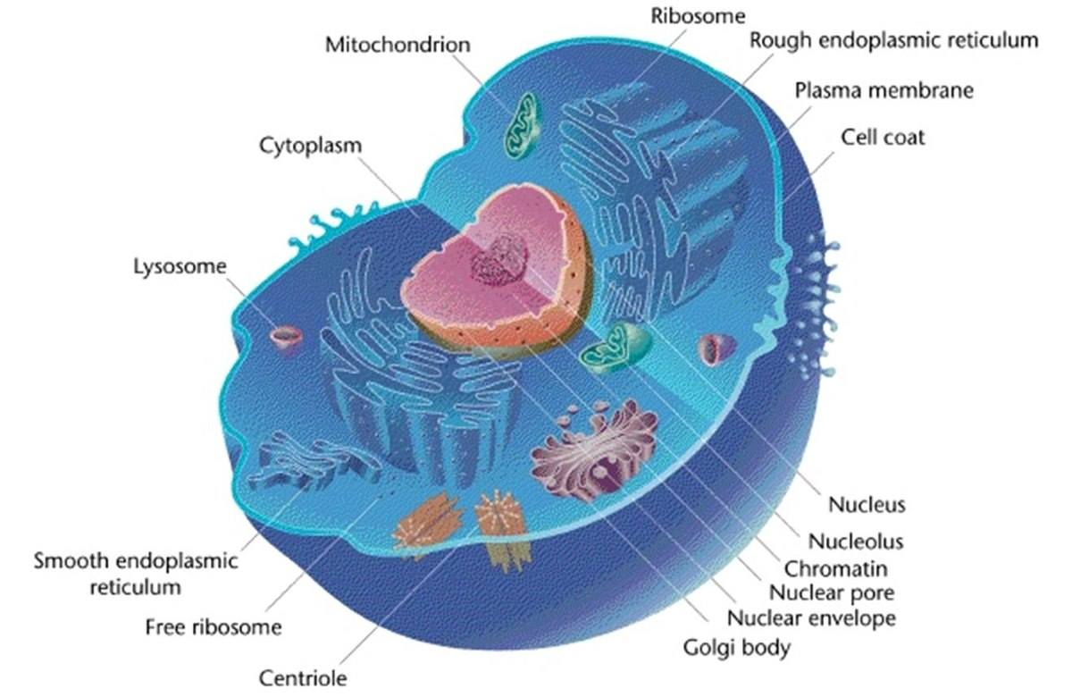

Slide 6
Components of a Cell
Plasma Membrane
Cytoplasm
Nucleus

Slide 7
Plasma Membrane
Structure: Fluid Mosaic Model
  Composed of phospholipid bilayer + proteins + cholesterol.
Functions:
  Selective permeability (controls entry/exit of substances)
  Cell communication via receptors
  Maintains cell integrity

Slide 8
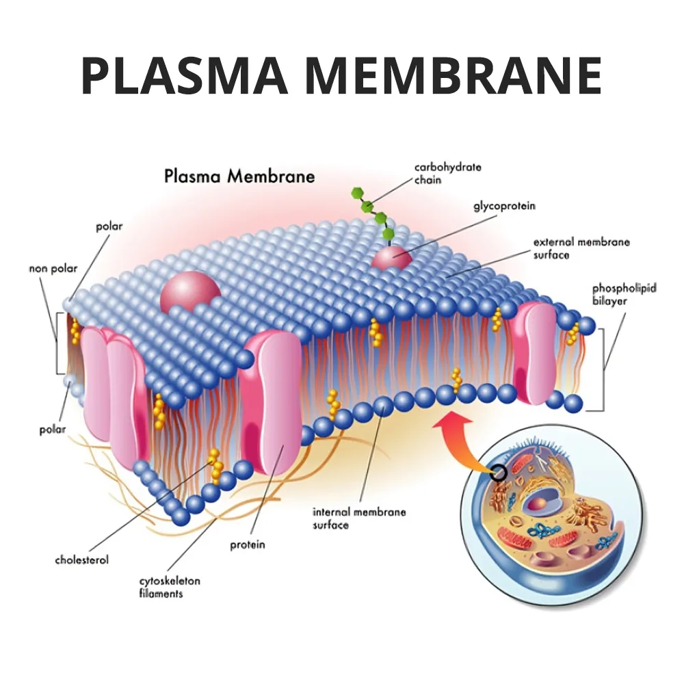

Slide 9
Cytoplasm
Includes cytosol + organelles
  Cytosol: gel-like matrix where reactions occur
Site of metabolic activity
  Contains enzymes, nutrients, ions

Slide 10
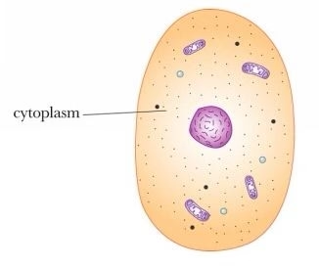

Slide 11
Nucleus
Control center of the cell
  Contains DNA → regulates protein synthesis
Components:
  Nuclear membrane (double-layered)
  Chromatin (DNA + proteins)
  Nucleolus (ribosome production)

Slide 12
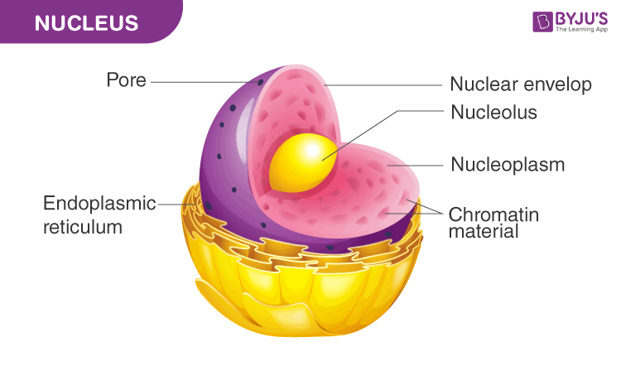

Slide 13
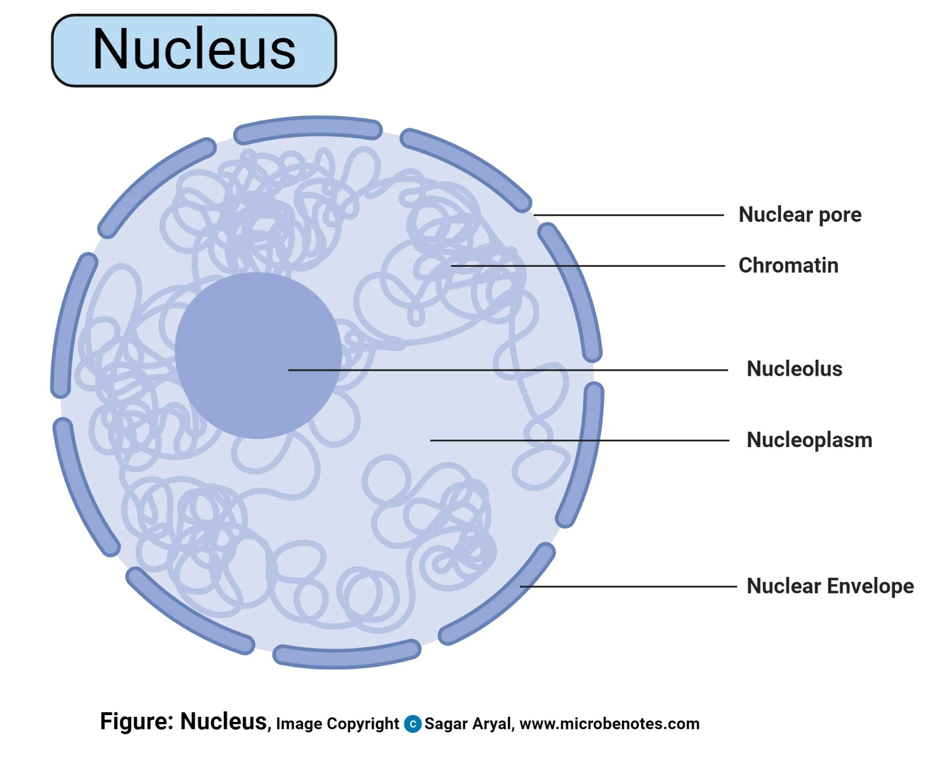

Slide 14
Cell Organelles and Their Functions
1. Mitochondria
“Powerhouse of the cell”
  Produces ATP via oxidative phosphorylation
Has its own DNA
  Semi-autonomous organelle

Slide 15
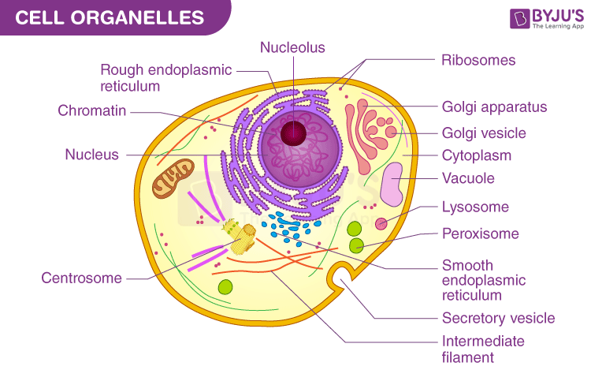

Slide 16
CONTINUED
2. Rough Endoplasmic Reticulum (RER)
Studded with ribosomes
  Synthesizes proteins for secretion or membranes
Prominent in protein-secreting cells
  e.g., plasma cells

Slide 18
CONTINUED
Smooth Endoplasmic Reticulum (SER)
No ribosomes
  Lipid and steroid synthesis
Detoxification
  Important in liver cells

Slide 20
CONTINUED
4. Golgi Apparatus
Protein modification & packaging
  Adds carbohydrates → glycoproteins
Forms secretory vesicles & lysosomes

Slide 22
CONTINUED
5. Ribosomes
Site of protein synthesis
  Free ribosomes → cytoplasmic proteins
  Bound ribosomes → secreted proteins

Slide 24
CONTINUED
6. Lysosomes
Digestive organelles
  Contain hydrolytic enzymes
Function:
  Break down waste, old organelles (autophagy)

Slide 26
CONTINUED
7. Peroxisomes
Detoxification & oxidation
  Break down hydrogen peroxide via catalase
Important in liver & kidney

Slide 28
CONTINUED
8. Cytoskeleton
Provides structure and movement
  Microfilaments (actin)
  Intermediate filaments
  Microtubules
Functions:
  Cell shape
  Intracellular transport

Slide 30
Cell Surface Specializations
Microvilli
  Increase surface area (e.g., intestine)
Cilia
  Movement of fluid (respiratory tract)
Flagella
  Movement of whole cell (e.g., sperm)

Slide 31
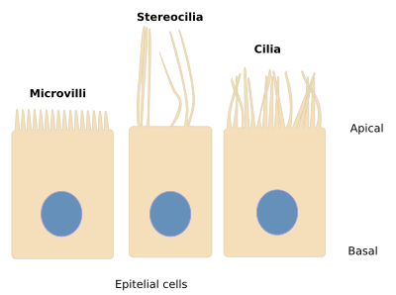

Slide 32
Cell Junctions
Tight Junctions
  Prevent leakage between cells
Adherens Junctions
  Provide mechanical attachment
Desmosomes
  Strong adhesion (skin cells)
Gap Junctions
  Allow communication (ion exchange)

Slide 33
Types of Cells
Epithelial cells
  Cover surfaces, form glands
Connective tissue cells
  Support and structure
Muscle cells
  Contraction and movement
Nerve cells (neurons)
  Transmission of impulses

Slide 34
Cell Cycle
Phases:
  G1 (growth)
  S (DNA replication)
  G2 (preparation)
  M (mitosis)
Importance:
  Growth, repair, and reproduction

Slide 35
Clinical Correlation
Cell injury
  Caused by hypoxia, toxins, infections
Apoptosis vs Necrosis
  Apoptosis = programmed cell death
  Necrosis = uncontrolled damage
Cancer
  Uncontrolled cell division due to mutations

Slide 36


Slide 37


