Slide 1
Intro to Visual Arts
DPT
Hafsa Rasheed

Slide 2

What is Art?
Art is not what you see… It’s what you make others feel.
Art is a form of expression
It communicates emotions, ideas, identity, and culture
It can be visual, auditory, physical, or literary
Art is both: Personal (your feelings)Universal (shared human experience)

Slide 3
Etymology of “Art”
The word art comes from Latin “ars”
Meaning:
Skill
Craft
Technique
In ancient times: Art = any mastered skill (even medicine or war!)

Slide 4
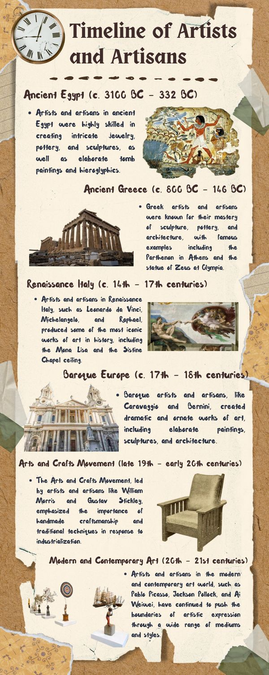

Slide 6
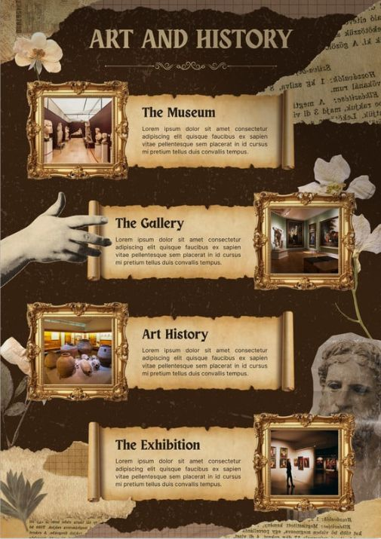

Slide 7
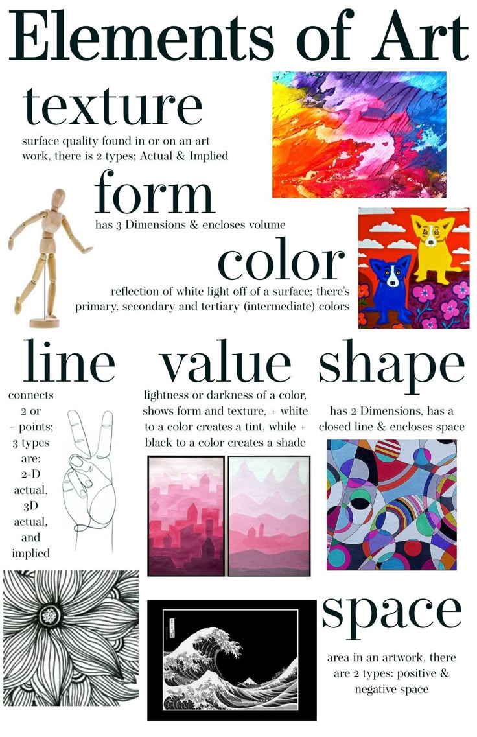

Slide 8
Art in Daily Life
Art is everywhere:
Clothes (fashion)
Social media aesthetics
Interior design
Music playlists 🎧
Even the way you decorate your notes
“Is your Instagram feed… art?” 👀

Slide 9
Art as an Academic Field
Art is studied as:
Theory (history, criticism)
Practice (painting, design, performance)
Analysis (meaning, symbolism)
Fields include:
Fine Arts
Visual Arts
Art History
Design & Media
Performing Arts

Slide 10
Why Visual Arts Matter Most
Visual art is instant (no translation needed)
It crosses: - Language barriers - Cultural boundaries
It is: The oldest form (cave art) - The most accessible
It shapes: - Media – Advertising - Identity
We see before we understand. That is why visual art leads all art

Slide 11
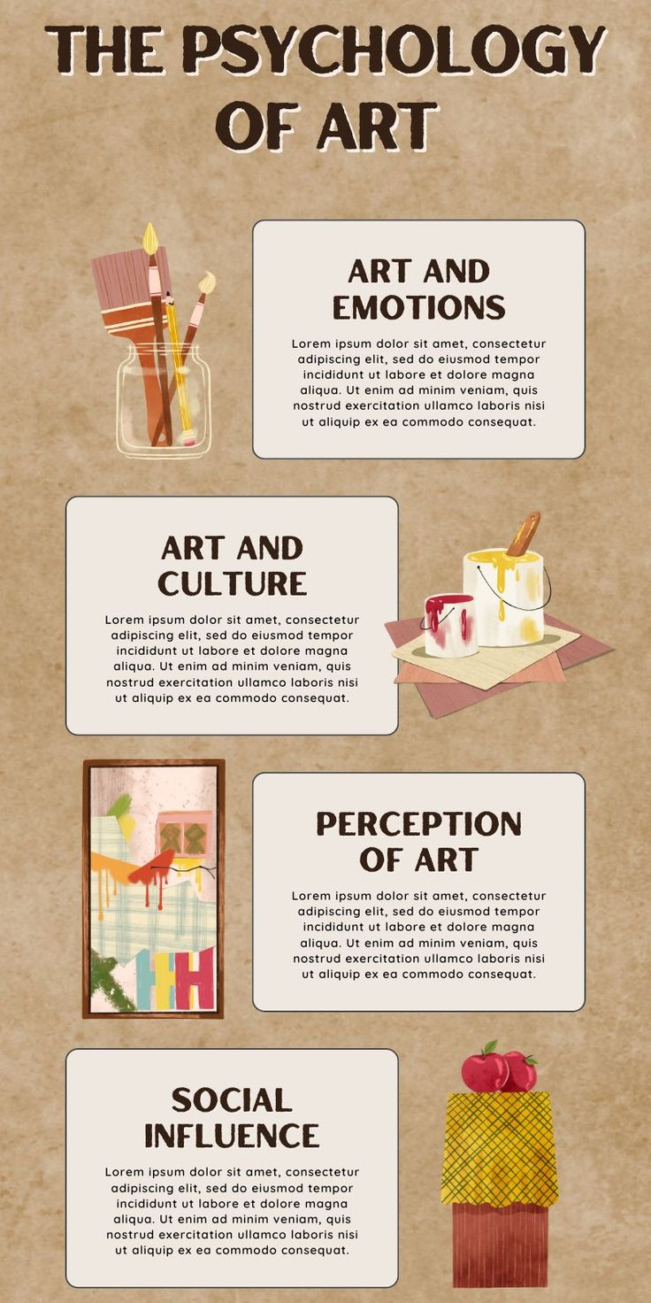

Slide 12
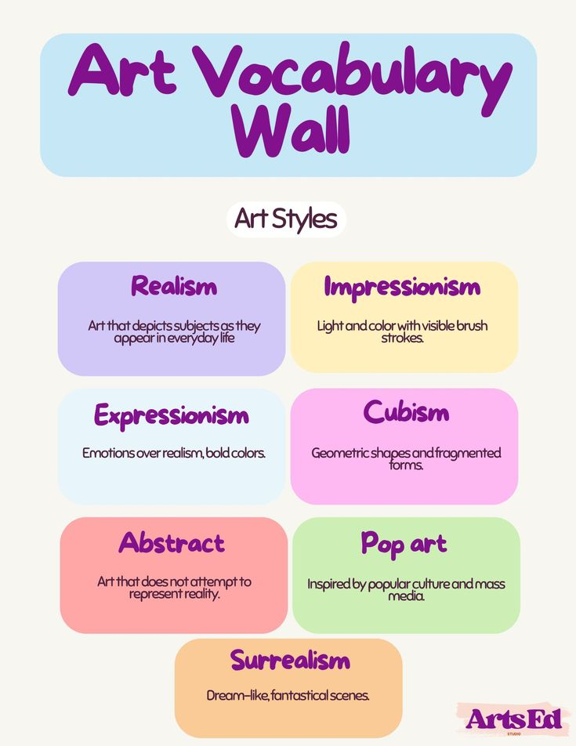

Slide 13


