Slide 1
Expository Writing
BS Psy & DPT
Hafsa Rasheed

Slide 2

What is Expository Writing?
Expository writing = writing that explains.
It presents facts, ideas, or information
It is objective (not emotional or biased)
It aims to inform, clarify, or instruct
Example: Essays, textbooks, reports

Slide 3
All Types of Writing
All writing is generally divided into 4 major:
Expository Writing (explains)
Narrative Writing (tells a story)
Descriptive Writing (paints a picture)
Argumentative / Persuasive Writing (convinces)

Slide 4
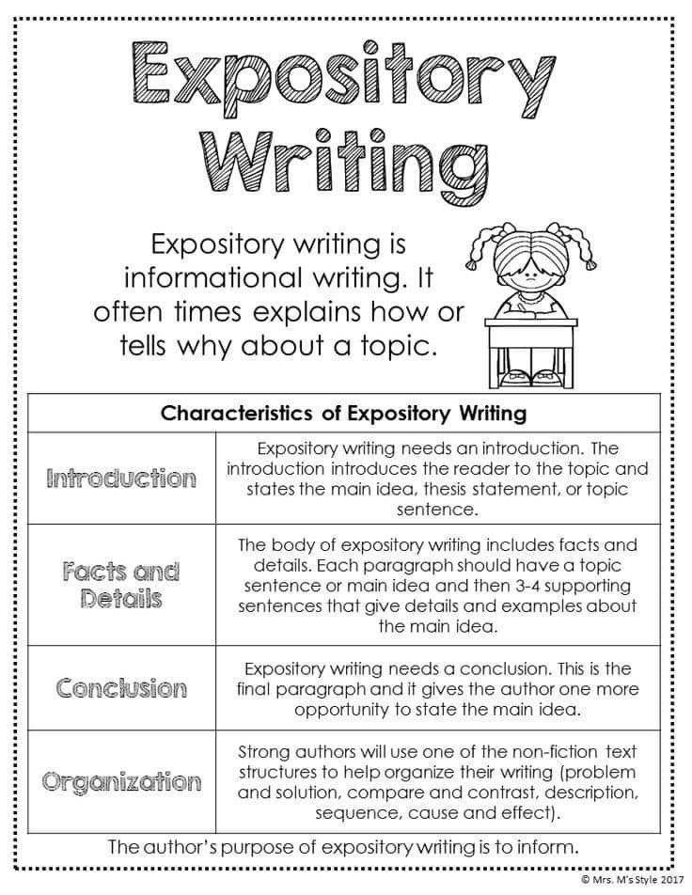

Slide 5
Etymology of “Expository”
Root word: “exposit”
From Latin: ex- = out
ponere = to place
“To place out in the open”
So, expository writing = putting ideas clearly in front of the reader

Slide 6
Formal Definition
Expository writing is a type of writing that explains, describes, or informs the reader about a topic using facts, examples, and logical organization.
Key features:
Clear thesis
Logical structure
Evidence-based
No personal bias (mostly)

Slide 7
Core Characteristics
🎯 Clarity → Easy to understand
📊 Facts & Evidence → Data, examples
🧱 Structure → Organized (intro, body, conclusion)
⚖️ Neutral tone → No emotional manipulation
🔍 Focus → One clear topic

Slide 8
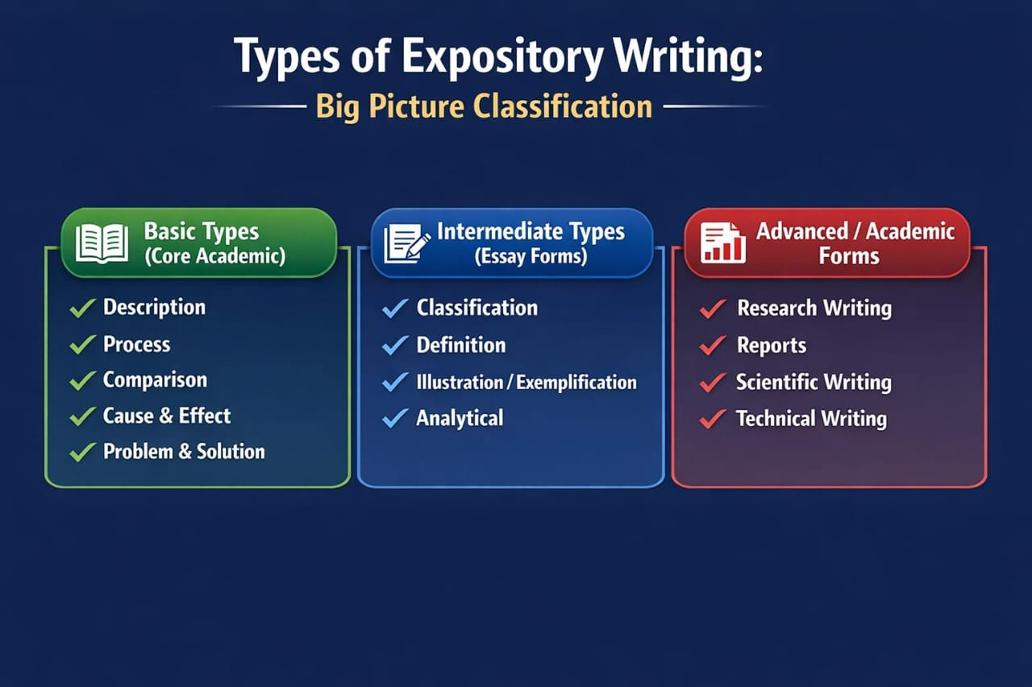
Types of Expository Writing

Slide 9
Descriptive Expository Writing
📌 Purpose: To describe a topic clearly using facts
Focuses on:
Features
Characteristics
Examples
📝 Example: “The human brain consists of…”
⚠️ Not creative writing—still factual.

Slide 10
Sequential / Process Writing (How-To)
can also be called Sequential Writing: the writer explains something in sequential order.
Purpose: To explain steps
Step-by-step structure
Chronological order
📝 Example: “How to apply for a UK student visa”
✔ Very practical type

Slide 11
Comparative / Compare & Contrast
📌 Purpose: To show similarities and differences
Two structures:
Block method
Point-by-point
📝 Example: Online vs Physical Education
can also be called Comparative

Slide 12
Cause & Effect
📌 Purpose:
Why something happens (cause)
What happens as a result (effect)
📝 Example: “Effects of mobile phone usage on sleep”

Slide 13
Problem & Solution
📌 Purpose:
Identify a problem
Suggest solutions
📝 Example: “How to reduce junk food consumption among students”

Slide 14

Additional / Advanced Types
Classification (grouping ideas)
Definition essays
Analytical essays
Informational reports
Research-based writing
Activity: Search and write about additional types if expository writing and make an assignment.

Slide 15
Purpose of Expository Writing
Main goals:
📘 To inform
🧠 To explain
📊 To analyze
🛠️ To instruct
It answers:
What?
How?
Why?

Slide 16
Applications
Expository writing is everywhere:
🎓 Academic
Essays
Exams
Research papers💼
💼 Professional
Reports
Emails
Proposals
🌐 Daily Life
Blog posts
News articles
Instruction manuals

Slide 17
As a Subject – What Topics Are Covered?
When studied formally, expository writing includes:
🧩 Writing Skills
Thesis statement
Topic sentences
Paragraph development
🏗️ Structure
Introduction
Body
Conclusion
🔍 Techniques
Use of evidence
Examples & statistics
Logical transitions
✍️ Language
Formal tone
Clarity & precision
Vocabulary building

Slide 18
Common Topics in Expository Writing
You’ll usually write on:
Education (e.g., online learning)
Health (e.g., junk food effects)
Technology (e.g., AI impact)
Society (e.g., gender roles)
Environment (e.g., climate change)
Psychology (e.g., stress, habits)

Slide 19
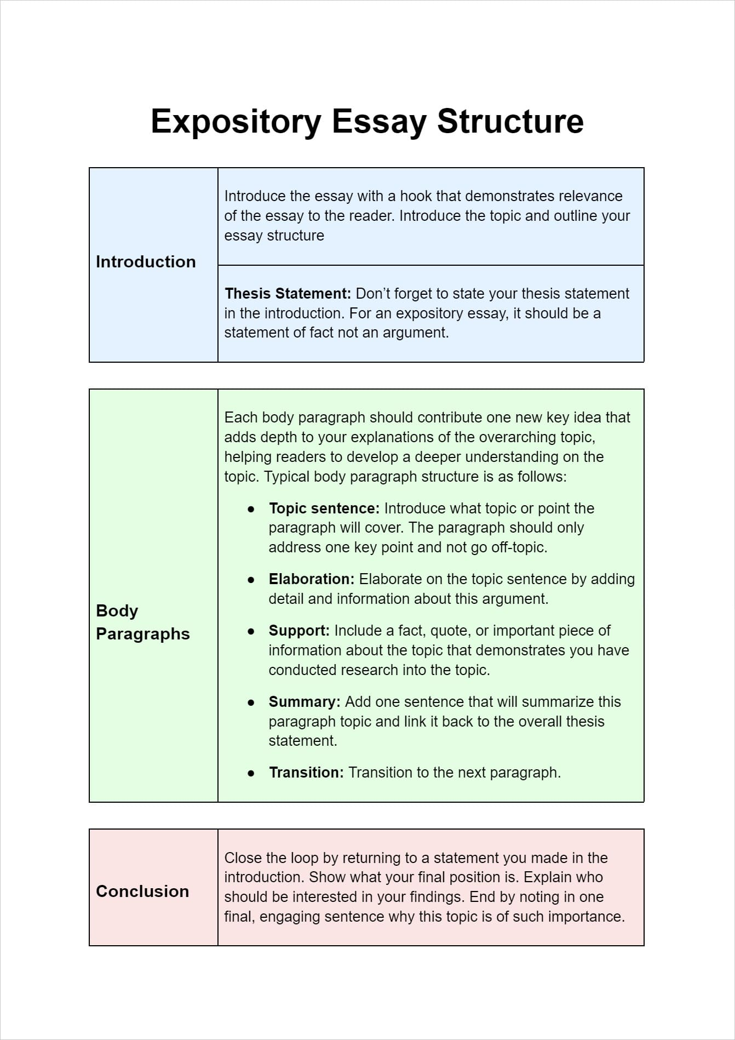

Slide 20


Slide 21
Quick Example
Topic: Mobile Phones & Sleep
Type: Cause & Effect
Thesis: Excessive mobile use disrupts sleep patterns
Body: - Blue light effect
- Mental stimulation
Conclusion: Limit usage

Slide 22
What Expository Writing is NOT
❌ Not storytelling (that’s narrative)
❌ Not persuasion (that’s argumentative)
❌ Not emotional expression (that’s descriptive/creative)

Slide 23


