Slide 1

PHARMACOLOGY
BS RIT,OTT,MLT
2ND SEMESTER
DR DANISH

Slide 2
ABSORPTION OF DRUGS
Overview:
Absorption = transfer of a drug from site of administration → bloodstream
Depends on:
  Site of absorption
  Chemical properties of drug
  Route of administration

Slide 3
MECHANISMS OF DRUG ABSORPTION (GI TRACT)
1. Passive Diffusion
2. Facilitated Diffusion
3. Active Transport
4. Endocytosis

Slide 4
1. Passive Diffusion
Movement: high → low concentration
No carrier required
Carrier : Specialized systems, such as nanoparticles, liposomes, or polymers, that encapsulate or bind therapeutic agents to transport them to specific sites in the body.
Not saturable
Low specificity
Most common mechanism

Slide 5
Continued
Drug properties:
Lipid-soluble → cross easily
Water-soluble → pass through pores
Example:
Lipid-soluble drug like diazepam → rapidly absorbed
Water-soluble drug like atenolol → slower absorption

Slide 6
2. Facilitated Diffusion
Uses carrier proteins
No energy required
Saturable
Can be inhibited by competing drugs
Example:
Glucose transporters helping drug-like molecules enter cells

Slide 7
3. Active Transport
Requires energy (ATP)
Uses specific carriers
Moves drugs against concentration gradient(the unequal distribution of particles between two solutions)
Saturable
Example:
Levodopa transported into brain via amino acid transporter (specialized membrane-bound proteins that move amino acids into and out of cells and organelles)

Slide 8
4. Endocytosis
Engulfs large molecules into vesicles
Used for very large drugs
Example:
Vitamin B12 absorption via intrinsic factor (The glycoprotein produced by stomach for vitamin B12 absorption in small intestine).

Slide 9
FACTORS INFLUENCING ABSORPTION
1. pH and Ionization
Drugs exist as:
  Weak acids (HA ⇌ H⁺ + A⁻)
  Weak bases (BH⁺ ⇌ B + H⁺)
Non-ionized form → better absorption
Examples:
Weak acid (aspirin) → absorbed in stomach
Weak base (morphine) → absorbed in intestine

Slide 10
Continued
2. Blood Flow
Higher blood flow → faster absorption
Example:
Intestine > stomach for drug absorption

Slide 11
Continued
3. Surface Area
Larger area → more absorption
Example:
Small intestine (large surface) → major absorption site

Slide 12
Continued
4. GI Motility
Faster movement → less time for absorption
Example:
Diarrhea → ↓ drug absorption

Slide 13
Continued
5. Transport Proteins (P-glycoprotein)
Pumps drug out of cells
Reduces absorption
Causes multidrug resistance
Example:
Anticancer drugs being pumped out of tumor cells

Slide 14
BIOAVAILABILITY
Definition
Fraction of drug reaching systemic circulation unchanged
Example:
100 mg given → 70 mg reaches blood → 70% bioavailability
IV route = 100% bioavailability

Slide 15
Factors Affecting Bioavailability
1. First-pass metabolism
Drug metabolized in liver before reaching circulation
Example:
Nitroglycerin → high first-pass metabolism

Slide 16
Continued
2. Drug Solubility
Hydrophilic → poor absorption
Lipophilic → better absorption

Slide 17
Continued
3. Chemical Instability
Some drugs destroyed in GI tract
Example:
Penicillin G unstable in stomach
Insulin destroyed by enzymes

Slide 18
Continued
4. Drug Formulation
Particle size, salt form, coatings affect absorption
Example:
Enteric-coated tablets resist stomach acid

Slide 19
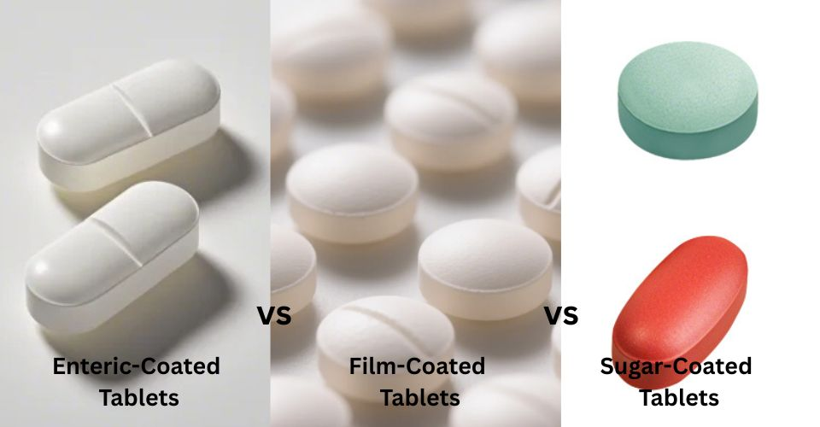

Slide 20
BIOEQUIVALENCE
Two drugs with similar bioavailability → bioequivalent

Slide 21
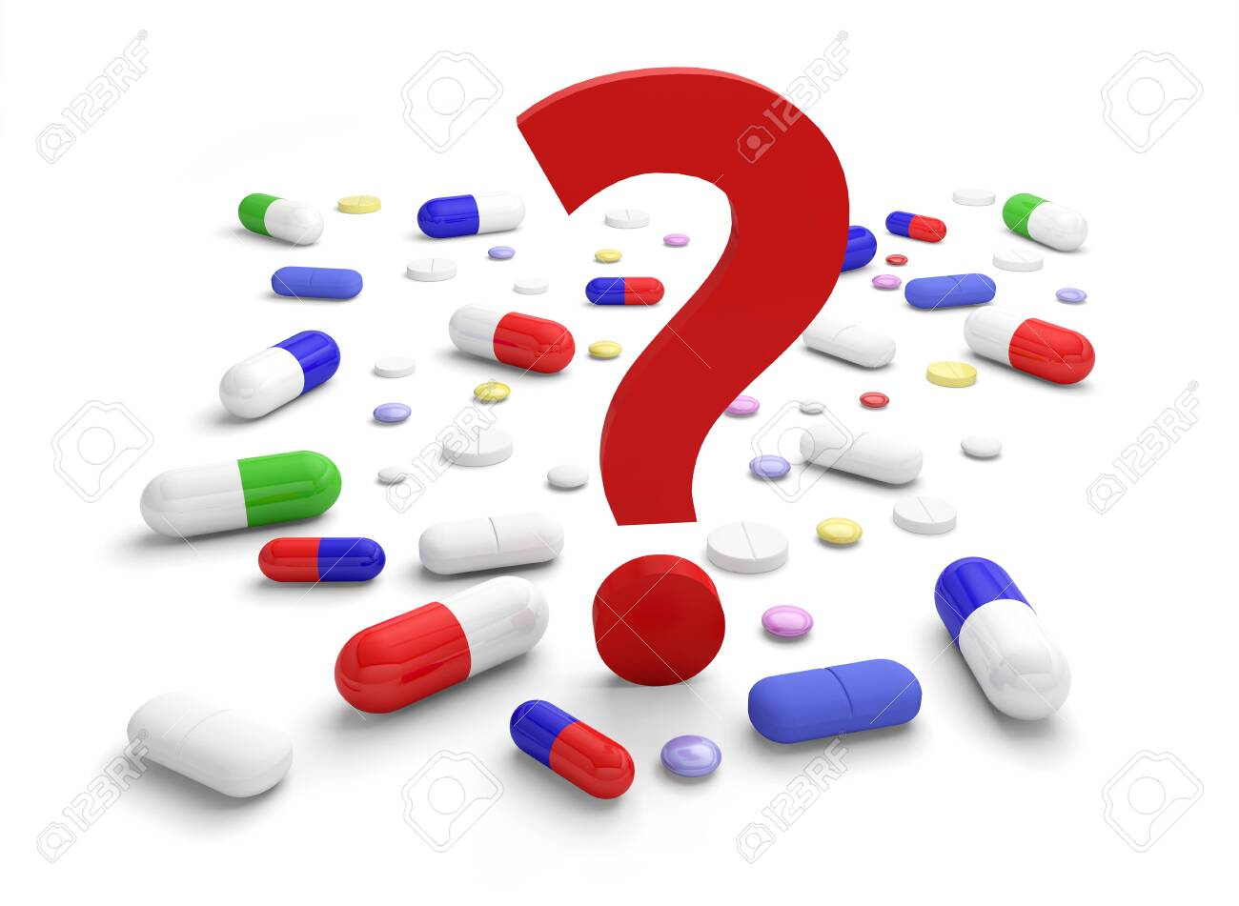

Slide 22
