Slide 1

Computer
BS (OT+ RIT+MLT)
2nd Semester
Adnan Ramzan

Slide 2
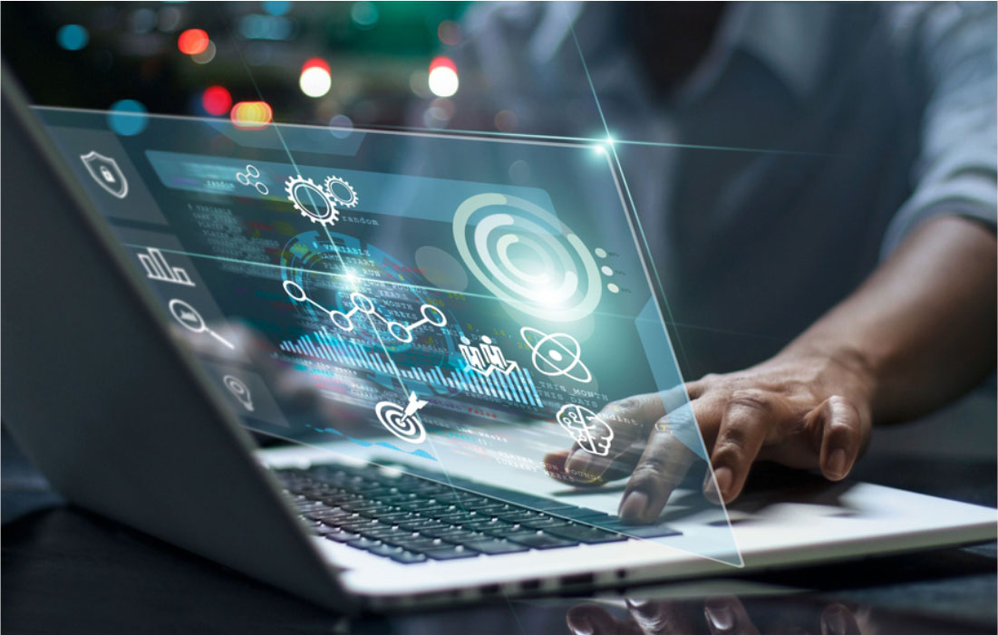

Slide 3
History of Computers
Computers are everywhere today, but they didn’t appear overnight.
Their development happened over centuries, starting from simple counting tools to the powerful machines we use now.
Used in every field today

Slide 4
Early Calculating Tools
Abacus (2400 BC)
The abacus is one of the earliest tools humans used to calculate.
It consists of a wooden frame with rods and sliding beads.
People used it for basic operations: addition, subtraction, multiplication, and division.
Even today, it’s sometimes used for teaching math.

Slide 5
Mechanical Calculators (1600s–1800s)
Inventors made machines that could do calculations automatically using gears and wheels.
Blaise Pascal invented Pascal’s Calculator in 1642 to add and subtract numbers mechanically.
Gottfried Leibniz developed a machine that could multiply and divide in the late 1600s.
These machines inspired later developments in computing.

Slide 6
Charles Babbage
Charles Babbage – The “Father of the Computer”
He designed the Difference Engine to automate mathematical tables.
Later, he designed the Analytical Engine, the first concept of a programmable machine.

Slide 7
The Analytical Engine had components similar to modern computers:
  Memory (to store numbers)
  CPU/Processor (to process numbers)
  Input/Output devices

Slide 8
Ada Lovelace
First computer programmer
Ada wrote the first algorithm to run on Babbage’s Analytical Engine.
She is known as the world’s first computer programmer.
Their work laid the foundation for modern computing.

Slide 9
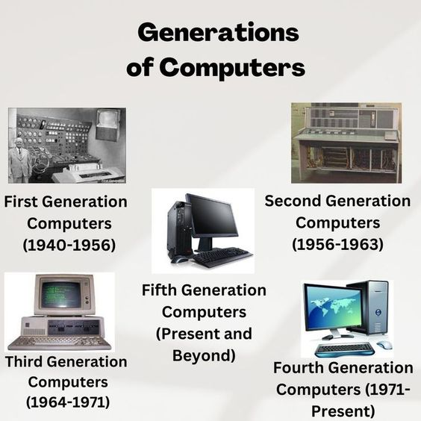

Slide 10
First Generation Computers
Period: 1940–1956
Computers used vacuum tubes to process data.
They were huge machines, often taking up entire rooms.
Problems: Very hot, slow, unreliable, and costly.

Slide 11
Examples
ENIAC (Electronic Numerical Integrator and Computer)
UNIVAC I (Universal Automatic Computer)
Uses
Mainly for military calculations and scientific research.
Could perform tasks that were impossible manually.

Slide 12
Second Generation Computers
Period: 1956–1963
Technology: Transistors
Transistors replaced vacuum tubes and were smaller, faster, and more reliable.
Computers consumed less power and generated less heat.
Programming became easier with new languages like COBOL and FORTRAN.

Slide 13
Advantages
Smaller size
Faster processing
Cheaper to make
More reliable

Slide 14
Third Generation Computers
Period: 1964–1971
Technology: Integrated Circuits
ICs combined many transistors into a small chip, making computers smaller and faster.
Computers now had keyboards, monitors, and operating systems, making them more user-friendly.
Impact
Computers became accessible to universities and businesses.
Cost dropped compared to earlier generations

Slide 15
Fourth Generation Computers
Period: 1971–Present
Technology: Microprocessors
Microprocessors put a complete CPU on a single chip.
This innovation led to the creation of Personal Computers (PCs).
Computers became faster, smaller, portable, and affordable.

Slide 16
Examples
IBM PCs
Apple Macintosh
Impact
Computers moved from specialized labs to homes and offices.
Everyday people could now own and use computers.

Slide 17
Fifth Generation Computers
Technology Used:
Artificial Intelligence (AI)
Machine Learning (ML)
Quantum computing
High-performance microprocessors
Modern computers are smart, interconnected, and capable of learning.

Slide 18
Capabilities
Smartphones and tablets for everyday tasks.
Supercomputers for scientific research.
AI-powered systems like Siri, Alexa, and autonomous cars.
Real-time global communication via the internet.

Slide 19
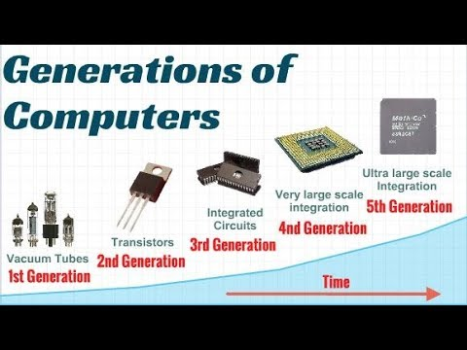

Slide 20
Summary Table of Computer Generations
Generation | Years | Technology Used | Size/Features | Examples
1st | 1940–1956 | Vacuum Tubes | Room-sized, huge machines | ENIAC, UNIVAC
2nd | 1956–1963 | Transistors | Smaller, faster, reliable | IBM 7090
3rd | 1964–1971 | Integrated Circuits | Compact, user-friendly | IBM 360
4th | 1971–Present | Microprocessors | Personal computers | Apple, IBM PCs
5th | Present & Future | AI, Quantum, Cloud | Smart, interconnected | Smartphones, AI

Slide 21
Boolean Logic
Boolean logic = math with TRUE or FALSE values.
Created by George Boole in the 1800s.
Computers use it because they only know ON (1/TRUE) and OFF (0/FALSE).
Example:
“Is the light on?” → YES (TRUE) or NO (FALSE)
Computers use the same idea to make decisions.

Slide 22
Boolean Operators
AND – both conditions must be true
OR – at least one must be true
NOT – reverses the value

Slide 23
Truth Tables
Show all possible outputs
Used for AND, OR, NOT
Important for circuits
Helps understand logic clearly

Slide 24
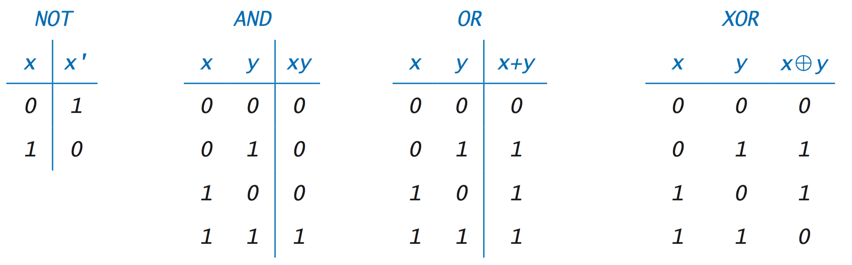
Truth Tables

Slide 25
Uses of Boolean Logic
Programming conditions
Digital circuits (logic gates)
Search engines filtering
Databases queries
Smart devices

Slide 26
Real Life Examples
Phone unlock: Face ID OR Passcode
Login: Password AND OTP
Traffic lights: Sensor AND Timer
Spam filter: Multiple conditions

Slide 27
Importance
Foundation of all computers
Helps in decision making
Used in AI and software
Essential for modern technology

Slide 28


