Slide 1

PHARMACOLOGY
BS RIT,OTT,MLT
2ND SEMESTER
DR DANISH

Slide 2
Pharmacokinetics
I. Overview
Pharmacokinetics refers to what the body does to a drug, whereas pharmacodynamics describes what the drug does to the body.
Four pharmacokinetic properties determine the onset, intensity, and duration of drug action:
Absorption
Entry of the drug into plasma from the site of administration.
Distribution
Reversible transfer of drug from blood to interstitial and intracellular fluids.

Slide 3
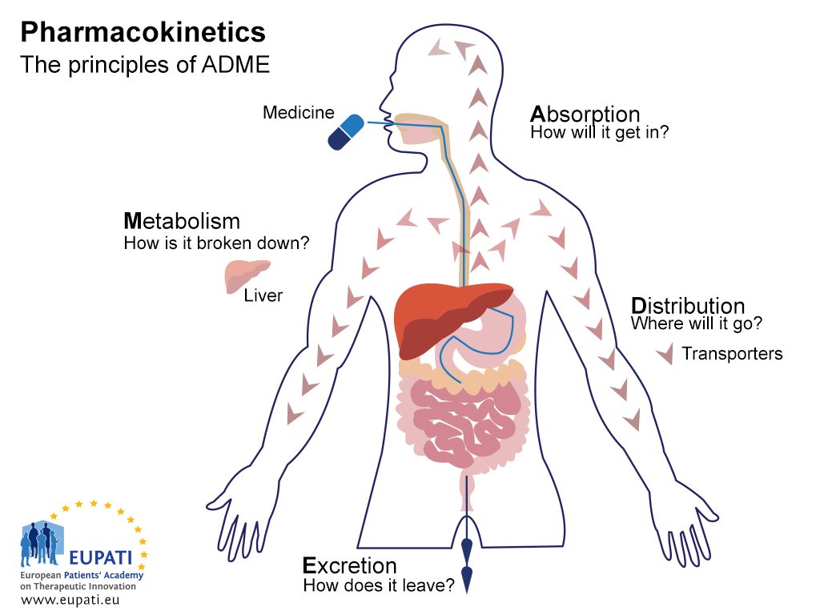

Slide 4
CONTINUED
Metabolism
Biotransformation of the drug, mainly by the liver or other tissues.
Elimination
Removal of drug and metabolites via urine, bile, or feces.

Slide 6
Routes of Drug Administration
Determined by:
  Drug properties (water/lipid solubility, ionization)
  Therapeutic objectives (rapid onset, long-term treatment, local delivery)

Slide 7
A. Enteral
Oral
  Most common, convenient, economical.
  Subject to first-pass metabolism.
  May involve extended-release preparations for prolonged effect.
Sublingual / Buccal
  Drug placed under tongue or in cheek pouch.
  Avoids first-pass metabolism.
  Rapid absorption.

Slide 8
B. Parenteral
Direct delivery into systemic circulation.
Intravenous (IV)
  Fastest onset, highest control.
  No absorption phase.
Intramuscular (IM)
  Slower than IV.
  Can use depot preparations for sustained release.
Subcutaneous (SC)
  Slower, sustained absorption.
  Suitable for small volumes.

Slide 9
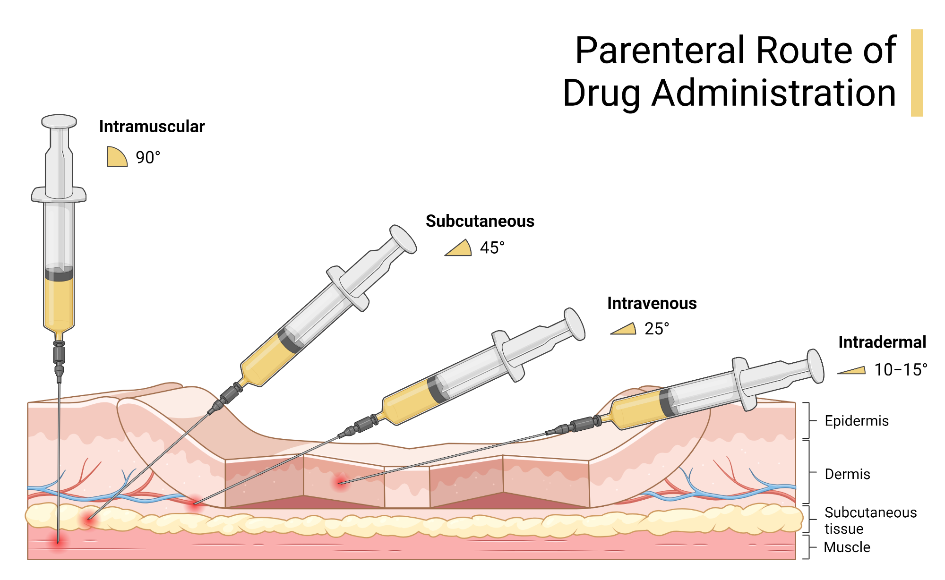

Slide 10
C. Other Routes
Oral Inhalation & Nasal
  Rapid absorption via mucous membranes.
  Used for local and systemic effects.
Intrathecal / Intraventricular
  Direct delivery into cerebrospinal fluid.
  Used to bypass blood-brain barrier.

Slide 11
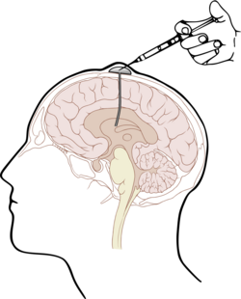

Slide 12
D. Topical
Transdermal
  Drug applied to skin (patch).
  Provides systemic effects.
  Absorption depends on skin condition and drug lipid solubility.
Rectal
  ~50% bypasses liver metabolism.
  Useful in vomiting or unconscious patients.
  Absorption may be erratic and incomplete.

Slide 14
Figure Summary
Drug pathway:
Absorption → Distribution → Metabolism → Elimination

Slide 15
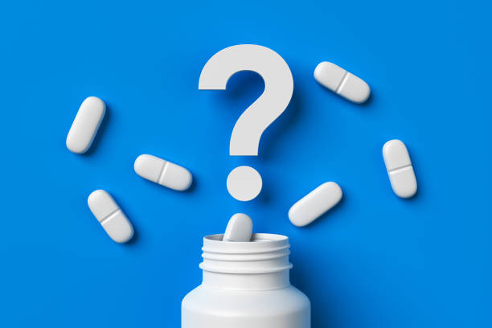

Slide 16


