Slide 1

Requests|Enquiries| Regrets | Apologies | Directions
Functional English | BS & DPT
Hafsa Rasheed

Slide 2
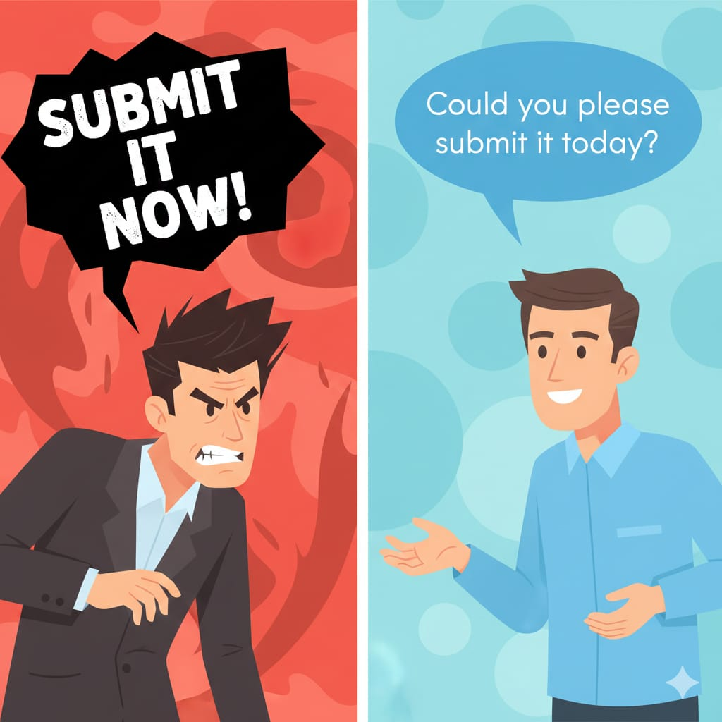

Slide 3
What is a Request?
A request is when you ask someone politely, knowing they can say yes or no.
You want something. But you respect the other person’s freedom.
Example:
“Close the door.” ❌ (command)
“Could you please close the door?” ✅ (request)

Slide 4
What is an Enquiry?
An enquiry is information-seeking communication.
Example:
“Where is the office?” (direct)
“Could you tell me where the office is?” (polite indirect)

Slide 5
Why This Matters
In real life:
In university → you write emails to teachers, coordinators, and administration.
In class → you ask questions respectfully and wait for your turn.
In group work → you request cooperation and divide tasks politely.
In jobs → you speak to seniors with respect and clarity.
In interviews → you answer confidently but courteously.
In public → you ask strangers for help politely.
In hospitals/clinical settings → you speak respectfully to patients and staff.
Remember: Politeness shows maturity Politeness = professionalism

Slide 6
Which sounds more respectful? Why?
Can you help me?
Could you help me?
Would you help me?
Would you mind helping me?
I would appreciate it if you could help me.

Slide 7
1. Modals Used in Requests
Modal / Expression | Meaning in Requests | Structure | Example
Can | Asking about ability / informal request | Can + subject + base verb? | Can you help me?
Could | More polite, less direct | Could + subject + base verb? | Could you help me?
Will | Asking willingness (direct) | Will + subject + base verb? | Will you open the door?
Would | More polite than “will” | Would + subject + base verb? | Would you open the door?
Would you mind | Very polite, indirect request | Would you mind + verb-ing? | Would you mind helping me?

Slide 8
Verb Phrase
Modal / Expression | Meaning in Requests | Structure | Example
Do you mind | Polite, but slightly less formal | Do you mind + verb-ing? | Do you mind closing the window?
May | Formal permission/request | May + I + base verb? | May I come in?
Might | Very soft and formal (rare in daily speech) | Might + I + base verb? | Might I ask a question?
I would appreciate it if… | Very formal and professional | I would appreciate it if + subject + past form | I would appreciate it if you could help me.
I was wondering if… | Extremely polite, indirect | I was wondering if + subject + could/would + base verb | I was wondering if you could assist me.

Slide 9
2. Indirect Questions
An indirect question is a more polite way to ask something.
We use it when:
Talking to strangers
Speaking to seniors
Writing formal emails
Being respectful
In indirect questions, we remove inversion.
The sentence becomes like a normal statement order: S + V + O
Could you tell me where the bank is?
Can you explain why you are late?
Do you know what he wants?
Inversion: In direct questions, the verb comes before the subject. Ex. Where is the bank?

Slide 10
3. Conditionals in Requests
This shows advanced politeness.
Structure: If + past tense → would + base verb
Examples:
If you could respond soon, I would be grateful.
I would appreciate it if you could clarify this issue.

Slide 11
Vocabulary for Requests & Enquiries
Kindly
Assistance
Clarify
Confirm
Inform
Procedure
Availability
Appreciate
Response
Inquiry

Slide 12
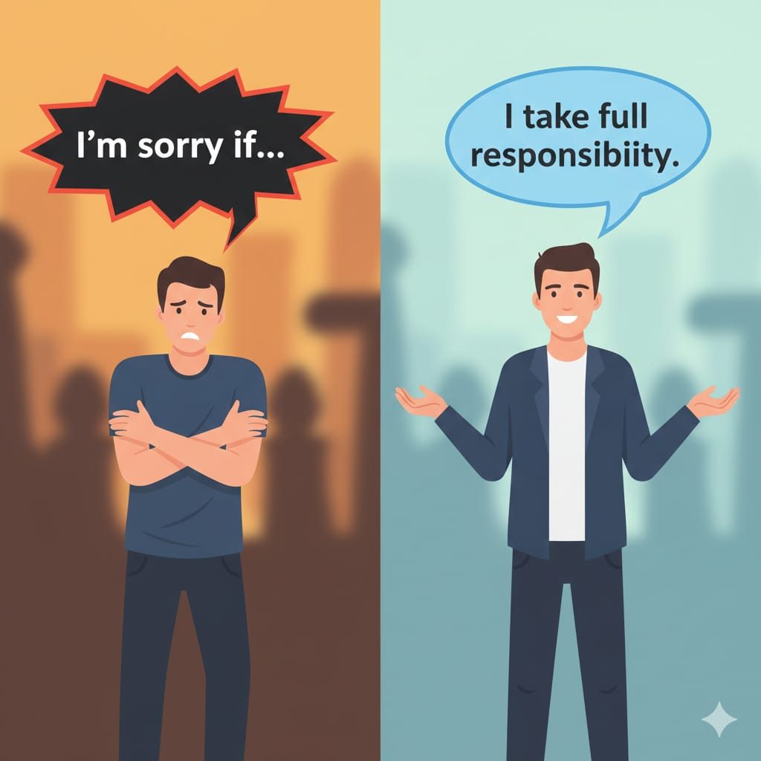

Slide 13
Regrets and Apologies
A powerful apology has structure. Most people say: “I’m sorry.”
But mature communication requires:
Acknowledge mistake
Accept responsibility
Express regret
Explain briefly (no excuses)
Offer solution

Slide 14
Weak vs Strong Apology
Example of Weak Apology: “I’m sorry if you felt bad.” ⚠ Problem: Blames the other person.
Example of Strong Apology:
“I realize I missed the deadline. It was my responsibility. I sincerely apologize for the inconvenience. I have completed the task and will ensure this does not happen again.”
That is professional communication.

Slide 15
1. Grammar of Regret
Regret + Gerund: (Used for past actions)
I regret missing the class.
She regrets not preparing.
2. Regret + Infinitive (Formal)
3. Third Conditional (Deep Regret) Structure: If + had + past participle → would have + past participle
This expresses impossible past change.
If I had studied harder, I would have passed.
If she had apologized earlier, things would have improved.

Slide 16
2. Modals of Regret
Should have | Could have | Might have
Examples:
I should have listened.
I could have acted differently.
I might have misunderstood.

Slide 17
Vocabulary for Regret & Apology
Sincere
Remorse
Accountability
Responsibility
Oversight
6. Inconvenience
7. Forgiveness
8. Regret
9. Negligence
10. Apologize

Slide 18
Model Formal Apology Letter
Subject: Apology for Miscommunication
Dear Sir/Madam,
I sincerely apologize for the misunderstanding during yesterday’s meeting. I take full responsibility for the confusion caused and deeply regret any inconvenience this may have resulted in.
I assure you that I will communicate more clearly in future to prevent such issues.
Thank you for your understanding.
Yours faithfully,[Signature]

Slide 19
Following and Giving Directions
Giving unclear directions = communication failure
1. Imperatives: - Turn left. - Go straight. - Stop at the signal
2. Prepositions of Place: - Between –Opposite -Next to –Behind -In front of
3. Conditionals: - If you see the hospital, turn right.
- If you reach the bridge, you’ve gone too far.

Slide 20
Vocabulary for Directions
Intersection
Crossroad
Landmark
Destination
Navigate
Adjacent
7. Route
8. Vicinity
9. Proceed
10. Pathway

Slide 21


