Slide 1

ANATOMY
THE UPPER LIMB
DPT
1ST SEMESTER
DR DANISH

Slide 2
Pectoral Region and Breast Anatomy
Pectoral Region:
Anterior aspect of the shoulder and chest
Considered part of the anterior thoracic wall
Contains structures that connect upper limb to trunk (e.g., pectoral muscles)
Houses the breasts

Slide 3
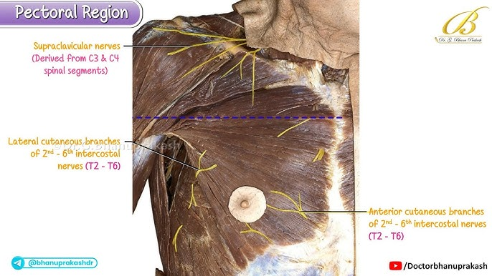

Slide 4
Breasts (Mammary Glands)
Not anatomically part of the upper limb
Located in the pectoral region
Blood supply and lymphatic drainage closely related to the axilla

Slide 5
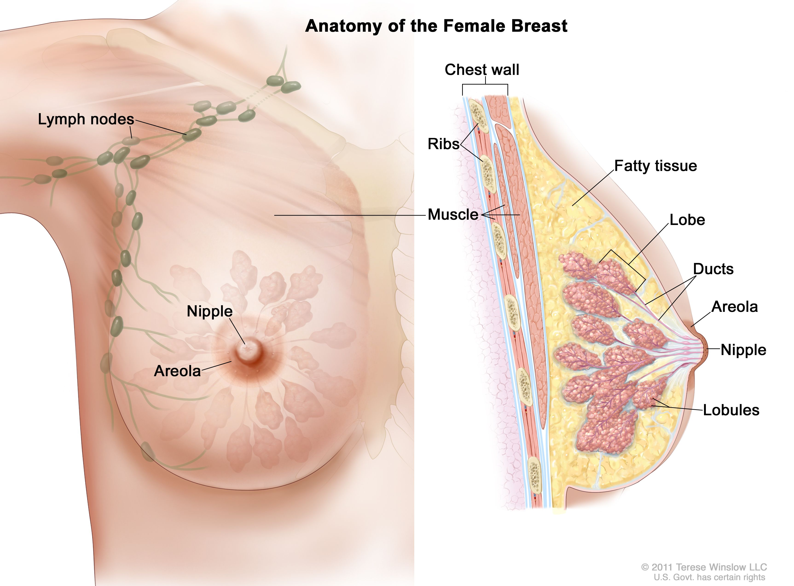

Slide 6
Location and Structure
Specialized accessory glands of the skin
Function: Secretion of milk
Present in both sexes

Slide 8
External Features
Nipple – small projection
Areola – pigmented skin surrounding nipple
Areolar glands produce small tubercles

Slide 10
Internal Structure
15–20 lobes in each breast
Lobes radiate from the nipple
Ducts open separately on the summit of the nipple
Each duct has a dilated ampulla near termination
Lobes separated by fibrous septa
Fibrous septa form suspensory ligaments
Retromammary space:
  Loose connective tissue
  Located between breast and pectoral muscles

Slide 12
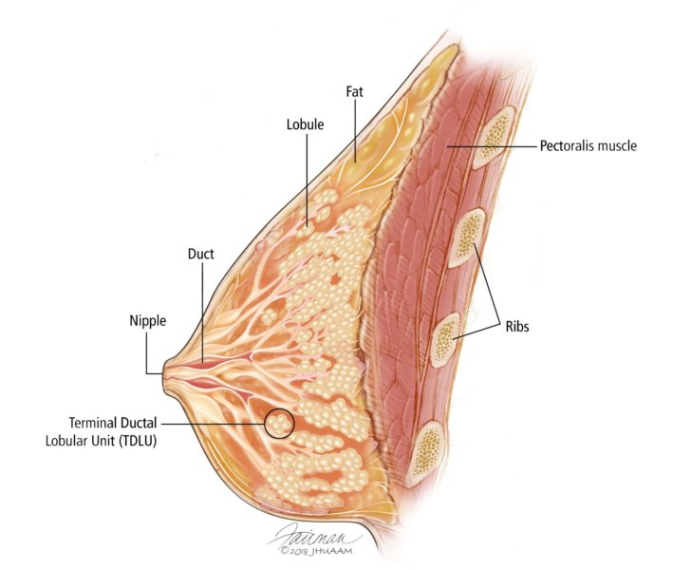

Slide 13
Axillary Tail
Extension of breast tissue
Extends upward and laterally
Pierces deep fascia
Enters the axilla

Slide 14
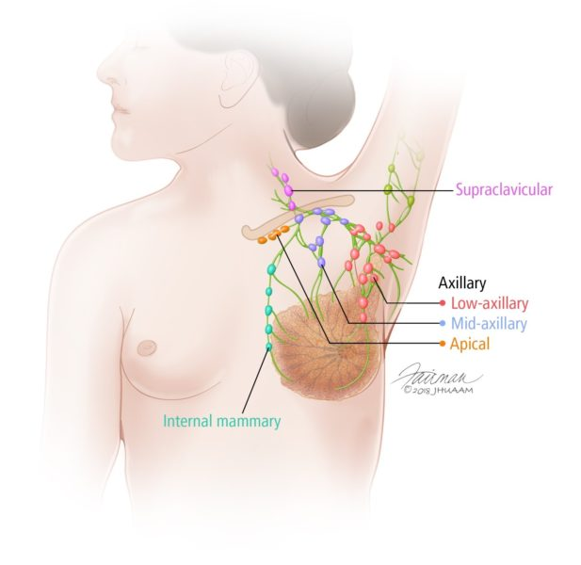

Slide 15
Puberty (Females)
Breasts enlarge gradually
Become hemispherical in shape
Influenced by ovarian hormones
Ducts elongate
Increase in gland size mainly due to fat deposition
Base extends:
  From rib 2 to rib 6
  From lateral margin of sternum to midaxillary line

Slide 16
Pregnancy
Early Pregnancy
Rapid increase in duct length and branching
Development of secretory alveoli
Connective tissue becomes filled
Vascularity increases
Nipple enlarges
Areola darkens due to increased melanin
Areolar glands enlarge and become more active

Slide 18
Continued
Late Pregnancy
Growth process slows in second half
Breasts continue to enlarge

Slide 19
Post-Parturition
Breasts return to inactive state if breastfeeding does not occur or after it stops
Remaining milk absorbed
Secretory alveoli shrink
Most alveoli disappear
Intralobular connective tissue thickens
Breasts and nipples shrink
Areolar pigmentation fades (but not to original color)

Slide 21
Postmenopause
Breast atrophies
Most secretory alveoli disappear
Ducts remain
Adipose tissue may increase or decrease
Breasts become smaller
Caused by absence of ovarian estrogen and progesterone

Slide 22
Blood Supply
Arterial Supply
Perforating branches of:
  Internal thoracic artery
  Intercostal arteries
Axillary artery via:
  Lateral thoracic branch
  Thoracoacromial branch
Venous Drainage
Veins correspond to arteries

Slide 23
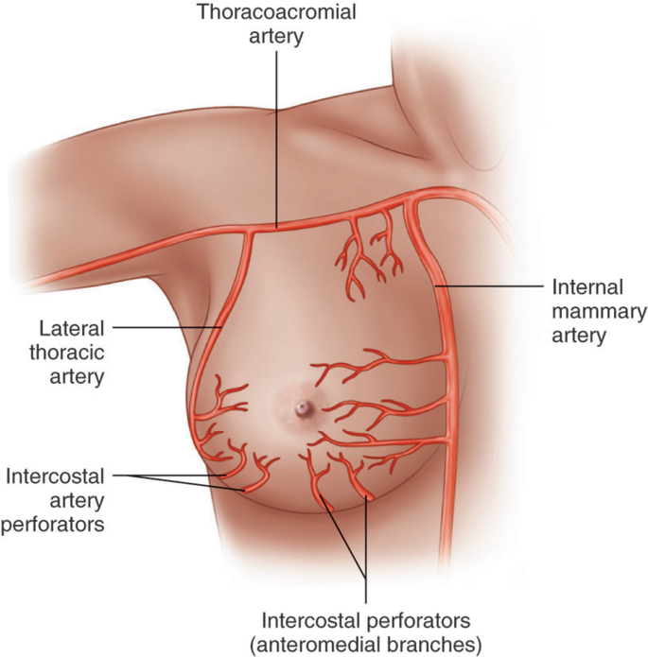

Slide 24
Drainage Pattern
Lateral quadrants → Anterior (pectoral) axillary nodes
Medial quadrants → Internal thoracic nodes
Some drainage → Posterior intercostal nodes

Slide 26


Slide 27


