Slide 1

ANATOMY
THE UPPER LIMB
DPT
1ST SEMESTER
DR DANISH

Slide 2
RADIAL ARTERY
Origin:
Smaller terminal branch of the brachial artery
Begins in the cubital fossa
At the level of the neck of the radius

Slide 3
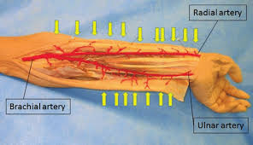

Slide 4
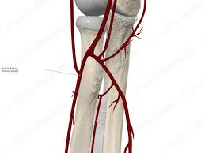

Slide 5
Course in the Forearm
Runs downward along the lateral (thumb) side of the forearm
Lies deep to brachioradialis in upper two-thirds
Becomes superficial in distal forearm
Lateral to flexor carpi radialis tendon at the wrist
Winds dorsally around lateral aspect of wrist
Passes through anatomical snuffbox
Enters palm between heads of first dorsal interosseous muscle

Slide 6
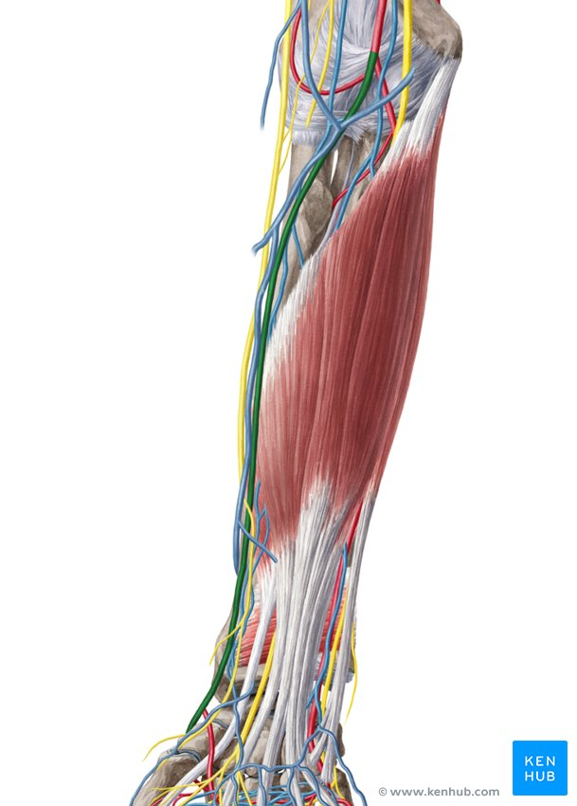

Slide 7
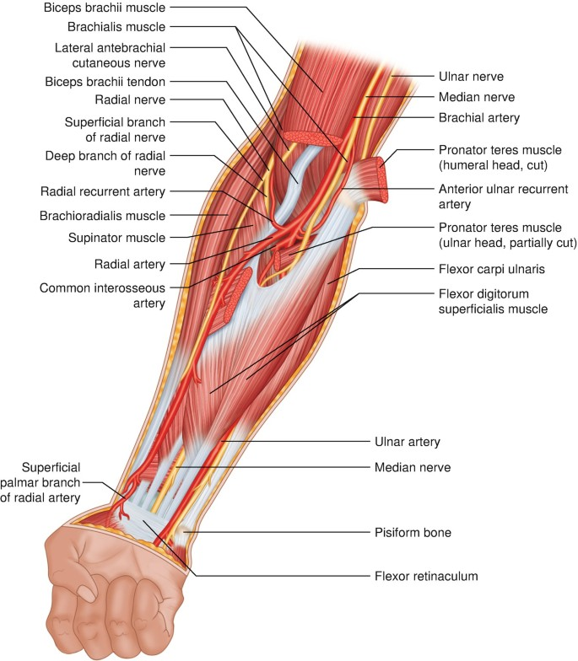

Slide 8
Termination
Forms the deep palmar arch
Anastomoses with deep branch of ulnar artery

Slide 9
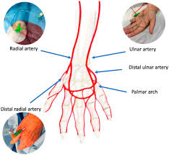

Slide 10
Relations
In the Forearm:
Accompanied by radial nerve (superficial branch) in upper part
Radial artery lies lateral to flexor carpi radialis in lower part
Superficial near wrist (site of pulse)
At the Wrist:
Lies lateral to flexor carpi radialis tendon
Covered only by skin and fascia

Slide 12
Branches in Forearm
Radial recurrent artery
Muscular branches
Palmar carpal branch
Dorsal carpal branch
Superficial palmar branch

Slide 14
Branches in Hand
Princeps pollicis artery
Radialis indicis artery
Contributes to deep palmar arch

Slide 15
ULNAR ARTERY
Origin
Larger terminal branch of brachial artery
Begins in cubital fossa opposite neck of radius

Slide 16
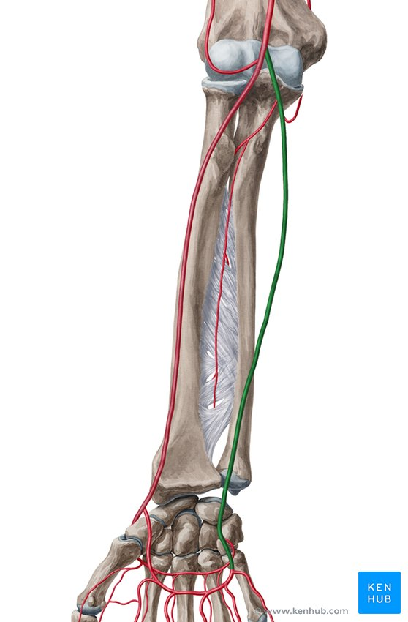

Slide 17
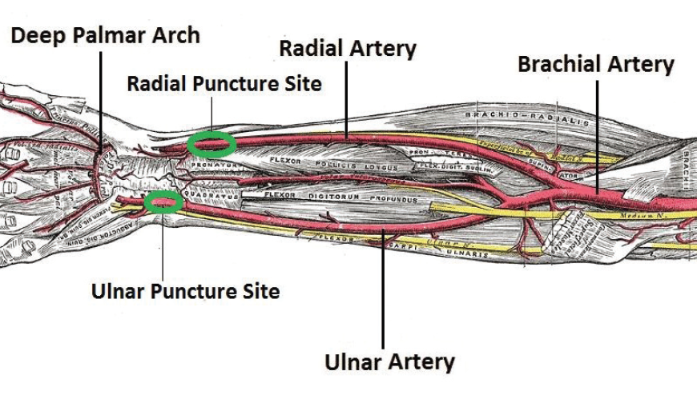

Slide 18
Course in Forearm
Passes deep to pronator teres
Runs obliquely toward medial side
Descends along medial forearm
Accompanied by ulnar nerve in lower half
Passes superficial to flexor retinaculum
Enters palm lateral to pisiform bone

Slide 21
Termination
Forms the superficial palmar arch
Anastomoses with superficial branch of radial artery

Slide 23
Relations
Upper Forearm:
Deep to pronator teres
Deep to flexor digitorum superficialis
Lower Forearm:
Lies between flexor carpi ulnaris and flexor digitorum superficialis
Ulnar nerve lies medial to artery

Slide 25
Branches in Forearm
Anterior ulnar recurrent artery
Posterior ulnar recurrent artery
Common interosseous artery
  Anterior interosseous artery
  Posterior interosseous artery
Muscular branches
Palmar carpal branch
Dorsal carpal branch

Slide 26
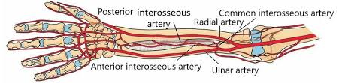

Slide 27
Branches in Hand
Forms superficial palmar arch
Gives common palmar digital arteries
Proper palmar digital arteries

Slide 29
COMPARISON (Exam Focus)
Feature | Radial Artery | Ulnar Artery
Size | Smaller | Larger
Main Palmar Contribution | Deep palmar arch | Superficial palmar arch
Pulse | Lateral wrist | Medial wrist
Nerve Relation | Radial nerve (upper part) | Ulnar nerve (lower half)

Slide 30


Slide 31


