Slide 1

ANATOMY
THE UPPER LIMB
DPT
1ST SEMESTER
DR DANISH

Slide 2
BRACHIAL ARTERY
Direct continuation of the axillary artery
Begins at the lower border of teres major muscle
Ends in the cubital fossa, opposite the neck of the radius
Divides into:
  Radial artery (lateral branch)
  Ulnar artery (medial and larger branch)
Main arterial supply to the arm

Slide 3
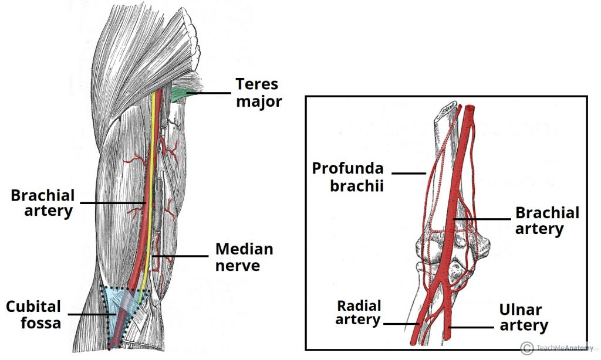

Slide 4
Course
Descends in the anterior compartment of the arm
Lies medial to the humerus in upper arm
Gradually moves anteriorly toward elbow
At the elbow:
  Lies in the cubital fossa
  Covered by the bicipital aponeurosis
  Divides into terminal branches

Slide 6
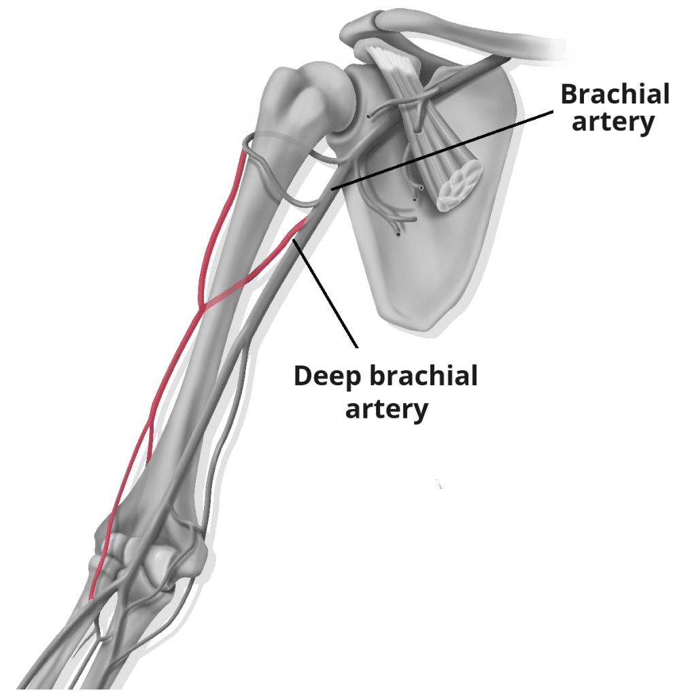

Slide 7
Surface Anatomy
Represented by a line from:
  Medial side of tendon of coracobrachialis
  To midpoint between medial and lateral epicondyles
Pulse can be palpated:
  Medial to biceps tendon in cubital fossa
  Along medial bicipital groove

Slide 9
Relations
Anterior Relations
Skin and fascia
Biceps brachii
Median nerve (initially lateral, crosses to medial side)

Slide 11
Continued
Posterior Relations
Humerus
Coracobrachialis
Brachialis muscle

Slide 13
Continued
Medial Relations
Median nerve (lower half)
Ulnar nerve
Basilic vein
Lateral Relations
Coracobrachialis
Biceps brachii

Slide 15
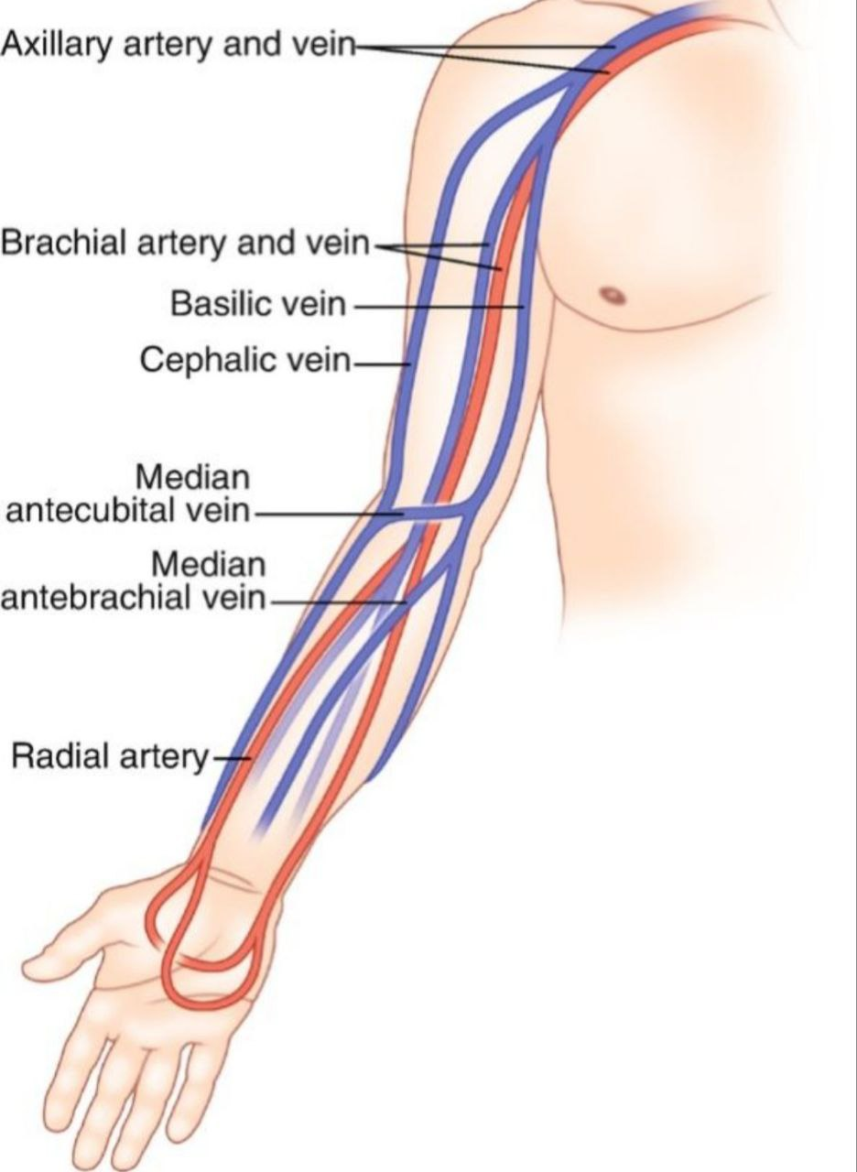

Slide 16
In Cubital Fossa (Important Exam Area)
Structures from lateral → medial:
TAN
T – Biceps Tendon
A – Brachial Artery
N – Median Nerve
Brachial artery lies:
  Medial to biceps tendon
  Lateral to median nerve
  Deep to bicipital aponeurosis

Slide 18
Branches
Muscular Branches:
Supply:
  Biceps brachii
  Coracobrachialis
  Brachialis

Slide 20
Continued
Profunda Brachii Artery (Deep artery of arm)
Largest branch
Accompanies radial nerve
Supplies posterior compartment
Participates in elbow anastomosis

Slide 22
Continued
C. Nutrient Artery
Enters humerus
Supplies bone marrow

Slide 23
Continued
Superior Ulnar Collateral Artery
Runs with ulnar nerve
Behind medial epicondyle
Participates in elbow anastomosis
Inferior Ulnar Collateral Artery
Arises near elbow
Anterior to medial epicondyle
Contributes to elbow anastomosis

Slide 24
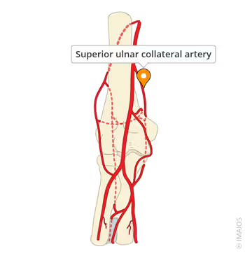

Slide 25
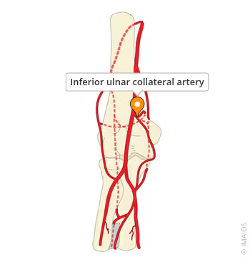

Slide 26
Anastomosis Around Elbow
Important for collateral circulation
Involves:
  Profunda brachii
  Radial collateral artery
  Superior and inferior ulnar collateral arteries
  Recurrent branches of radial and ulnar arteries

Slide 28
Clinical Importance
1. Blood Pressure Measurement
Compression against humerus
Stethoscope placed over artery in cubital fossa
2. Supracondylar Fracture of Humerus
Common in children
May injure brachial artery

Slide 29
Continued
3. Compression Site
Can compress artery against humerus to control bleeding

Slide 30


Slide 31


