Slide 1

BASIC MEDICAL SCIENCE
FSC MEDICAL TECHNOLOGIES I
DR DANISH

Slide 2
LIVER
The liver is the largest internal organ in the human body.
It plays a central role in:
  Metabolism
  Detoxification
  Nutrient storage

Slide 3
Anatomy of the Liver
1. Location
Located in the right upper quadrant of the abdomen.
Lies beneath the diaphragm.
Extends slightly to the left upper quadrant.
Partially overlaps:
  Stomach
  Spleen
  Intestines

Slide 4
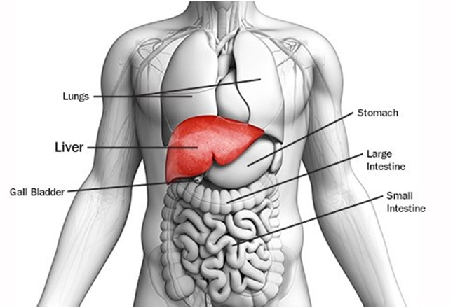

Slide 5
2. Shape and Size
Wedge-shaped organ.
Reddish-brown in color.
Weighs approximately 1.4–1.6 kg (3–3.5 pounds) in adults.
Divided into:
  Right lobe (larger)
  Left lobe (smaller)
Further divided into smaller functional segments based on blood supply.

Slide 7
3. Anatomical Lobes
Right lobe:
  Largest portion
  Makes up most of liver mass
Left lobe:
  Smaller portion
Caudate lobe (posterior)
Quadrate lobe (inferior surface)
The falciform ligament separates right and left lobes.

Slide 8
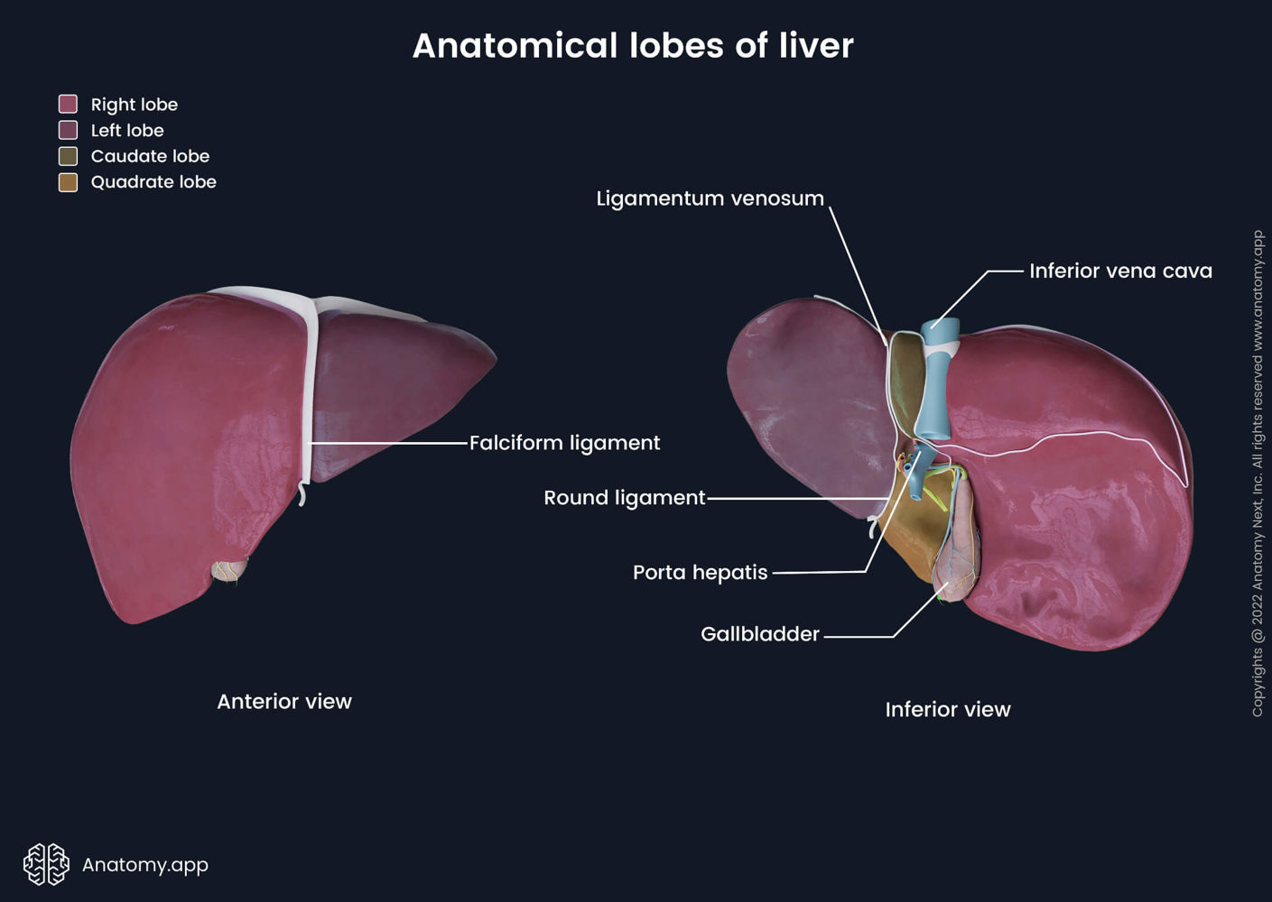

Slide 9
4. Internal Structure
Made up of functional units called lobules.
Lobules contain:
  Hepatocytes (main liver cells)
  Central vein
  Sinusoids (specialized capillaries)
Hepatocytes are responsible for:
  Metabolism
  Detoxification
  Bile production

Slide 10
5. Blood Supply
Dual blood supply:
  Hepatic artery
    Supplies oxygen-rich blood
  Portal vein
    Brings nutrient-rich blood from digestive organs
Blood exits through the hepatic vein → drains into inferior vena cava.

Slide 11
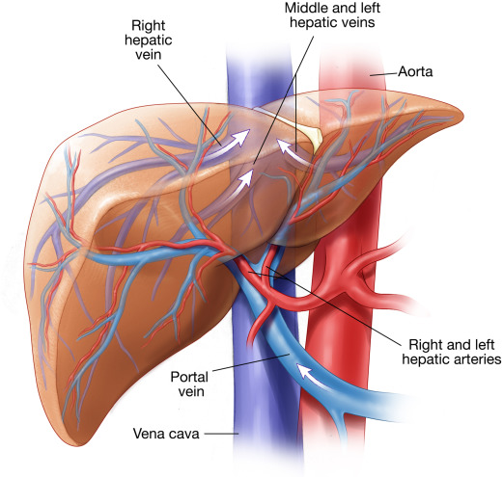

Slide 12
6. Biliary System
Hepatocytes produce bile.
Bile flows through:
  Bile canaliculi
  Small bile ducts
  Hepatic duct
  Common bile duct
Stored and concentrated in the gallbladder.
Released into the duodenum for digestion.

Slide 13
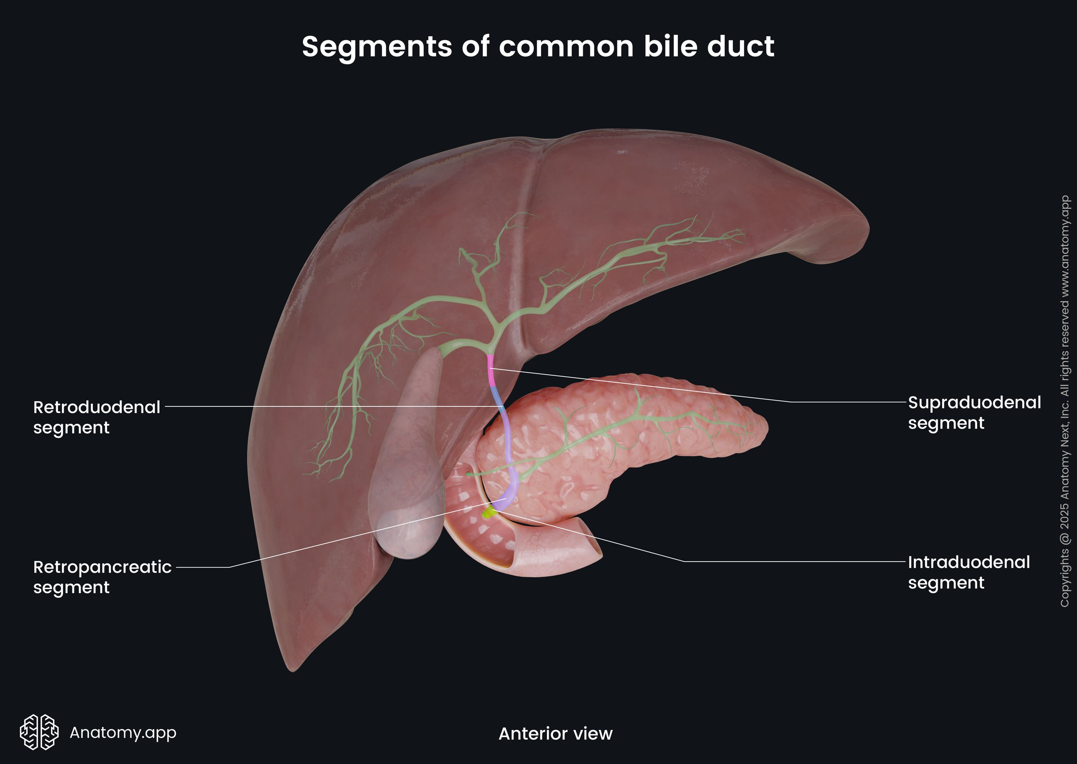

Slide 14
7. Ligaments
Support and attach liver to abdominal cavity:
  Falciform ligament
  Coronary ligament
  Triangular ligaments
  Ligamentum teres

Slide 15
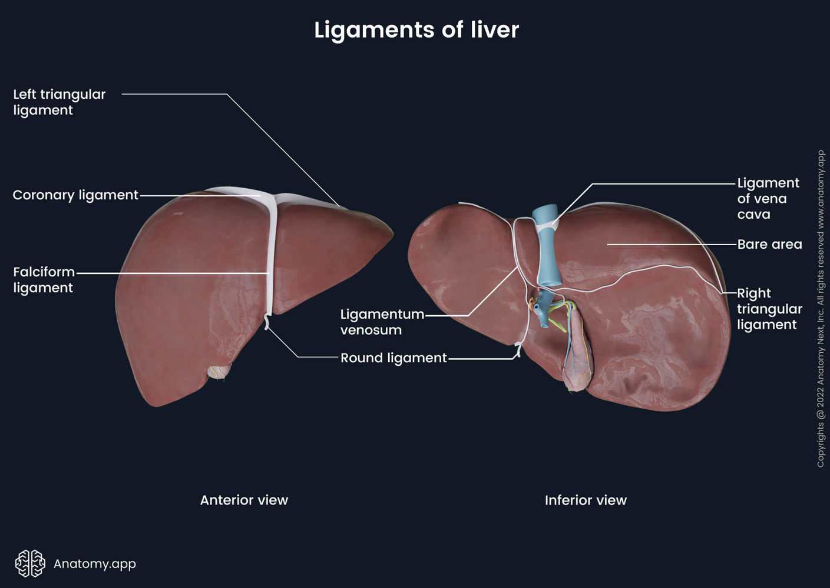

Slide 16
Functions of the Liver
1. Metabolism
Carbohydrate metabolism:
  Regulates blood glucose
  Converts glucose ↔ glycogen
Protein metabolism:
  Synthesizes plasma proteins
  Converts ammonia to urea
Fat metabolism:
  Processes fatty acids

Slide 17
2. Detoxification
Breaks down:
  Drugs
  Alcohol
  Toxins
Eliminates metabolic waste products.

Slide 18
3. Bile Production
Produces bile for fat digestion.
Bile helps in:
  Emulsification of fats
  Absorption of fat-soluble vitamins

Slide 19
4. Storage
Stores:
  Glycogen
  Vitamins (A, D, E, K)
  Minerals (iron, copper)
Acts as a blood reservoir.

Slide 20
5. Immune Function
Contains Kupffer cells.
Removes:
  Pathogens
  Foreign particles
  Damaged cells

Slide 21
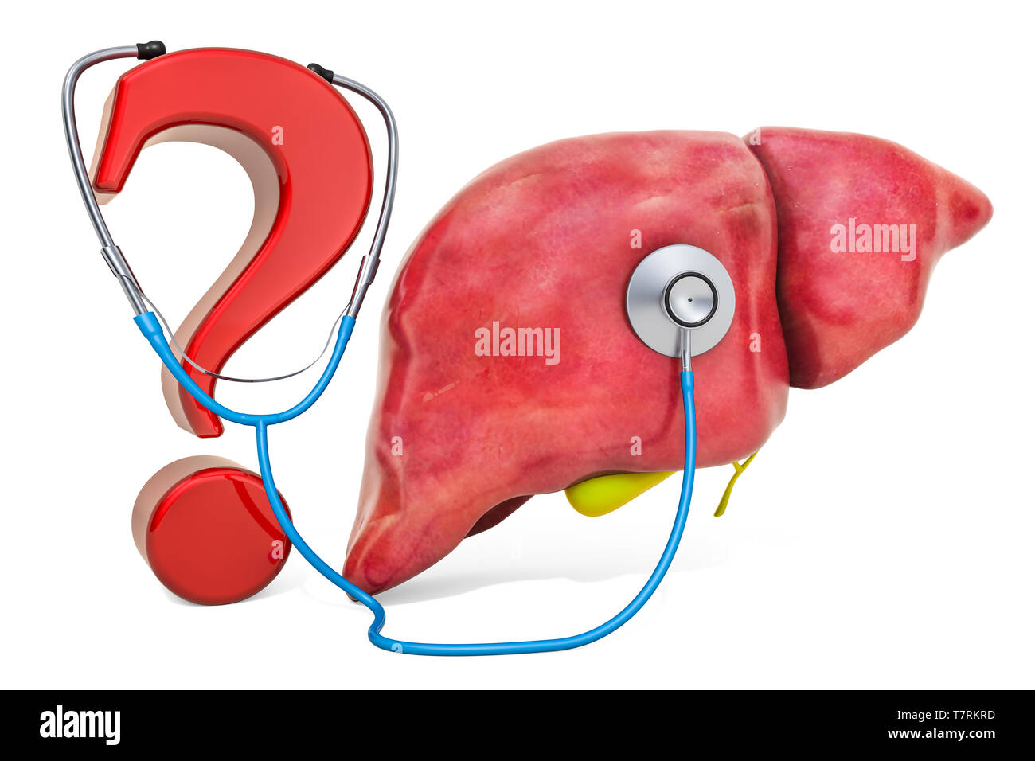

Slide 22
