Slide 1

ALLIED HEALTH SCIENCES
BS RIT,OTT,MLT
1ST SEMESTER
DR DANISH

Slide 2
Hearing Sciences
What is Hearing Sciences?
Hearing Sciences is the scientific study of how we hear and maintain balance
It explains how sound is:
  Produced
  Transmitted through the ear
  Converted into nerve signals
  Interpreted by the brain

Slide 3
Components Studied
Anatomy of Ear – outer, middle, inner ear
Physiology of Hearing – how sound vibrations become electrical signals
Psychoacoustics – how we perceive loudness, pitch, and quality of sound
Balance System – vestibular system in the inner ear

Slide 4
Example
When a doorbell rings:
  Sound waves enter the outer ear
  Ossicles amplify vibrations
  Cochlea converts sound into nerve impulses
  Brain recognizes it as a “bell”

Slide 5
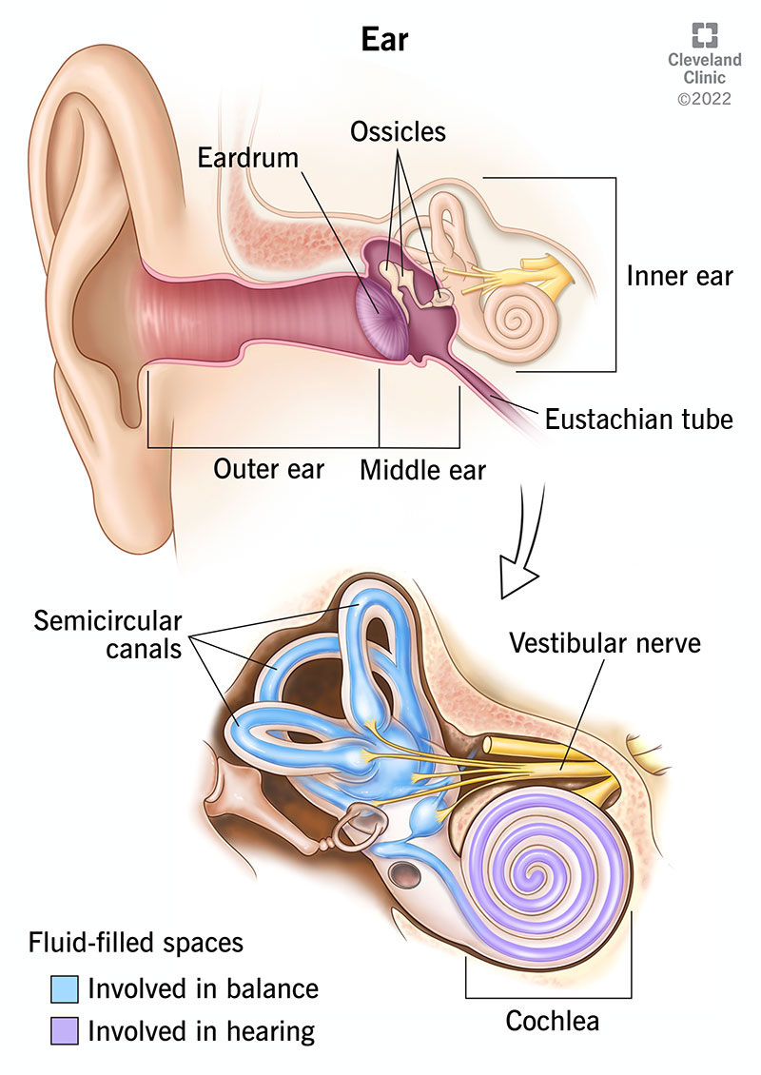

Slide 6
Types of Hearing Disorders
Conductive Hearing Loss
Problem in outer or middle ear
Sound is not properly conducted
Causes:
Ear wax
Ear infections
Fluid in middle ear
Example:
Child with ear infection hears muffled sounds

Slide 7
Sensorineural Hearing Loss
Damage to inner ear or auditory nerve
Usually permanent
Causes:
Aging
Noise exposure
Ototoxic drugs
Example:
Factory worker exposed to loud noise for many years

Slide 8
Mixed Hearing Loss
Combination of conductive and sensorineural loss
Example:
Elderly person with ear infection and age-related hearing loss

Slide 9
Audiology
What is Audiology?
A clinical branch of Hearing Sciences
Deals with prevention, diagnosis, and management of hearing and balance disorders

Slide 10
Role of an Audiologist
Identify hearing loss early
Measure type and degree of hearing loss
Provide rehabilitation services

Slide 11
Settings Where Audiologists Work
Hospitals
Hearing clinics
Schools
Rehabilitation centers

Slide 12
Audiological Tests Explained
Pure Tone Audiometry (PTA)
Measures hearing sensitivity
Patient responds to tones at different frequencies
Example:
Audiogram showing mild to severe hearing loss

Slide 13
Continued
Speech Audiometry
Measures ability to understand speech
Example:
Patient hears sounds but cannot understand words clearly

Slide 14
Continued
Tympanometry
Checks middle ear function
Example:
Detects fluid behind the eardrum

Slide 15
Speech-Language Pathology (SLP)
Study and treatment of:
  Speech
  Language
  Voice
  Swallowing disorders
Speech-Language Pathologists (SLPs) help people communicate effectively

Slide 16
Speech Disorders
Articulation Disorders
Difficulty producing sounds correctly
Example:
Saying “wabbit” instead of “rabbit”

Slide 17
Fluency Disorders
Disruption in flow of speech
Example:
Stuttering with repetitions and blocks

Slide 18
Voice Disorders
Problems with pitch, loudness, or quality
Example:
Hoarse voice in teachers due to vocal strain

Slide 19
Language Disorders
Expressive Language Disorder
Difficulty expressing thoughts
Example:
Child knows answers but cannot explain verbally

Slide 20
Continued
Receptive Language Disorder
Difficulty understanding spoken language
Example:
Child unable to follow simple instructions

Slide 21
Speech-Language Therapy
Assessment
Evaluation of speech and language skills
Standardized tests and observation
Therapy
Individual or group sessions
Exercises and structured activities
Example:
Therapy sessions for a child with delayed speech

Slide 22
Role in Rehabilitation and Society
Helps children develop communication skills
Supports adults after stroke or brain injury
Improves academic performance
Enhances social interaction and confidence
Example:
Stroke patient regaining speech with therapy

Slide 23
Importance for Allied Health Sciences Students
Builds understanding of communication disorders
Encourages interdisciplinary teamwork
Improves patient-centered care

Slide 24


Slide 25


