Slide 1
Audition
Presented by: Aqeela Nawaz
Assigned by: Mam Shehwar Saeed

Slide 2
Audition (Sense of Hearing)
Audition refers to the process of hearing and interpreting sound.
It enables us to communicate, understand speech, enjoy music, and be alert to environmental sounds.
Audition is an important sensory process that contributes to perception.

Slide 3
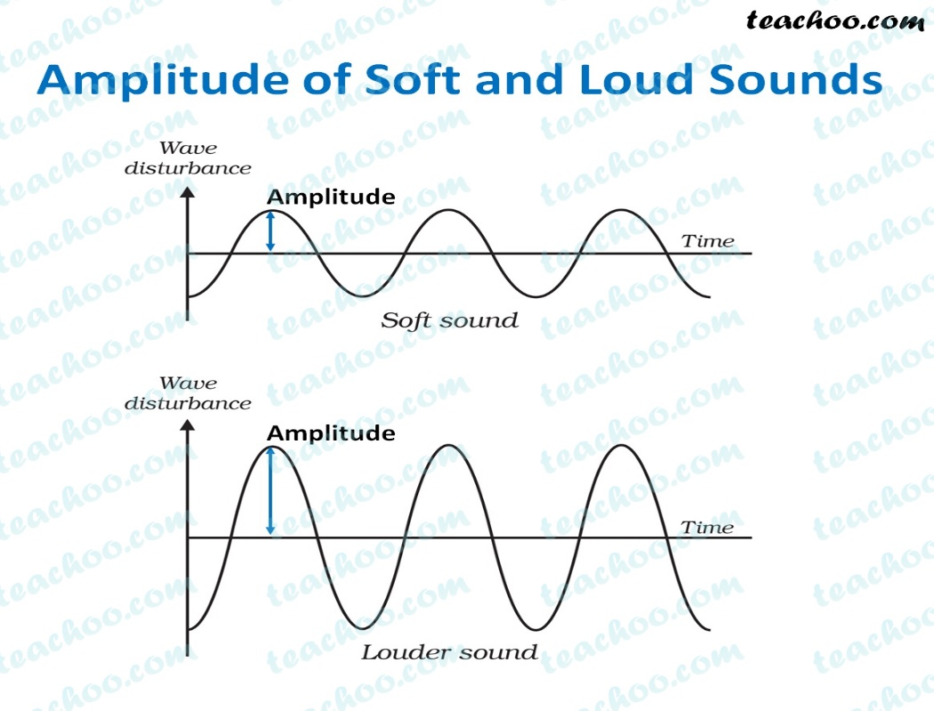
Nature of Sound
Sound has three main characteristics:
1. Pitch
Related to the frequency of sound waves.
Determines whether a sound is high or low.
2. Loudness
Related to the amplitude of sound waves.
Determines whether a sound is soft or loud.
.

Slide 4
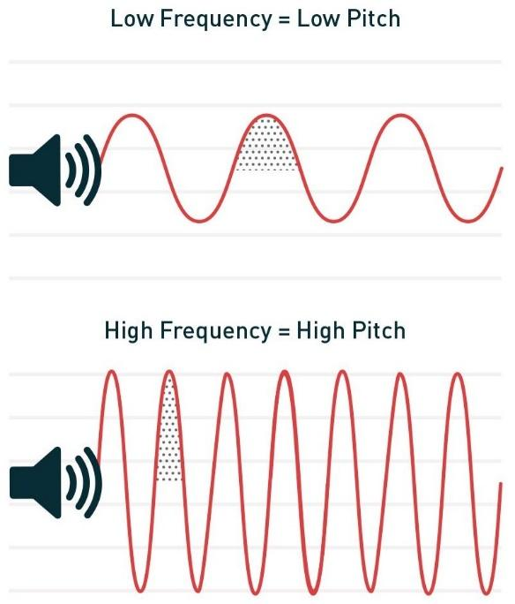
3. Timbre (Quality)
Refers to the richness or quality of sound.
Helps distinguish between different sounds having the same pitch and loudness.

Slide 5
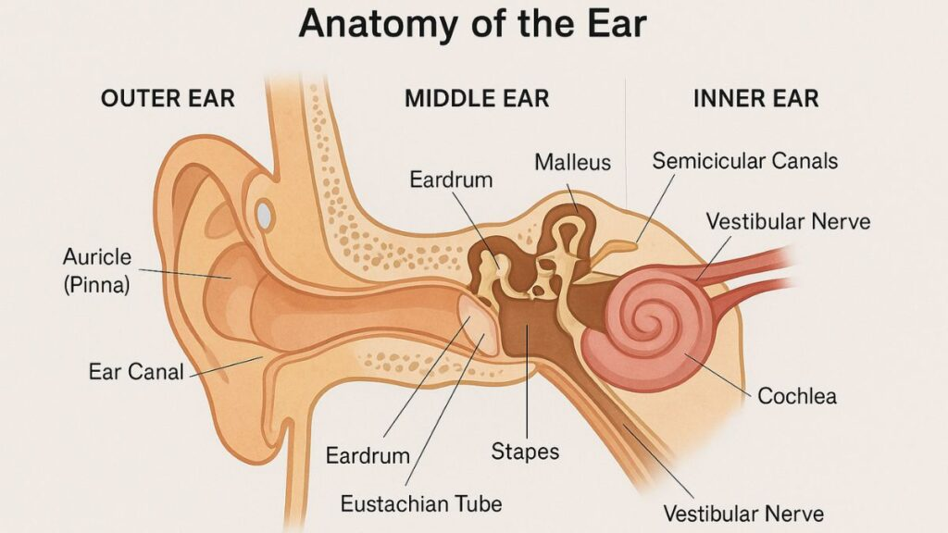

Slide 6
Structure of the Ear
The ear is divided into three main parts:
1. Outer Ear
Collects sound waves.
Includes pinna and auditory canal.
2. Middle Ear
Amplifies sound vibrations.
Contains three bones: hammer (malleus), anvil (incus), and stirrup (stapes).

Slide 7
3. Inner Ear
Converts vibrations into nerve impulses.
Includes the cochlea, which plays a key role in hearing.

Slide 8
Process of Hearing
Sound waves enter the outer ear.
Vibrations pass through the middle ear bones.
Vibrations reach the inner ear (cochlea).
Hair cells convert vibrations into neural impulses.
Impulses travel to the brain via the auditory nerve

Slide 9
Theories of Hearing
Place Theory
Different sound frequencies stimulate different places in the cochlea.
Frequency Theory
Frequency of sound waves determines pitch.

Slide 10


Slide 11


