Slide 1

PRESENTATION OF PSYCHOLOGY.
  Assigned By: Ms. Shehwar Saeed

Slide 2


Slide 3
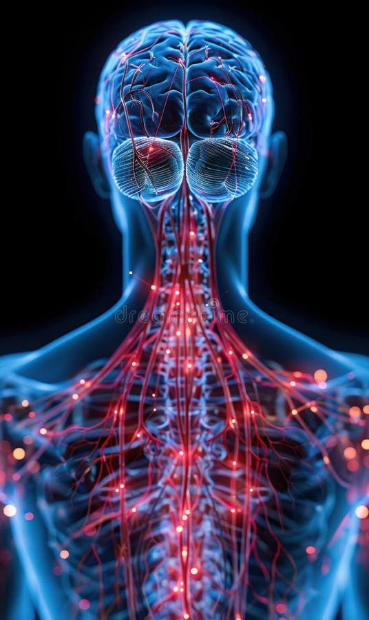
Sensation:
Sensation: A sense is a system that translates information from outside the nervous system into neural activity.
This neural activity tells the brain something about the object or stimulus. These messages from the senses are called sensation.

Slide 4
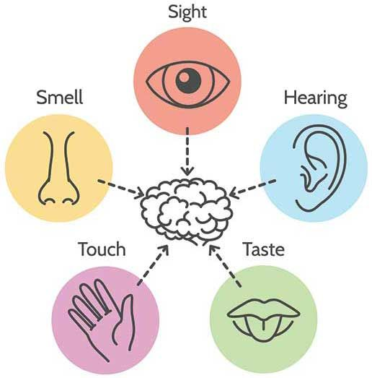
Process of Sensation:
Process: Sensation is the process of receiving stimulus energies from the external environment.
Stimulus consists of physical energy i.e. light, sound & heat.
A stimulus is detected by specialized receptor cells in the sense organs which are eyes, ears, skin, nose & tongue.

Slide 5
Transduction:
Definition:
The process of transforming physical energy into electrochemical energy is called transduction.
Transduction produces an action potential that relays information about the stimulus through the nervous system to the brain
When it reaches the brain, the information travels to the appropriate area of the cerebral cortex.

Slide 6
General Characteristics:
Following are the general characteristics of sensation;
Quality: Every sensation has some quality. This is the attribute due to which we name the sensation.
For example: a drink can be hot or cold; food may be sweet or salty; sound can be clear or loud etc.
Quality is the basic thing about sensation.

Slide 7
Intensity:
Intensity is so important, because without intensity sensation would not be noticed. Actually it is the strength of sensation.
We cannot compare the intensity of one kind of sensation with that of another. intensity. Difference can be noticed in different stimuli
e.g. torch light & head lights of a truck few grains of sugar in a cup of milk & thundering sounds; all are different in intensity.

Slide 8
Duration:
It is the time aspect of sensation.
It is the time for which a sensation endures.
A sensation which does not last for an instant can’t be perceived.

Slide 9
Specific Stimulus:
Every sense has its own sense organ & specific stimulus can produce the sensation in it.
For visual sensation, eye is stimulated; for audition the sense organ is ear; nose to smell & tongue for taste; each has its own specific stimulus.
Sound wave stimulates ear, light wave stimulates eye, same in the case with olfactory gustation. Sound wave is as useless for eyes as light is for ears.

Slide 10
Sensory Threshold:
Each sense organ ahs different capacity to perceive its stimulus.
Sense organs receive their specific stimulus according to their physical limit. Every sense organ has sensory threshold.
It is the minimum level of stimulation that can be perceived . It has three types; Absolute, terminal & differential threshold.

Slide 11
Absolute Threshold:
The minimum level of energy which can be stimulate the sense organ is called the absolute threshold.
The lower limit of stimulus value which can be detected is absolute threshold & lesser then this, the stimulus become undetectable.
For example: one grain of sugar in glass of water is undetectable, because it is lesser then the absolute value.

Slide 12
Terminal Threshold:
The maximum level of energy that can be detected by sensory organs is the terminal threshold. Beyond that level, sensory organ can’t detect or receive that stimulus.
It is actually the upper limit of stimulus value, when stimulus exceeds the upper limit it becomes undetectable. At this Level stimulus becomes painful for our sensation.
If we face head lights of a car during night & it prolongs, then our vision blocks & eyes stop functioning for a short while.

Slide 13
Differential Threshold:
It is that stimulus value which can be differentiated by our sensation e.g. to difference between light of one candle & two candles etc.

Slide 14
Sensory Acuity:
Here are the approximate thresholds of senses.
For vision, individual can see a candle flame at 30 miles on a dark, clear night. For audition, the tick of watch can be listened under quite conditions at 20 feet.
One teaspoon of sugar can be detected in 2 gallons of water. One drop pf perfume can be smelled in 3 room apartment. The wing of a bee can be perceived, falling on our check from a distance of 1 centimeter.

Slide 15


Slide 16


