Slide 1
GOWNING & GLOVING TECHNIQUE
ADNAN RAMZAN
Doctors Institute of Medical & Emerging Science

Slide 2

INTRODUCTION
Performed after Surgical Scrub.
Involve the donning of Sterile Surgical
Gown and Gloves.
Donn in such a way as to maintain sterility of
the outside of both gown & gloves.

Slide 3
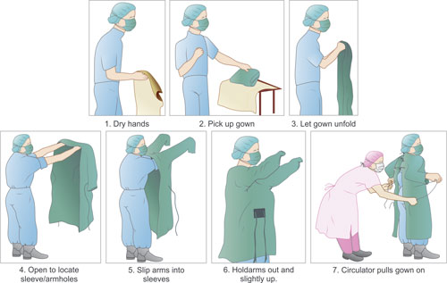
GOWNING

Slide 4
Gowning Procedure
Use one hand to pic up the entire folded gown from the table grasping the gown through all layers being careful to touch only the inside top layer .
Step back from the table into a clear area , providing a wide margin of safety while gowning.

Slide 5
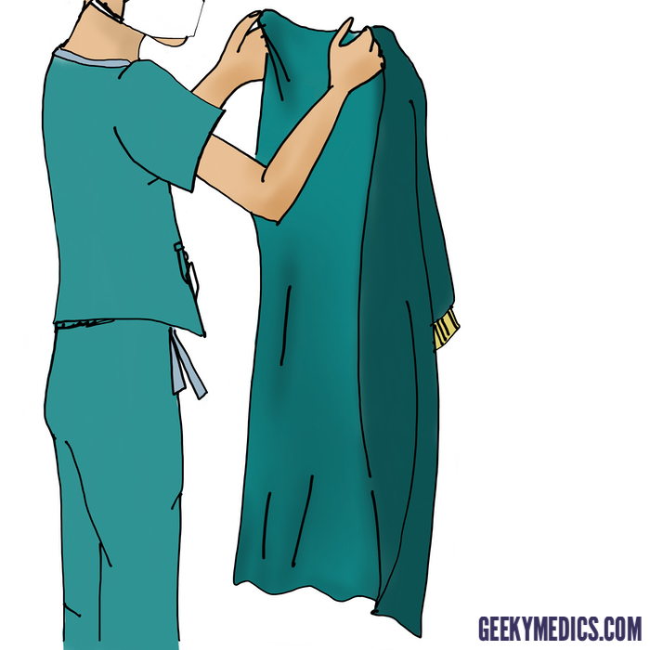
Hold the gown in the rear neck and allow it to
unfold , being careful not to touch either the body
or other unsterile items or objects.
4. Grasp the inside of the gown , just below the
neckband , unfold the gown, and keep the inside
of the gown towards the body.

Slide 6
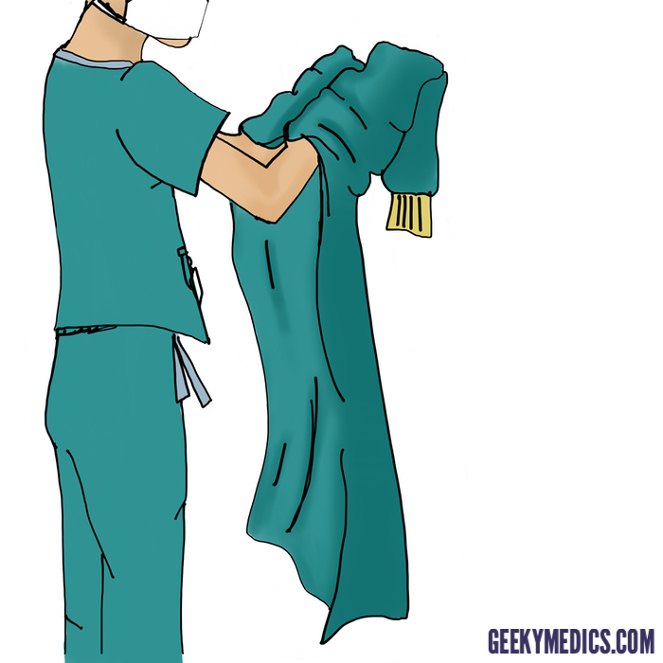
Keep the hands at the shoulder level and put
hands inside the shoulders of the gown and
work the arm pathway into the sleeves without
touching the outside of the Gown .

Slide 7
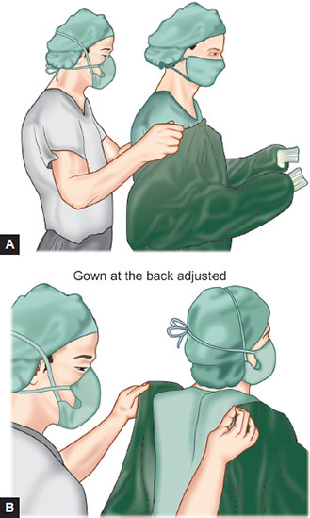
Back of the gown is securely closed at the
neck and waist with ties by circulating nurse.
7. Touch the outside of the gown only at line of
tie at the neck.

Slide 8
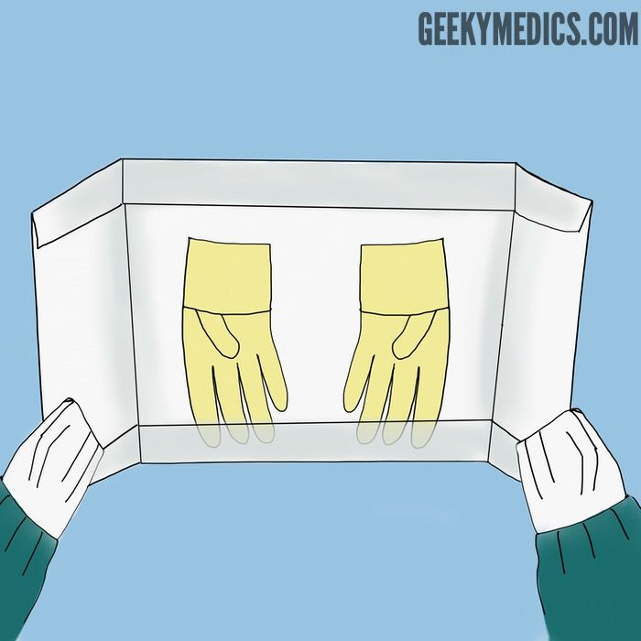
Glowing Procedure
Open the sterile gloves wrapper while the hands
are still covered by the sleeves.
2. Pick the write hand glove with the left hand by
holding it at the edge of averted cuff and step
back from the field .

Slide 9
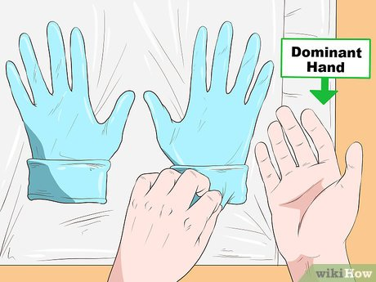
Insert the right hand into the glove and explore
the finger holes before inserting the whole hand
completely , leave the averted cuff as is.
4. Slip the glove right hand under the fold of the
averted cuff.

Slide 10
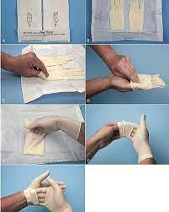
5. Make a pleat of averted glove over the cuff
of gown
Repeat all steps for left hand
Now open the averted cuff of glove of right
hand by holding it at the fingers of left
hand from the outer surface of glove.
Repeat it for the left hand .

Slide 11


