Slide 1

ANATOMY
THE UPPER LIMB
DPT
1ST SEMESTER
DR DANISH

Slide 2
Skin Innervation of the Upper Limb
Several cutaneous nerves from multiple sources carry neurons from the skin of the upper limb
Posterior (dorsal) rami of spinal nerves
  Supply the skin of the scapular region
  C1 and C8 posterior rami do NOT supply the skin
Supraclavicular nerves (C3, C4)
  Arise from the cervical plexus
  Supply skin:
    Over the point of the shoulder
    Down to halfway over the deltoid muscle

Slide 3
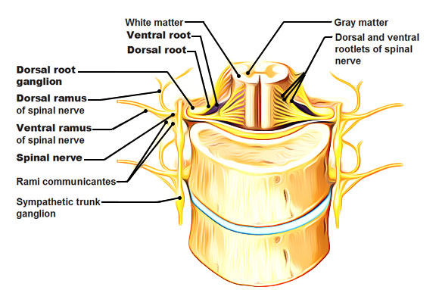

Slide 4
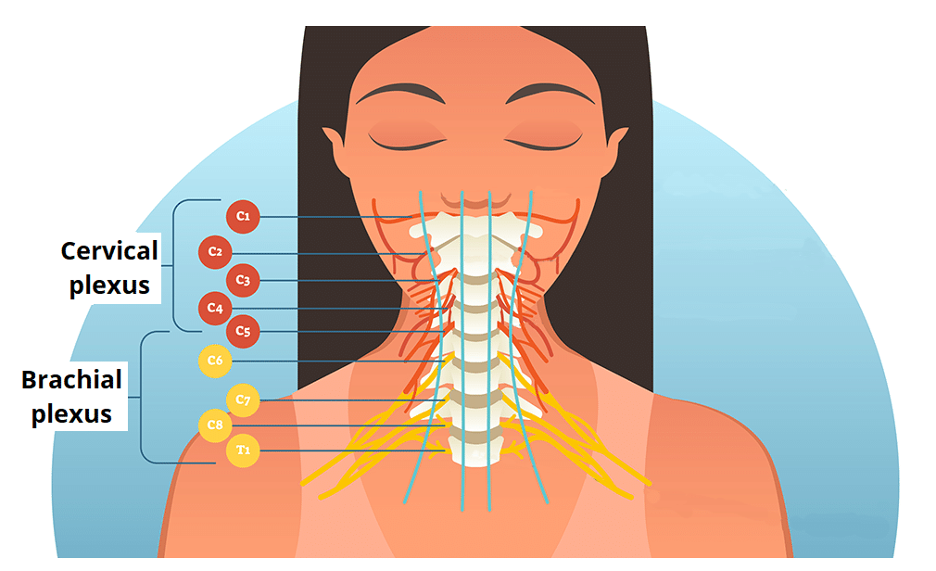

Slide 5
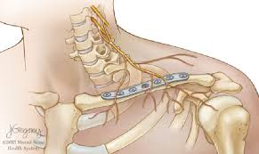

Slide 6
Continued
Medial cutaneous nerve of the arm (T1)
  Supplies skin of the armpit and medial side of the arm
Intercostobrachial nerve
  Branch of the T2 intercostal nerve
  Supplies skin of:
    Armpit
    Medial side of the arm
Cutaneous branches of the cords and terminal branches of the brachial plexus
  Supply the remainder of the skin of the upper limb

Slide 7
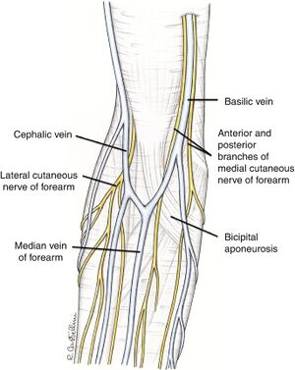

Slide 8
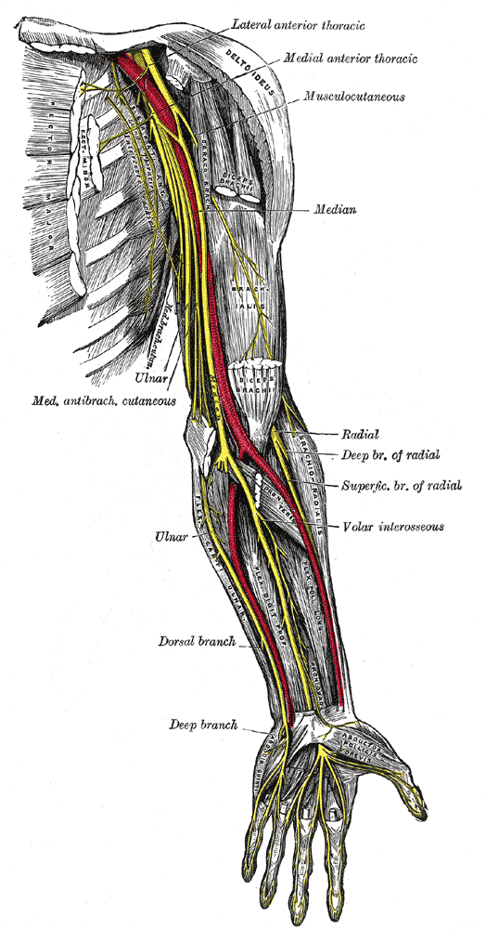

Slide 9
Branches from Brachial Plexus Roots
Dorsal scapular nerve
  Arises from the C5 root
  Supplies:
    Levator scapulae muscle
    Rhomboid muscles

Slide 10
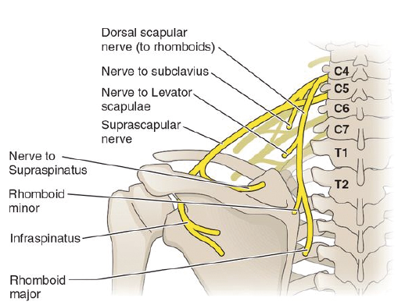

Slide 11
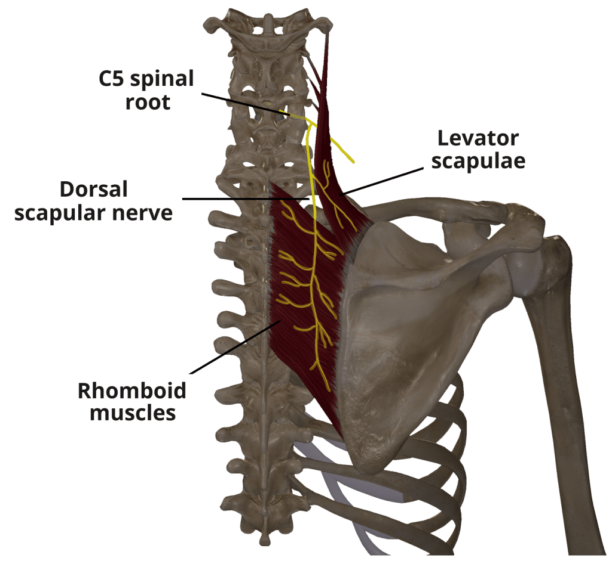

Slide 12
Branches from Brachial Plexus Trunks and Divisions
Upper and lower trunks:
  Do not give branches
Nerve to subclavius:
  Arises from the upper trunk
  Supplies the subclavius muscle
  May give a contribution (C5) to the phrenic nerve
  When present, this branch is called the accessory phrenic nerve

Slide 13
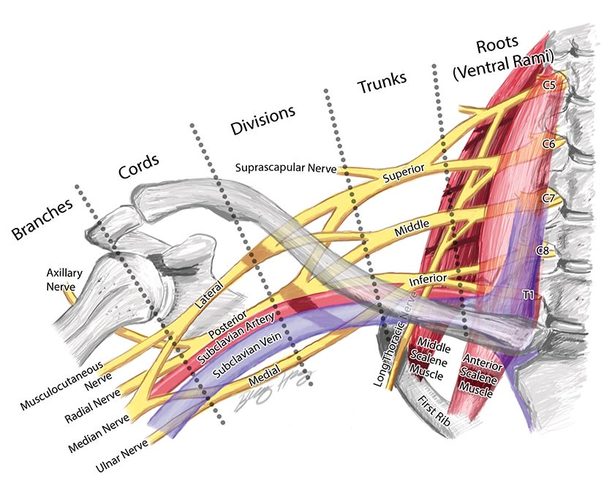

Slide 14
Branches from Brachial Plexus Lateral Cord
Lateral pectoral nerve
  Arises from the lateral cord
  Supplies the pectoralis major muscle
Musculocutaneous nerve
  Supplies:
    Coracobrachialis muscle
    Biceps brachii muscle
    Brachialis muscle
  Leaves the axilla by piercing the coracobrachialis muscle

Slide 15
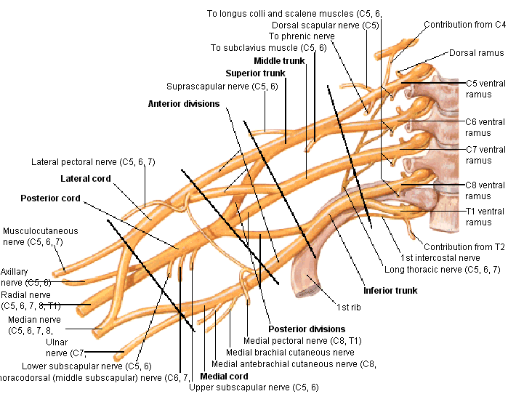

Slide 16
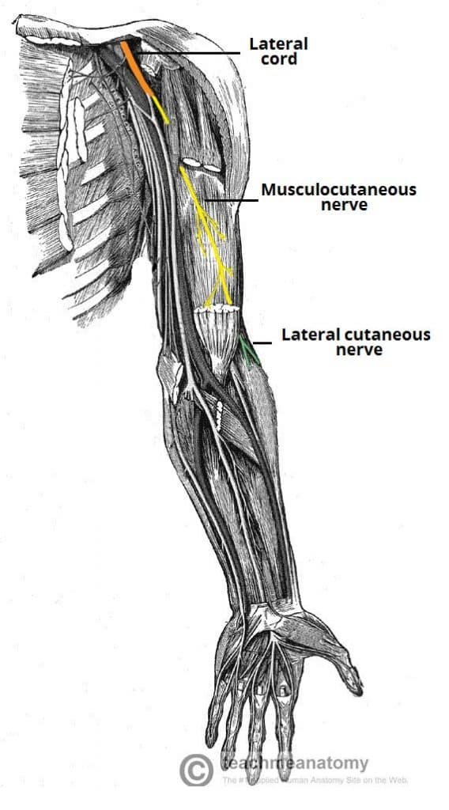

Slide 17
Branches from Brachial Plexus Medial Cord
Medial pectoral nerve
  Arises from the medial cord
  Pierces pectoralis minor
  Supplies pectoralis major

Slide 18
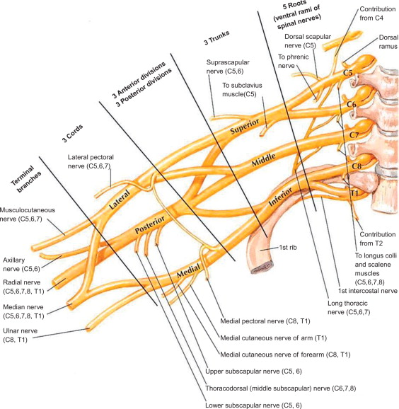

Slide 19
Continued
Medial cutaneous nerve of the arm (T1)
Arises from the medial cord
Supplies skin on the medial side of the arm

Slide 22
Continued
Medial cutaneous nerve of the forearm
Arises from the medial cord
Descends in front of the axillary artery
Supplies skin on the medial side of the forearm

Slide 25
Ulnar nerve (C8, T1)
Arises from the medial cord
Descends between the axillary artery and vein
Gives no branches in the axilla

Slide 27
Median Nerve Formation
Medial root of the median nerve
  Direct continuation of the medial cord
  Crosses in front of the third part of the axillary artery
  Joins the lateral root to form the median nerve trunk

Slide 29
Branches from Brachial Plexus Posterior Cord
Upper and lower subscapular nerves
Supply the subscapularis muscle
Lower subscapular nerve also supplies the teres major muscle
Thoracodorsal nerve (middle subscapular nerve)
Supplies the latissimus dorsi muscle

Slide 31
Continued
Axillary nerve
Terminal branch of the posterior cord
Passes through the quadrangular space

Slide 32
Continued
Radial nerve
Largest branch of the brachial plexus
Lies deep in the axilla behind the axillary artery
Supplies triceps brachii
Gives rise to the posterior cutaneous nerve of the arm
Supplies skin on the middle of the back of the arm

Slide 34


Slide 35


