Slide 1

Conditional Sentences
Functional English | BS & DPT
Hafsa Rasheed

Slide 2
What are Conditional Sentences?
Conditional sentences talk about and.
a condition (if-clause)
a result (main clause)
If something happens, something else happens.
Example:
If it rains, I will stay at home.
Basic Structure:
Most conditional sentences have two parts:
If-clause (condition)
Main clause (result)
The order can change:
If you study, you will pass.
You will pass if you study.

Slide 3
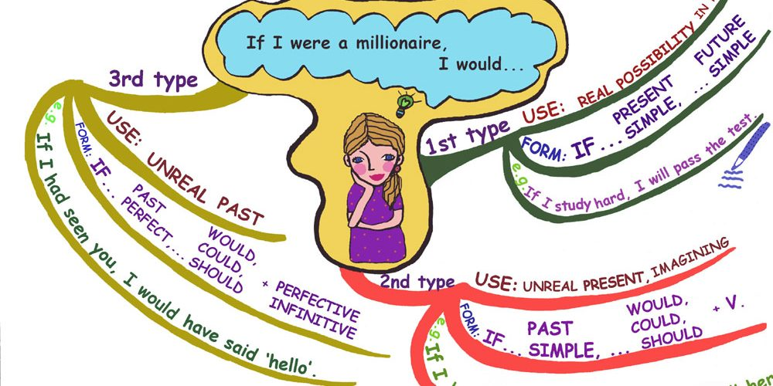

Slide 4
Zero Conditional
A Zero Conditional is used for:
Scientific facts
General truths
Habits
Examples
If you heat ice, it melts.
If I don’t sleep, I get a headache.
Structure
If + present simple → present simple
No future meaning—always true.

Slide 5
First Conditional
A First Conditional is used for:
Real, possible situations in the future
Examples
If it rains, I will stay home.
If you study, you can pass..
Structure
If + present simple → will / can / may + base verb
- Very common in daily English.

Slide 6
Second Conditional
A Second Conditional is used for:
Unreal situations
Imaginary or unlikely situations
Giving advice
Examples
If I were rich, I would travel the world.
If I were you, I would apologize.
Structure
If + past simple → would / could / might + base verb
- Were is used with all subjects (formal English).

Slide 7
Third Conditional
A Second Conditional is used for:
Regrets
Imaginary past situations
Criticism
Examples
If I had studied, I would have passed.
If she had left earlier, she wouldn’t have missed the train.
Structure
If + past perfect → would have + past participle
Too late to change now.

Slide 8
Quick Comparison Table
Type | Time | Reality
Zero | Real | Real
First | Future | Real
Second | Present/Future | Unreal
Third | Past | Impossible

Slide 9

Learning Task
Activity 1: Choose the correct option
If it _ (rain), we will cancel the match.
If I _ rich, I would buy a house.
If she had studied, she _ passed.
Activity 2: Complete the sentences
If you heat water, ____
If I were you, ____
If they had arrived earlier, ____

Slide 10
Learning Task
Activity 3: Identify the type
1. If you mix blue and yellow, you get green.
If I had known, I would have helped you.
If she studies hard, she will succeed.

Slide 11


