Slide 1

Effective Communication
Functional English | BS & DPT
Hafsa Rasheed

Slide 2
Introduction
Effective communication means conveying a message clearly, accurately, and appropriately so that the receiver understands it exactly as the sender intends
In academics, professional life, leadership, and daily interaction, communication fails not because we lack words—but because we fail to use them effectively.
To ensure effectiveness, communication experts proposed the 7 Cs of Communication.

Slide 3
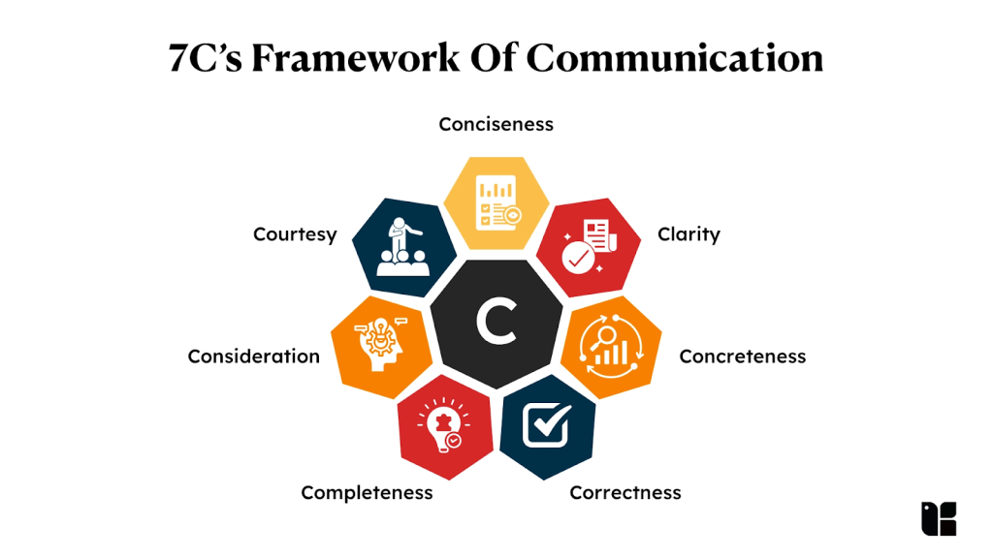

Slide 4
Who coined the 7 Cs of Communication?
The 7 Cs of Effective Communication were formulated and popularized by:
Scott M. Cutlip and Allen H. Center
They introduced the concept in 1952
Effective Public Relations (1952)

Slide 5
1. Clarity
Clarity means that the message is easy to understand and free from ambiguity.
How to achieve clarity
Use simple language
Avoid jargon
Focus on one idea at a time
Example:
“You should complete it soon.” ---wrong
--- “Please submit the assignment by Friday, 5 PM.

Slide 6
2. Conciseness
Conciseness means saying more in fewer words without losing meaning.
How to achieve conciseness
Avoid repetition
Remove unnecessary words
Be direct
Example
“I am writing this letter to inform you that…”
----“This letter informs you that…”

Slide 7
3. Concreteness
Concreteness means being specific and definite, not vague.
How to achieve conciseness
Use facts and figures
Give real examples
Example
“We will contact you soon.”
---“We will contact you within two working days.”

Slide 8
4. Correctness
Correctness refers to accuracy of information, grammar, spelling, and tone.
How to achieve conciseness
Check facts
Use correct grammar
Use appropriate vocabulary
Example
“He don’t know the rules.”
--- “He doesn’t know the rules.”

Slide 9
5. Coherence
Coherence means that ideas are logically connected and well-organized.
How to achieve conciseness
Arrange ideas logically
Use linking words (therefore, however, moreover)
Example
“The exam is difficult. I like literature. Students are stressed.”
--- “The exam is difficult; therefore, students are stressed.”

Slide 10
6. Courtesy
Courtesy means being polite, respectful, and considerate of the receiver.
How to achieve conciseness
Use polite expressions
Respect cultural and emotional sensitivities
Avoid harsh language
Example
“You failed to submit the form.”
--- “Kindly submit the form at your earliest convenience.”

Slide 11
7. Completeness
Completeness means providing all necessary information so the receiver can act.
How to achieve conciseness
Answer all questions (who, what, when, where, why)
Avoid leaving gaps
Example
“The meeting is on Monday.”
---“The meeting is on Monday at 10 AM in Conference Room B.”

Slide 12
Conclusion
The 7 Cs of Communication—Clarity, Conciseness, Concreteness, Correctness, Coherence, Courtesy, and Completeness— ensure that communication is:
Clear
Effective
Professional
Receiver-oriented
In both spoken and written communication, applying these principles reduces misunderstanding and improves impact.

Slide 13

Learning Task
Activity 1: Search and write about
More C’s of Communication
More uses of these C’s
Example:
Creativity

Slide 14


