Slide 1

BASIC MEDICAL SCIENCE
FSC MEDICAL TECHNOLOGIES I
DR DANISH

Slide 2
SPINAL CORD
The spinal cord is a long, thin, tubular structure
Extends from the base of the brainstem
Continues down to the lumbar region of the spine
Serves as the main pathway for transmitting signals between the brain and the rest of the body

Slide 3
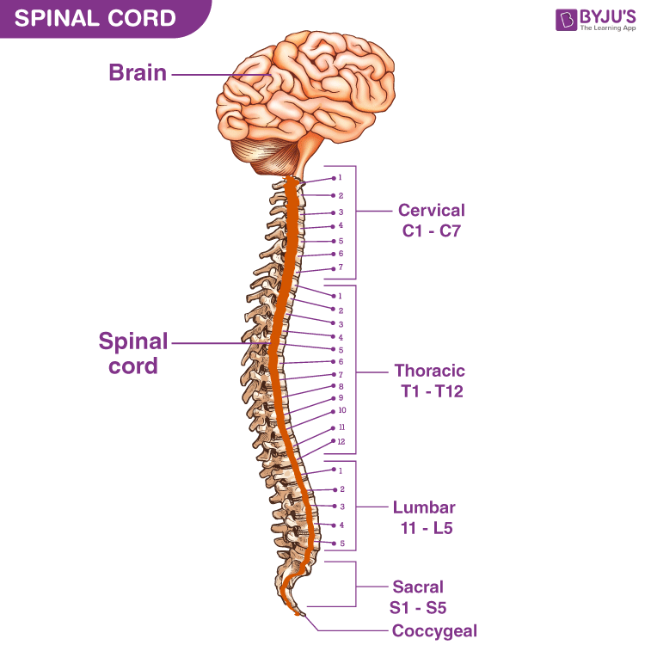

Slide 4
LOCATION
The spinal cord is situated within the vertebral canal
It is protected by the vertebrae
In most adults, it extends from the base of the skull to the level of the first or second lumbar vertebra
It ends in a tapered structure called the conus medullaris

Slide 5
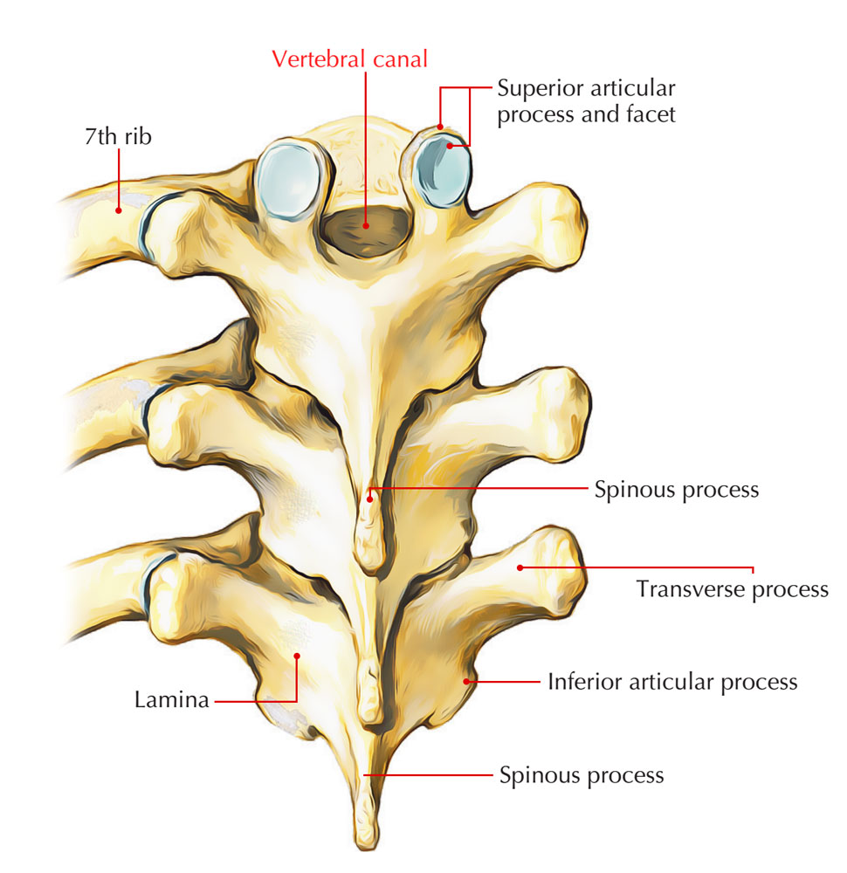

Slide 6
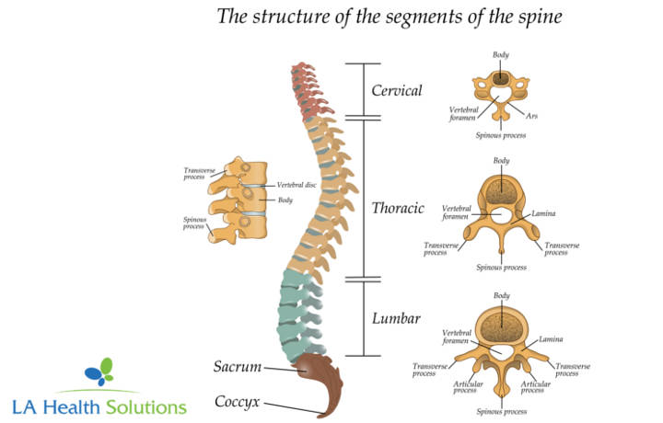

Slide 7
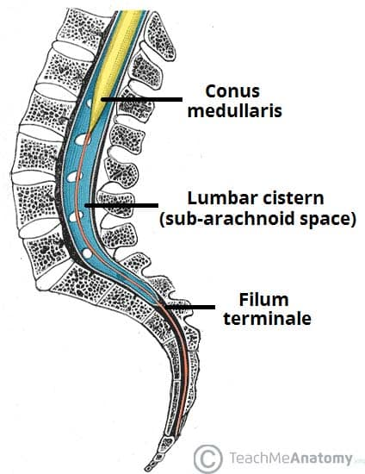

Slide 8
SEGMENTS OF THE SPINAL CORD
The spinal cord is divided into segments
Each segment gives rise to a pair of spinal nerves
There are 31 pairs of spinal nerves:
  8 cervical segments (C1–C8)
  12 thoracic segments (T1–T12)
  5 lumbar segments (L1–L5)
  5 sacral segments (S1–S5)
  1 coccygeal segment (Co1)

Slide 9
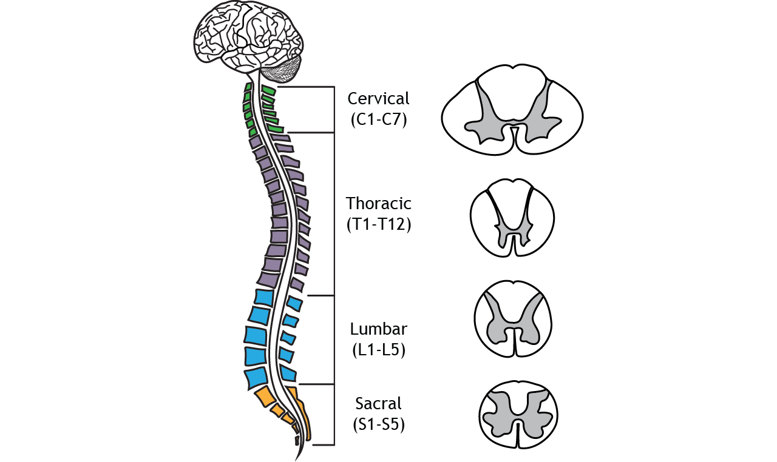

Slide 10
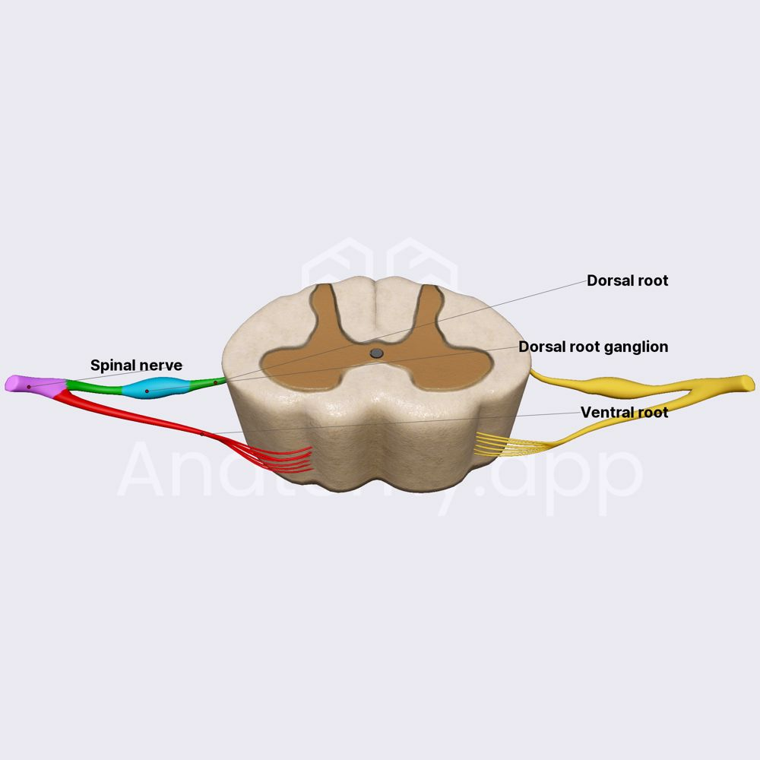

Slide 11
GRAY MATTER
Located in the center of the spinal cord
Appears as an H-shaped core
Contains cell bodies, dendrites, and glial cells

Slide 12
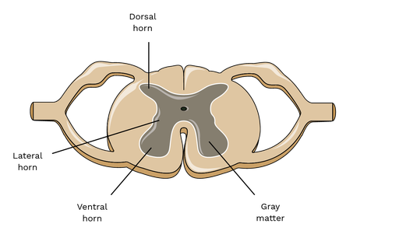

Slide 13
Continued
Divided into regions called horns:
  Anterior (ventral) horns
    Contain motor neurons
    Send signals to skeletal muscles
  Posterior (dorsal) horns
    Receive sensory input from the body
  Lateral horns
    Present in the thoracic and upper lumbar segments
    Contain autonomic neurons involved in regulation of visceral functions

Slide 15
WHITE MATTER
Surrounds the gray matter
Consists of myelinated nerve fibers
Organized into ascending and descending tracts

Slide 17
Continued
Ascending tracts:
  Carry sensory information from the body to the brain
Descending tracts:
  Carry motor signals from the brain to the body
Organized into columns (funiculi):
  Dorsal (posterior)
  Lateral
  Ventral (anterior)

Slide 18
SPINAL NERVES
Spinal nerves emerge from the spinal cord through spaces between adjacent vertebrae
These spaces are called intervertebral foramina

Slide 19
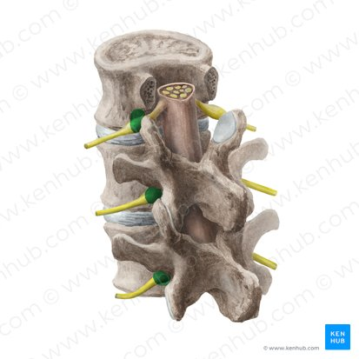

Slide 20
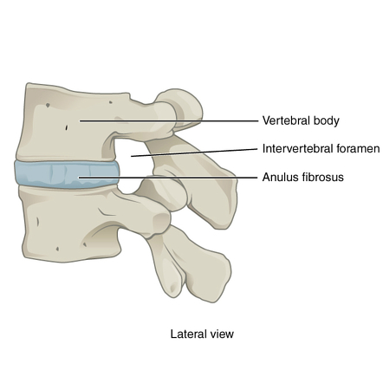

Slide 21
Continued
Each spinal nerve has two roots:
  Dorsal (posterior) root
    Contains sensory nerve fibers
    Carries information to the spinal cord
  Ventral (anterior) root
    Contains motor nerve fibers
    Carries signals from the spinal cord to muscles and glands

Slide 22
MENINGES
The spinal cord is protected by three layers of meninges:
  Dura mater
    Tough outer layer
  Arachnoid mater
    Middle layer
    Filled with cerebrospinal fluid
  Pia mater
    Delicate inner layer
    In direct contact with the spinal cord

Slide 23
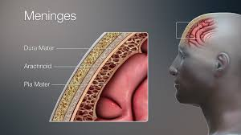

Slide 24
AUTONOMIC NERVOUS SYSTEM (ANS)
A branch of the peripheral nervous system
Regulates involuntary body functions
Includes regulation of:
  Heart rate
  Blood pressure
  Digestion
  Respiratory rate
  Pupillary diameter
  Sexual arousal

Slide 25
Continued
Divided into:
  Sympathetic nervous system
  Parasympathetic nervous system

Slide 26
SYMPATHETIC NERVOUS SYSTEM
Associated with the “fight or flight” response
Prepares the body for stress or danger
Main functions include:
  Increasing heart rate
  Dilating airways
  Redirecting blood to muscles
  Releasing adrenaline (epinephrine) from adrenal glands

Slide 27
Continued
Preganglionic fibers arise from the thoracic and lumbar regions of the spinal cord
Synapse with postganglionic neurons in ganglia
Postganglionic neurons release norepinephrine (noradrenaline) at target organs

Slide 28
PARASYMPATHETIC NERVOUS SYSTEM
Associated with “rest and digest” activities
Conserves energy
Main functions include:
  Slowing heart rate
  Stimulating digestion
  Promoting salivation and lacrimation
Arises from:
  Brainstem (via cranial nerves, e.g., vagus nerve)
  Sacral spinal cord (S2–S4)
Postganglionic neurons release acetylcholine

Slide 29
ENTERIC NERVOUS SYSTEM
A complex network of neurons located within the walls of the gastrointestinal tract
Regulates digestive processes, including:
  Peristalsis
  Secretion of digestive enzymes
  Absorption of nutrients
Can function independently
Also modulated by the sympathetic and parasympathetic nervous systems

Slide 30
NEUROTRANSMITTERS
Sympathetic nervous system
  Primarily releases norepinephrine (noradrenaline)
  Acts on adrenergic receptors
Parasympathetic nervous system
  Primarily releases acetylcholine
  Acts on cholinergic receptors
Balance between sympathetic and parasympathetic activity:
  Maintains homeostasis
  Helps the body adapt to changing physiological demands

Slide 31


Slide 32


