Slide 1

ANATOMY
THE UPPER LIMB
DPT
1ST SEMESTER
DR DANISH

Slide 2
NERVES
Nerves are cable-like bundles of fibers.
Acting as communication lines carrying electrochemical signals.
Between the brain, spinal cord, and the rest of the body, enabling sensation, movement, and autonomic functions.

Slide 3
BRACHIAL PLEXUS
Definition:
The brachial plexus is a complex nerve network
Formed by anterior (ventral) rami of spinal nerves C5–T1
Supplies the upper limb

Slide 4
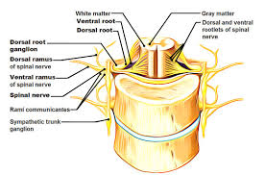

Slide 5
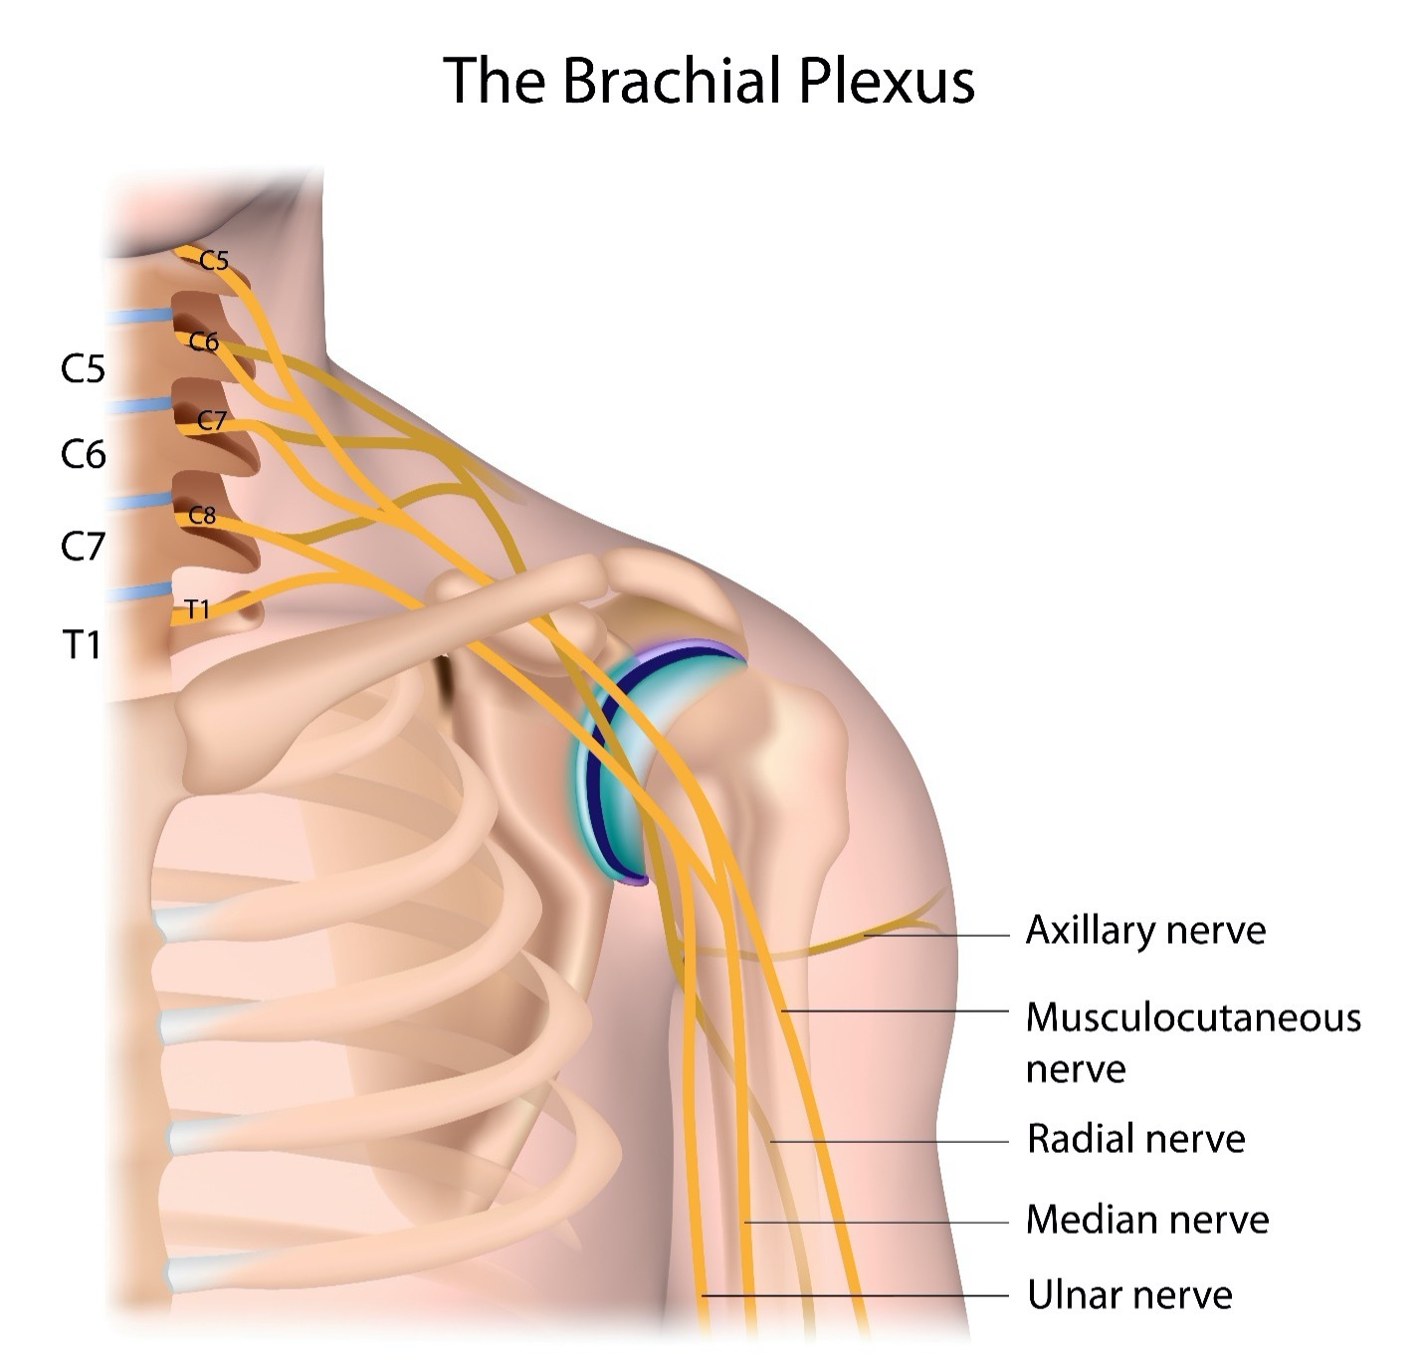

Slide 6
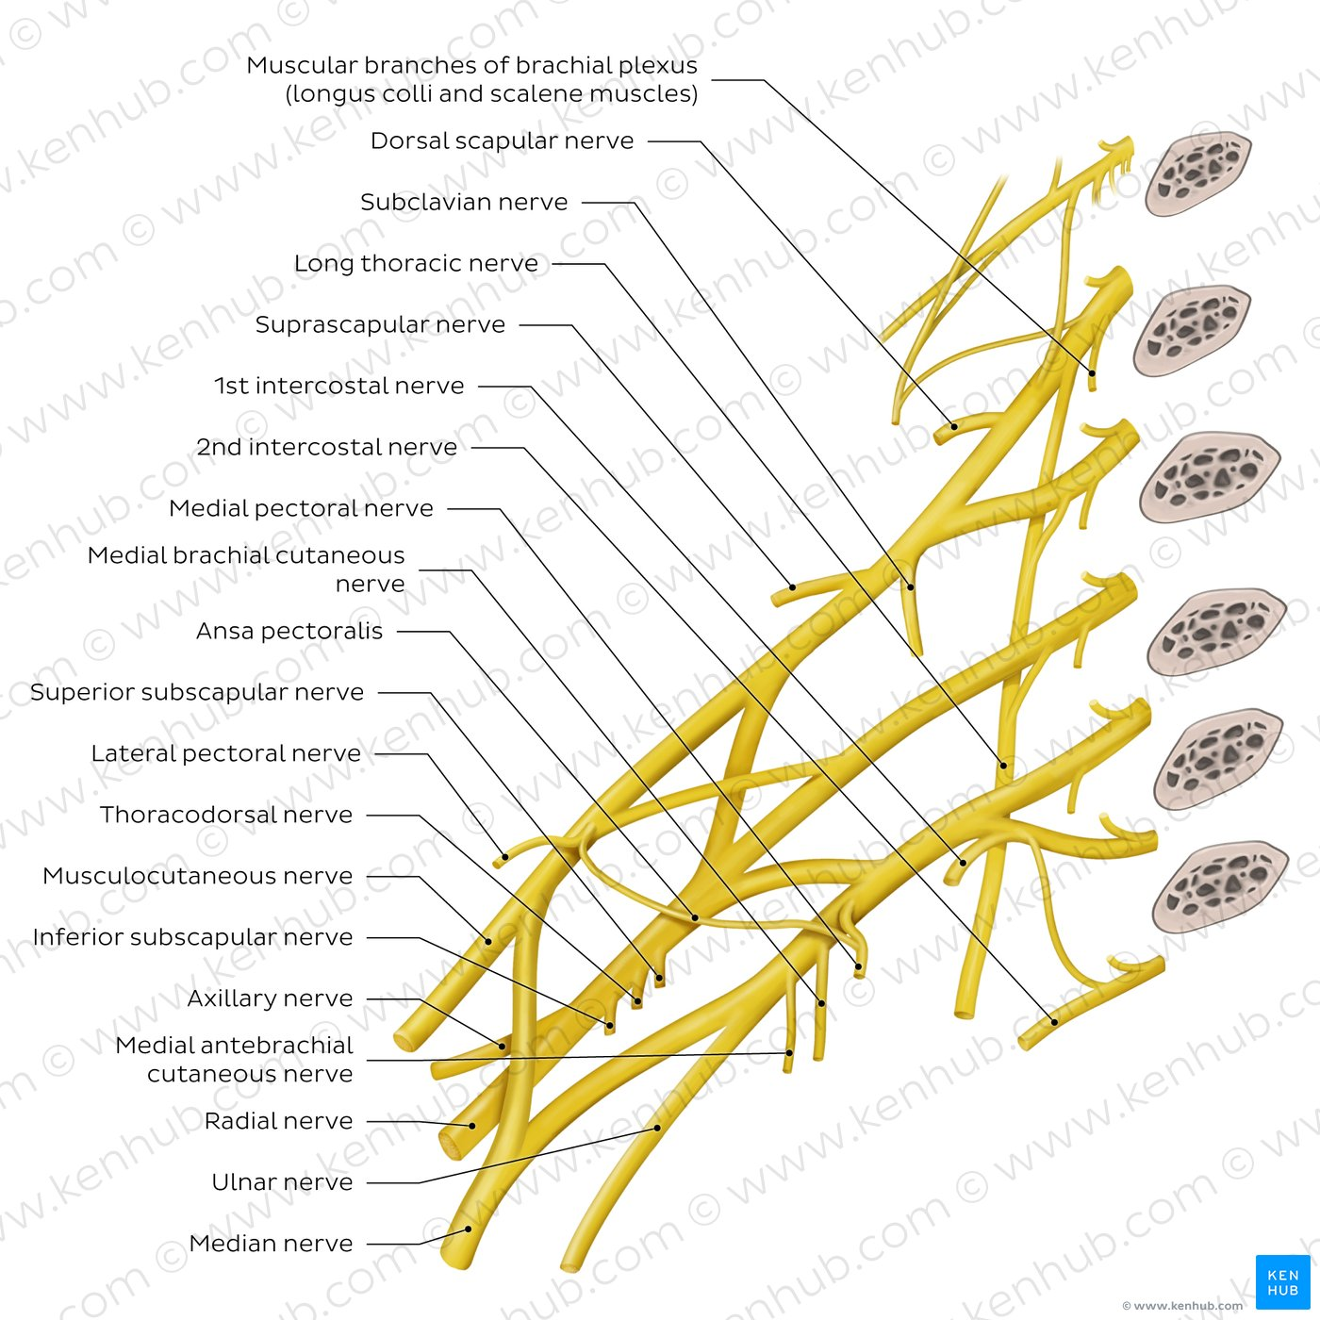

Slide 7
Location
Occupies a cervicobrachial position
  Partly in the neck
  Partly in the upper limb
The clavicle divides the plexus into:
  Supraclavicular part
  Infraclavicular part

Slide 8
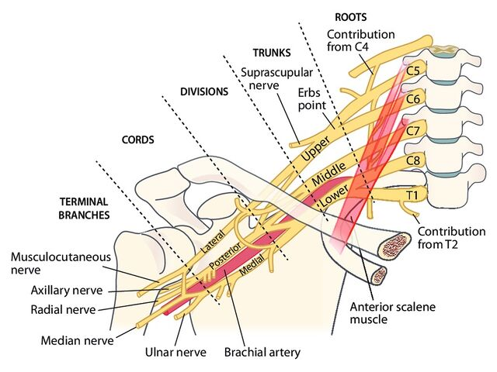

Slide 9
Parts of the Brachial Plexus
The plexus is divided schematically into five parts:
Roots
Trunks
Divisions
Cords
Terminal branches

Slide 11
“Robert Taylor Drinks Cold Beer”
Roots
Trunks
Divisions
Cords
Branches

Slide 12
ROOTS
Formed by anterior rami of C5–T1
Located in the posterior triangle of the neck
Roots intermingle to form trunks
Branches from Roots
Dorsal scapular nerve (C5)
Long thoracic nerve (C5–C7)

Slide 14
TRUNKS
Roots unite to form three trunks:
  Upper trunk → C5 + C6
  Middle trunk → C7
  Lower trunk → C8 + T1
Located in the lower part of posterior triangle of neck
Branches from Trunks
Suprascapular nerve
Nerve to subclavius

Slide 16
DIVISIONS
Each trunk divides into:
  Anterior division
  Posterior division
Total = 6 divisions
Located behind the clavicle
No branches arise from divisions

Slide 18
CORDS
Divisions recombine to form three cords
Located in the axilla
Cords are named according to their relation to the second part of the axillary artery

Slide 20
Formation of Cords
Lateral cord
  From anterior divisions of upper + middle trunks
Medial cord
  From anterior division of lower trunk
Posterior cord
  From posterior divisions of all three trunks

Slide 22
Relation of Cords to Axillary Artery
All cords lie above and lateral to the first part of the artery
Lateral cord → lateral to second part
Medial cord → medial to second part
Posterior cord → posterior to second part
Plexus and artery are enclosed in axillary sheath

Slide 23
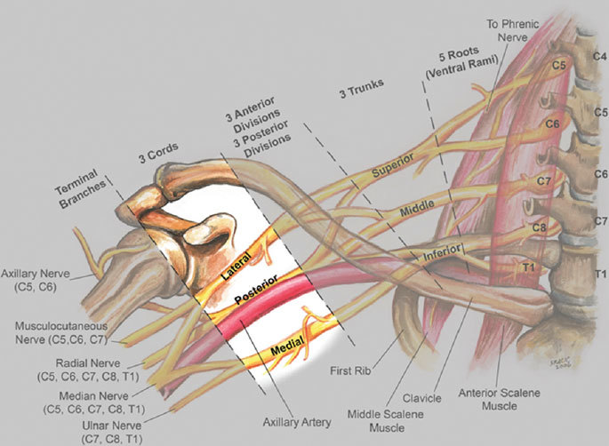

Slide 24
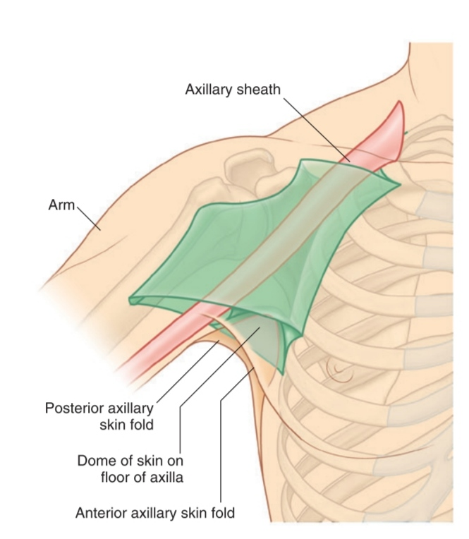

Slide 25
Branches of CORDS
Lateral Cord
Lateral pectoral nerve
Musculocutaneous nerve
Lateral root of median nerve

Slide 26
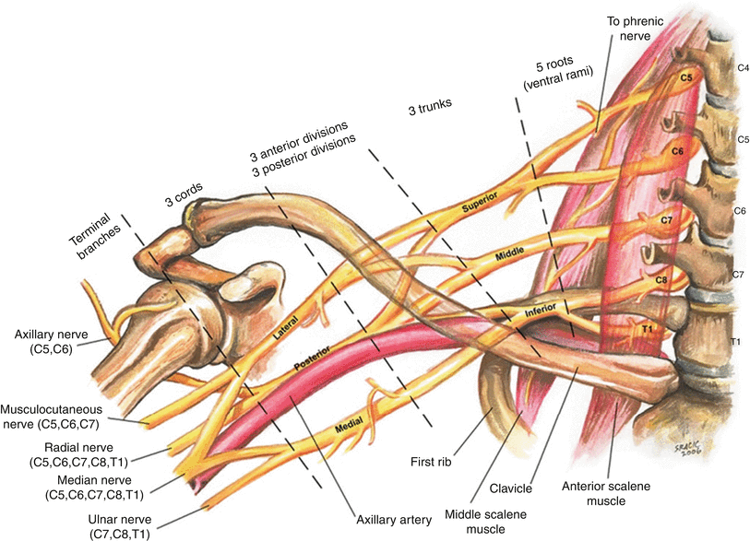

Slide 27
Continued
Medial Cord
Medial pectoral nerve
Medial cutaneous nerve of arm
Medial cutaneous nerve of forearm
Ulnar nerve
Medial root of median nerve

Slide 29
Posterior Cord
Upper subscapular nerve
Thoracodorsal nerve
Lower subscapular nerve
Axillary nerve
Radial nerve

Slide 31
TERMINAL BRANCHES
Five major nerves supplying the upper limb:
  Musculocutaneous
  Axillary
  Radial
  Median
  Ulnar

Slide 33
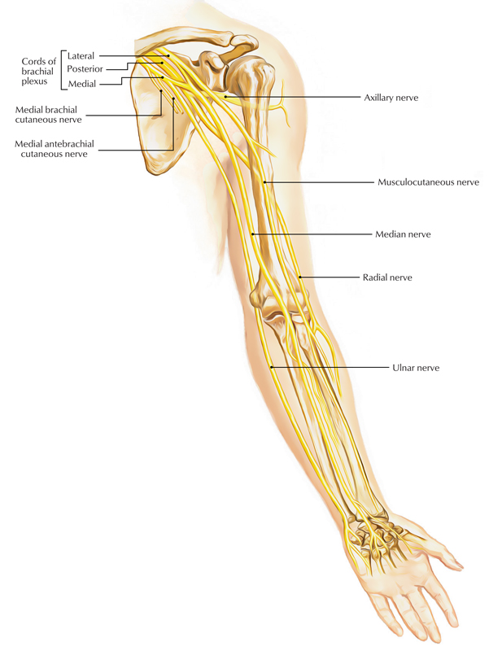

Slide 34


Slide 35


