Slide 1

HUMAN ANATOMY
BS RIT,MLT,OTT
1ST SEMESTER
DR DANISH

Slide 2
Endocrine System
System of ductless glands that secrete hormones directly into blood
Hormones regulate:
  Growth and development
  Metabolism and energy level
  Reproduction
  Response to stress and injury
  Sleep and mood

Slide 3
Continued
Endocrine system works closely with the nervous system
The hypothalamus acts as a link between nervous and endocrine systems

Slide 4
Pituitary Gland (Hypophysis)
Known as the master endocrine gland
Located at the base of the brain
Connected to the hypothalamus
Has two lobes:
  Anterior lobe
  Posterior lobe

Slide 5
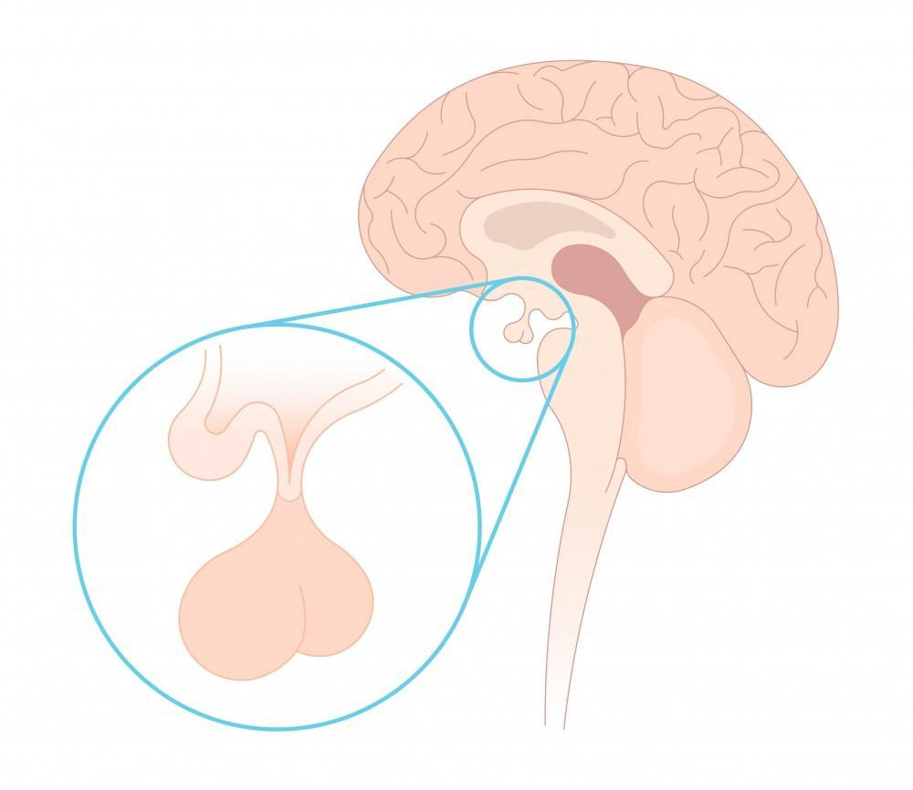

Slide 6
Hormones of Anterior Pituitary
ACTH (Adrenocorticotropic hormone)
  Controls functioning of adrenal cortex
TSH (Thyroid-stimulating hormone)
  Regulates thyroid gland
FSH (Follicle-stimulating hormone)
  Females: development of ovarian follicles
  Males: sperm production

Slide 7
Continued
LH (Luteinizing hormone)
  Females: ovulation & corpus luteum formation
  Males: testosterone secretion
GH (Growth hormone / Somatotropin)
  Regulates growth of the body
Prolactin
  Stimulates milk production

Slide 8
Thyroid Gland
Butterfly-shaped gland in the neck
Consists of two lobes joined by an isthmus
Hormones produced:
  Thyroxine (T₄)
  Triiodothyronine (T₃)
Functions:
  Controls metabolism
  Regulates growth, energy, and body temperature
  Influences heart rate and development

Slide 9
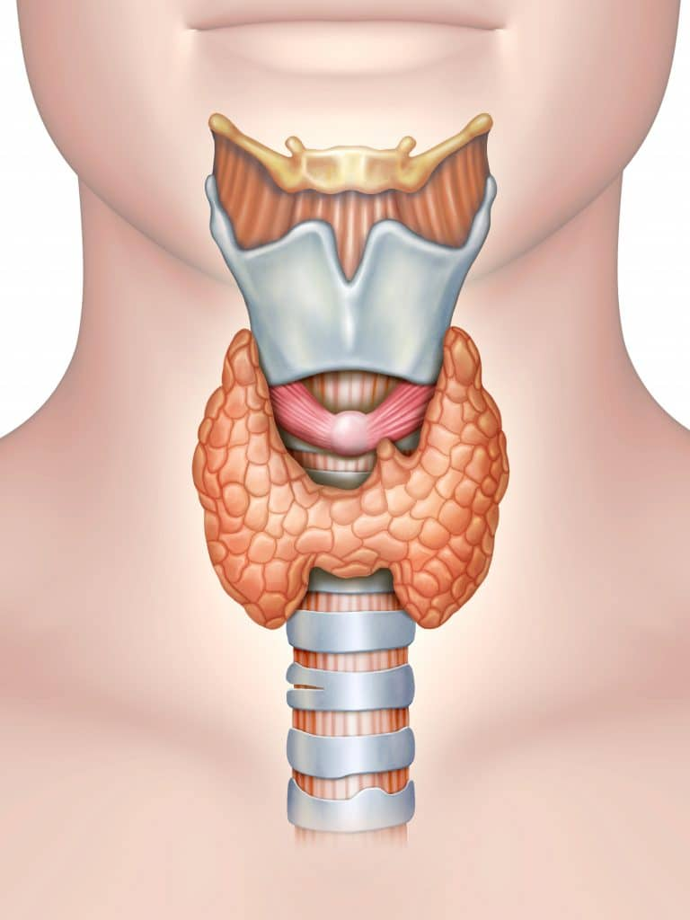

Slide 10
Parathyroid Glands
Parathyroid Glands
Small, pea-sized glands (usually four)
Located on the posterior side of thyroid
Hormone secreted:
  Parathyroid hormone (PTH / Parathormone)
Function:
  Regulates calcium and phosphorus levels in blood
  Essential for bone and teeth health

Slide 11
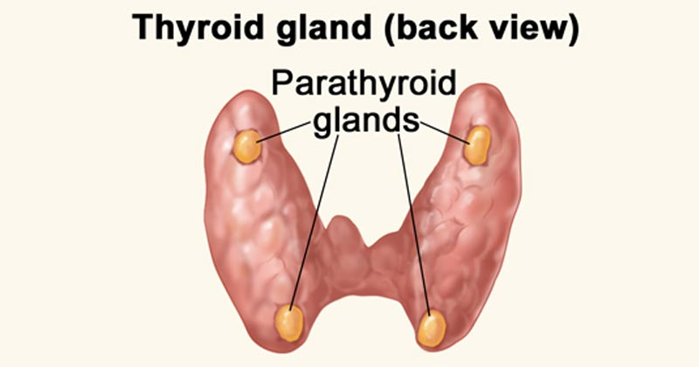

Slide 12
Adrenal Glands (Suprarenal Glands)
Located on top of each kidney
Two parts:
  Adrenal cortex
  Adrenal medulla
Adrenal Cortex Hormones
Corticosteroids (regulate metabolism & stress response)
Mineralocorticoids (salt & water balance)
Small amounts of sex hormones

Slide 13
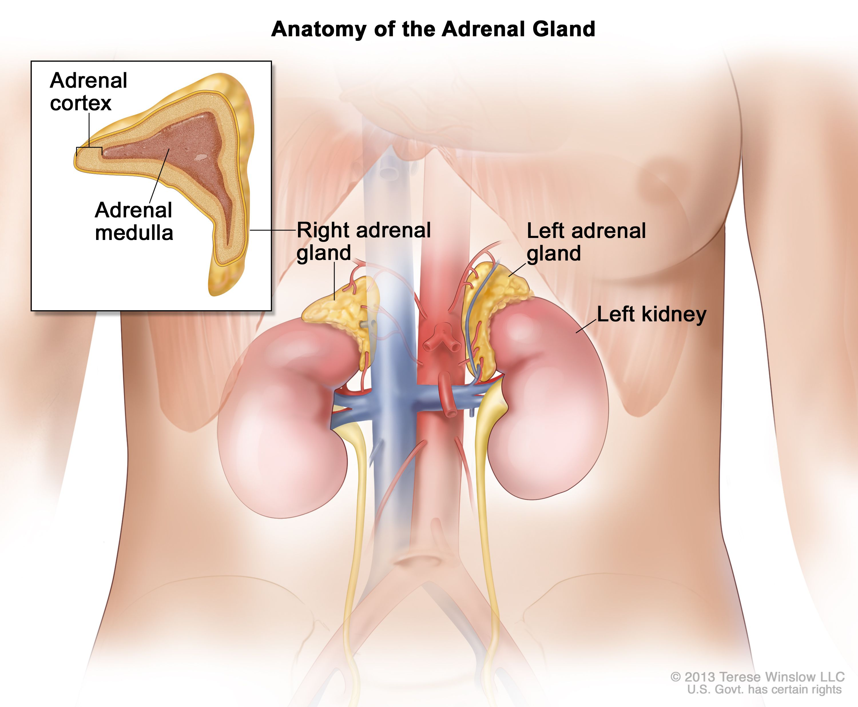

Slide 14
Adrenal Medulla Hormones
Adrenaline (Epinephrine)
Noradrenaline (Norepinephrine)
Help body respond to emergency (“fight or flight”)

Slide 15
Pancreas
Associated with digestive system
Has both exocrine and endocrine functions
Hormones
Insulin (β-cells)
  Lowers blood glucose level
Glucagon (α-cells)
  Raises blood glucose level
Somatostatin (δ-cells)
  Regulates secretion of other hormones
Imbalance can lead to diabetes mellitus

Slide 16
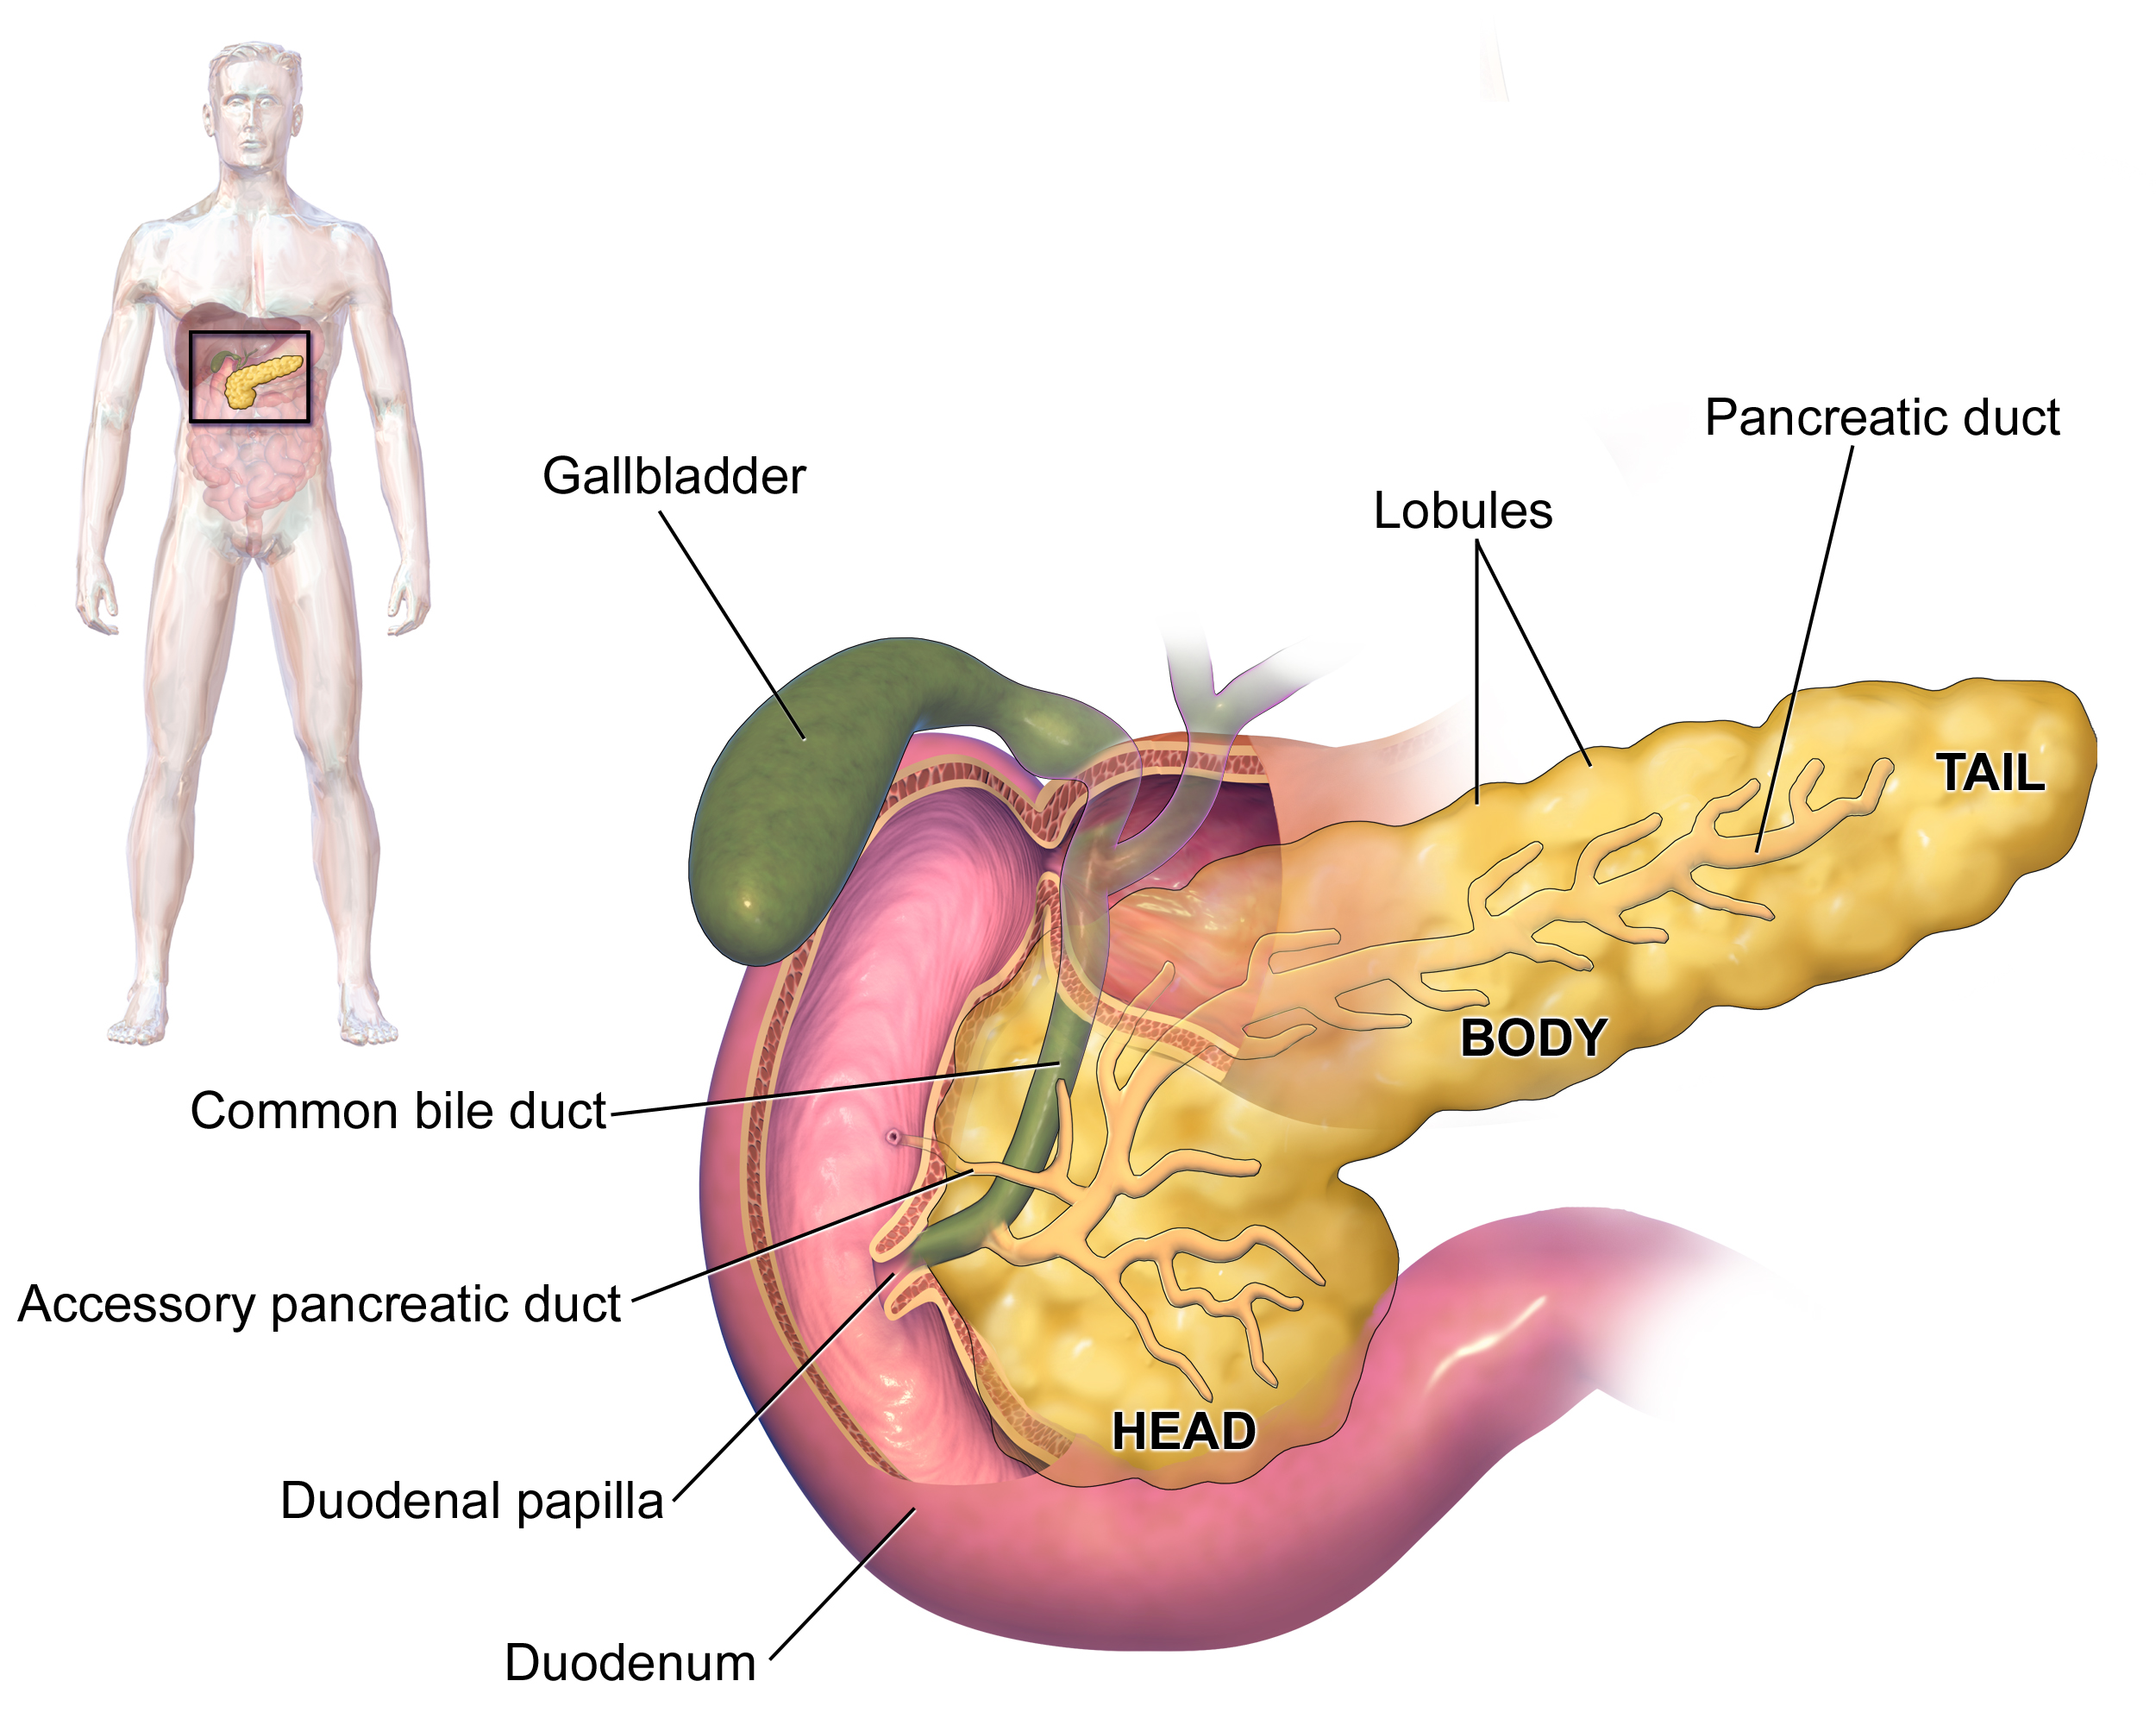

Slide 17
Ovaries (Female)
Primary female reproductive organs
Functions:
  Produce ova (eggs)
  Act as endocrine glands
Hormones secreted:
  Estrogen
  Progesterone
Regulate:
  Menstrual cycle
  Female secondary sexual characters
  Pregnancy

Slide 18
Testes (Male)
Primary male reproductive organs
Functions:
  Produce sperm
  Secrete male hormone
Hormone secreted:
  Testosterone
Regulates:
  Male secondary sexual characters
  Spermatogenesis

Slide 19
IMMUNE SYSTEM
The immune system is the defense system of the body
It protects the body against:
  Microorganisms (bacteria, viruses, fungi, parasites)
  Toxins
  Foreign substances (antigens)
Maintains body homeostasis

Slide 20
Functions of Immune System
Recognizes self and non-self
Destroys invading pathogens
Prevents spread of infection
Provides immunity after exposure
Removes damaged and abnormal cells

Slide 21
Organs of Immune System
Primary Lymphoid Organs
Bone marrow – formation of blood cells
Thymus – maturation of T-lymphocytes

Slide 22
Secondary Lymphoid Organs
Lymph nodes
Spleen
Tonsils
Peyer’s patches
Appendix

Slide 23
Cells of Immune System
Lymphocytes
  T-cells (cell-mediated immunity)
  B-cells (antibody production)
Phagocytes
  Neutrophils
  Macrophages
Natural killer (NK) cells

Slide 24


Slide 25


