Slide 1

BASIC MEDICAL SCIENCE
FSC MEDICAL TECHNOLOGIES I
DR DANISH

Slide 2
Peripheral Nervous System (PNS)
Part of the nervous system outside the brain and spinal cord (CNS)
Includes sensory neurons and motor neurons
Sensory neurons carry signals to the CNS
Motor neurons carry signals from the CNS
PNS has two components:
  Somatic Nervous System
  Autonomic Nervous System

Slide 3
Somatic Nervous System
Made up of nerves connecting:
  Voluntary skeletal muscles
  Sensory receptors
Functions:
  Carries information to the CNS
  Carries neural impulses away from the CNS
Responsible for voluntary actions

Slide 4
Autonomic Nervous System (ANS)
Controls involuntary activities
Consists of two divisions:
  Sympathetic Nervous System
  Parasympathetic Nervous System

Slide 5
Sympathetic Nervous System
Prepares the body for emergency situations
Known as “fight or flight” response
Causes:
  Rapid heartbeat
  Tremors
  Sweating
Mobilizes the body to respond to stress

Slide 6
Parasympathetic Nervous System
Controls normal body operations
Functions include:
  Digestion
  Regulation of blood pressure
  Heart rate control
Helps the body return to normal after emergencies

Slide 7
Cerebrum
Largest and most prominent part of the human brain
Responsible for:
  Higher mental functions
  Intelligence and memory
  Conscious thought
  Voluntary movements

Slide 8
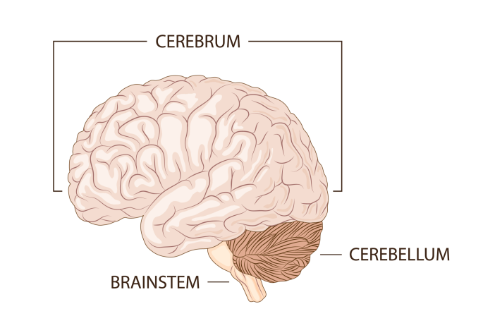

Slide 9
Continued
Divided into two hemispheres:
  Left Hemisphere
  Right Hemisphere
Each hemisphere controls the opposite side of the body

Slide 10
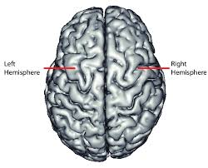

Slide 11
Cerebral Hemispheres
Connected by a thick bundle of nerve fibers called the corpus callosum
Enables communication between both hemispheres
Though similar in structure, hemispheres have specialized functions

Slide 12
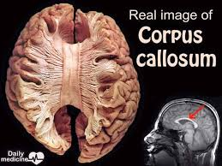

Slide 13
Lobes of the Cerebrum
Frontal Lobe
Located at the front of the brain
Functions:
  Thinking and reasoning
  Planning and judgment
  Memory and language
  Control of voluntary movements

Slide 14
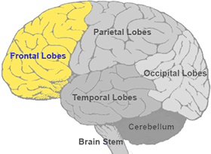

Slide 15
Parietal Lobe
Located behind the frontal lobe
Functions:
  Processing sensory information
  Perception and manipulation
  Spatial orientation

Slide 17
Temporal Lobe
Located on the sides of the brain
Functions:
  Hearing
  Memory
  Language comprehension
  Emotional responses

Slide 19
Occipital Lobe
Located at the back of the brain
Functions:
  Vision
  Interpreting visual information from the eyes

Slide 21
Cerebral Cortex
Outer layer of the cerebrum
Responsible for:
  Higher brain functions
  Consciousness
  Intelligence
  Learning and memory
Divided into functional areas for different activities

Slide 22
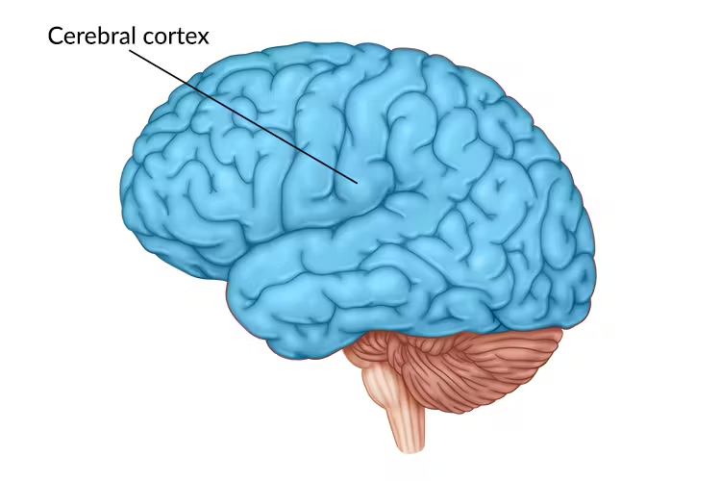

Slide 23
Basal Ganglia
Group of nuclei located deep in the cerebral cortex
Involved in:
  Regulation of movement
  Behavior
  Cognition

Slide 24
Limbic System
Located beneath the cerebrum
Plays a key role in:
  Emotions
  Memory
  Motivation
Includes structures such as:
  Amygdala
  Hippocampus
  Thalamus
  Hypothalamus
  Cingulate gyrus

Slide 25
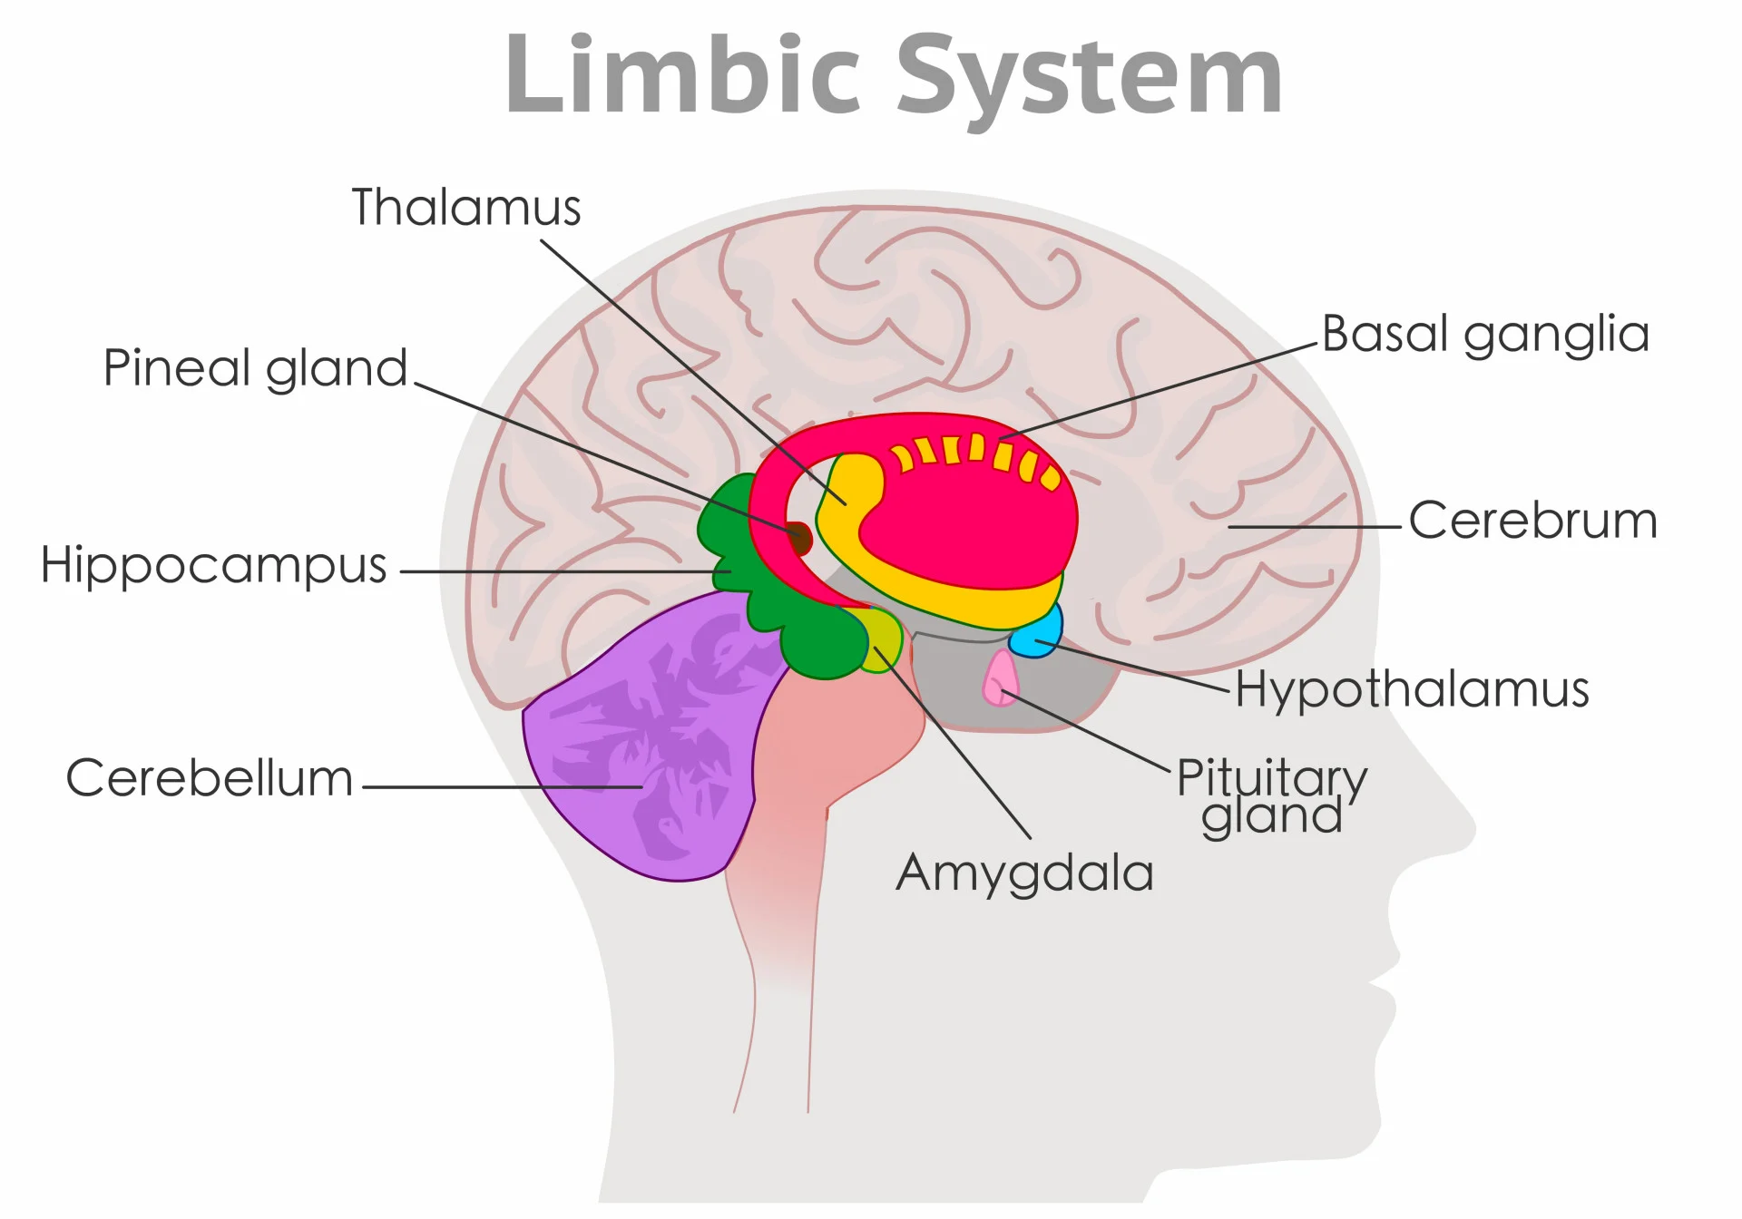

Slide 26
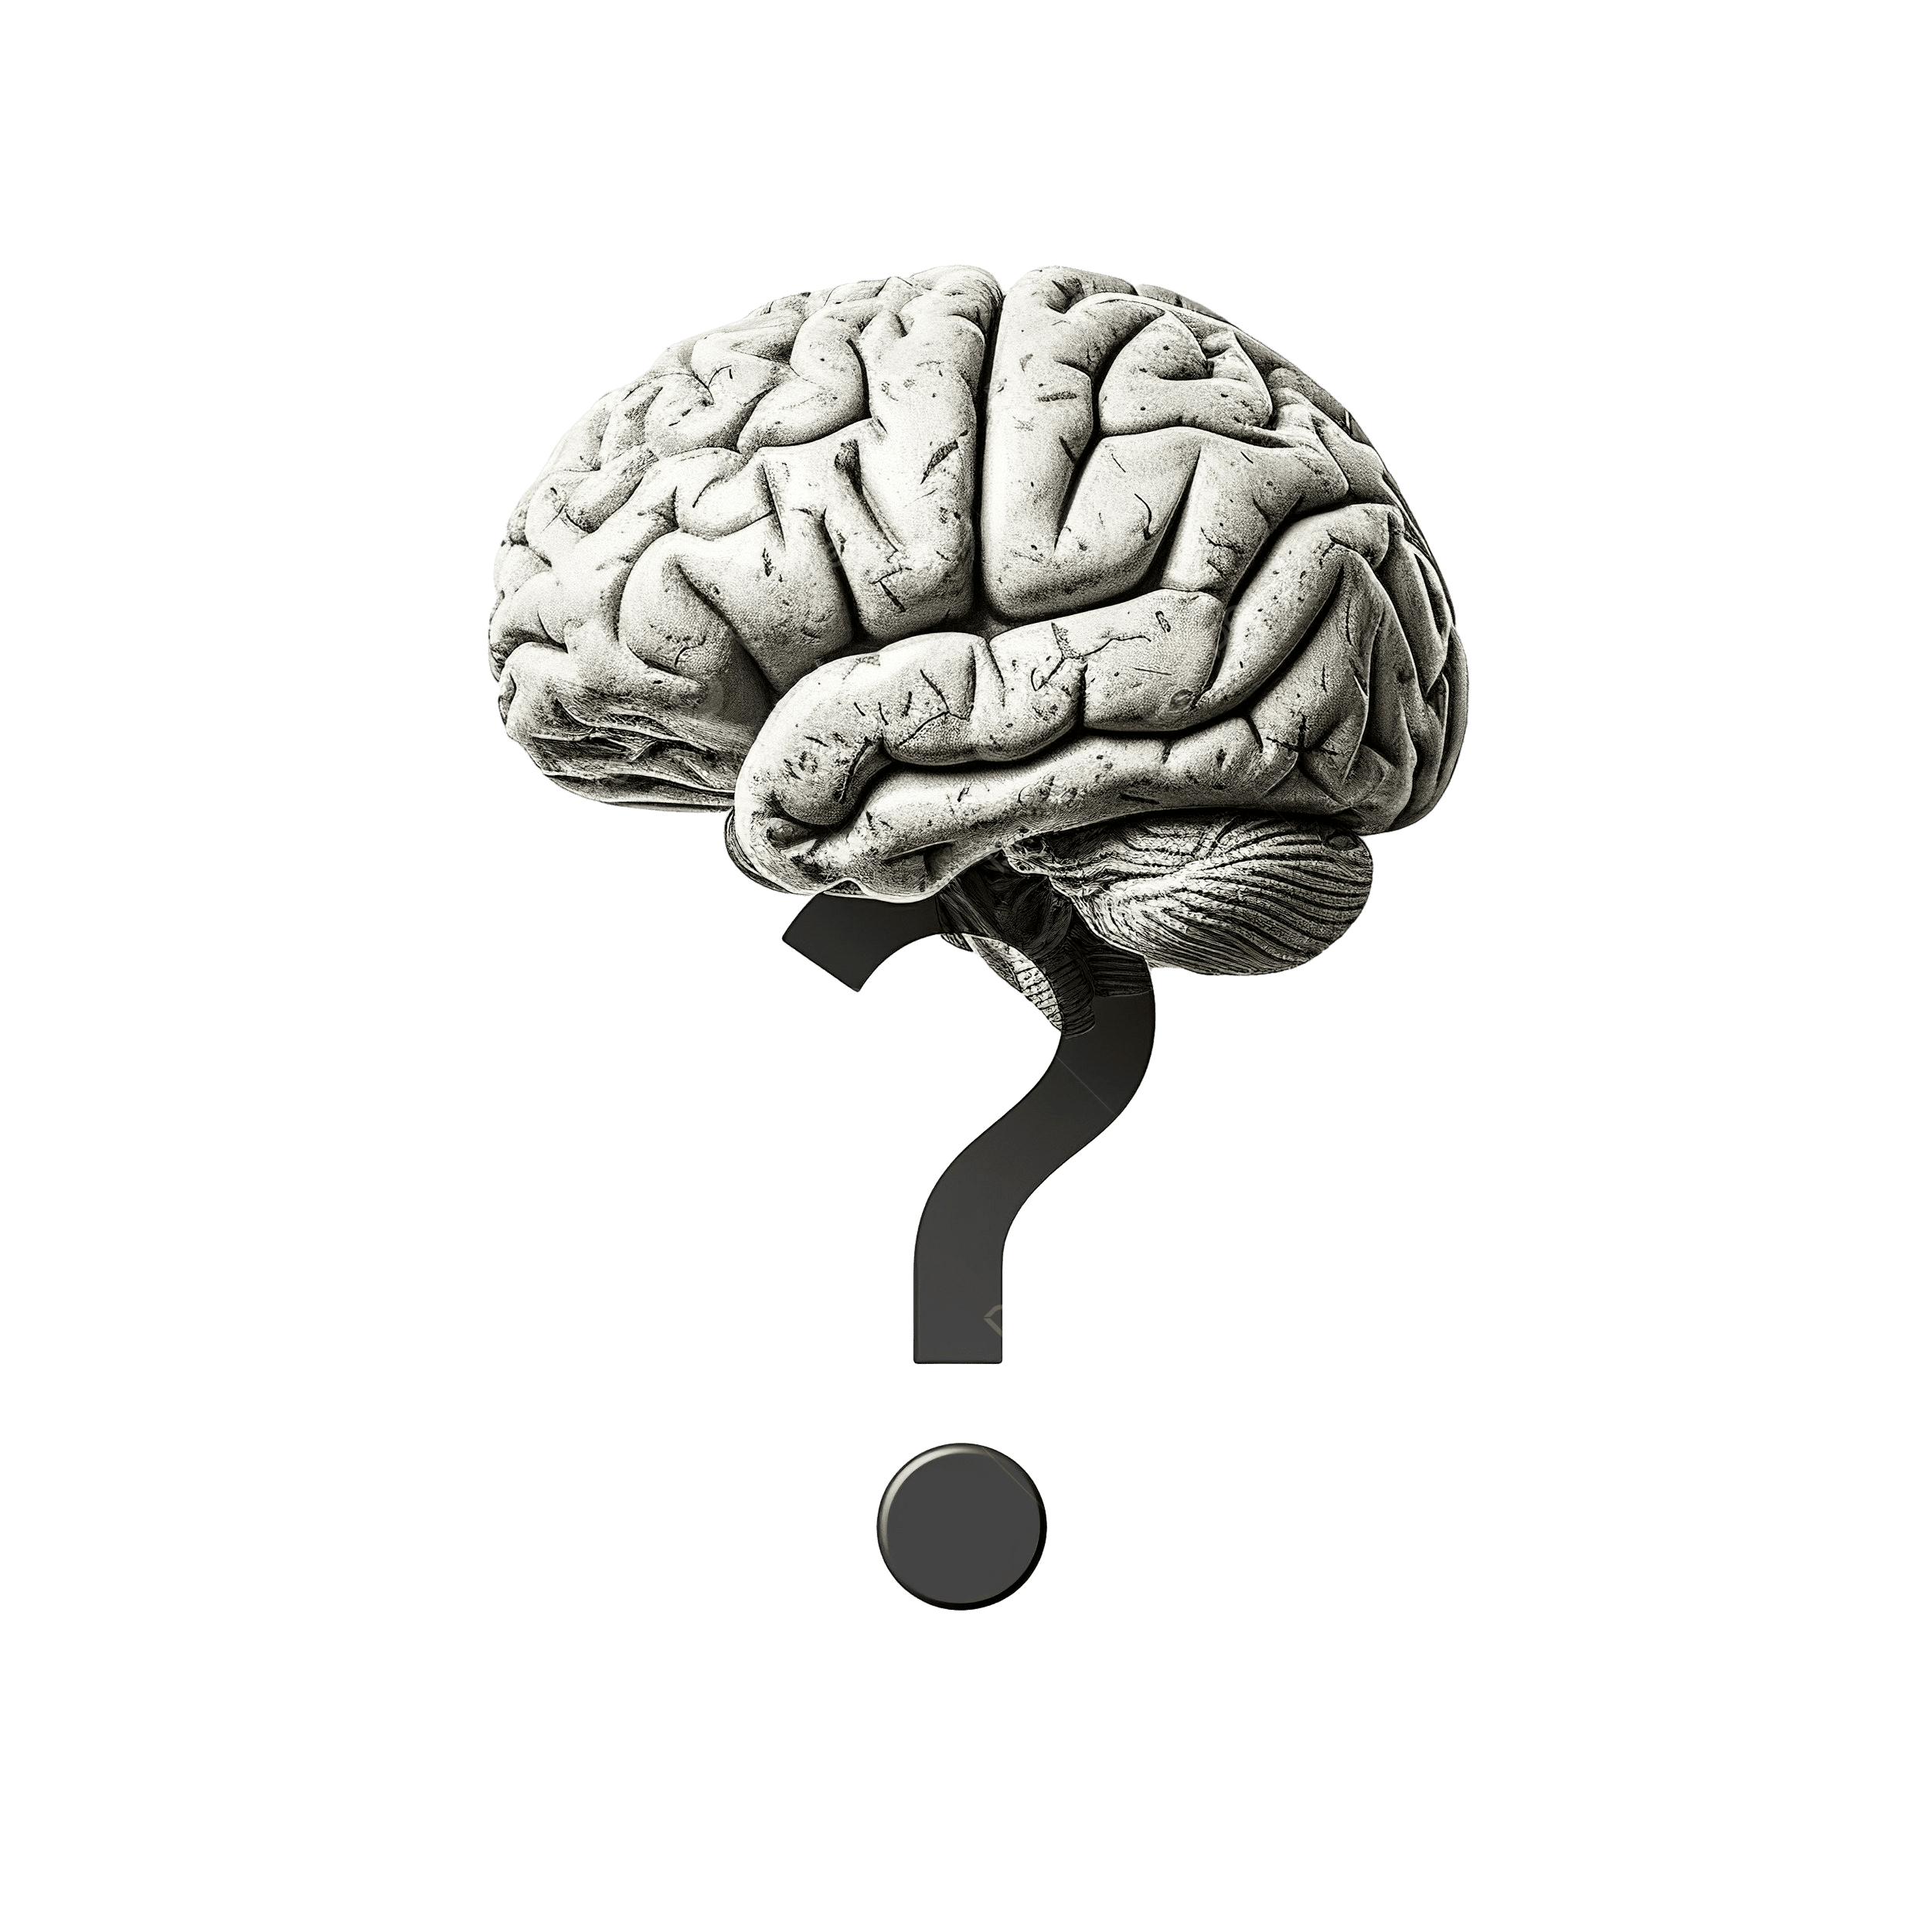

Slide 27


